Slide 1
Welcome!
COMP 3522 Object Oriented Programming 2
Week 1: Python Fundamentals
Slides by Jeffrey Yim & Rahul Kukreja

Slide 2
Agenda
Introduction
Logistics and Expectations
Intro to Python
Comments and docstrings
PEP-8 Style Guide
Strings, ASCII and Unicode in Python
Formatting output (str.format, f-strings, conversion specifiers)

Slide 3
A Bit About Me…
Nabil
Office Hours:
Tuesdays: 9:30 – 10:00 AM Tech Hub Area Kindly message me in advance Email:
nabil_alrousan@bcit.ca

Slide 4
Let’s Get Through Some Administrative Stuff First

Slide 5
COMP 3522 - Three pillars of this course:
1. Learn how to code in Python
OOP concepts Classes, inheritance, polymorphism
Containers
Exceptions
2. Learn how to write good clean reusable code using the S.O.L.I.D principles
3. Learn how to write Design Patterns – Behavioral, Creational, Structural patterns

Slide 6
Class Schedule
Lecture 1 Tuesday, 10:30 – 11:20 AM
Lecture 2 Thursday, 10:30 – 12:20 PM

Slide 7
Schedule
Lecture Breakdown:
Explaining topic and theory
Write and Examine code

Slide 8
Schedule
Labs
Try your best to be punctual
Time to work on lab and ask me questions
Attendance is taken during labs
I need to report unapproved absences
Unapproved absence of 10% or more of the labs may result in failure or forced withdrawal from this course
Labs to be done in lab time. You have always one week to demonstrate your work. Labs will be graded in lab time. You have to present your work and answer questions to receive 100%. Atomic and Incremental commits are always expected.

Slide 9
Schedule
Assignments
- No late submissions
- Submit code to github classroom
- Must be demonstrated in person

Slide 10
Schedule
Midterm & Final exam
In-person hand-written paper exams
True/false, multiple choice
Short and long guided coding questions
Best way to practice is to complete the labs, assignments, and exercises in lectures
Previous exams will be shared with you

Slide 11
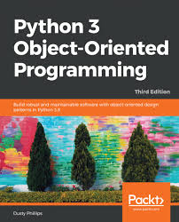
Textbook (Optional)
Philips, Dusty. (2018) Python 3 Object Oriented Programming 3rd Edition. Packt Publishing;
The text is available as an eBook via the BCIT Library and is a great supplemental read.
There is a real shortage of tutorials and materials on advanced OOP in Python. This is a good one.

Slide 12
Online Resources
ChatGPT cheat sheets.
Try “Python strings cheat sheets”
Or “Differences between f-strings, format(), and % formatting in Python.”
https://www.geeksforgeeks.org/python-programming-language/
https://www.tutorialspoint.com/python/index.htm
Or search for specific topic:
“tutorialspoint python dunders”
“geeksforgeeks python dunders”

Slide 13
The Learning Hub
Will use for grades and posting lecture notes/labs/assignments
Github classroom
Will use for submitting labs/assignments
IDE
Pycharm and/or VS Code

Slide 14
Communication
Communication with Discord!
- Check out the news post on the learning hub for the link
Use Discord for all communication. If it is something important, send me an email as well.
Responses may be delayed after school hours/weekends

Slide 15
Assessments
Quizzes 10%
Labs 10%
Assignments 30%
Midterm 20%
Final exam 30%
To Pass: 50% overall 50% weighted average between the Midterm and Final Exam
Please aim higher (obviously)!

Slide 16
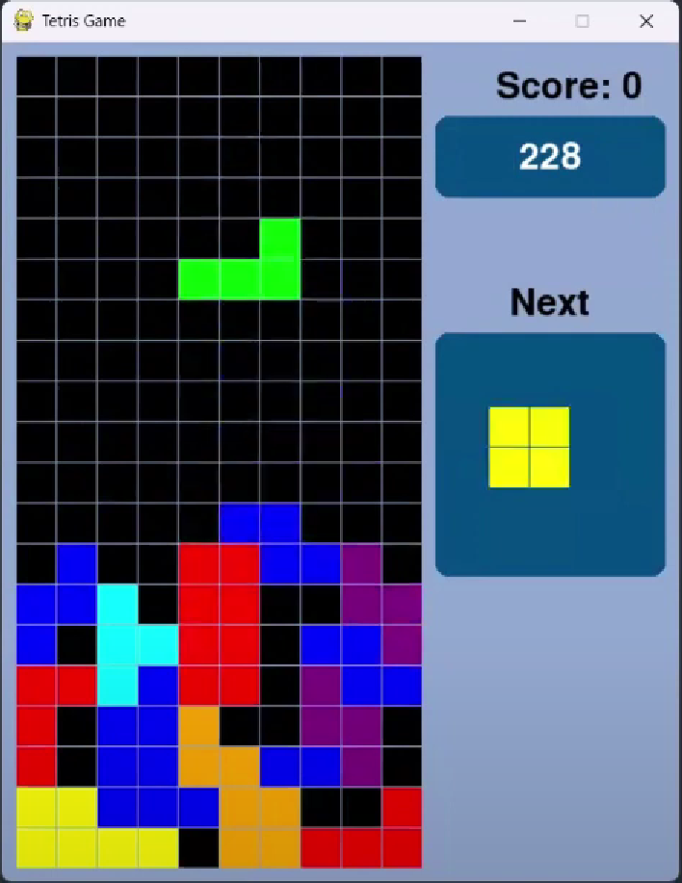
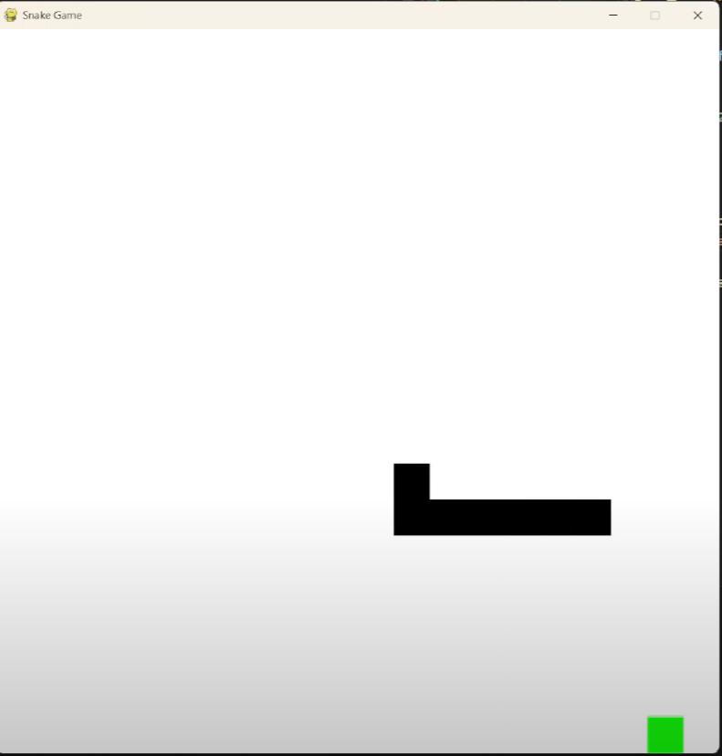

Practice OOP & DP with Games
?

Slide 17
Let’s Lay Down Some Ground Rules…
Be on time. Let me know if you can’t make it. Attendance will be taken each lab. (There is an attendance requirement).
Be professional. Let’s make our class a safe space with no judgements.
Assignments should be submitted on time. No late submissions (barring emergencies, medical reasons, or any such special circumstance).
Plagiarism and cheating won’t be tolerated. If you submit work that is not yours, it NEEDS to be accredited. Work is to be submitted individually unless they explicitly require you to work in groups. If you are found in infringement of these policies, this will result in a grade of ZERO! (BCIT Plagiarism Policy: https://www.bcit.ca/files/pdf/policies/5104.pdf )
That being said, don’t hesitate to discuss concepts introduced in class and help each other understand them. If you are in doubt, err on the side of caution. Ask me if you’re not sure!

Slide 18
Let’s Lay Down Some Ground Rules…
You are responsible for your own learning. Ask questions, come to office hours, reach out for assistance if you are falling behind and are stressed out.
Phones should be on Silent and put away.
Support your peers and know when to ask for help! Your class mates are your support network and will be your contacts in the industry in the future. Be nice ☺
Again, ask questions if in doubt! There are no stupid questions, and I will reiterate, this is a judgement free safe space. You are here to learn. If you want to chat privately or are outside of class, shoot me a message/email!
Most importantly, have fun! Enjoy the learning process.

Slide 19
Intro to Python

Slide 20
Why Python?
Modern (released in 1991, updated every few months)
Easy to learn
Lots of support on the net
Large and comprehensive standard library
Supports multiple programming paradigms like OOP, functional, and procedural
It’s an interpreted (not compiled) language
Python is dynamically typed and strongly typed
We say that batteries are included: there is a large standard library with GREAT documentation (see python.org)

Slide 21
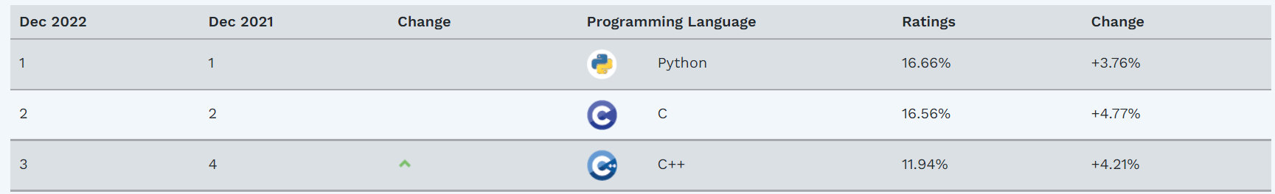
Python and Comp 3522
This is a second course in OOP
The concepts you learn here will be largely language agnostic
We can teach this course in C++ or Java or any other object oriented language
But Python is in the ascendant and is a leading language that implements the OOP Paradigm
According to the TIOBE index, Python is the most popular programming language!
https://www.tiobe.com/tiobe-index/ *

Slide 22
Hello World

Slide 23
My first Python program
print('hello world')
Seriously, that’s it!
Notice there’s no semicolon ;
Python executes whatever code that’s in the file, even without a main function. Code is interpreted top to bottom
Where’s the main function???

Slide 24
My first Python program
Need to add some code to the bottom of the file
if __name__ == ‘__main__’:
main() #main is a function we’ll write
__name__ is a special Python variable
Its value is automatically set by Python
__name__ is set to ‘__main__’ if the code begins running from a script
__name__ is set to the module filename if the code started running from a different script
file_1.py, file_2.py

Slide 25
My first Python program
def main():
print(‘hello world’)
if __name__ == ‘__main__’:
main() #calls main function to print hello world
This is the complete code to print out hello world, with a main function
What this code is saying is “if we’re running code starting from this script, call a main function”
Hello_world2.py

Slide 26
My first Python program
def jeff():
print(‘hello world’)
if __name__ == ‘__main__’:
jeff() #does the same thing as the previous slide
Notice there’s nothing special about the naming of the main function
I’ve changed the function to jeff and it behaves the same

Slide 27
Intro to Variables and Functions

Slide 28
Intro to Variables and Functions
def add(a, b): return a + b num1 = input(‘Enter a number’) num2 = input(‘Enter a second number’) print(add(num1,num2))
Function bodies begin after the :
Notice how there are no curly braces
Code sections are separated by indentation. Notice the indent before ‘return a + b’
That’s not just for readability, python requires indentation to separate code sections

Slide 29

Intro to Variables and Functions
def add(a, b): return a + b num1 = input(‘Enter a number’) num2 = input(‘Enter a second number’) print(add(num1,num2))
Compiler error if there’s no indent for function. This applies for if/else, for, while etc
Think of where you’d normally have curly braces in Java, and that’s where you’d indent
Missing indent!

Slide 30
Intro to Variables and Functions
def add(a, b): return a + b num1 = 5 num2 = 10 print(add(num1,num2))
Python is a dynamically typed language.
Notice how there’s no type (int) in front of num1 and num2. Types are inferred

Slide 31
Intro to Variables and Functions
def add(a, b): return a + b num1 = 5 num2 = 10 print(add(num1,num2))
Same as parameters in a function, notice how types are not specified

Slide 32
Intro to Variables and Functions
def add(a : int, b : int): return a + b num1 = 5 num2 = 10 print(add(num1,num2))
Can add : type after the parameter to indicate type
But this is just for programmer intention/readability and it doesn’t change functionality
Can still pass in types other than int into function and it will work

Slide 33
Intro to Variables and Functions
def add(a, b): return a + b num1 = 5 num2 = 10 print(add(num1,num2))
Functions begin with def
def is used in place of void or return types you’re used to in Java
No need to specify a function is void if it doesn’t return anything, or a return type if it does return something

Slide 34
Intro to Variables and Functions
def add(a, b) -> int: return a + b num1 = 5 num2 = 10 print(add(num1,num2))
Can add -> type after the function header to indicate return type
But this is just for programmer intention/readability and it doesn’t change functionality
Function can still return non-int types

Slide 35
If Statement

Slide 36
The if statement
if_stmt ::= "if" expression ":" suite
("elif" expression ":" suite)
["else" ":" suite]

Slide 37
Branching: if
A branch in a program is only taken if an expression’s value is true
This is known as an if-branch:
def calculate(salary, earned_bonus):
if earned_bonus == True:
salary = salary * 1.2
return salary

Slide 38
Branching: if-else
An if-else structure has two branches:
The first branch is executed if the testing expression is true
The second branch is executed if the testing expression is false
def positive(number):
if number < 0:
return False
else:
return True
Notes:
No return type needed to be specified, just have def

Slide 39
An example
password = input("Enter your password: ")
if password == "1234" :
print("Unacceptable password")
else:
print("Thank you")
print("End of program")

Slide 40
Another example
Getting the maximum of two numbers:
def max(first, second):
if first >= second:
max_value = first
else:
max_value = second
return max_value
Notes:
Here is a function called max that accepts 2 parameters
Notice no return type needed to be specified, just def

Slide 41
Be careful with your indentation!
def positive(number):
if number < 0:
print(”Negative”)
return False
else:
print(”Positive”)
return True
We can insert a group (block) of statements after if and else

Slide 42
Multi-branch if-else
if expression1:
# Statements that execute when expression1 is true
# (first branch)
elif expression2:
# Statements that execute when expression1 is false
# and expression2 is true
# (second branch)
else:
# Statements that execute when expression1 is false
# and expression2 is false
# (third branch)

Slide 43
Another example
password = input("Enter your password: ")
if password == "1234":
print("Unacceptable password")
elif password == "abcd”:
print("Dude, come on")
else:
print("Thank you")
print("End of program")

Slide 44
Nested if-else statements
A branch’s statements can include any valid statements, including another if-else statement
if sales_type == 2:
if sales_bonus < 5:
sales_bonus = 10
else:
sales_bonus = sales_bonus + 2
else:
sales_bonus = sales_bonus + 1

Slide 45
We can use multiple sequential ifs
Sometimes we can use multiple if statements in sequence
Each if statement is independent
More than one can execute:
user_age = int(input('Enter age: ‘))
if user_age >= 16:
print('You are old enough to drive.')
if user_age < 25:
print('Enjoy your early years.')
if user_age > 25:
print('Most car rental companies will rent to you.')

Slide 46
Comments and Docstrings

Slide 47
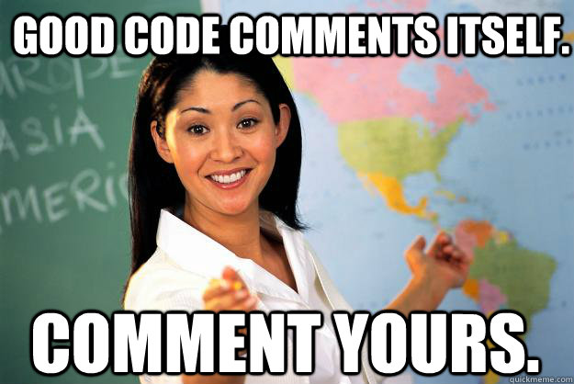
# Good Comments & Readable Code
Why do we comment?
We strive to make our code self-documenting by using descriptive identifiers for functions, variables, etc.
Good code should be self explanatory (right?)
Python Comments
In line comments that start with #
Docstrings. Think Javadoc
// single line comment in java
# single line comment in python
Notes:
Explain complex code, assumptions, flaws and limitations
Record our thoughts and ideas for posterity

Slide 48
Docstrings
A special kind of comment
A string literal that describes a chunk of code
Implemented as the first statement inside a:
Module (file)
Function
Class
Method definition.
Used to create “official” documentation
Wrap with triple-quotes to span multiple lines
Python can use this to generate documentation

Slide 49
Docstring Example
def add_ints(a, b):
”””
Return the sum of the two arguments.
:param a: an int
:param b: an int
:precondition: a must be an int
:precondition: b must be an int
:return: the sum of the ints
”””
return a + b

Slide 50
Docstring Formatting
Ensure you use a phrase that ends in a period.
Describe the function’s effect as a command, i.e., ‘‘‘Do this.’’’ or ‘‘‘ Return that.’’’
A multi-line docstring must start with a one-line summary, followed by a blank line, followed by the details of the description.
Suppose we have a program called my_module.py. The first statement in the file must be a triple-quote wrapped string, which will become the my_module.py module’s docstring when the file is imported and used by another project.
>>> import my_module
>>> help(my_module)
>>> help(my_module.my_function)

Slide 51
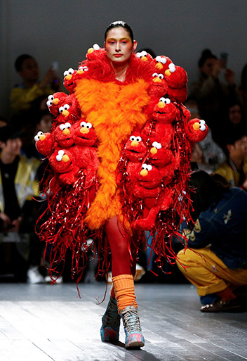
Styling Your Code
Fashion Police

Slide 52
PEP 8 Style Guide
https://www.python.org/dev/peps/pep-0008/
The defacto accepted standard for formatting your Python code.
At some point everyone here should go through it.
There are a lot of rules but it eventually becomes second nature.
Another website that summarized the PEP 8 guide (An easier read): https://realpython.com/python-pep8/
Why does this matter?
Notes:
PEP stands for Python Enhancement Proposal. PEPs are proposals for improvements to the Python language, made by members of the Python community. PEPs are reviewed and accepted or rejected by the Python community, and are used to document and communicate changes to the language.

Slide 53
PEP 8 Style Guide
Consistency
Readability
Parsing
Efficient and Ease While Coding
Collaboration
Notes:
Easier to locate and find relevant code
Code is read more often than written
Code is modified more often too
Communication between developers within a project

Slide 54
Naming Conventions
Type | Naming Convention | Examples
Function | Use a lowercase word or words. Separate words by underscores to improve readability. | function, my_function
Variable | Use a lowercase single letter, word, or words. Separate words with underscores to improve readability. | x, var, my_variable
Class | Start each word with a capital letter. Do not separate words with underscores. This style is called camel case. | Model, MyClass
Method | Use a lowercase word or words. Separate words with underscores to improve readability. | class_method, method
Constant | Use an uppercase single letter, word, or words. Separate words with underscores to improve readability. | CONSTANT, MY_CONSTANT, MY_LONG_CONSTANT
Module | Use a short, lowercase word or words. Separate words with underscores to improve readability. | module.py, my_module.py
Package | Use a short, lowercase word or words. Do not separate words with underscores. | package, mypackage

Slide 55
There a lot more rules that I won’t reiterate here. Check out the links!
Notes:
This isn’t Java
Don’t write novels!
Don’t comment every single little thing!
Only docstring comments should be necessary unless we need to say why we made a choice
Pass some modules and functions to the help function to see how library module docstrings are formatted
Ensure your docstrings adhere to the same format and style

Slide 56
Strings

Slide 57
Python String
A string is an immutable sequence (or string) of Unicode (UTF-8) codepoints
We can bind a string object to a variable
A string literal is the value of a string
We create a string literal using double- or single-quotes:
May contain letters, numbers, spaces, or symbols like @ or #.
“BCIT CST grads are the best”
‘BCIT CST grads make the most money’

Slide 58
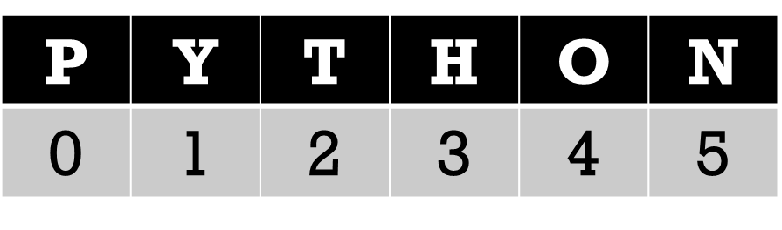
Python Strings are a Sequence Type
A string’s letters (characters) are kept in order from first to last
A character’s position in a string is called its index
The plural of index is indices
Indices start at 0
An empty Python string has zero elements and is created like this:
my_empty_string = ‘’

Slide 59
Unicode
Python uses Unicode to represent every possible character as a unique integer, known as a code point
For example, the character ‘A' has the code point value of 65
Sometimes converting between a text character and the encoded code point integer is useful. (Easier to process numerical data, especially when analyzing large sets or during encryption).
The built-in function ord( ) returns the encoded code point integer for a string of length one (a Unicode character).
ord(‘A’) return 65
The built-in function chr( ) returns the one-character string for a code point passed as an argument.
chr(65) returns ‘A’
Notes:
ord(‘A’) return 65
chr(65) returns ‘A’

Slide 60
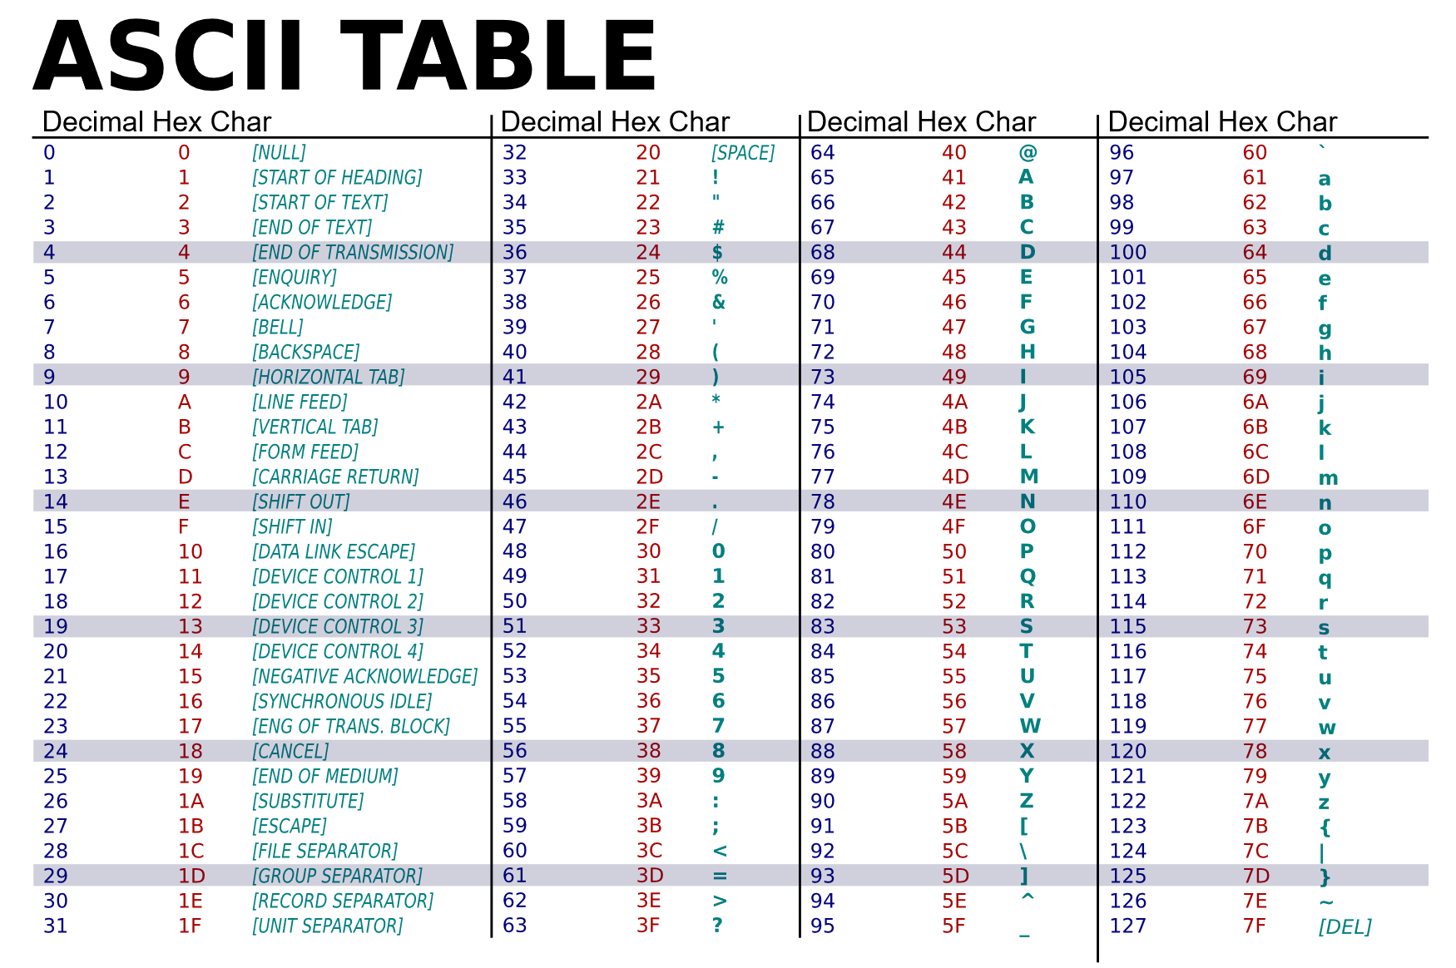

Slide 61
Escape sequences
They’re the same as everywhere else
Another way to print quotation marks is to wrap the string around different quotes as opposed to its content
Eg: print(“That’s skipping an unnecessary \’ .”)
Escape Sequence | Meaning
\’ | Single quote (‘)
\” | Double quote (“)
\t | Horizontal tab
\a | Bell (please don’t do this)
\b | Backspace
\r | Carriage return
\n | New line (line feed)
print("hello'") print('hello"')
Notes:
An escape sequence is a combination of characters that represents a special character or symbol that is not represented by a single character. Escape sequences are used in string literals to represent characters that are difficult or impossible to include directly, such as tabs, newlines, and quotation marks.

Slide 62
Raw Strings
If we do not want to use escape characters we can create a raw string
A raw string is prefixed by the letter r or R
Python raw strings treat the backslash as a literal character
This is useful if we have a string that contains backslashes that should be interpreted as backslashes
Compare:
print(“Hello\nworld”)
Hello
World
print(r“Hello\nworld”)
Hello\nworld

Slide 63
Some Common String Methods, Functions and Features
Try them out now in a python console
“string”.title()
my_string = “Comp 3522”
my_string.upper()
my_string.lower()
len(my_string)
my_string[3]
my_string[0]
my_string[-2]
my_string.find(“2”)
my_string.split(“ “, 0)
Question: if we invoke these methods, does the original string change?
Notes:
No the original doesn’t change my_string = "Comp 3522"
print(my_string.upper())
print(my_string.lower())
print(len(my_string))
print(my_string[3])
print(my_string[0])
print(my_string[-2])
print(my_string.find("2"))
print(my_string.split(" ", 1))

Slide 64
Some Common String Methods, Functions and Features
Question: if we invoke these methods, does the original string change?
NO!

Slide 65
Some Common String Methods, Functions and Features
capitalize
replace
isalpha
isdigit
split
join
this is faster than concatenation using += because no temp strings are created
This is an important and fast way to concatenate strings
https://docs.python.org/3.7/library/stdtypes.html#string-methods

Slide 66
Some Common String Methods, Functions and Features
capitalize
replace
isalpha
isdigit
split
join
this is faster than concatenation using += because no temp strings are created
This is an important and fast way to concatenate strings
https://docs.python.org/3.7/library/stdtypes.html#string-methods
REMEMBER: You can always type
help(function name) to read the documentation
dir(object) to read the properties and methods of the specified object
Eg:
help(str.isdigit)
print(dir(str))
Notes:
The dir function is a built-in function in Python that returns a list of attributes and methods for a given object. For example, if you have a list object my_list, you can use dir(my_list) to get a list of the methods and attributes that you can use with my_list.
The help function is also a built-in function in Python that provides help information for a given object. For example, if you have a list object my_list, you can use help(my_list) to get a list of the methods and attributes that you can use with my_list, as well as a description of what each one does.
So, the main difference between dir and help is that dir simply returns a list of attributes and methods for an object, while help provides more detailed information about each attribute and method, including a description of what it does.

Slide 67
String Concatenation
What happens when you do this?
pokemon_cast = “pikachu”
num_members = 150
print(pokemon_cast + “ and “ + num_members + “others”)
Notes:
Error! Num_members is an int

Slide 68
String Concatenation
What happens when you do this?
pokemon_cast = “pikachu”
num_members = 150
print(pokemon_cast + “ and “ + str(num_members) + “others”)
NOTE: Try casting num_members to a string
Notes:
pikachu and 6others

Slide 69
Multi-line strings
There are three ways we can do this:
Break lines with the \ character:
string_long = "This is a very long string" \
" that I wrote to help somebody" \
" who had a question about" \
" writing long strings in Python"

Slide 70
Multi-line strings
Use parentheses:
string_long = ("This is a very long string"
" that I wrote to help somebody"
" who had a question about”
" writing long strings in Python”)

Slide 71
Multi-line strings
Use triple quotes:
string_long = """This is a very long string
that I wrote to help somebody
who had a question about
writing long strings in Python"""
NOTE: PEP-8 has some thoughts about multi-line code too!
Notes:
This will actually produce multiple new lines vs one long line of text
They like version 2 with the (

Slide 72
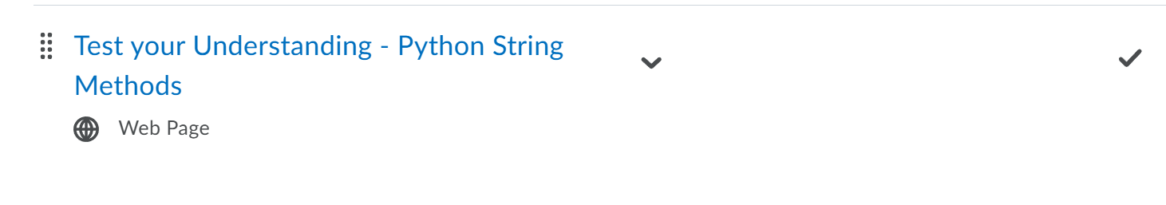
Test Your Understanding
https://learn.bcit.ca/d2l/le/content/1192286/viewContent/12370933/View

Slide 73
String Formatting

Slide 74
Formatting output
There are three easy ways to format output in Python
We can use:
the string format method
f-strings
% operator along with format specifiers
It is always better to format than to concatenate! Change your habits if you tend to use ‘+’ to display data

Slide 75
The str.format() Method
The format method inserts values into strings
Replacement fields are delimited by curly braces:
“I earned {0} in {1}”.format(98.5, “Architecture”)
“I earned {} in {}”.format(98.5, “Architecture”)
“I earned {0} in {1} and {0} in {2}”.format(65, “Comm”, “Math”)
“I earned {grade} in {course}”.format(grade=65,
course=“Comm”)

Slide 76
The str.format() Method
Eg: Try examples like these now!
grades = (98.5, 65)
“I earned {g[0]} and {g[1]}”.format(g = grades)
import math
“Pi equals {m.pi}”.format(m = math)
“Pi equals {m.pi:.3f}”.format(m = math)
Notes:
I earned 98.5 and 65
Pi equals 3.141592653589793
Pi equals 3.142

Slide 77
F-strings
f-strings are string literals preceded by an f or F (like raw strings!)
Curly braces contain expressions that can be replaced with their values
Lets you drop in variable names directly in place
Evaluated at runtime:
grade = 98.5
course = “C”
f”I earned {grade} in {course}”
name = “OOP 2 with Python”
F”My favourite course (so far) is {name.title()}!”

Slide 78
A note on print()
There are different versions of the print( ) function:
print(‘Hello world’)
print(“Hello world”)
print(“Hello world”, end=‘ ’) #default end is newline
print(“I\’m ” + str(age) + “ years old”)
print(“I\’m”, age, “years old”)
You can learn more here: https://docs.python.org/3/library/functions.html
Notes:
The main difference between using a comma and a plus sign in a print statement is that the comma adds a space between the concatenated values, while the plus sign does not. So, if you want to add a space between the values you're printing, you can use a comma to separate them. If you don't want to add a space, you can use a plus sign to concatenate the values.
Note that when using a plus sign, you may need to explicitly convert variables to strings if you want to concatenate them with strings. In the example above, we used the str() function to convert the age variable to a string before concatenating it with the other strings.

Slide 79
Conversion Specifiers
Program output commonly includes the value of variables as a part of the text
A string formatting expression allows a programmer to create a string with placeholders that are replaced by the value of variables
This placeholder is called a conversion specifier
Different conversion specifiers are used to perform a conversion of a given variable value to a different type when creating a string

Slide 80
Conversion Specifiers with % operator
Conversion Specifier | Notes | Example | Output
%d | For an integer | print(‘My num %d’ % 17) | My num 17
Notes:
Marvel movie example print("%s is %d years old." % (name, age))
mylist = [1,2,3]
print("A list: %s" % mylist)
I don’t like these but they are common across many languages

Slide 81
Conversion Specifiers
Conversion Specifier | Notes | Example | Output
%d | For an integer | print(‘My num %d’ % 17) | My num 17
%f | For a floating point number | print(‘%f’ % 3.14) | 3.14
%s | For a string | print(‘%s’ % name) | Oliver
%x, %X | For hexadecimal | print(‘%X’ % 17) | 11
%e, %E | For scientific notation | print(‘%e’ % 314) | 3.140000e+02
Notes:
Marvel movie example print("%s is %d years old." % (name, age))
mylist = [1,2,3]
print("A list: %s" % mylist)
I don’t like these but they are common across many languages

Slide 82
Conversion Specifiers (floats)
apr = float(input('Enter APR:\n’))
# Print using a float conversion specifier
print('Annual percentage rate as a float is %f ' % apr)
Annual percentage rate as a float is 100.000000
# Print using a float conversion specifier and trailing %
# Need extra % sign for % symbol to appear in string
print('Annual percentage rate as a float is %f%% ' % apr)
Annual percentage rate as a float is 100.000000%

Slide 83
Conversion Specifiers (Multiple)
Super easy:
name = ‘COMP 3522’
room = 645
print(‘Course %s is in %d\n’ % (name, room)) #make sure to have enclosing brackets for multiple params
Notes:
Order matters

