Slide 1
Welcome!
COMP 3522 Object Oriented Programming 2
Week 1 Day 2: Python Fundamentals
Slides by Jeffrey Yim & Rahul Kukreja

Slide 2
Agenda
Questions/Review
Mutability in Python
Sequence types
Lists
Tuples
Dictionaries
Iteration and views
Loops

Slide 3
Questions/Review

Slide 4
__name__
__name__ is a built in variable in every python module (file)
Its value is set automatically
__name__ is set to the name of the current module
file_1.py
file_2.py
__name__ == ‘file_1’
__name__ == ‘file_2’

Slide 5
__name__
But as soon as code begins running from a file, the __name__ of that file evaluates to ‘__main__’
That file’s name remains ‘__main__’ for the duration of the program
file_1.py
file_2.py
Executing code
from file_1
__name__ == ‘__main__’
__name__ == ‘file_2’

Slide 6
__name__
But as soon as code begins running from a file, the __name__ of that file evaluates to ‘__main__’
That file’s name remains ‘__main__’ for the duration of the program
file_1.py
file_2.py
Executing code
from file_2
__name__ == ‘file_1’
__name__ == ‘__main__’

Slide 7
__name__
Python doesn’t have a main function ☹ We’ll need to ‘hack’ one in
Since we know __name__ == ‘__main__’ from the file we’re running, we can ‘hack’ our code to have a main function
If __name__ == ‘__main__’
main() #execute our main function
file_1.py
file_2.py
Executing code
from file_1
__name__ == ‘__main__’
__name__ == ‘file_2’
file_1.py, file_2.py

Slide 8
Importance of indentation
Some of you were wondering why we needed the following in our calculator class
#calculator code somewhere above
if __name__ == ‘__main__’
main() #indented
Since the following code also worked just as well
#calculator code somewhere above
main() #no indent and no if

Slide 9
Importance of indentation
Everything on indent level 0 that’s a code expression will execute
Your calculator code worked fine because it was one program in one file
If you needed to import code from another file, all code on indent 0 in the other file would also execute
indent_example.py, indent_example_2.py

Slide 10
Decimal places, extra curly braces
name = "Jeff" room = 202 my_string = 'hello {0} {{0}}, it is the year {1}'.format('class', 2023.123) print(my_string) print('Course %s is in %.2f\n' % (name, room)) #decimal places with .2f print('Course %s {0} is in %.2f\n' % (name, room))
Questions.py
Notes:
hello class {0}, it is the year 2023.123
Course Jeff is in 202.00
Course Jeff {0} is in 202.00

Slide 11
Mutability

Slide 12
im·mu·ta·ble
/i(m)ˈmyo͞odəb(ə)l/
Adjective
From the Latin roots “in” (not) and “mutabilis” (to change)
unchanging over time or unable to be changed

Slide 13
String are Immutable
Writing or altering individual characters of a string variable is not allowed
Strings cannot change once created
Instead, an assignment statement must be used
word = ‘supercalifragilisticexpialidocious’
word = word.title( ) # this allocates new memory (and un-references the previous one)
print(word) # ‘Supercalifragilisticexpialidocious’

Slide 14
Python Immutable Types
int( )
float( )
complex( )
str( )
tuple( )
bytes( )
frozenset( )
Everything else is mutable (I think!).

Slide 15
Assignment Is Not Mutation
When we assign a value to a variable, we are actually assigning the reference to that value’s location in memory
We will review this in some detail later in the term
For now, we can test this like so:
id(2.5)
a = 2.5
type(a)
id(a) # same address as id(2.5)!
a = a + 0.0456
id(a) # Not the same – a contains the address of a new float!
Memory.py

Slide 16
Sequence Types
Probably the thing python is most famous for

Slide 17
Sequence Types
Sequence is the generic term for an ordered set
There are several distinct kinds of sequence types in Python
str (the string)
list
range
tuple
bytes
These are not the same thing.
They are stored differently and are treated differently, but they can be processed similarly
Only some sequence operations are common to all

Slide 18
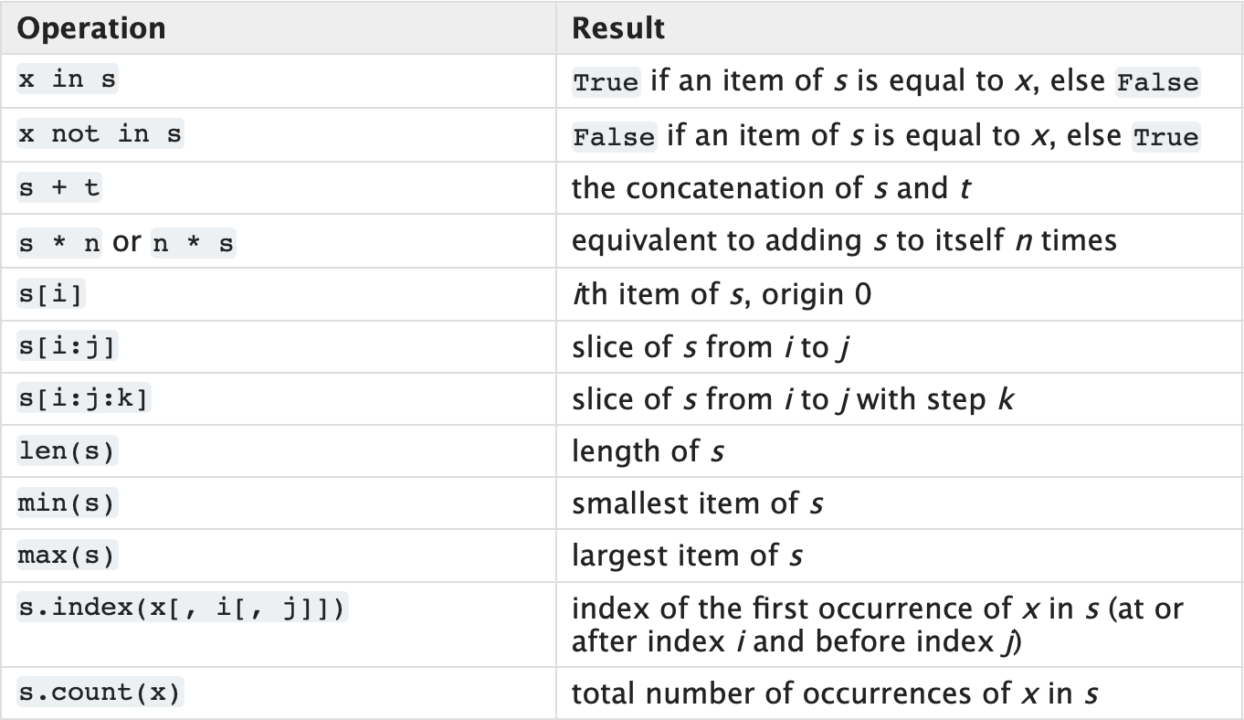
Common Sequence Operations
* Well almost.
Range only supports item sequences that follow specific patterns, and hence doesn’t support sequence concatenation or repetition
Notes:
Normal sequences like lists or strings support concatenation (+) and repetition (*):
[1, 2] + [3, 4] # → [1, 2, 3, 4]
"ab" * 3 # → "ababab"
But with range:
range(3) + range(3) # ❌ TypeError
range(3) * 2 # ❌ TypeError

Slide 19
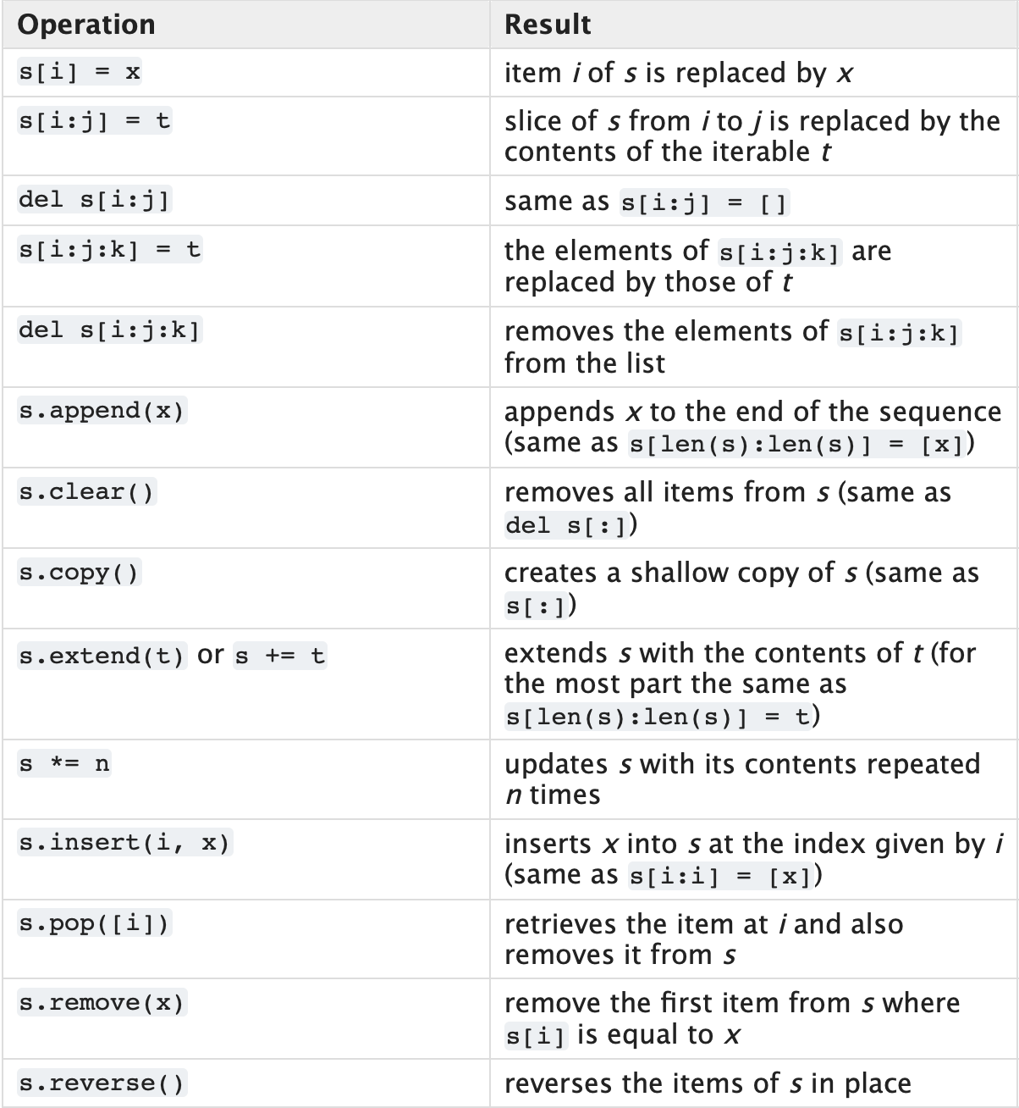
Mutable Sequence Operations

Slide 20
List

Slide 21
Containers
A container is a data structure used to group related values together
A kind of compound type
A container contains references to other objects
A list is a container created by surrounding a sequence of variables or literals with square brackets [ ]
It’s like an array, but since it’s an object it has useful methods available. (It’s similar to but better than Java’s ArrayList)

Slide 22
List
This line of code creates a new list variable my_list that contains the two items, an integer and a string:
my_list = [10, 'abc’]
A list item is called an element
A list is ordered, and indexed. Just like arrays in other languages.
my_empty_list = []
A list can have many different types of elements. That is, its heterogenous.
student_data = [“A022343234”, [99,70,85.0], ‘P’]
Notes:
Very important container when writing python code

Slide 23
List
Lists are useful for reducing the number of variables in a program (a single list can store an entire collection of related variables)
Individual list elements can be accessed by their index
A list's index must be an integer.
>>> student_data = [“A022343234”, [99,70,85.0], ‘P’]
>>> student_data[0] #A022342334
Try this:
>>> student_data[-1] #P >>> len(student_data) #3

Slide 24
Lists are Mutable
Let’s try some of these list methods!
list_name.append(value)
list_name.pop(index) # remove and use value
list_name.remove(value) # remove by value
list() (Eg: spelling = list(“ComplicatedWord”)
print(list_name)
list_name[1] = ‘new updated value’
del list_name[3] # remove by position
list_examples.py
Notes:
Can create a new list with the list constructor

Slide 25
list_name.sort() # does this change the original list? Or does it return a new instance?
sorted(list_name) # how does this differ from list.sort?
len(list_name)
reverse(list_name)
dir(list)
list_examples.py
Notes:
List_name.sort modifies original list
Sort function creates a new sorted list, leave original intact

Slide 26
Sequence Functions and Methods
Sequence-type functions are built-in functions that operate on sequences like lists and strings
Examples include len( ), sorted( )
length = len(my_sequence)
new_sorted = sorted(my_sequence)
Sequence-type methods are methods built into the class definitions of sequences like lists and strings
Examples include sort( ), append( ), clear( ), insert( ), pop( ), remove( ), and reverse( )
my_sequence.sort()
my_sequence.clear()
What’s the difference?

Slide 27
Membership Operator
A common task is to determine if a container contains a specific value
Python has membership operators in and not in
These operators return true if the left operand matches the value of some element in a container
>>> colours = [‘red’, ‘white’, ‘cerulean’]
>>> print(‘cerulean’ in colours) #true, cerulean exists in colours
>>> print(‘magenta’ not in colours) #true, magenta doesn’t exist in colours

Slide 28
Membership Operators
Can be used with sequence types (string, list so far)
We can check if a list contains something
We can also use to determine whether a string is a substring, or a matching subset of characters, in a larger string:
So much easier in Python compared to say C or C++
request_str = 'GET index.html HTTP/1.1'
if '/1.1' in request_str:
print('HTTP protocol 1.1')
if 'HTTPS' not in request_str:
print('Unsecured connection')

Slide 29
Test Your Understanding

Slide 30
Tuples

Slide 31
Tuples
Think Lists, but fixed and unchanging. That is, it is immutable.
A tuple is also a sequence type, supporting len( ), indexing, and other sequence type functions
Eg: pos_vector = (3, 7.0, -39)
Not commonly used, but great when element position and data is usually fixed and unchanging. Eg: location (longitude, longitude)

Slide 32
Tuples (Example)
parliament_hill_coords = (45.4236, 75.7009) #tuples use round parentheses
print('Coordinates:', parliament_hill_coords)
print('Tuple length:', len(parliament_hill_coords))
# Access tuples via index
print('\nLatitude:', parliament_hill_coords[0], 'north')
print('Longitude:', parliament_hill_coords[1], 'west\n')
# Error. Tuples are immutable
parliament_hill_coords[1] = 50

Slide 33
Dictionaries

Slide 34
Dictionaries
Similar to other languages, it is a collection of key-value pairs
Each key should be unique
dictionary_one = { ‘name’ : ‘Lwaxana Troi’ }
dictionary_two = { 1 : ‘COMP3522’,
2 : ‘COMP1712’, }
dictionary_three = { ‘Picard’ : ‘SP-937-215’ }
empty_dictionary = { }

Slide 35
What can we use for keys?
We do not want to be able to change the key once it is in the dictionary.
Data is accessed using a key instead of an index
Strings, numbers, tuples (anything immutable)
The keys in a dictionary do not have to be the same type, either!
>>> my_dictionary = {} #create new empty dictionary using curly braces
>>> my_dictionary['value'] = 100.0
>>> my_dictionary[1] = 1
>>> my_dictionary[2] = 2
>>> my_dictionary[2.5] = 'hello'
>>> print(my_dictionary)
{'value': 100.0, 1: 1, 2: 2, 2.5: 'hello'}

Slide 36
Challenge: what’s this?
>>> my_dictionary[()] = []
>>> print(my_dictionary)
{'value': 100.0, 1: 1, 2: 2, 2.5: 'hello', (): []}
>>> my_dictionary[()] = 'hello world'
>>> print(my_dictionary)
{'value': 100.0, 1: 1, 2: 2, 2.5: 'hello', (): 'hello world'}
Notes:
*Hint: it’s a tuple key paired to an empty list

Slide 37
Growing a dictionary
The dictionary, like the list, is a dynamic structure (it grows and shrinks as we add and remove key-value pairs):
>>> my_character = { 'name' : 'Boaty McBoatface' }
>>> print(my_character)
{'name': 'Boaty McBoatface’}
>>> my_character['occupation'] = 'water bard'
>>> print(my_character)
{'name': 'Boaty McBoatface', 'occupation': 'water bard'}

Slide 38
Dictionaries are mutable
We can delete key value pairs too
Use the del statement
>>> my_dict = { 1: 'first', 2: 'second', 3: 'third', 3.5: 'third and a halfthth'}
>>> print(my_dict)
{1: 'first', 2: 'second', 3: 'third', 3.5: 'third and a halfthth'}
>>> del my_dict[3.5]
>>> print(my_dict)
{1: 'first', 2: 'second', 3: 'third'}

Slide 39
We can use a dictionary in many ways
We can use it to store:
key value pairs that represent the attributes of some single object, like a character
character = {
‘age' : 40,
‘height' : 100,
‘fav_food' : ‘donut’,
‘name' : ‘homer’,
}

Slide 40
We can use a dictionary in many ways
We can use it to store:
key value pairs that represent the attributes of some single object, like a character
a single piece of information about many kinds of objects, like this.
exam_results = {
'abraham' : 50.0,
'betty' : 60.0,
'chuck' : 70.0,
'dolorys' : 80.0,
'edgar' : 90.0,
'ferne mae' : 99.9
}

Slide 41
Views

Slide 42
When a list is not a list but in fact a view
Remember dictionaries?
meals = {‘bfast’:’egg’, ‘lunch’:’poké’, ‘dinner’:’spinach’}
keys = meals.keys()
values = meals.values()
entries = meals.items()
These methods return views, not lists!
>>> print(type(keys))
<class 'dict_keys'>
>>> print(type(values))
<class 'dict_values'>
>>> print(type(entries))
<class 'dict_items'>

Slide 43
What is a view
A virtual sequence (like the range object we use)
Used for looping
Provides a dynamic ‘view’ of the entries
Dynamic: when the dictionary changes, so does the view
Views support three functions:
len(dictview) returns the number of entries in the dictionary
x in dictview returns True if x is in the underlying dictionary’s keys(), values(), or items()
iter(dictview) returns an iterator over the view
* https://docs.python.org/3/library/stdtypes.html#dict-views

Slide 44
View example
new_dictionary = {1 : 'jeff', 2 : 'eric'} entries = new_dictionary.items() print(new_dictionary) print(entries) del new_dictionary[1] print(new_dictionary) print(entries)

Slide 45
View example
new_dictionary = {1 : 'jeff', 2 : 'eric'} entries = new_dictionary.items() print(new_dictionary) #{1: 'jeff', 2: 'eric'} print(entries) #dict_items([(1, 'jeff'), (2, 'eric')]) del new_dictionary[1] print(new_dictionary) #{2: 'eric'} print(entries) #dict_items([(2, 'eric')])

Slide 46
Iteration - Loops

Slide 47
For Loops
Used with sequence types
Will Loop over every element in the given sequence or view
Very efficient
for x in sequence:
do something
Like other languages we can break and continue

Slide 48
For Loops
>>> dishes = {'eggs': 2, 'sausage': 1,
'bacon': 1, 'spam': 500}
>>> keys = dishes.keys()
>>> values = dishes.values()
>>> # Use a view for iteration
>>> n = 0
>>> for val in values: #values contains (2, 1, 1, 500)
... n += val
>>> print(n)
504

Slide 49
For Loops
What do these two pieces of code do?
for (name,age) in [(“James”, 22), (“Danica”, 35), (“Rohit”,28)]: if age > 30: print(“Name: {0}, Age: {1}”.format(name, age)) break
for val in "string": if val == "i": continue print(val)
print("The end")
Notes:
Finds first person with age > 30, prints it and breaks
Name: Danica, Age: 35
Second code skips over i
s
t
r
n
g
The end

Slide 50
For Loops
#the classic for loop, iterating over number range
for x in range(0,5): print(x)
Output:
0
1
2
3
4 #notice range does not include 5

Slide 51
While Loops
i = 1
while i < 6:
print(i)
i += 1
Use while loops when you need to loop over something that is not a sequence.
Remember to update the test expression!

Slide 52
Treat Python With Care

Slide 53
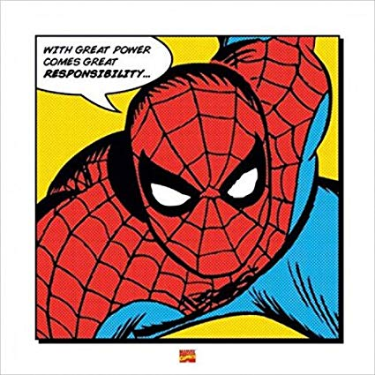
Python Pitfalls
At first glance Python feels more like a scripting language without rigid rules.
It’s “Loosey Goosey”
It is tempting to use Python to write bad code
We will come across situations where this flexible nature of Python is an asset

Slide 54

That’s All For Week 1!
Quizzes start next week!
The Quiz next week will be during the first lecture
Next week we will cover Ranges and Slicing. This will be followed by Scope. That will give you all enough knowledge to get familiar with Python! (If you aren’t already).
Next week we will also get into OOP concepts and all the good stuff!

