Slide 1
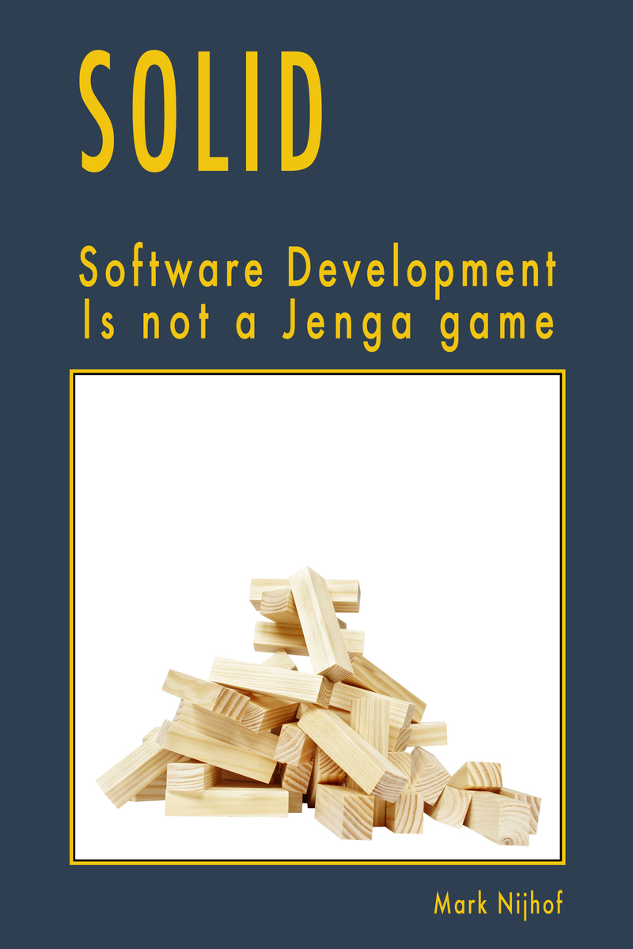
SOLID Design Principles
And the Law of Demeter.
COMP3522 Object Oriented Programming 2: Week 3

Slide 2
Recap: Remember this?
UI
Text File
read() write() search()
Say we were developing an app with a UI that was populated with some data from a text file.
After a few releases and years of development, for some reason we decide to switch out to a more secure source of data , perhaps an encrypted JSON file or even perhaps a SQLite Database. We would have to edit all the modules/classes that dealt with our app’s UI!

Slide 3
Recap: Decoupling dependencies
UI
Data Source
We can decouple our system to instead depend on a data source which is an abstraction that hides different data sources.
Our UI would just have to be dependent on a common interface provided by the Data Source and not be concerned with how that data source is implemented
retrieve() update() search()
delete
Text File
SQLite DB
JSON File
read() write() search()
connect()
read() write() search()
read() write() search()
serialize()
deserialize()

Slide 4
Recap: Decoupling dependencies
UI
Data Source
We actually used at least 3 SOLID Design Principles here!
Today we’re going to learn what these principles are and why are they so important.
retrieve() update() search()
delete
Text File
SQLite DB
JSON File
read() write() search()
connect()
read() write() search()
read() write() search()
serialize()
deserialize()

Slide 5
Recap: Dependencies and Coupling
What are they?
Why do we need to be aware of them?
Are they undesirable?

Slide 6

Recap: Dependencies & Coupling
Dependency:
If entity A uses entity B, then A is said to be dependent on B.
Coupling:
Coupling is a form of a strong dependency.
If Entity A is coupled with Entity B then Entity A will not be able to function without Entity B, even if it was replaced with another similar Entity. Entity A would need to be refactored to use the new Entity
We usually want to avoid this as it hinders us from creating flexible, dynamic, maintainable code.

Slide 7
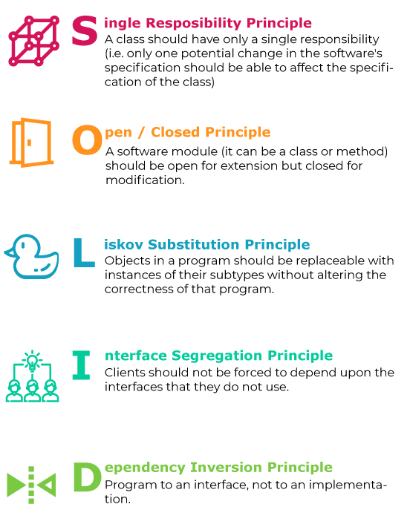
SOLID Design Principles
A set of guidelines to help us write Maintainable, decoupled, flexible Object Oriented Code
Created by Robert C. Martin, also known as Uncle Bob amongst developers.
Highly respected and has a bunch of books on writing clean code.

Slide 8
Single Responsibility Principle

Slide 9
Say we had a system where a user could write and create forum posts
User
Post
class User: def __init__(self, username, password, name, email): self._username = username self._password = password self._name = name self._email = email self._database = MyDatabase() def post_to_forum(message, subject): post = Post(subject, message, self.username) self._database.add_simple_post(post)
MyDatabase
Why is this code bad?
The User class is very coupled and dependent. It carries out a number of different roles and responsibilities. Changing any part of this system will probably cause a change in the User class as well.

Slide 10
Say we had a system where a user could write and create forum posts
User
Post
class User: def __init__(self, username, password, name, email): self._username = username self._password = password self._name = name self._email = email self._database = MyDatabase() def post_to_forum(message, subject): post = Post(subject, message, self.username) self._database.add_simple_post(post)
MyDatabase
Why is this code bad?
User class has code to:
be a user

Slide 11
Say we had a system where a user could write and create forum posts
User
Post
class User: def __init__(self, username, password, name, email): self._username = username self._password = password self._name = name self._email = email self._database = MyDatabase() def post_to_forum(message, subject): post = Post(subject, message, self.username) self._database.add_simple_post(post)
MyDatabase
Why is this code bad?
User class has code to:
be a user
create a database

Slide 12
Say we had a system where a user could write and create forum posts
User
Post
class User: def __init__(self, username, password, name, email): self._username = username self._password = password self._name = name self._email = email self._database = MyDatabase() def post_to_forum(message, subject): post = Post(subject, message, self.username) self._database.add_simple_post(post)
MyDatabase
Why is this code bad?
User class has code to:
be a user
create a database
Post to a forum

Slide 13
Say we had a system where a user could write and create forum posts
User
Post
class User: def __init__(self, username, password, name, email): self._username = username self._password = password self._name = name self._email = email self._database = MyDatabase() def post_to_forum(message, subject): post = Post(subject, message, self.username) self._database.add_simple_post(post)
MyDatabase
The User class should focus on only being a user

Slide 14
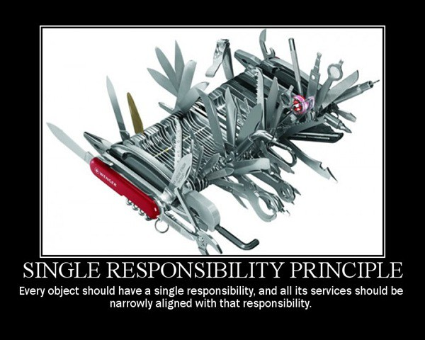
Single Responsibility Principle
“The Single Responsibility Principle requires that each class is responsible for only one thing.”
Ask yourself, are there multiple reasons to change my class?
There should only be one reason to change your class. Each class should have one and only one responsibility.

Slide 15
We Split the User Class! Pt.1
User
class User: def __init__(self, username, password, name, email): self._username = username self._password = password self._name = name self._email = email
PostWriter
Post
MyDatabase

Slide 16
We Split the User Class! Pt.2
User
class PostWriter: def __init__(self, database): self._database = database def post_to_forum(self, user, message, subject): post = Post(subject, message, user._username) self._database.add_post(post)
PostWriter
Post
MyDatabase

Slide 17
Open-closed principle

Slide 18
Now, Say we had a UI widget class….
Say we had a graphical user interface, where each UI element was a UI widget.
class UIWidget:
def draw_widget(self): if self._type == "Button": # complicated button draw logic here else: # complicated draw logic for other widget types
UIWidget

Slide 19
Now over time, what if our UIPanelWidgetClass looked like this?
class UIWidget: def draw_widget(self): if self._type == "Button": #complicated button draw logic here elif self._type == “TextBox”: # complicated draw logic for a generic UI box elif self._type == “ScrollBar”: # complicated draw logic for a generic UI box elif self._type == “Label”: # complicated draw logic for a generic UI box else: # complicated draw logic for a generic UI box
UIWidget
This is terrible design! If we wanted to change the logic / algorithm behind drawing a button, we would need to edit this massive draw method.
An error or bug here would effect all the widgets on screen and crash our whole system!

Slide 20
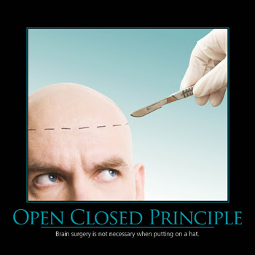
Open Closed Principle
The Open/Closed Principle states that software entities (classes, modules, functions, etc.) should be open for extension, but closed for modification.
Once a class is made, it’s behaviour shouldn’t be modified to support special cases. It should be CLOSED for modification.
Instead, we extend (or inherit) from the class and override behaviours. That is, it’s OPEN for extension.

Slide 21
We use Inheritance (and overriding)!
class UIWidget(abc.ABC): @abc.abstractmethod def draw_widget(self): pass
class UIButton(UIWidget): def draw_widget(self): # complicated draw code for text box goes here
class UITextBox(UIWidget): def draw_widget(self): # complicated draw code for text box goes here class UIScrollBar(UIWidget): def draw_widget(self): # complicated draw code for scroll bar goes here
UIWidget
UITextBox
UIScrollBar
.…
UIButton
Now, any change to UIButton would not affect any other widget.
Each widget class is modular and decoupled. It even follows the Single Responsibility Principle!

Slide 22
We use Inheritance (and overriding)!
class UIWidget(abc.ABC): @abc.abstractmethod def draw_widget(self): pass
class UIButton(UIWidget): def draw_widget(self): # complicated draw code for text box goes here
class UITextBox(UIWidget): def draw_widget(self): # complicated draw code for text box goes here class UIScrollBar(UIWidget): def draw_widget(self): # complicated draw code for scroll bar goes here
UIWidget
UITextBox
UIScrollBar
.…
UIButton
We used abstraction to do this.
The UIWidget class is now an interface ensuring that each UI component that inherits from it has the same interface.

Slide 23
Liskov Substition Principle

Slide 24
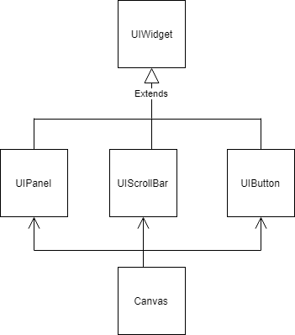
Now how do we draw all these widgets?
class Canvas: def __init__(self, panel, scrollbar, …, button): self._panel = panel self._scrollbar = scrollbar self._button = button .. def draw_screen(self): self._panel.draw() self._scrollbar.draw() self._button.draw() .. ..
Say we have a Canvas Object that needs to draw the screen. Would this be a good way of drawing all the widgets?

Slide 25
Now how do we draw all these widgets?
class Canvas: def __init__(self, panel, scrollbar, …, button): self._panel = panel self._scrollbar = scrollbar self._button = button .. def draw_screen(self): self._panel.draw() self._scrollbar.draw() self._button.draw() .. ..
This would be terrible! Why inherit if you have to keep an explicit reference to each subtype?

Slide 26
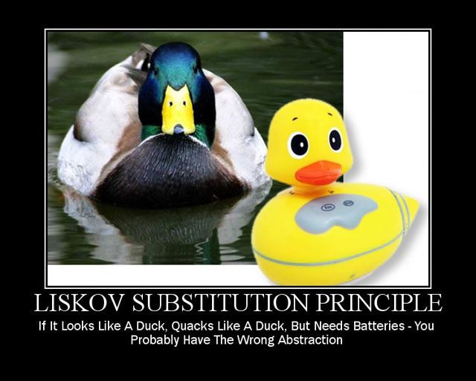
Liskov Substitution Principle
In programming, the Liskov substitution principle states that if S is a subtype of T, then objects of type T may be replaced (or substituted) with objects of type S.
Or
Objects in a program should be replaceable with instances of their sub types without altering the correctness of that program.
Simply put, you should be able to refer to all the different UI components as its parent class, UIWidget

Slide 27
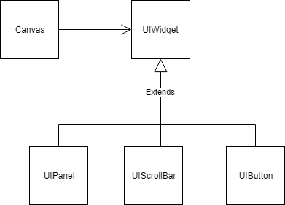
In Python this is easy, since we don’t worry about types!
class Canvas: def __init__(self, widget_list): self._ui_widgets = widget_list
def draw_screen(self): for widget in self._ui_widgets: widget.draw()
Now we just have a widget list filled with all the different kinds of UI Widget objects.
Since they all have the same interface (draw method) they can be treated as if they were their base class (UIWidget).
We don’t care about the subtype.

Slide 28
Interface segregation principle

Slide 29
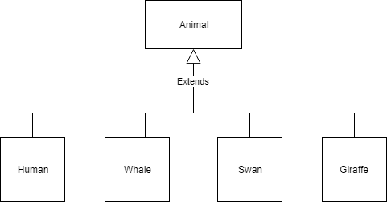
Now Say We Were Modeling A Zoo…
class Animal(abc.ABC):
def breathe(self): # common breathing code here
def eat(self): # common eating code here
@abc.abstractmethod def walk(self): # common walking code
@abc.abstractmethod def swim(self): # common swimming code
@abc.abstractmethod def fly(self): # common flying code
So we followed all our design principles and wrote the animal ABC Class.
But this is terrible! Now our Human class needs to override the fly method. Our Whale can walk!

Slide 30

Interface Segregation Principle
Many client-specific interfaces are better than one general-purpose interface.
Or
The interface segregation principle states that no client should be forced to depend on methods it does not use.
Put more simply: Do not add additional functionality to an existing interface by adding new methods.
This is the Single Responsibility Principle for Interfaces/Abstractions!

Slide 31
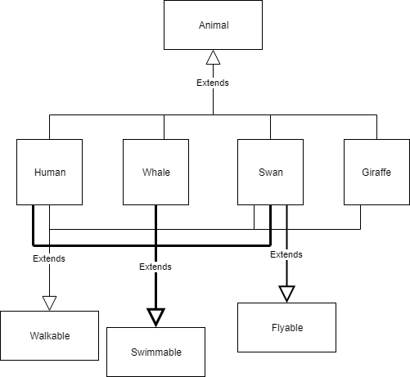
Back To Our Zoo!
Instead of polluting the animal base class with additional functionality, we create separate interfaces (read: ABC) that handle different responsibilities.
This may seem difficult to maintain, but in fact it isn’t.
class Animal: def breathe(self): #common breathing code here def eat(self): #common eating code here
Extract code that all Animals share

Slide 32
Back To Our Zoo!
Instead of polluting the animal base class with additional functionality, we create separate interfaces (read: ABC) that handle different responsibilities.
This may seem difficult to maintain, but in fact it isn’t.
class Walkable(abc.ABC): @abc.abstractmethod def walk(self): pass class Swimmable(abc.ABC): @abc.abstractmethod def swim(self): pass class Flyable(abc.ABC): @abc.abstractmethod def fly(self): pass
Extract optional functionality to separate interfaces

Slide 33
Back To Our Zoo!
Instead of polluting the animal base class with additional functionality, we create separate interfaces (read: ABC) that handle different responsibilities.
This may seem difficult to maintain, but in fact it isn’t.
class Human(Animal, Walkable, Swimmable): def walk(self): # overridden walking code def swim(self): # overridden swimming code
Human class inherits only the functionality they need

Slide 34
Dependency inversion principle

Slide 35
Dependency Inversion Principle
Dependency Inversion Principle can be thought as a combined effect of the previous principles.
Specifically, the Open Closed Principle and Liskov Substitution Principle
Before we dive into this, we need to look at a few concepts.

Slide 36
High Level & Low Level Modules
UI
Text File
read() write() search()
High Level Module
Low Level Module
High Level Modules are the ones that contain complex logic made up of small ‘chunks’ of simpler code. For example, our UI class
A Low Level Module on the other hand, is a class that encapsulates some simple atomic behaviour. Such as writing and reading from a file, displaying an image, etc.
We generally compose high level modules with low level modules. That is, high level modules are Coupled and Dependent on low level modules

Slide 37
High Level & Low Level Modules
UI
Text File
read() write() search()
High Level Module
Low Level Module
This is not very good design.
We don’t want this dependency. We want to be able to change or replace the lower level modules without tampering with the complex code in the higher level modules

Slide 38
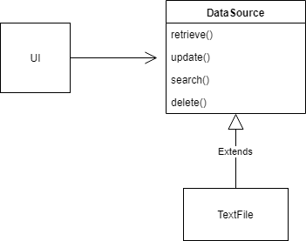
We inversed the dependencies!
We introduced an abstract layer that does not depend on anything.
We made both our high level and low level modules depend on the abstract instead.
Now we can switch out either side, the UI and the text file could be replaced with something completely different

Slide 39
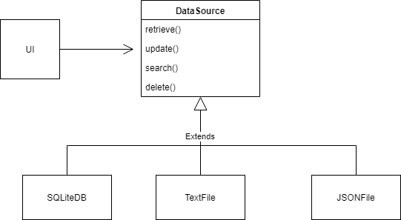
We inversed the dependencies!
Everyone here has seen a diagram like this many times now.
We can even see the building blocks that are Liskov Substitution and Open Closed Principles.

Slide 40
Dependency Inversion Principle
High-level modules should not depend on low-level modules. Both should depend on abstractions.
UI
Text File
textFile
read() write() search()
High Level Module
Low Level Module

Slide 41
Dependency Inversion Principle
Abstractions should not depend on details. Details should depend on abstractions.

Slide 42
Dependency Inversion Principle
We call classes that implement details ‘Concrete Classes’. In the example we just saw, the Data Source is our abstract class or interface, and the UI and TextFile classes are concrete classes.
Abstract classes declare an interface.
Concrete classes actually contain the code that implements the details of the interface.

Slide 43

Right, now your turn! Say we had a character creation UI in a game.
We have a Character Creation UI, where a player creates their character. When they click the create button, it gets saved to a save file.
Apply everything you’ve learnt so far to “fix” this terrible design.
Game
CharacterCreationUI
SaveFileWriter

Slide 44
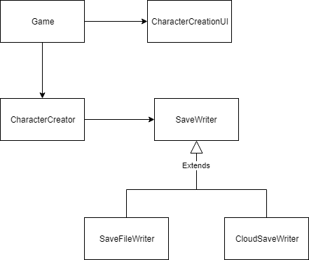
My Solution
Single Responsibility Principle
Single Responsibility Principle
Dependency Inversion Principle

Slide 45
Law of Demeter

Slide 46
Law of Demeter
Real life - Wallet example

Slide 47
Law of Demeter
Real life - Wallet example
Imagine if customer, cashier, wallet are classes
Cashier should not reach in customer, then reach into their wallet to get the money
Classes should not have knowledge of public members several classes away
Cashier can access customer, but not wallet, through customer

Slide 48
Law of Demeter
“Each unit should have only limited knowledge about other units: only units “closely” related to the current unit. Each unit should only talk to its friends; don’t talk to strangers.”
Don’t have train wrecks like these:
obj.getX().getY().getZ().doSomething();
Or
MyCharacterUI.GetCharacterData().CreateCharacter().Save()
Poor Demeter is often forgotten, some people even call it “Suggestion of Demeter” since this is difficult to avoid

Slide 49
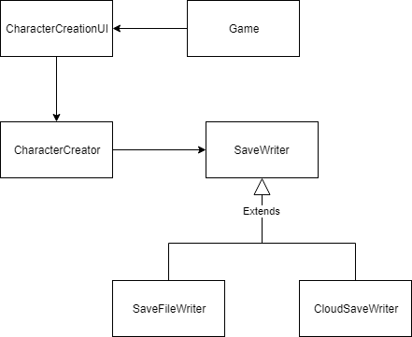
Law of Demeter – Example Code
class game: def create_character(self): self._data = self.character_ui.get_character_creator().save(self.character_ui.get_character_creator().create_character())
This code tries to create a character and save it
This is obviously bad and hard to read code
I also had a hard time getting the lines to fit in powerpoint. Bad for many reasons
Any change in the save method, which is all the way in SaveWriter, could have a ripple effect of changes all the way to our game class

Slide 50
Law of Demeter – Example Code
Part of the solution is to restructure the system by swapping Game and CharacterCreationUI
Therefore Game does not need to reach through CharacterCreationUI to get CharacterCreator

Slide 51
Law of Demeter – Example Code - Solution
Restructure code so each class is responsible for their own data. This prevents classes reaching deeply through multiple classes
class game: def create_character(self): data = self.character_ui.get_data() self.character_creator .initiate_character_creation(data)
class CharacterCreationUI: def get_data(self): return self.character_data
class CharacterCreator: def initiate_character_creation(self, data): my_char = self.create_character(data) self.save_manager.save(my_char)
Notes:
Code is rewritten so characterCreationUI doesn’t depend on CharacterCreator. Put Game in the middle and re-wrote how character creator saves character

Slide 52
Function parameters
Pass by value? Pass by reference? Or something else???

Slide 53
Pass by value
Check out this code, and let’s assume it’s pass by value
def func(in_list): in_list.append(1) in_list = [2, 3] out_list = [0] func(out_list) print(out_list)
[0]
out_list
A new object is created in memory, and the variable out_list is assigned to it
http://stupidpythonideas.blogspot.com/2013/11/does-python-pass-by-value-or-by.html

Slide 54
Pass by value
Check out this code, and let’s assume it’s pass by value
def func(in_list): in_list.append(1) in_list = [2, 3] out_list = [0] func(out_list) print(out_list)
[0]
[0]
Copy
[0]
out_list
in_list
in_list is a new parameter. A new piece of memory is created and a copy of [0] is placed into the memory of in_list

Slide 55
Pass by value
Check out this code, and let’s assume it’s pass by value
def func(in_list): in_list.append(1) in_list = [2, 3] out_list = [0] func(out_list) print(out_list)
[0]
[0, 1]
out_list
in_list
in_list has the value 1 appended to it. This does not change the original out_list

Slide 56
Pass by value
Check out this code, and let’s assume it’s pass by value
def func(in_list): in_list.append(1) in_list = [2, 3] out_list = [0] func(out_list) print(out_list)
[0]
[2, 3]
out_list
in_list
in_list has now changed its value to [2,3]

Slide 57
Pass by value
Check out this code, and let’s assume it’s pass by value
def func(in_list): in_list.append(1) in_list = [2, 3] out_list = [0] func(out_list) print(out_list)
[0]
[2, 3]
out_list
in_list
When we print out_list, its value still remains as [0]

Slide 58
Pass by reference
Check out this code, and let’s assume it’s pass by reference
def func(in_list): in_list.append(1) in_list = [2, 3] out_list = [0] func(out_list) print(out_list)
[0]
out_list
A new object is created in memory, and the variable out_list is assigned to it

Slide 59
Pass by reference
Check out this code, and let’s assume it’s pass by reference
def func(in_list): in_list.append(1) in_list = [2, 3] out_list = [0] func(out_list) print(out_list)
[0]
out_list
in_list
in_list is a reference to out_list. in_list and out_list are both referencing the same object in memory. There is NO COPYING

Slide 60
Pass by reference
Check out this code, and let’s assume it’s pass by reference
def func(in_list): in_list.append(1) in_list = [2, 3] out_list = [0] func(out_list) print(out_list)
[0,1]
out_list
in_list
in_list has the value 1 appended to it. This changes the original value out_list is assigned to

Slide 61
Pass by reference
Check out this code, and let’s assume it’s pass by reference
def func(in_list): in_list.append(1) in_list = [2, 3] out_list = [0] func(out_list) print(out_list)
[2,3]
out_list
in_list
in_list has now changed its value to [2,3]. Again this changes the original value out_list is assigned to

Slide 62
Pass by reference
Check out this code, and let’s assume it’s pass by reference
def func(in_list): in_list.append(1) in_list = [2, 3] out_list = [0] func(out_list) print(out_list)
[2,3]
out_list
in_list
When we print out_list, its value was changed within the function to [2,3]. These changes are reflected even outside the function

Slide 63
Python - Pass by ???
def func(in_list): in_list.append(1) in_list = [2, 3] out_list = [0] func(out_list) print(out_list)
[0]
out_list
A new object is created in memory, and the variable out_list is assigned to it

Slide 64
Python - Pass by ???
def func(in_list): in_list.append(1) in_list = [2, 3] out_list = [0] func(out_list) print(out_list)
[0]
out_list
in_list
in_list is a new parameter that points to the same value out_list is pointing at. in_list and out_list are both pointing at the same object in memory. There is NO COPYING

Slide 65
Python - Pass by ???
def func(in_list): in_list.append(1) in_list = [2, 3] out_list = [0] func(out_list) print(out_list)
[0,1]
out_list
in_list
in_list has the value 1 appended to it. This changes the original value out_list is assigned to

Slide 66
Python - Pass by ???
def func(in_list): in_list.append(1) in_list = [2, 3] out_list = [0] func(out_list) print(out_list)
[0,1]
[2, 3]
out_list
in_list
The object [2,3] is created in memory and in_list has now changed to point to it

Slide 67
Python - Pass by ???
def func(in_list): in_list.append(1) in_list = [2, 3] out_list = [0] func(out_list) print(out_list)
[0,1]
[2, 3]
out_list
in_list
When we print out_list, its value is [0,1]

Slide 68
Python - Pass by ???
Soooo, what is it called?
You might see some of the following ways to call it:
Call-by-Object
Call by Object Reference
Call by Sharing
Pass-by-object-reference
Passed by assignment
Pass by name
Some people don’t bother giving it a name because it’s an entirely different concept from pass by value or pass by reference

