Slide 1
Creational Patterns: Factory & Abstract Factory
COMP3522 Object Oriented Programming 2
Week 9
Reference: https://refactoring.guru/design-patterns/abstract-factory

Slide 2
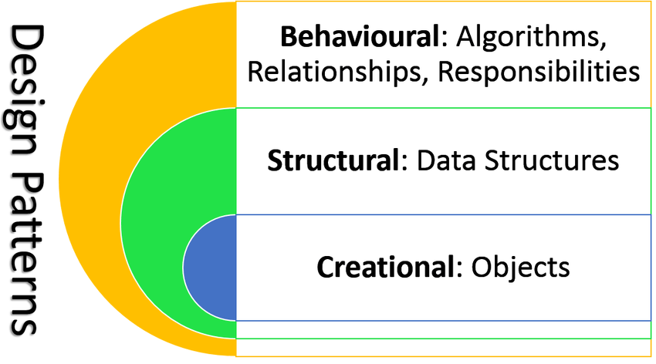
Categorizing Design Patterns
Behavioural
Focused on communication and interaction between objects. How do we get objects talking to each other while minimizing coupling?
Structural How do classes and objects combine to form structures in our programs? Focus on architecting to allow for maximum flexibility and maintainability.
Creational (We are looking at these!)
All about class instantiation. Different strategies and techniques to instantiate an object, or group of objects

Slide 3
Today we will be looking at 2 patterns…
Factory (Also known as Factory Method)
When you want to separate creation code from client code.
Abstract Factory
A more evolved form of the Factory Pattern
When you want a client or service to only depend on a base class for object creation and not each concrete class.
Allows for the creation of a group of related objects .
When you want to create different variants of families of objects.

Slide 4
Factory Pattern

Slide 5

First let’s clarify the word Factory…
Something that is responsible for making things
In this case objects.
The word factory is thrown around a lot, don’t mix it up with the Factory Pattern or the Abstract Factory Pattern. They are also responsible for making objects but are different.
A Factory could refer to:
The pattern(s)
A class that creates objects
A static/class method that generates objects.

Slide 6
Some more lingo – Creation Method
A method or function that is responsible for creating an object. It is a factory.
Different from the constructor, although you can argue that a constructor is a creation method too. A creation method can be a wrapper around a constructor call. (Check the example below)
A creation method doesn’t have to make a new instances of a class, it can return a cached object or even re-use objects from a collection.
Resist the urge to call it a Factory Method. The Factory Pattern is also known as the Factory Method Pattern and it can cause all sorts of confusion.
@classmethod def generate_random_asteroid(cls, min_speed, max_speed): speed = random.randomint(min_speed, max_speed) asteroid = cls() asteroid.speed = speed return asteroid
Notes:
Creation method is a method/function that creates an object
Though it’s different from a constructor
See in the code below that generate_ranom_asteroid is a static creation method that wraps around a construction call
In fact creation methods don’t have to create at all, they must just return a cached or re-used object from a collection
Resist the urge to call creation methods factory methods just because it can be confused with the factory pattern

Slide 7
Remember the dependency inversion principle?
UI
Text File
read() write() search()
Say we were developing an app with a UI that was populated with some data from a text file.
After a few releases and years of development, for some reason we decide to switch out to a more secure source of data , perhaps an encrypted JSON file or even perhaps a SQLite Database. We would have to edit all the modules/classes that dealt with our app’s UI!

Slide 8
Remember the dependency inversion principle?
UI
Data Source
We can decouple our system to instead depend on a data source which is an abstraction that hides different data sources.
Our UI would just have to be dependent on a common interface provided by the Data Source and not be concerned with how that data source is implemented
read()
write() search()
delete
Text File
SQLite DB
JSON File
read() write() search()
connect()
read() write() search()
read() write() search()
serialize()
deserialize()

Slide 9

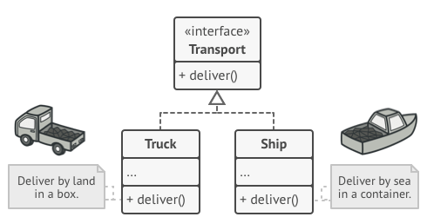
Factory Pattern
A way to decouple client code that uses an object or a service, from the code that creates an object or a service.
Consider a scenario where a system is managing the logistics of delivering goods.
If inheritance is done correctly, a Logistics System should only care about depending on the Transport Interface, not the concrete transports (Truck or Ship). This follows the Dependency Inversion Principle.
LogisticsSystem

Slide 10

Factory Pattern
But at some point we need to create the concrete class. If the Logistics System did that, then it would need to call the Truck() or Ship() constructors.
This would make it dependent on the concrete classes and break the Dependency Inversion Principles. A high level module is now dependent on a low level module.
LogisticsSystem

Slide 11
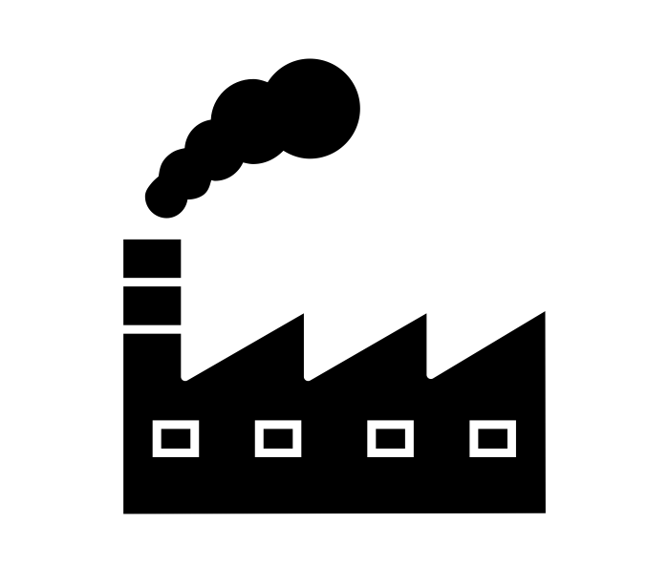
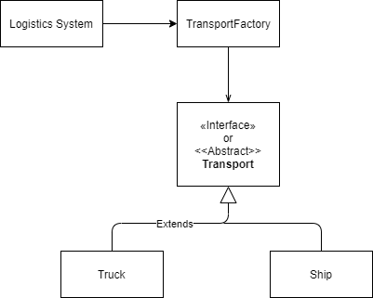
Factory Pattern
So when it comes to creating these objects we need another entity to handle the responsibility of creating a specific type of Transport.
We need a factory which will create a concrete transport and return it to the Logistics System.
As far as the Logistics System is concerned. It doesn’t necessarily know that it is receiving a Truck, or Ship. All it needs to know is that it is receiving a Transport.
For Creation only

Slide 12
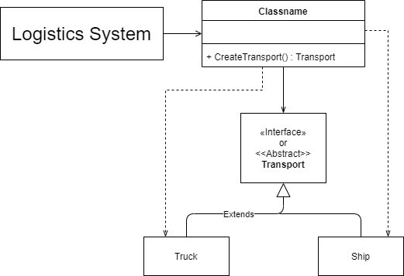
Factory Pattern
This still isn’t enough. All we have done is move the call to our Truck() or Ship() initializer to the TransportFactory. This isn’t that useful.
Say our TransportFactory has a create_transport() method. Now this method will have a massive if-else or switch statement block where it will be dependent on the concrete Truck and ship Classes
def create_transport(self) -> Transport: if self.current_type == Ship: return Ship() else: return Truck()
TransportFactory
+create_transport(): Transport

Slide 13
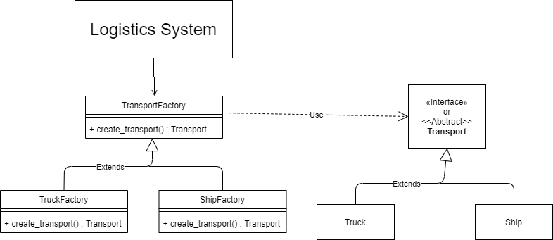
Factory Pattern
That’s better.
We can simply inherit from TransportFactory and override the create_transport() method.
All we need to do is supply the Logistics System with the right factory. (Which can be done by a controller).
As far as the Logistics System is concerned it needs an object with the TransportFactory interface.
def create_transport(self)-> Transport: return Truck()

Slide 14
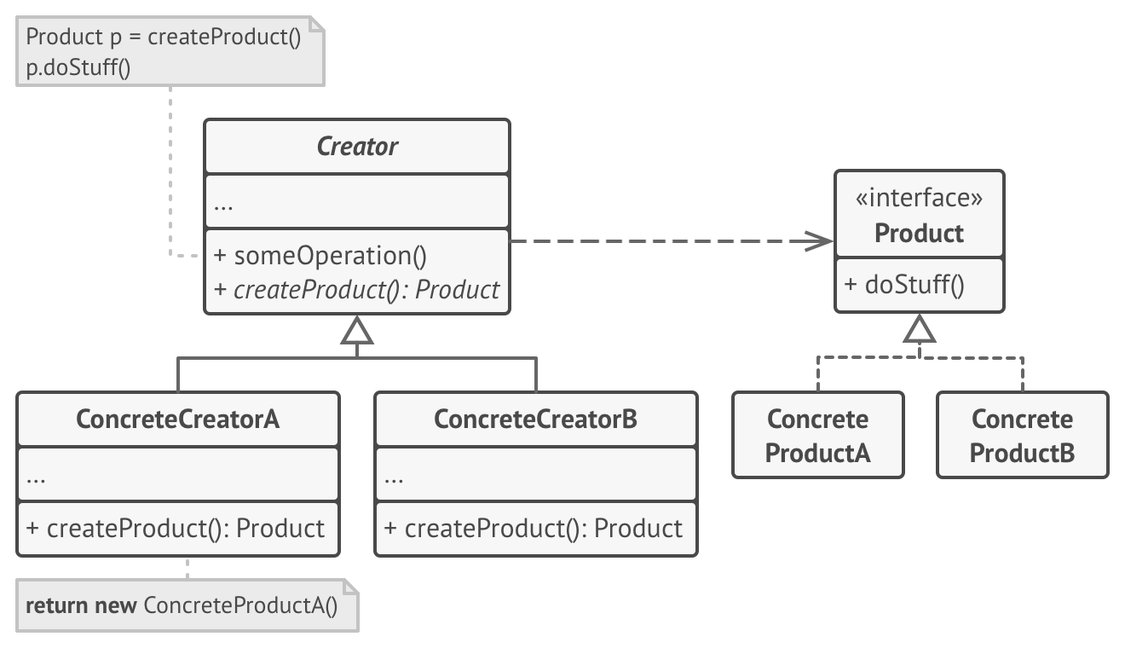
Factory Pattern
AbstractFactory
ConcreteFactoryA
ConcreteFactoryB

Slide 15
Let’s Build a Factory Pattern Together.
Let’s say we need to implement a Factory Pattern for a website hosting a forum messaging board. This website creates a new user object when a user:
Signs up to be a member or
Views the forum as a guest.
Our system can deal with two kinds of users. A Guest and a Member.
A Guest has the following permissions (this is our attribute, it is a tuple):
Read Posts
Like
Share Posts
Flag Posts
A Member can do everything a Guest can, but they can also write posts.
Step 1: Let’s create a UML Class diagram depicting the User hierarchy.

Slide 16
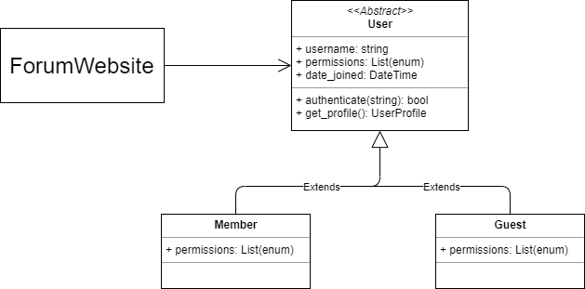
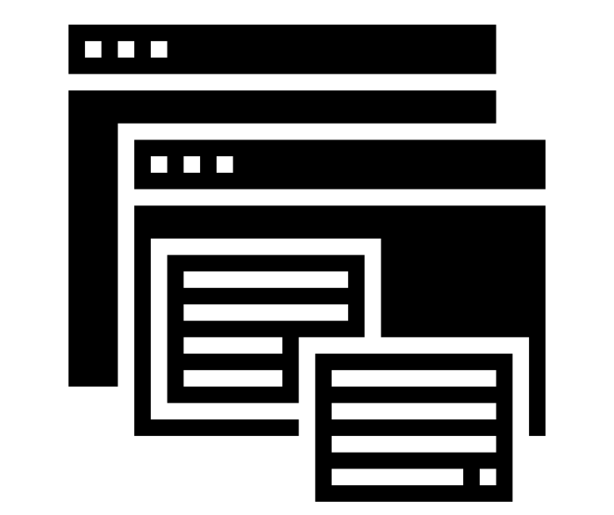

Step 1: Define a product hierarchy

Slide 17
Step 2: Define a factory class
Let’s create a UserFactory class.
Add it to the UML diagram
Specify the creation method.

Slide 18
Step 2: Define a factory class
In the Factory Pattern, a Factory class doesn’t need to solely be responsible for creating objects. It can be a larger class with a creation method.
The base factory doesn’t need to be abstract. It can create a default product. In our case, let’s make it abstract though.
For example a UserFactoryClass might also keep track of how many user accounts are currently active.
<<Abstract>> UserFactory
+ create_user() : User

Slide 19
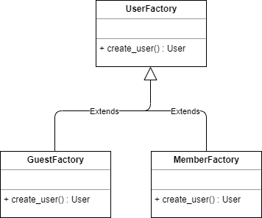
Step 3: Create a Factory hierarchy and override the creation method.
The title says it all.
We want to create our concrete factories in this step.
Each concrete factory will create a new object of its corresponding user type and return it.

Slide 20
Step 4: Integrate it into our Forum Website
Bring it all together.
Add a client class, and mark the associations between Client, Factories and Users.
Client
Factory
Users

Slide 21
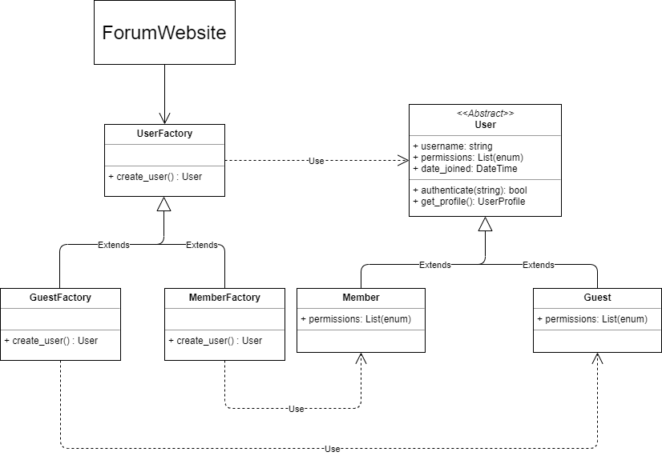
Step 4: Integrate it into our Forum Website
We can have a ForumController that prompts the user for the type of user to create
And that’s it! We have a working Factory Pattern.
It’s pretty straight forward if you break it down right?
forum_user_factory.py

Slide 22

Factory Pattern: Why and When do we use it
Use this pattern when you want to separate and encapsulate the creation process.
When we want to provide a separate interface for object creation where each subclass can alter the type of object created.
Adheres to the Single Responsibility, Open Closed, Liskov Substitution and Dependency Inversion Principle.
Use the Factory Pattern when the exact type and dependencies of the objects you need are unknown or susceptible to change. If we want to add a new product, all we need to do is create a new Factory and override the creation method in it.
Notes:
Object creation is separated from object use
Every separate object has its own unique subclass
Adheres to many of the SOLID principles
Great if you don’t know ahead of time all the different types of objects you want to create

Slide 23

Factory Pattern – Disadvantages
There are a lot of classes in play. This can make the code complex and hard to debug.
Sometimes the classes can get artificial. You may decide to create a whole new subclass for a very minor change in the object creation process.

Slide 24
Abstract Factory Pattern
When You need to create families of objects instead of a single object.

Slide 25
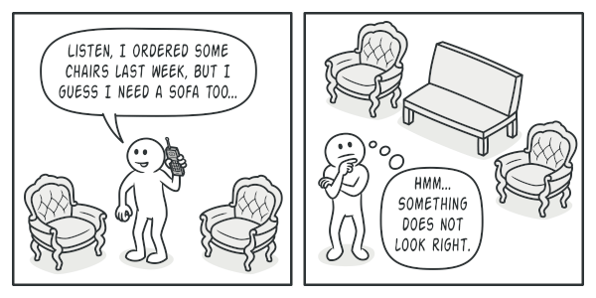
Create Families of Products.
Abstract Factory is a creational design pattern that lets you produce families of related objects without specifying their concrete classes.
In a Factory pattern, each factory creates a single product.
In a Abstract Factory pattern, each factory creates a group of related products
This is useful if our code requires objects in specific groups that are compatible with each other.

Slide 26
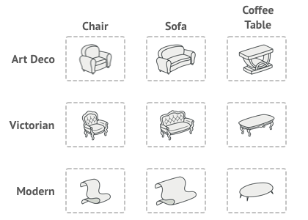
Create Families of Products.
The Abstract Factory builds upon the Factory Pattern.
No, making the base factory abstract is not enough to make an Abstract Factory Pattern.
So here’s a new scenario.
Say we have a bunch of objects that are related to each other somehow, they make sense together. Let’s call this a “product family”.
Now say there are different variations of these product families.
The Abstract Factory Pattern modifies the Factory Pattern to accommodate this type of complexity.
Product Family (related products):
Chair + Sofa + CoffeeTable
Product Family Variations:
Art Deco, or Victorian, or Modern

Slide 27
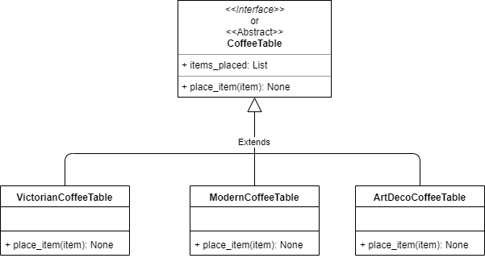
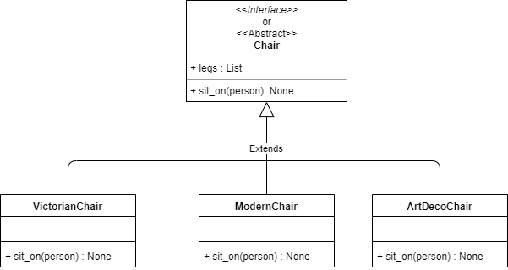
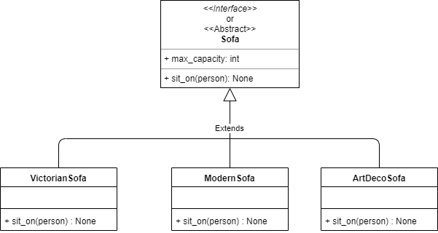
Abstract Factory
COFFEE
TABLES
Product Family (related products): Chair + Sofa + CoffeeTable
Product Family Variations: Art Deco, or Victorian, or Modern
In the abstract factory pattern, instead of one product hierarchy, you would have a different hierarchy for each distinct product in the product family.
CHAIRS
SOFAS

Slide 28
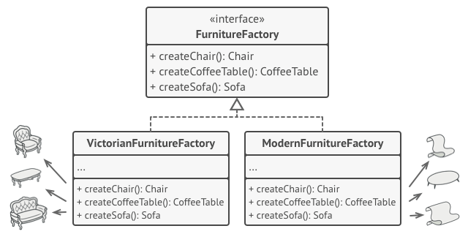
Abstract Factory
Product Family (related products): Chair + Sofa + CoffeeTable
Product Family Variations: Art Deco, or Victorian, or Modern
Instead of having a factory that creates one item, we would have a factory that creates a product family.
A factory creates an instance of each object in the family and those objects are guaranteed to be compatible.

Slide 29
Abstract Factory
Product Family (related products): Chair + Sofa + CoffeeTable
Product Family Variations: Art Deco, or Victorian, or Modern
Just like the factory pattern, we have to extend our Base Factory class (Furniture Factory) and create a Concrete Factory.
Each Concrete Factory now represents a theme/variety. This is what determines the compatibility.
Each Concrete Factory overrides the creation methods to return objects from the same Product Family.
ArtDecoFurnitureFactory
+ createChair() : Chair + createCoffeeTable() : CoffeeTable + createSofa() : Sofa

Slide 30
Abstract Factory
Product Family (related products): Chair + Sofa + CoffeeTable
Product Family Variations: Art Deco, or Victorian, or Modern
class VictorianFurnitureFactory(FurnitureFactory): def create_chair() -> Chair: return VictorianChair()
def create_coffee_table() -> CoffeeTable: return VictorianCoffeeTable() def create_sofa() -> Sofa: return VictorianSofa()
ArtDecoFurnitureFactory
+ createChair() : Chair +createCoffeeTable() : CoffeeTable +createSofa() : Sofa

Slide 31
Abstract Factory
Now we just need to add in the client.
The client expects an object with FurnitureFactory Interface.
We can have a controller initialize the right factory and pass it on to the client.
Once the factory is passed to the client, it shouldn’t matter if it is a Victorian, Modern or ArtDeco Furniture Factory. What matters is that it has the right interface.
FurnitureStore
ArtDecoFurnitureFactory
+ createChair() : Chair +createCoffeeTable() : CoffeeTable +createSofa() : Sofa

Slide 32
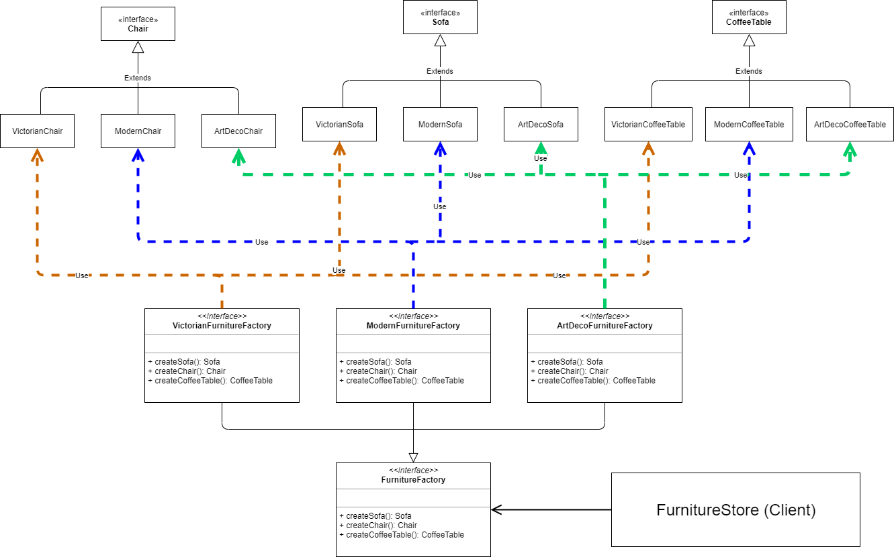
Abstract Factory – Putting it all together

Slide 33
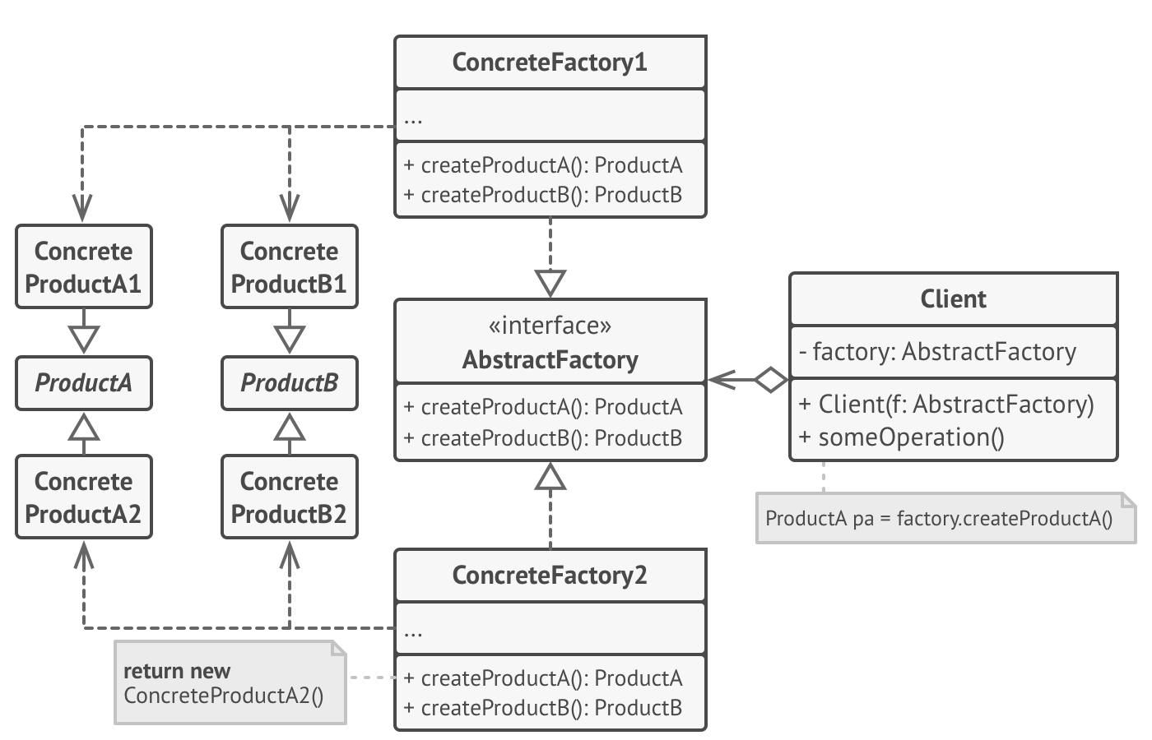
Abstract Factory
It’s essentially very similar to the Factory Pattern. It just looks complicated since we are dealing with more classes due to the large number of products.

Slide 34
Abstract Factory – Let’s Make one!
Say we were working on a game that wanted to spawn groups of characters (Friendlies, Enemy and Animals) in different worlds.
Each world would have characters following various themes.
The first step is to create a matrix identifying our Product Families (groups of related objects) in one dimension, and varieties (themes) in another dimension.
Theme/Product | Friendlies | Enemies | Animals
Aquatica | MerPerson | Kraken | Jellyfish
Firelands | FireSprite | Imp | Firefly

Slide 35
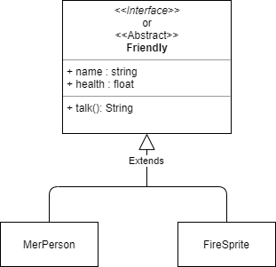
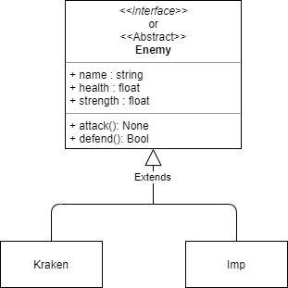
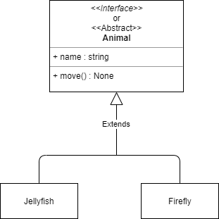
Step 1: Define the inheritance hierarchy for each product in the product family.
Theme/Product | Friendlies | Enemies | Animals
Aquatica | MerPerson | Kraken | Jellyfish
Firelands | FireSprite | Imp | Firefly

Slide 36
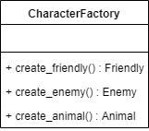
Step 2: Define a Factory base class that can create a Product Family

Slide 37
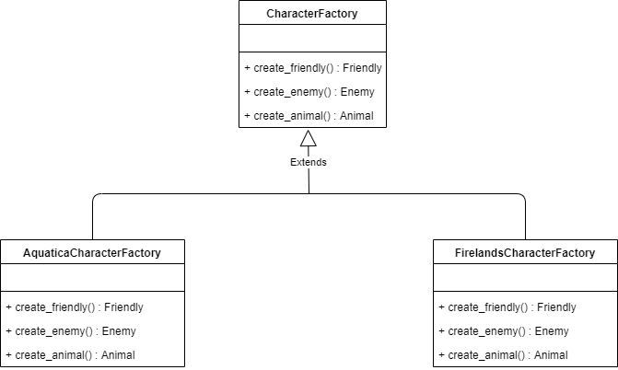
Step 3: Extend the Factory base class with Concrete Factories that can create Varieties.

Slide 38
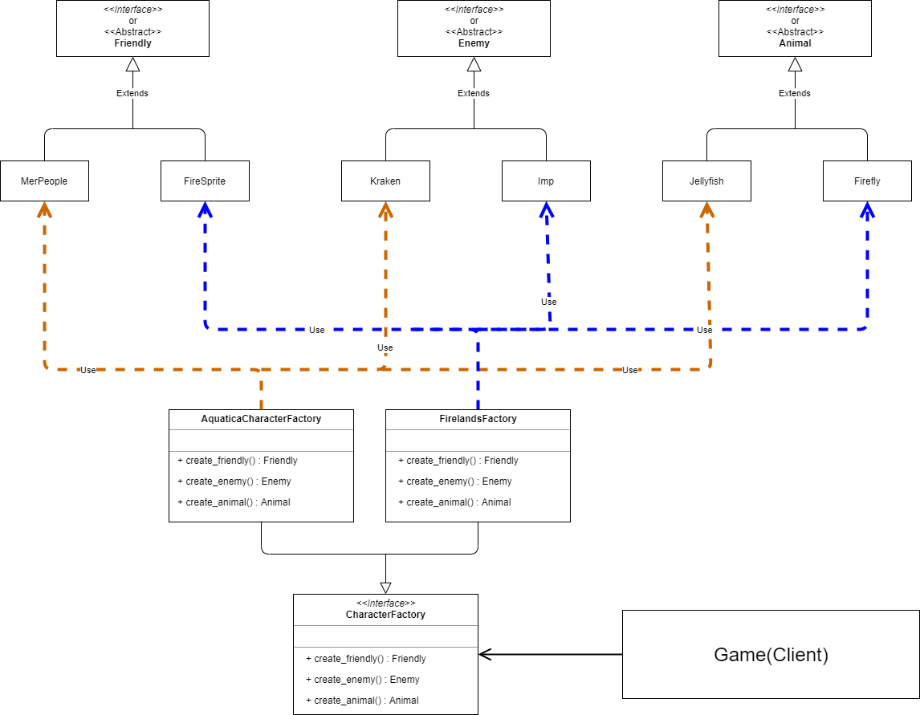
Step 4: Put it all together
game_abstract_factory.py

Slide 39
Abstract Factory Pattern: Why and When do we use it
Use this pattern if the code needs to work with families of related objects.
If the exact number of Product Families are unknown and you will have to add in new ones in the future.
Single Responsibility, Open/Closed Principle, Liskov Substitution and Dependency Inversion Principle.

Slide 40
Abstract Factory Pattern – Disadvantages
There are a lot of classes and interfaces in play. This can make the code complex and hard to debug.
Sometimes the classes can get artificial. You may decide to create a whole new subclass for a very minor change in the object creation process.

