Slide 1

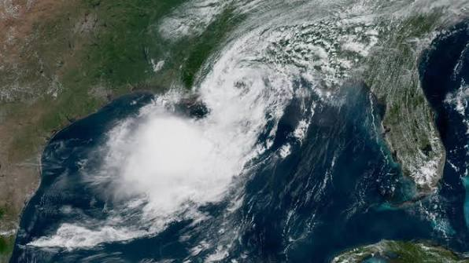
DSC 450 • CAPSTONE PROJECT 1 • MILESTONE 3
Predicting Economic Damage from Severe Weather
Using NOAA storm-event characteristics to forecast impact — not just occurrence.
Matthew Scarpello
Andrea Barfield
Sarah Parsons
Group 1 • October 2026
Notes:
Hi, we're Group 1 -- Matthew, Andrea, and I'm Sarah. This is our Milestone 3 presentation for Project 1: Predicting Economic Damage from Severe Weather, built on NOAA's Storm Events Database. Over the next few minutes we'll walk through the business problem, how we approached it, what the models found, and what that means going forward.

Slide 2

ROADMAP
What We'll Cover
1
Business Problem & Research Question
4
Ethical Considerations
Why occurrence isn't the same problem as impact
Who this affects, and where it could be misused
2
Methods & Data
5
Conclusion & Next Steps
NOAA Storm Events, 2020–2025, and how we modeled it
What this means for climate-impact planning
3
Results
6
Q&A
Model performance and what actually predicts damage
The questions we prepared for
NOAA Storm Events • 2020–2025
2
Notes:
Here's the shape of the talk: we'll start with the business problem and research question, walk through our methods and data, show you the results, talk through the ethical considerations we were asked to address, wrap up with our conclusion and next steps, and leave room for the Q&A we prepared.

Slide 3
INTRODUCTION
Two Kinds of Uncertainty
Weather forecasting is rooted in using data to reduce the uncertainty of our climate. Radar, satellites, and predictive models let us quantify and visualize storms around the globe.
But radar can't measure what an event will do to people, property, and communities. That's a second, harder form of uncertainty — impact.
BUSINESS PROBLEM / HYPOTHESIS
Economic damage from severe weather is costly and difficult to anticipate. We wanted to test whether the characteristics NOAA already records about a storm — before its full impact is known — carry enough signal to predict that damage on their own.
NOAA Storm Events • 2020–2025
3
Notes:
Here's the gap we're working in. We can see a storm forming -- radar and satellites are very good at that. What they can't tell us is what that storm will actually cost once it hits. That's the business problem: can the characteristics NOAA already records about an event -- before we know the outcome -- tell us anything about whether it'll produce real economic damage?

Slide 4
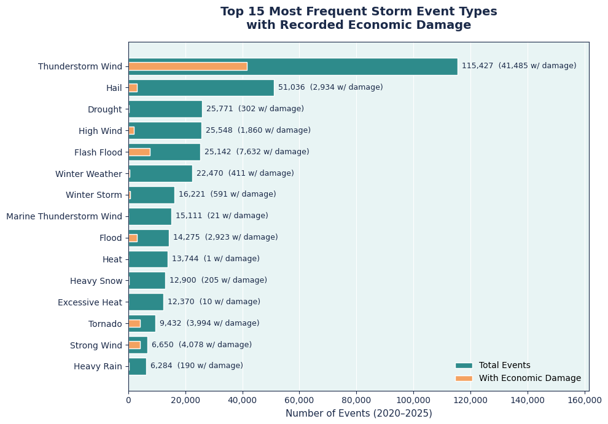
RESEARCH QUESTION
Frequency Isn't the Same as Risk
Can we predict whether a weather event will result in economic damage, based on recorded event characteristics in the NOAA Storm Events Database (2020–2025)?
Hail is one of the most common events in the dataset — but rarely linked to recorded damage. Tornado and Strong Wind are far less frequent, yet show damage much more often.
NOAA Storm Events • 2020–2025
4
Notes:
That's our research question. This chart is why it's worth asking: it compares how often each storm type occurs against how often it's actually linked to recorded economic damage. Hail happens constantly but almost never shows damage. Tornado and Strong Wind are much rarer, but damage shows up on a much higher share of them. That gap told us event type probably carries real signal -- which is where the modeling starts.

Slide 5
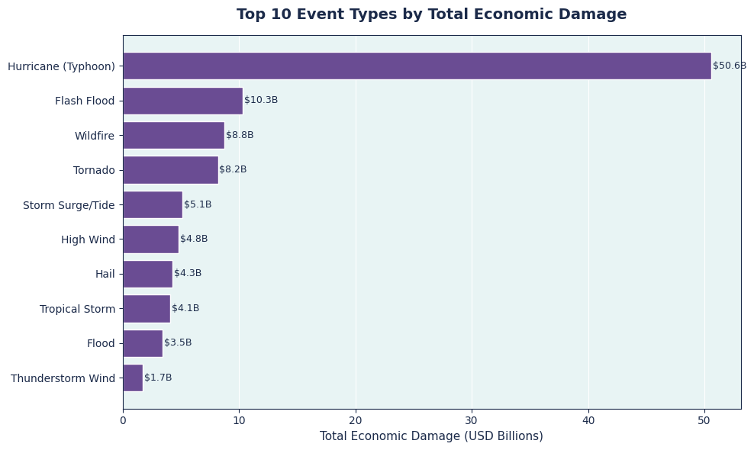
WHERE THE DOLLARS ARE
Occurrence and Cost Are Different Problems
HYPOTHESIS
Event type is the strongest predictor of recorded economic damage, with region, storm duration, and seasonal timing contributing secondary signal.
We expect storm characteristics available near an event's onset to beat a no-skill baseline by a meaningful margin — supporting their use for forward-looking risk assessment.
NOAA Storm Events • 2020–2025
5
Notes:
Here's the other half of that picture: total dollars. Hurricane events are far less common than something like Thunderstorm Wind, but they account for the largest total losses by a wide margin. So frequency and cost are genuinely two different axes of this problem. That's what our hypothesis is built on: event type should be the strongest predictor of damage, with region, duration, and season adding secondary signal on top.

Slide 6
METHODS / ANALYSIS
From Raw Records to a Modeling Table
410,311
54 → 12
75% / 25%
2 models
Storm events, 2020–2025
Columns cleaned down to modeling features
Known vs. unknown economic outcome
Logistic Regression + Random Forest
Predictors: event type, region, season, storm duration
Target: did the event have any recorded property/crop damage?
Evaluation: Average Precision (PR-AUC) alongside ROC-AUC, because the positive class is only ~23% of events
Split: grouped by storm episode (EPISODE_ID), not by row — events from the same storm system share near-identical characteristics, so a row-level split would leak near-duplicates across train and test.
NOAA Storm Events • 2020–2025
6
Notes:
On the data side: we pulled five years of NOAA Storm Events records, cleaned and engineered them down to a focused feature set, and trained two models -- Logistic Regression as an interpretable baseline, and Random Forest as our primary model. Two choices are worth calling out. First, we reported Average Precision alongside ROC-AUC because our positive class -- events with recorded damage -- is only about 23% of the data, so ROC-AUC alone can be misleading. Second, and this one we spent real time getting right: we split train and test by storm episode, not by individual row. Events from the same storm system share nearly identical characteristics, so splitting by row would let the model see near-duplicates on both sides of the split and inflate how good it looks.

Slide 7
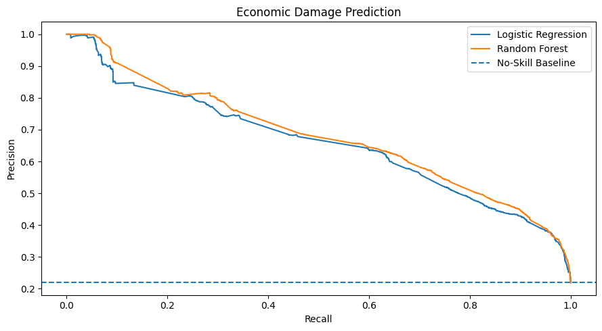
RESULTS
Both Models Beat the Baseline
0.880
Random Forest — ROC-AUC
0.669
Random Forest — Avg. Precision
0.500
No-skill baseline (ROC-AUC)
NOAA Storm Events • 2020–2025
7
Notes:
Both models landed well above the no-skill baseline. Random Forest came out slightly ahead of Logistic Regression on both metrics -- 0.880 ROC-AUC and 0.669 Average Precision -- but the two models are close enough that a lot of the predictive pattern is already visible in the simpler, more interpretable Logistic Regression. That's reassuring: it means the signal is real, not an artifact of a more complex model.

Slide 8
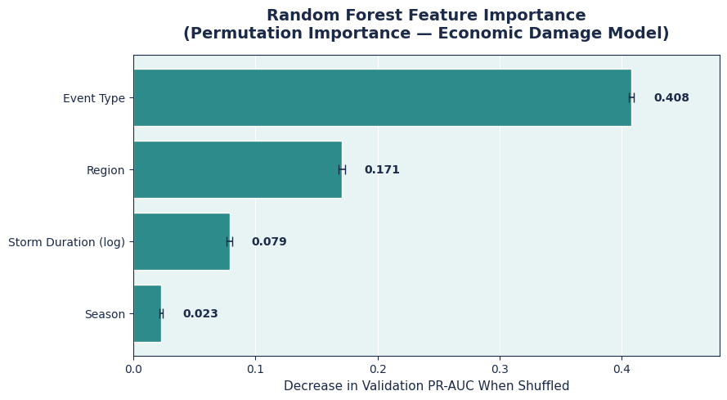
RESULTS
What Actually Predicts Damage
Event type is roughly 2.4× more important than region in the model.
That's predictive weight, not proof of cause — the model finds association in historical records, not a physical mechanism.
NOAA Storm Events • 2020–2025
8
Notes:
After training Random Forest, we looked at which characteristics actually drove its predictions. Event type came out roughly two and a half times more important than region, with duration and season contributing smaller amounts. That lines up with what we saw earlier in the raw data. One caveat we were careful to state in the report: this is predictive importance, not causation -- the model is finding association in historical records, it isn't identifying a physical cause of damage.

Slide 9
RECOMMENDATIONS / ETHICAL CONSIDERATIONS
Who This Affects — and Where It Could Go Wrong
STAKEHOLDER IMPACT
DATA ASSUMPTIONS & BIAS
Emergency managers, local governments, and insurers could use these patterns to prepare and allocate resources. The risk: over-relying on results for storm types or regions that are rare or less consistently recorded.
The model assumes NOAA's historical records are accurate and complete. Reporting practices vary by storm type and have changed over time, and the model assumes future events follow past patterns — a limitation we state plainly wherever these results are used.
NOAA Storm Events • 2020–2025
9
Notes:
We were asked to think through ten ethics and bias questions as a team -- two of the core ones are summarized here, and the full written answers to all ten are submitted with the report. On stakeholder impact: emergency managers, local governments, and insurers are the most likely users of this kind of analysis, and the main risk is leaning on it too heavily for storm types that are rare or inconsistently reported. On data assumptions: the model is only as good as NOAA's own reporting, which has changed over time and isn't uniform across event types -- and it assumes the future looks like 2020 through 2025, which is a real limitation we're upfront about.

Slide 10
CONCLUSION
Back to the Real Question
Our interest was never just whether a storm happens — it was what it costs once it does. Frequency tells you what's common, not what's costly.
NEXT STEPS
1
Add FEMA National Risk Index exposure/vulnerability data
2
Test whether damage patterns can predict storm type — reversing the current approach
Heat and Excessive Heat are among the most frequent events in the dataset, yet almost none carry a recorded economic outcome — while far rarer events like Strong Wind and Tornado are disproportionately tied to damage. As the mix of severe weather shifts, planning that leans on frequency alone risks preparing for the wrong thing.
3
Document limitations everywhere results are shared or reused
NOAA Storm Events • 2020–2025
10
Notes:
So, back to where we started. We weren't just asking whether a storm happens -- radar already answers that. We were asking what it costs once it does, and this project shows that NOAA's own recorded characteristics carry real signal on that question. Heat and Excessive Heat are some of the most frequent events in our data, and almost none of them show a recorded economic outcome -- while far rarer events like Strong Wind and Tornado are disproportionately tied to damage. That's exactly the kind of pattern a climate-impact lens is meant to catch: frequency tells you what's common, not what's costly. As severe weather patterns shift, planning that leans on frequency alone risks preparing for the wrong thing. From here, the clearest next step is layering in exposure and vulnerability data -- things like FEMA's National Risk Index -- so predictions reflect not just the storm, but who and what is actually in its path.

Slide 11
Q&A
Questions We Prepared For
1
2
3
Why split the data by storm episode instead of by row?
Could this model guide withholding disaster-response resources?
What would most improve this model's real-world usefulness?
Events from the same storm share nearly identical characteristics. A row-level split would let the model see near-duplicates across training and testing, inflating how good it looks.
No. It estimates likelihood from historical recording patterns, not ground-truth risk. Using it that way would be a misuse of a correlational tool.
Adding exposure and vulnerability data — like FEMA's National Risk Index — so predictions reflect who and what is actually in a storm's path, not just its characteristics.
Full written responses to all 10 questions are submitted alongside the report.
Notes:
As a team we worked through ten stakeholder questions in writing -- here are three we think are worth saying out loud. [Read through the three on screen.] The full set of ten, written out in full, is submitted with the report as our Q&A deliverable.

Slide 12
REFERENCES
References
Doswell, C. A. (2007). Small sample size and data quality issues illustrated using tornado occurrence data. Electronic Journal of Severe Storms Meteorology, 2(5), 1–16.
Federal Emergency Management Agency. (2024). National Risk Index. https://hazards.fema.gov/nri/
Intergovernmental Panel on Climate Change. (2023). Climate change 2023: Synthesis report. IPCC. https://www.ipcc.ch/report/ar6/syr/
National Centers for Environmental Information. (2026). Storm Events Database. National Oceanic and Atmospheric Administration. https://www.ncei.noaa.gov/pub/data/swdi/stormevents/csvfiles/
National Oceanic and Atmospheric Administration. (n.d.). NOAA's National Ocean Service: About us. U.S. Department of Commerce. https://oceanservice.noaa.gov/about/
National Oceanic and Atmospheric Administration. (n.d.). Weather. U.S. Department of Commerce. https://www.noaa.gov/weather
Verbout, S. M., Brooks, H. E., Leslie, L. M., & Schultz, D. M. (2006). Evolution of the U.S. tornado database: 1954–2003. Weather and Forecasting, 21(1), 86–93.
NOAA Storm Events • 2020–2025
12
Notes:
Our full reference list in APA format is included here and in the written report.

Slide 13
THANK YOU
Questions?
Matthew Scarpello • Andrea Barfield • Sarah Parsons
DSC 450 • Group 1 • Project 1, Milestone 3
iqproductionz.com / Data Science Portfolio
Notes:
Thank you -- that's our Milestone 3 presentation for Project 1. Happy to take any questions now, and this project will also be live on our portfolio site shortly.

