Slide 1
Logic Gate Simulator
By Haled Odat (201516)

Slide 2
Project Description
Logic gate simulator is a software tool or application that allows users to design, test, and simulate digital logic circuits. These simulators provide a virtual environment for creating and experimenting with various logic gates and other digital components.

Slide 3


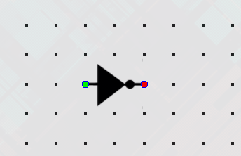



Built-in Components

Slide 4

Wires - Connectors

Slide 5
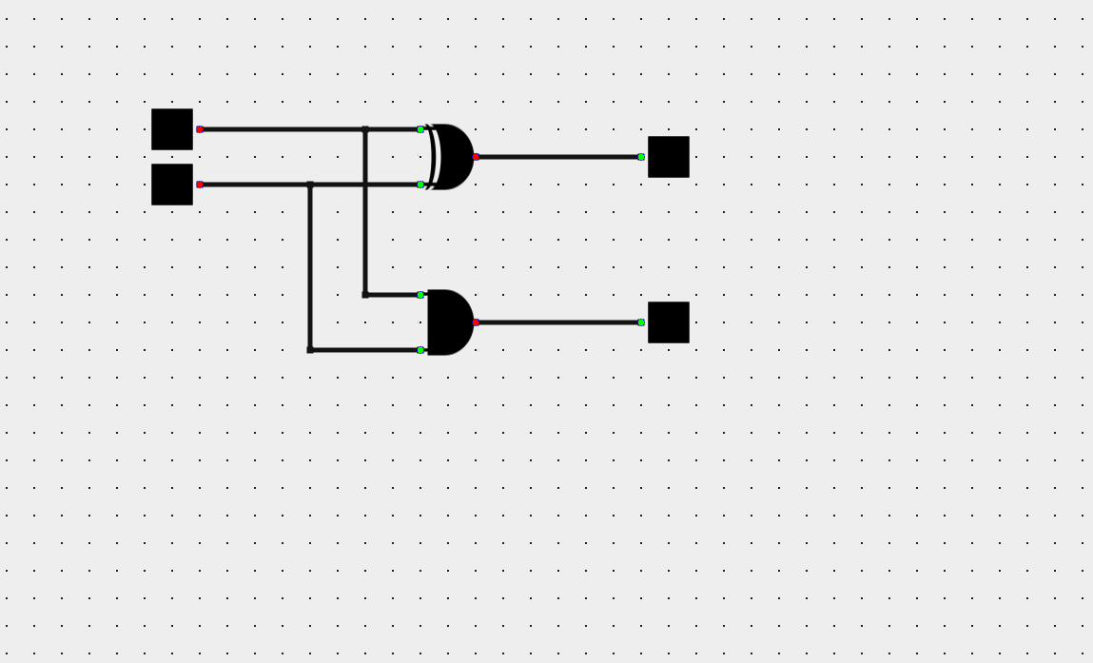
Chips

Slide 6
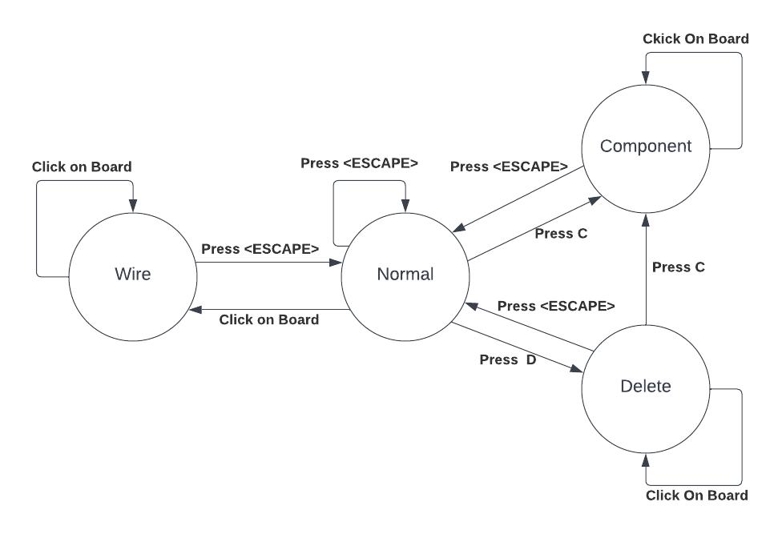
Editing Modes

Slide 7
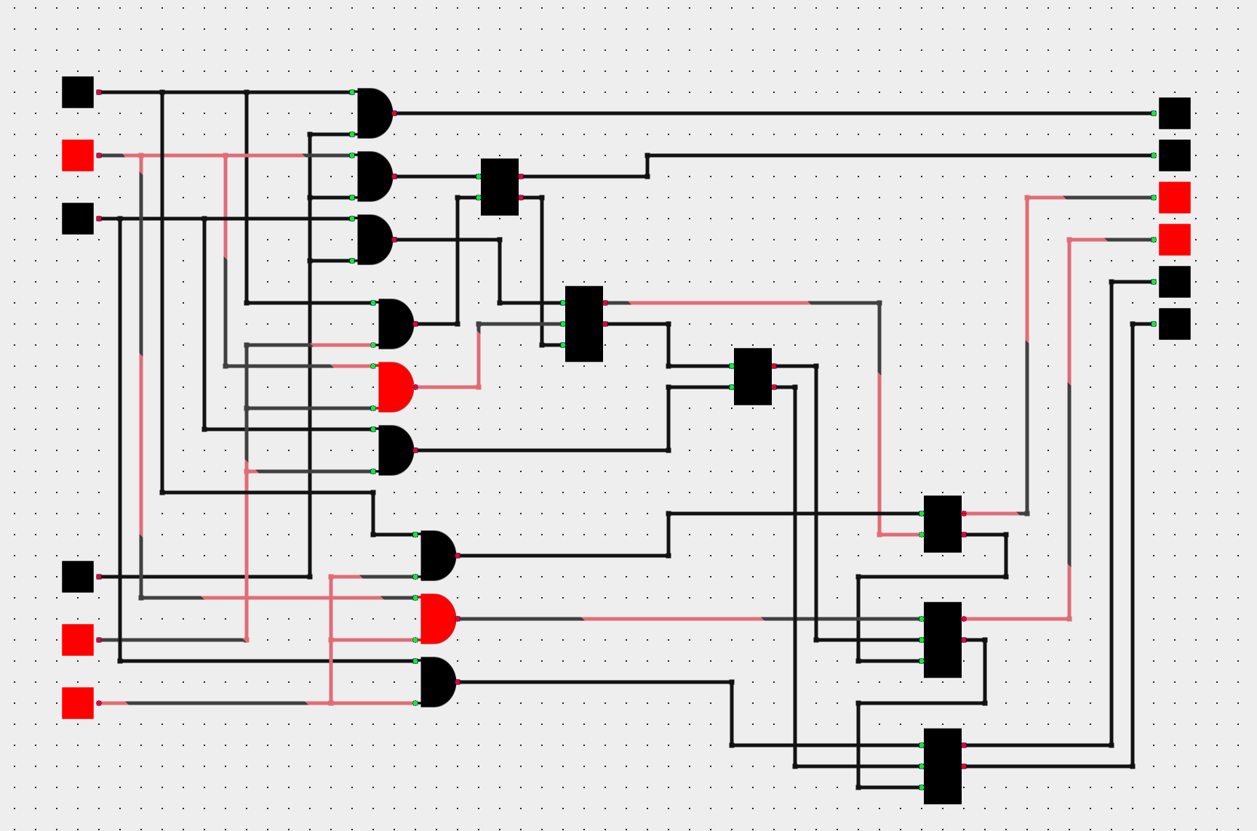
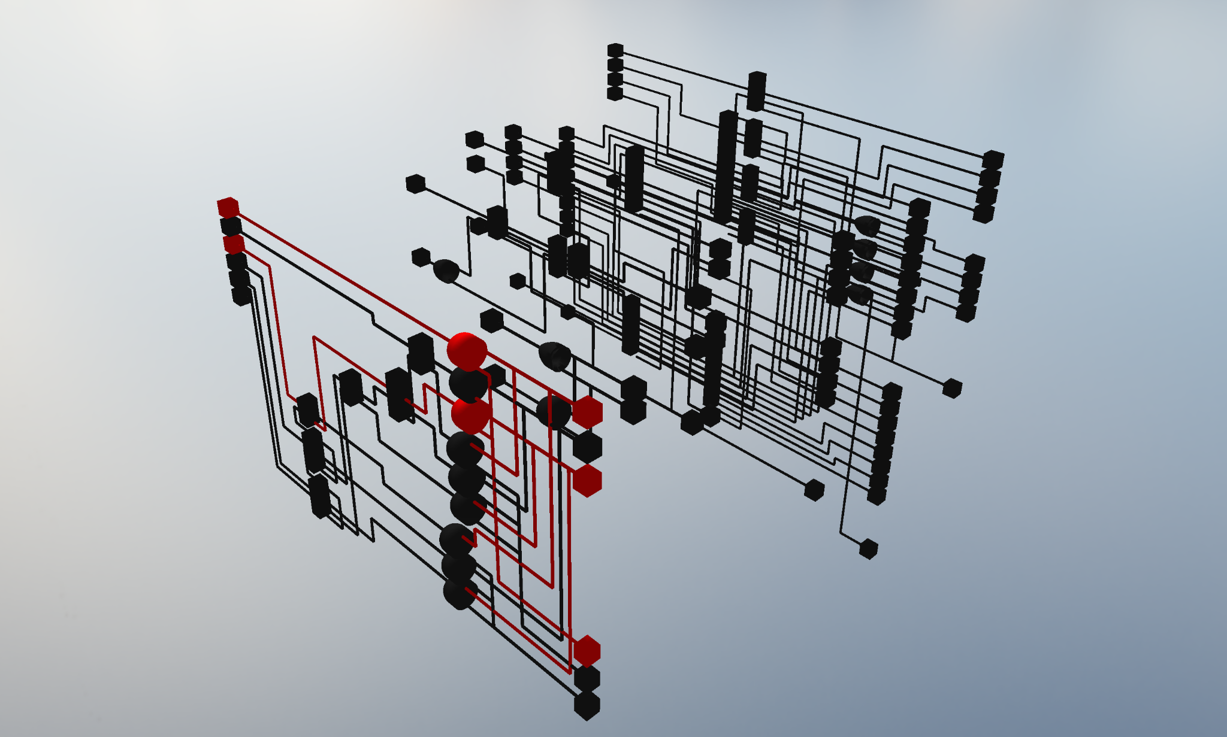
Render Modes - 2D and 3D

Slide 8

Chip Components - Custom Components

Slide 9
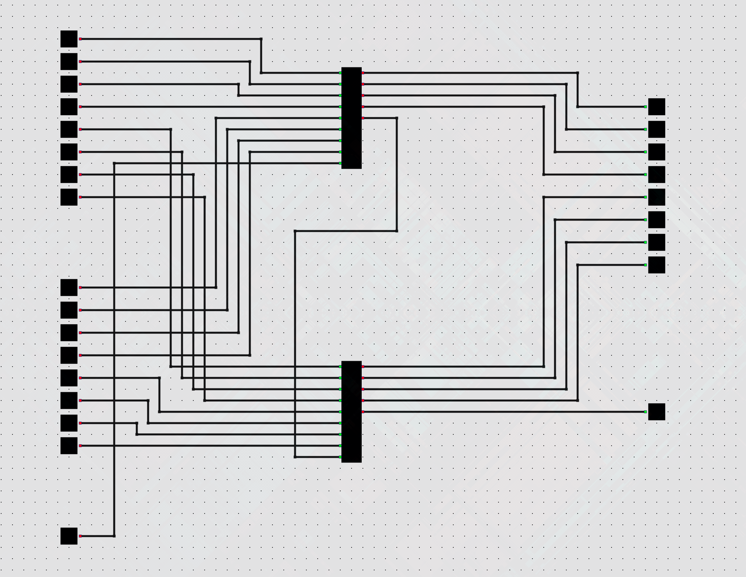
Chip Components - Custom Components

Slide 10
Live Demo
https://halidodat.github.io/gate/

Slide 11
Thank you!

