Slide 1
Divide & Conquer Algorithms
Halima
Meera
Rafiaa
Hayat
Eiman

Slide 2
What is Divide and Conquer?
Divide and Conquer is an algorithmic paradigm in which the problem is solved using the Divide, Conquer, and Combine strategy.
Divide: This involves dividing the problem into smaller sub-problems.
Conquer: Solve sub-problems by calling recursively until solved.
Combine: Combine the sub-problems to get the final solution of the whole problem.

Slide 3
Some Standard algorithms:
Binary Search
Merge Sort
Quick Sort
Calculate pow(x, n)
Karatsuba algorithm for fast multiplication
Strassen’s Matrix Multiplication
Convex Hull (Simple Divide and Conquer Algorithm)
Quickhull Algorithm for Convex Hull

Slide 4
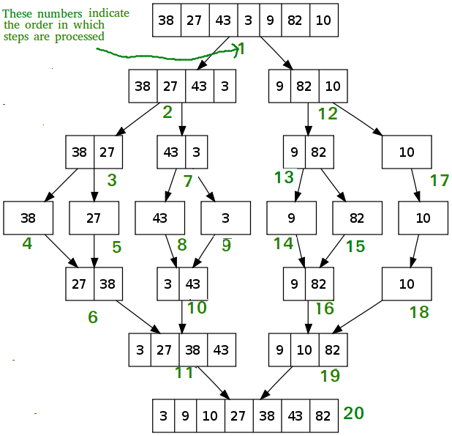
Example of Divide and Conquer algorithm

Slide 5
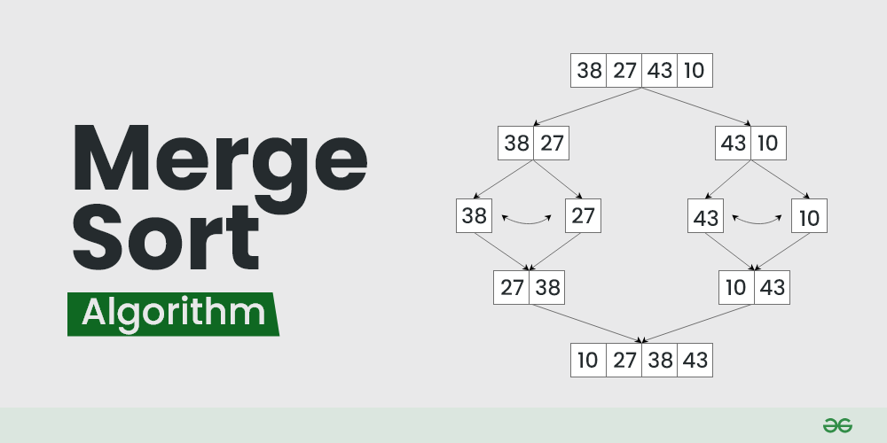
Merge sort
Defined as a sorting algorithm that works by dividing an array into smaller subarrays, sorting each subarray, and then merging the sorted subarrays back together to form the final sorted array.

Slide 6
complexity of merge sort
Merge Sort is a recursive algorithm and time complexity can be expressed as following recurrence relation. T(n) = 2T(n/2) + O(n) The solution of the above recurrence is O(nLogn).

Slide 7
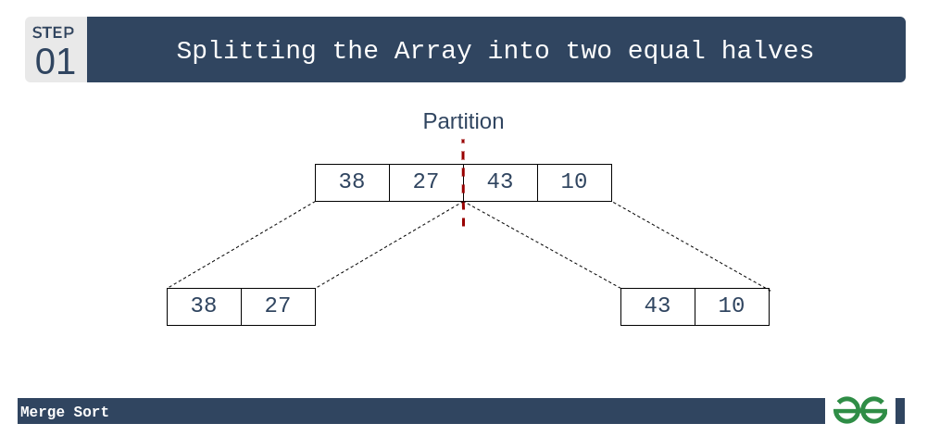
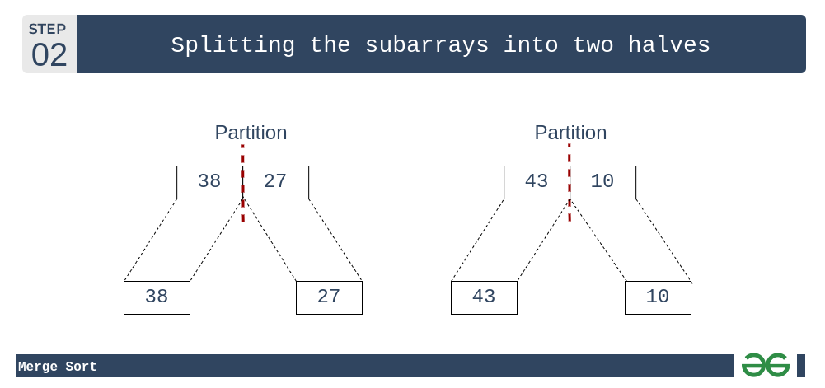

Slide 8

