Slide 1
ROCKBUSTER STEALTH LLC
LAUNCH STRATEGY
ONLINE VIDEO RENTAL SERVICE
Halima Begum
Home Key Questions Analysis Summary

Slide 2
Rockbuster Stealth LLC is a movie rental company that used to have stores around the world. To stay competitive, the Rockbuster Stealth management team is planning to use its existing movie licenses to launch an online video rental service. As it stands, Rockbuster Stealth LLC currently has:
Total Revenue:
$61,312
ROCKBUSTER STEALTH LLC
Stores:
2
Active Customers:
584
Number of Films:
4581
Countries:
109

Slide 3
KEY QUESTIONS
What was the average rental duration for all videos?
Which movies contributed the most/least to revenue gain?
Which countries are Rockbuster customers based in?
Where are customers with a high lifetime value based?
Do sales figures vary between geographic regions?
ROCKBUSTER STEALTH LLC

Slide 4
RENTAL AVERAGES
DURATION
Based on these findings, we can assume that anyone renting a video will, on average, rent it for 5 days. Therefore we can place a standardized fee of 4.99 for renting a video for one week. Additionally, we could charge late fees for videos that are overdue and issue reminders after day 5.
MIN
MAX
AVERAGE
3 days
7 days
5 days
RATE
MIN
MAX
AVERAGE
$0.99
$4.99
$2.98
LENGTH(minutes)
MIN
MAX
AVERAGE
46.00
185.00
115.30
ROCKBUSTER STEALTH
LLC
We also know that the video is out of stock for at least 5 days. Knowing this means that we can provide customers with a time frame in which they can rent the video if they’re waiting in line, metaphorically.

Slide 5
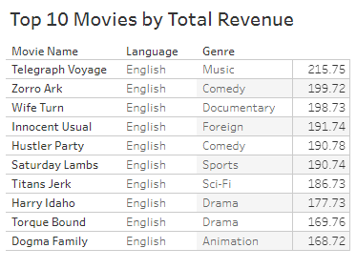

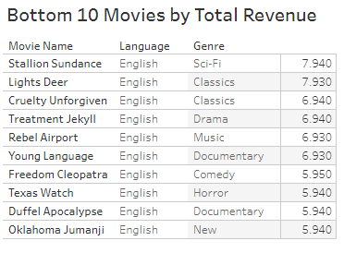
WHICH MOVIES CONTRIBUTED THE MOST TO REVENUE GAIN?
In order to be able to acquire and rent out movies, Rockbuster has to pay licensing fees which gives them the rights to distribute and rent the content they offer to customers.
We should stock multiple copies of the movies with revenue over $100.
These videos are in high demand and thus will lead to increased rentals and higher revenue.
Movies with low demand should be culled as the licensing cost outweighs the benefits.
This Photo by Unknown Author is licensed under CC BY

Slide 6
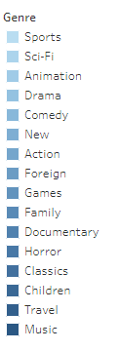
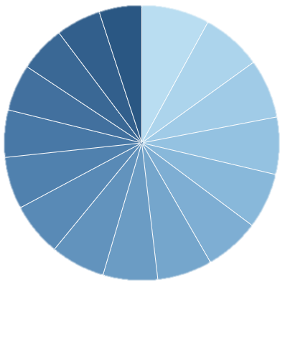
Highest Revenue by Genre
The pie chart shows that all genres have a similar contribution to revenue gain. Regardless, the top 3 genres are: Sports, Sci-Fi and Animation.
Sports ($4,892)
Sci-Fi ($4,336)
Animation ($4,245)
Interestingly, you can see from the table that the genres that they belong to, are not from the top 5. Therefore, we can’t use the popularity of genre to determine the highest revenue movies.

Slide 7
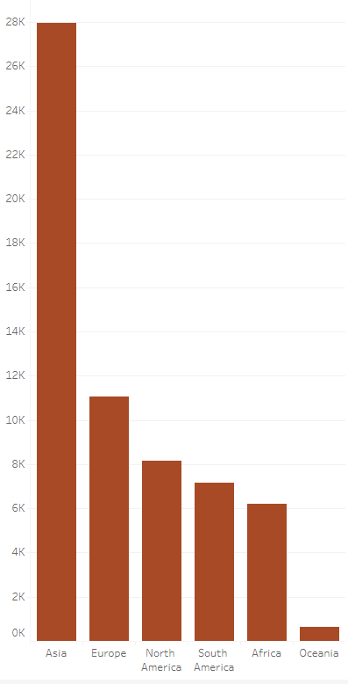
DO SALES FIGURES VARY BETWEEN GEOGRAPHIC REGIONS?
As you can see, Asia dwarfs its neighbouring regions in sales. This suggests that Rockbuster should promote their online services to Asia, namely India and China.
ROCKBUSTER STEALTH
LLC

Slide 8
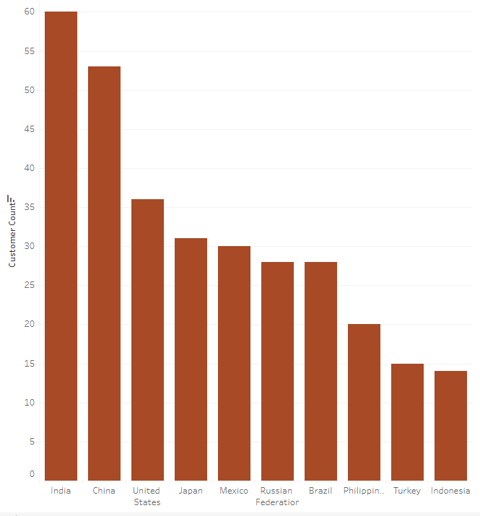
WHICH COUNTRIES ARE ROCKBUSTER CUSTOMERS BASED IN?
Rockbuster customers are predominately based in Asia, namely India and China. Therefore, mainstream videos should be tailored to suit these target audience by way of subtitles and dubbed versions/translations.

Slide 9
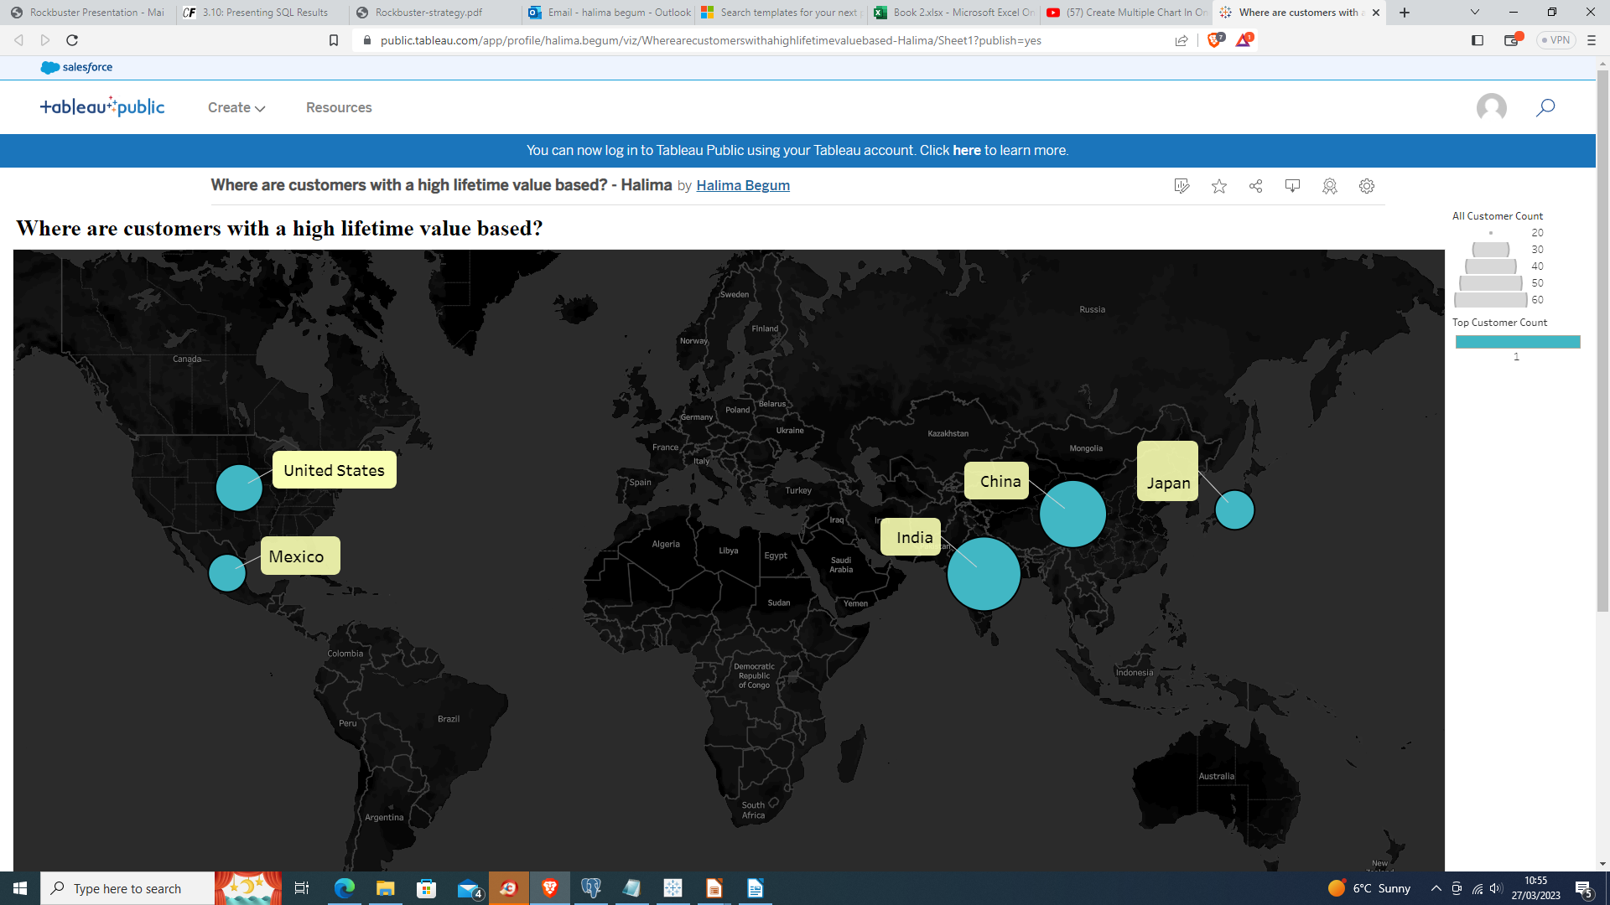
Where are customers with a high lifetime value based?
The top 5 customers who have greatly contributed to the revenue gains are located in: India, China, United States, Mexico and Japan. As loyal members, they should be issued with rewards such as:
top picks for new videos and releases;
extended rental duration;
increased rental allowances,
discounted video rentals and subscription offers.
For example, from our rental averages, we can concur that 6 movies a month (since the average rental duration is 5 days) will cost $29.94* . Therefore, we could offer a subscription service in which a monthly fee of $20.00 can grant a subscriber all the perks mentioned previously.
*if a rental is standardised and cost 4.99 each.

Slide 10
SUMMARY
RENTAL RATES
The rent for videos should be standardised to allow customers to know with more certainty as to when certain videos are in stock. Additionally, standardising rental payments allows for definitive decision making.
MOVIE REVENUE
The stock of high revenue videos (revenue over $100) should be increased. Movies with low demand (under $10) should be culled as the licensing cost outweighs the benefits.
TARGET MARKET
Rockbuster customers predominately reside in Asia and therefore we should market our promotions and videos by way of subtitles, dubbed translations and region set advertisements.
HIGH VALUE CUSTOMERS
High value customers should be rewarded with scheme such as: top picks for new videos and releases, extended rental duration, increased rental allowances, discounted video rentals and subscription offers.
ROCKBUSTER STEALTH LLC

Slide 11
TABLEAU LINKS
You can find all the visualizations if you click on ‘Tableau Links’ above
Any Questions?
Thank you!
Halima Begum

