Slide 1
BLG 454E Learning From Data Term Project Presentation May 2018
Numara ve isimler

Slide 2
Introduction
Goal is to fit our data in a training model and predict possible returnShipment values from a test set.
Python Programming Language is used.

Slide 3
Data Set and Properties
Data set includes 13 features and 1 label.
Some features include missing or possible invalid data.

Slide 4
Data Set and Properties

Slide 5
Data Cleaning
Missing and invalid values needs to be cleaned before the data can be processed.
Several methods used for this purpose.
Strings which represent Date values are converted into Datetime objects
Missing color values are filled with the most common color: ‘black’
Missing delivery date values are filled with adding their order dates the average transmission time of all other non-missing shipments.
Missing date of birth is also filled the same way data cleaning is done. Average age of users are calculated and missing values are filled accordingly.
Invalid values such as nearly impossible birth dates (1900) are also filled according to average age of users.

Slide 6
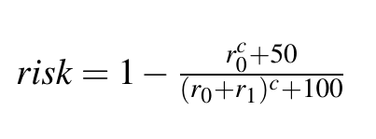
Generating New Features
New features needed from data to get a better understanding for unusable columns such as customerID, manufacturerID etc.
A risk calculation is used from [1], r0 and r1 represents the count for the returned and unreturned shipment depending on the ID.
Other features are self explanatory in terms of calculation.

Slide 7
11 New Feature
Average money paid by per user
Item purchase count per user
Distance of order date from lovers date
Distance of order date from New years eve
Time passed between order and delivery
Customer ages
Account ages
Risk calculation for manufacturerID, customerID, itemID (3x features)
Probability depending on the ratio of a customers returned items / total items ordered

Slide 8
Methodology

Slide 9
Experimentation Results
KMeansClassifier gave a %60 accuracy score
RandomForestClassifire

Slide 10
Conclusion

Slide 11
References
[1] ˙I. Bilgen and O. S. Sarac¸, “Prediction of return in online shopping,” in ¨ Signal Processing and Communications Applications Conference (SIU), 2015 23th, pp. 2577–2580, IEEE, 2015.

