Slide 1
Agenda
Introduction
Problem Statement
Objectives
Literature Survey
Methodology
Results and Discussion
Conclusion
References
KLE Technological University, Belagavi campus

Slide 2
Introduction
Flood is a natural disaster that occurs when water overflows onto land, impacting communities, livelihoods, and economies. It can result from heavy rainfall, dam failures, river overflow, low pressure, or coastal cyclonic storms. Floods disrupt human life by damaging homes, infrastructure, and farmland. Historically, people predicted floods using natural signs, oral traditions, and early engineering methods. However, traditional prediction techniques are often inaccurate due to unpredictable events like cloudbursts or dam failures.
This study explores the application of Artificial Intelligence (AI), including Machine Learning (ML) and Deep Learning (DL), to improve flood prediction accuracy. With rising flood unpredictability, ML and DL models have become crucial for disaster preparedness. Flood prediction approaches include (i) Hydrological models and (ii) Data-driven models. The latter analyze statistical relationships between variables to identify patterns, predict future risks, and support proactive decision-making. They are particularly useful in sensor-scarce regions by using data from neighboring areas.
Various ML models have been utilized:
Naive Bayes assumes feature independence and uses conditional probabilities.
KNN classifies data based on the majority class of the ‘k’ nearest neighbors, capturing non-linear relationships.
SVM finds the optimal hyperplane for classification and works well with small, complex datasets.
Random Forest employs multiple decision trees, providing high accuracy and avoiding overfitting.
KLE Technological University, Belagavi campus

Slide 3
Introduction
ANNs mimic brain neurons and can model complex, non-linear flood data through layers that adjust to minimize prediction error.
Bootstrap Forest enhances prediction by averaging results from decision trees trained on different samples.
Among DL models, LSTM, a type of RNN, is highly effective for time-series data. It uses input, forget, and output gates to manage memory, enabling it to learn from past trends and predict future events. DL models often outperform traditional ML methods due to their ability to learn hierarchical features from large datasets without manual feature engineering.
Our approach integrates rainfall, river discharge, soil moisture, and atmospheric pressure data to build a robust, scalable flood prediction system applicable across different geographies and climates. By combining ML and DL methods, we aim to estimate flood occurrence, severity, and timing. These models are evaluated using the ‘level class’ as the target variable and can be incorporated into decision support systems to improve disaster response and resource allocation.
In summary, this study leverages AI to enhance flood risk prediction and identify vulnerable areas, offering a powerful tool for proactive disaster management.
KLE Technological University, Belagavi campus

Slide 4
Problem Statement
Designing of a flood prediction model that accurately estimates flood occurrence using Machine Learning and Deep Learning algorithms that remains as a critical challenge due to the complex and dynamic nature of environmental factors. This study aims to develop a data-driven model that leverages variables such as rainfall, river discharge, soil moisture, and atmospheric pressure to enhance prediction accuracy. By integrating models like Random Forest, SVM, ANN, and LSTM, the research seeks to provide a robust and scalable solution for timely disaster preparedness and risk mitigation.
KLE Technological University, Belagavi campus

Slide 5
Objectives
To design and develop a flood prediction model that utilizes Machine Learning (ML) and Deep Learning (DL) techniques for accurate forecasting of flood occurrence, severity, and timing.
To collect and preprocess environmental data including rainfall, river discharge, soil moisture, and atmospheric pressure for model training and evaluation.
To compare and evaluate various ML algorithms such as Naïve Bayes, K-Nearest Neighbors (KNN), Support Vector Machine (SVM), Random Forest, and Artificial Neural Networks (ANN) for flood prediction performance.
To implement Long Short-Term Memory (LSTM) networks and other DL approaches for handling time-series data and capturing temporal dependencies in flood patterns.
To identify the most effective model or hybrid approach based on evaluation metrics such as accuracy, precision, recall, and F1-score using the 'level class' as the target variable.
To develop a scalable and adaptable system that can be applied to different geographic regions and integrated into disaster management decision support systems.
KLE Technological University, Belagavi campus

Slide 6
Literature Survey
1. Data & Preprocessing
Data Types: Most studies utilize rainfall data, river/stream flow, water level, meteorological variables (temperature, humidity, wind), and geospatial or topographic indices (e.g., DEM, TWI, GIS layers).
Sources:Data is sourced from government agencies, open datasets (Kaggle, OpenData), local meteorological departments, and satellite products.
Preprocessing:Steps include filling missing values, normalization/scaling, encoding categorical variables, feature selection (e.g., SelectKBest), and handling class imbalance (e.g., RandomOverSampler).
Challenges:Data imbalance and limited real-time data are common. Feature selection can sometimes reduce accuracy, indicating the importance of comprehensive variable inclusion.
2.ML/DL Models Applied
Traditional ML: Logistic Regression, Decision Trees, Random Forests, SVM, KNN, and Naive Bayes. Random Forests and XGBoost often outperform simpler models.
Ensemble/Boosting Methods** Random Forest, XGBoost, LightGBM—favored for higher accuracy and robustness, especially with hyperparameter tuning.
KLE Technological University, Belagavi campus

Slide 7
Literature Survey
Deep Learning:LSTM, CNN, and RNN excel on time-series and multi-dimensional data but at the cost of computational resources.
Hybrid Approaches: Combining CNNs with RF or SVR leverages feature extraction and prediction strengths, often achieving best-in-class results.
Other Methods:Time-series forecasting (Facebook Prophet), clustering (K-means, Fuzzy), and hydrological models are explored for multi-faceted flood prediction.
3. Methodological Approaches
Pipeline: Typical workflow: Data collection → Preprocessing → Model training → Evaluation (using metrics such as accuracy, recall, R², etc.).
Model Tuning: Grid/random search and cross-validation are widely used for parameter optimization.
Feature Engineering: Integration of spatial (GIS), temporal (lag features), and environmental data is increasingly common, enhancing the contextual relevance of models.
Evaluation: Studies often perform comparative analyses across several models and split datasets into multiple time periods or regions for robustness checks.
KLE Technological University, Belagavi campus

Slide 8
Literature Survey
4. Performance & Results
Classification: Metrics like Accuracy, Precision, Recall, F1-score, and ROC-AUC are standard. Well-tuned models (RF, XGBoost, DL models) often exceed 90% accuracy.
Regression: MAE, MSE, RMSE, R² are used. Deep models (LSTM, CNN) and Bayesian Ridge Regression sometimes achieve R² near 0.99–1.00, indicating almost perfect fit.
Interpretability: Explainable AI tools (e.g., SHAP, LIME) are being introduced to clarify model decisions and support disaster management teams.
Model Trade-offs: Deep models offer accuracy but are computationally heavy; ensemble methods provide a balance between performance and interpretability.
5. Identified Gaps & Limitations
Limited Features: Many studies rely primarily on rainfall, omitting key real-time and environmental features (river level, soil moisture, etc.).
Overfitting & Imbalance: Decision trees and some ML models exhibit overfitting, especially with small or imbalanced datasets.
Deployment: Few systems are operationalized into real-time, web, or mobile applications. Most remain at the
KLE Technological University, Belagavi campus

Slide 9
Literature Survey
research/prototype level.
Integration: There is a lack of integration with urban planning, IoT, and GIS for actionable flood alert systems.
Benchmarking: Absence of standardized datasets and evaluation metrics hinders model comparison and benchmarking.
6. Future Directions
Data Expansion: Incorporate more comprehensive and real-time data (e.g., from sensors, IoT, drones) for richer and more timely predictions.
Advanced Modeling: Explore more hybrid, ensemble, and deep learning models, focusing on hyperparameter tuning and robust feature engineering.
Interpretability & Usability: Adopt explainable AI techniques and design models for operational deployment in web/mobile platforms.
Standardization: Develop benchmark datasets and common evaluation frameworks for fair model comparison across studies and regions.
System Integration: Integrate ML models into GIS, urban infrastructure, and disaster management tools for real-world impact.
KLE Technological University, Belagavi campus

Slide 10
Methodology
This detailed study focuses on the application of various supervised machine learning (ML) and deep learning (DL) techniques for flood prediction using a real-world dataset. The data was collected from credible sources such as government portals, Kaggle, and GitHub, ensuring diversity and relevance for experimental analysis. The dataset comprised 3,535 rows and 15 columns, with a file size of approximately 337 KB. It contained a combination of numerical and categorical predictor variables, along with a target classification variable labeled as "level," which indicates the severity or risk class of a flood event.
Prior to model development, the dataset underwent a comprehensive pre-processing phase. This included handling missing values by replacing them with central tendency measures such as mean, median, or mode depending on the nature of each attribute. Data cleaning and transformation tasks were performed using Python in the Jupyter Notebook environment, leveraging libraries such as Pandas, NumPy, and Scikit-learn.
Categorical variables were encoded into numerical formats using techniques like one-hot encoding or label encoding to make the data compatible with ML algorithms. Feature scaling was applied where necessary to normalize numerical variables, ensuring consistent ranges and improved model convergence.
Following preprocessing, the dataset was split into training and testing sets in an 80:20 ratio. The training data was used to train various ML and DL models including Naïve Bayes, KNN, SVM, Random Forest, Bootstrap Forest, ANN, and LSTM. The test data was used to evaluate model performance based on accuracy, precision, recall, and F1-score. This systematic approach enabled the identification of models best suited for reliable flood prediction across different data conditions
KLE Technological University, Belagavi campus

Slide 11
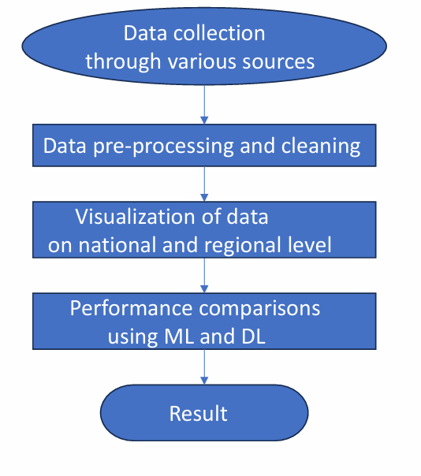
Methodology
Fig 1 : Flowchart of Methodology
KLE Technological University, Belagavi campus

Slide 12
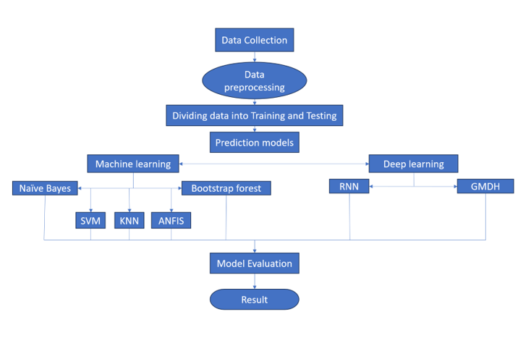
Methodology
Fig 1 : Flowchart of Methodology
KLE Technological University, Belagavi campus

Slide 13
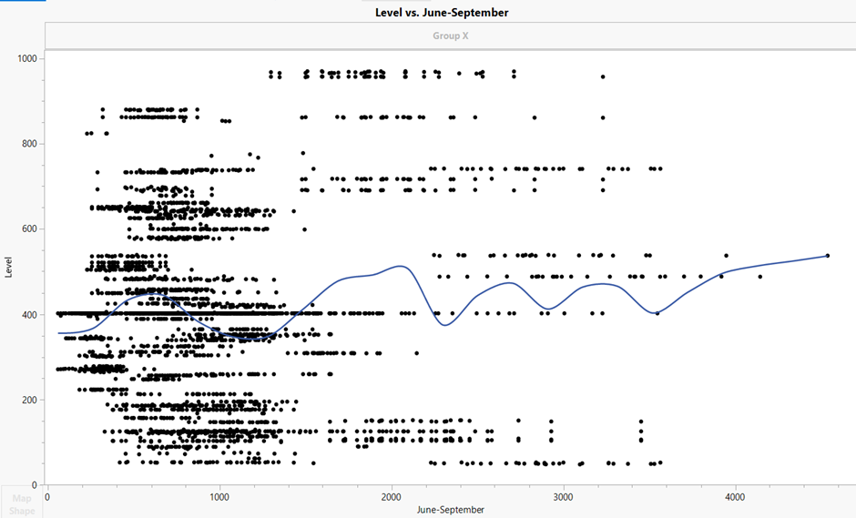
Results and Discussion
National level visualisation
1. Scatterplot of Cumulative rainfall(June-September) vs water level
The scatterplot illustrates the relationship between water levels and cumulative rainfall from June to September. Each point represents an observation, with rainfall on the x-axis and water level on the y-axis. The data is widely dispersed, indicating variability in water levels across different rainfall amounts. A slight upward wave-like trend suggests that water levels gradually increase with higher rainfall.
KLE Technological University, Belagavi campus

Slide 14
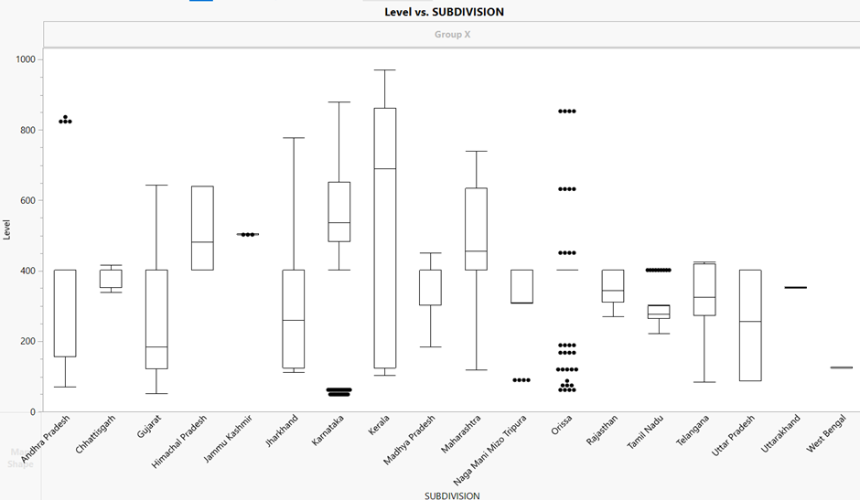
Results and Discussion
2. Boxplot for distribution of reservoir water levels across various states of India
The boxplot compares water level distributions across various subdivisions, showing medians, interquartile ranges, and potential outliers. Some regions like Kerala and Himachal Pradesh exhibit high variability, while others like Karnataka and West Bengal show more consistent water levels. Several subdivisions also display extreme values as outliers. These variations highlight the influence of regional geographic and climatic factors.
KLE Technological University, Belagavi campus

Slide 15
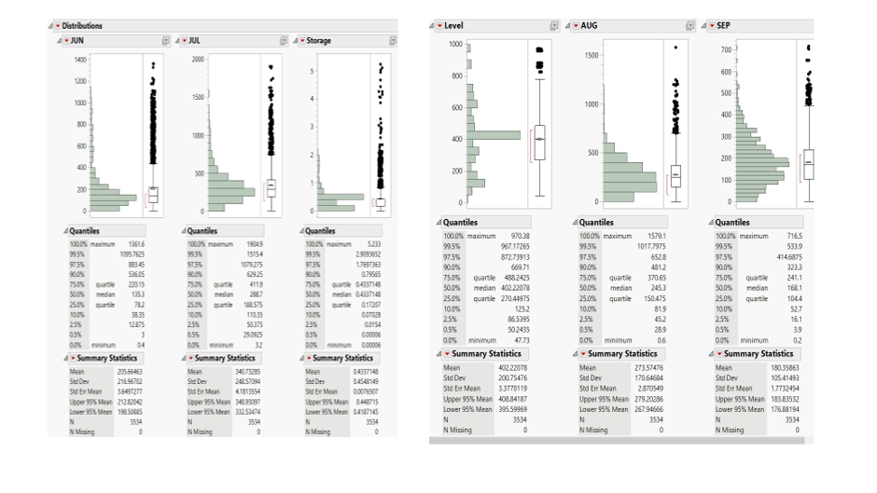
Results and Discussion
3. Distribution plots of monthly rainfall and storage levels
The distribution plots revealed strong right-skewness and high variability in monthly rainfall data, especially in JUL and AUG, with extreme outliers and narrow interquartile ranges. Storage values were mostly near zero with a few high spikes, while Level showed a more symmetric distribution. All variables had high standard deviations relative to their means, indicating significant variability. No missing data ensured reliability for further analysis.
KLE Technological University, Belagavi campus

Slide 16
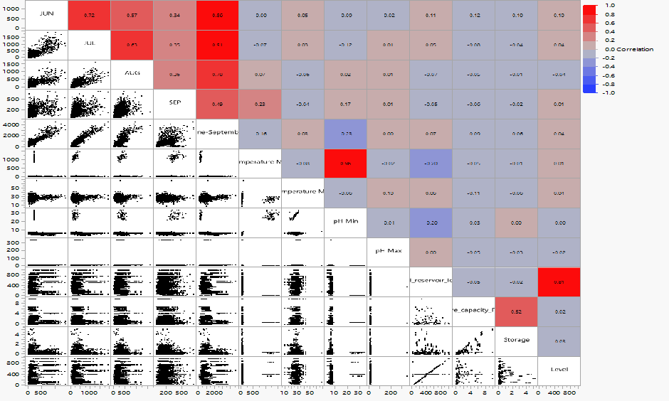
Results and Discussion
4. Scatterplot matrix and correlation heatmap
The integrated correlation-scatterplot matrix revealed strong positive relationships, especially among monsoon months like June and July (r = 0.72) and cumulative rainfall with July (r = 0.91). In contrast, variables like temperature and pH showed minimal correlation with rainfall or storage parameters. The strongest correlation was noted between full reservoir level and level (r = 0.81), suggesting a direct hydro-environmental link. Scatterplots also helped visualize linear trends and outliers.
KLE Technological University, Belagavi campus

Slide 17
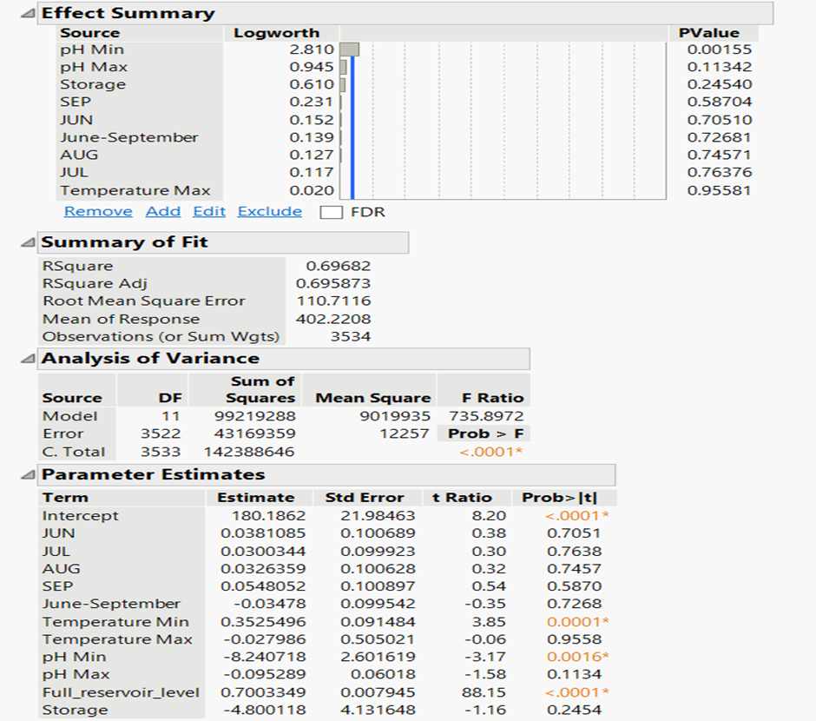
Results and Discussion
4. Summary of regression analysis for estimation of reservoir level
The multiple linear regression model showed high significance (R² = 0.6968), explaining nearly 70% of the variance in the response variable. While parameters like full reservoir level and minimum pH had strong predictive power, individual monthly rainfall values and pH max were not statistically significant. The model highlighted the importance of reservoir metrics and specific environmental factors over isolated rainfall data.
KLE Technological University, Belagavi campus

Slide 18
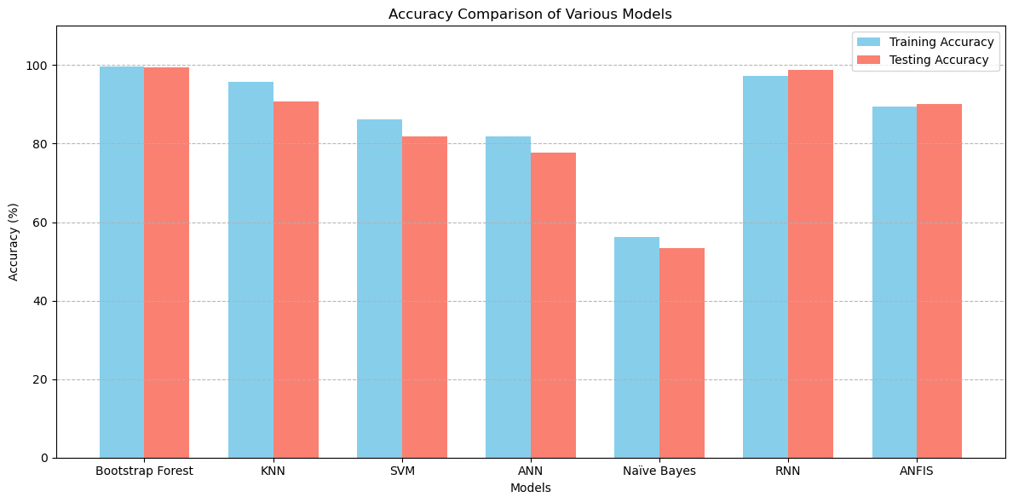
Results and Discussion
Comparison of models
The comparison of model accuracies shows that RNN achieved the highest performance, with both training and testing accuracies nearing 98–99%, making it the most reliable model overall. While Bootstrap Forest also showed excellent accuracy, it was excluded due to signs of overfitting, as its training and testing accuracy were almost identical and unrealistically high (≈100%). Models like KNN, SVM, and ANN demonstrated good generalization with moderate accuracy drops from training to testing. In contrast, Naive Bayes showed the lowest performance, suggesting it may not capture the complexity of the dataset well.
KLE Technological University, Belagavi campus

Slide 19
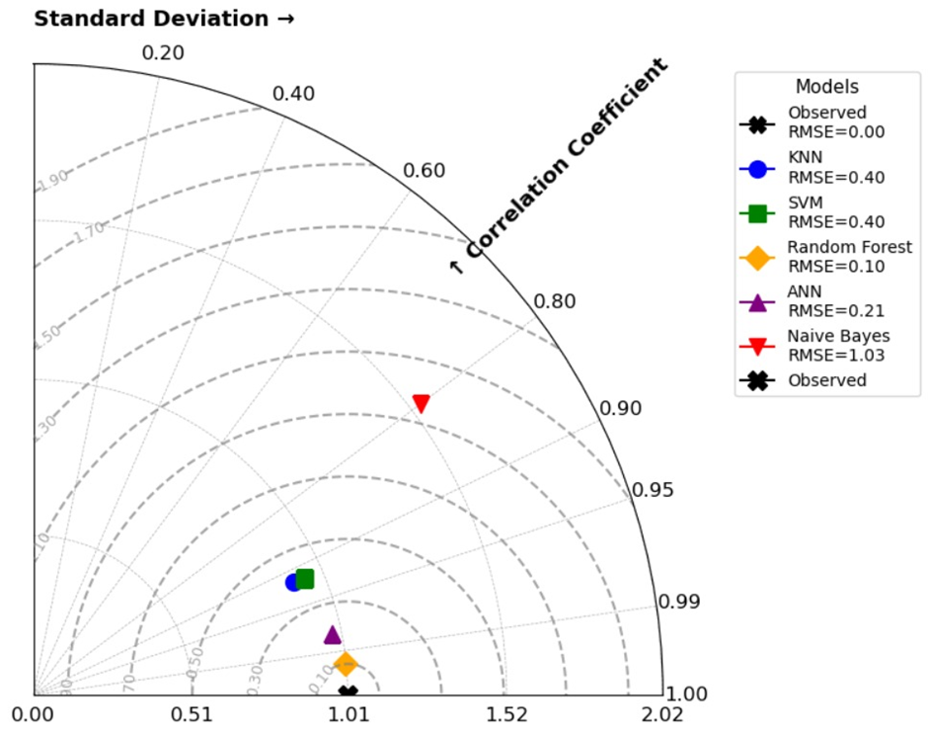
Results and Discussion
Taylor diagram comparing the performance of different models
The Taylor Diagram effectively compares predictive models based on correlation, standard deviation, and RMSE. In this study, it assessed five models for reservoir water level prediction. Models near the “Observed” point with high correlation and matching standard deviation are more accurate. Random Forest performed best, showing both strong correlation and realistic variability. In contrast, Naive Bayes showed poor correlation and mismatched variability. Overall, the diagram provides a comprehensive visual evaluation of model accuracy and reliability
KLE Technological University, Belagavi campus

Slide 20
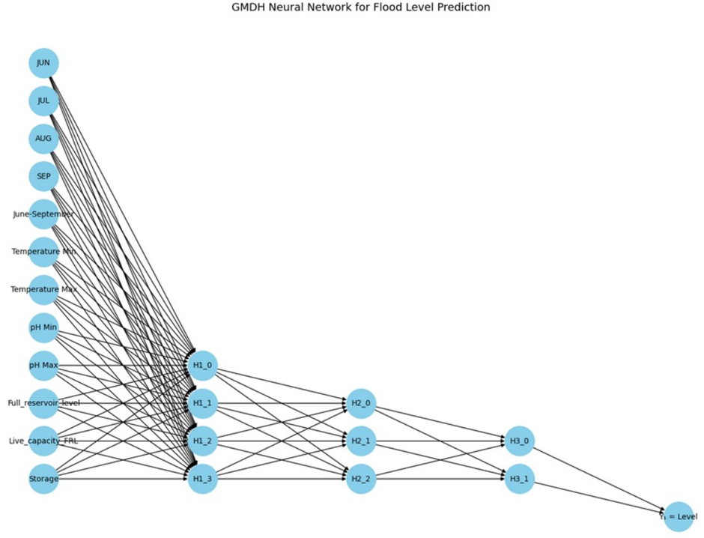
Results and Discussion
Feature Dependency Network for Flood Risk Prediction
The GMDH-based neural network for flood level forecasting uses 13 input variables (rainfall, temperature, pH, and reservoir characteristics) and builds a multi-layered polynomial model. The network self-organizes into three hidden layers, progressively combining variable pairs using second-degree polynomials to model complex interactions. Each layer filters and refines the most predictive features. The final output layer synthesizes these interactions into a single flood level prediction. This architecture ensures high accuracy, interpretability, and adaptability by letting the structure emerge from the data itself.
KLE Technological University, Belagavi campus

Slide 21
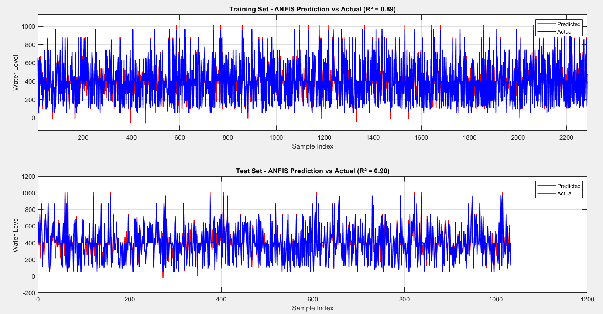
Results and Discussion
Adaptive Neuro Fuzzy Inference System (ANFIS)
The ANFIS model shows strong predictive performance for water level forecasting, with R² values of 0.89 (training) and 0.90 (testing). Despite high fluctuations in the data, the predicted (red) and actual (blue) values closely align, indicating good model accuracy. This highlights ANFIS’s effectiveness and reliability for dynamic water level prediction and flood or resource management.
KLE Technological University, Belagavi campus

Slide 22
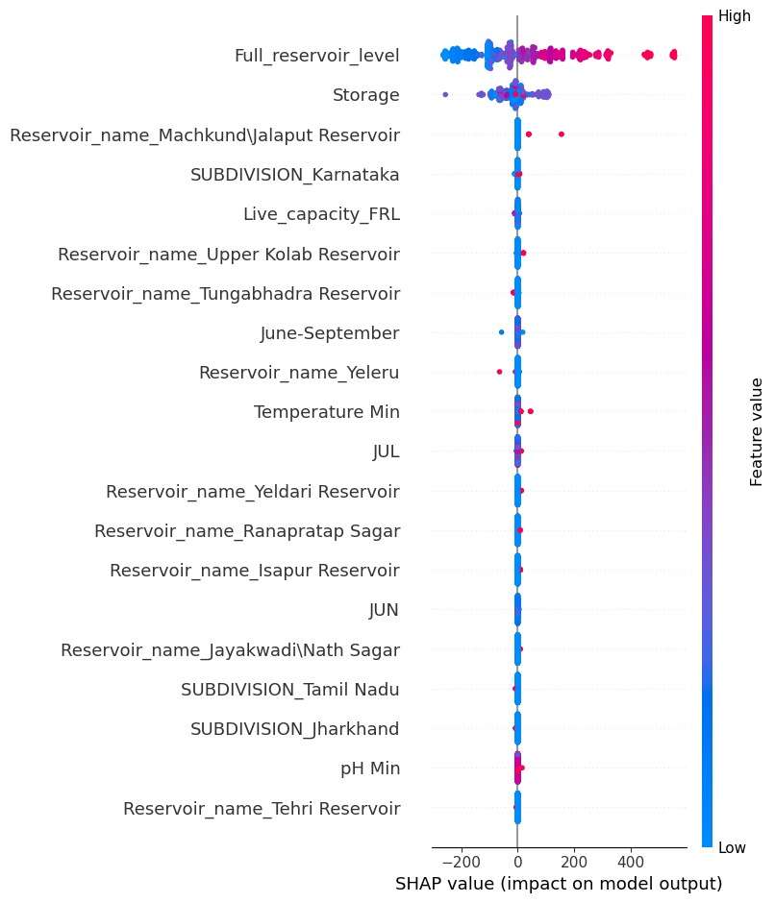
Results and Discussion
SHAP Analysis
The SHAP summary plot (Figure 18) highlights that Full Reservoir Level is the most influential feature, with high values significantly increasing the model’s output. Storage also has a strong positive impact, indicating that the model heavily relies on current water levels for flood prediction. Other features like the presence of Machkund/Jalaput Reservoir, SUBDIVISION Karnataka, and Live Capacity FRL show moderate contributions. In contrast, seasonal variables (like June–September, JUL, JUN), environmental factors (Temperature Min, pH Min), and some regional indicators (Tamil Nadu, Jharkhand) have minimal or no impact, suggesting the model is primarily driven by direct water quantity indicators rather than climatic or categorical variables.
KLE Technological University, Belagavi campus

Slide 23
Conclusion
This study compared five different supervised machine learning models: Bootstrap forest , K-Nearest Neighbors, Support Vector Machine Naive Bayes, and Artificial Neural Network. The goal was to predict classifications using a real-world dataset. Out of all the models tested, Bootstrap forest stood out for delivering the best performance, achieving the highest accuracy on both the training and testing datasets. This result highlights the known benefits of ensemble learning methods, showing they tend to produce strong and generalizable predictions, especially when dealing with complex tabular datasets. Besides evaluating the models, the study used spatial visualization techniques to shed light on geographic patterns in the model outputs. The visualizations at both national and regional levels offered clear insights into spatial distributions, making it easier to interpret the variations in predicted levels across different geographic areas. This kind of visualization not only supports the numerical findings but also enhances how the predictive models can be applied in practice, allowing for more informed decision-making based on spatial factors. In summary, merging predictive modeling with spatial visualization creates a comprehensive framework that blends analytical precision with clarity in interpretation. Looking ahead, fu -ture research could build on this framework by investigating more advanced ensemble methods like Random Forest or XG Boost, adding more layers of geospatial data, or designing inter active visualization dashboards to aid in real-time policymaking and decision support systems.
KLE Technological University, Belagavi campus

Slide 24
References
[1] Dang, T. Q., Tran, B. H., Le, Q. N., Dang, T. D., Tanim, A. H., Pham, Q. B., Bui, V. H., Mai, S. T., Thanh, P. N., & Anh, D. T. (2024). Appli cation of machine learning-based surrogate models for urban flood depth modeling in Ho Chi Minh City, Vietnam. Applied Soft Computing, 150, 111031. https://doi.org/10.1016/j.asoc.2023.111031
[2] Reddy, N. U., Kumar, P. V., Kapileswar, N., Simon, J., & Kumar, P. P. (2022). A Prediction Model for Minimization of Flood Effects using Machine Learning Algorithms. 2022 Sixth International Conference on I SMAC(IoTinSocial, Mobile, Analytics and Cloud)(I-SMAC),593–597. https://doi.org/10.1109/i-smac55078.2022.9987332
[3] Grady, F., Tarigan, J. K., Wahidiyat, J. R., & Prasetyo, A. (2022). Classifi cation of Flood Alert in Jakarta with Random Forest. 2022 IEEE 7th Inter national Conference on Information Technology and Digital Applications (ICITDA), 1–6. https://doi.org/10.1109/icitda55840.2022.9971411
[4] Yani, D., Razaq, T. A., Stevanie, F., & Kusrini. (2024). Compar ative Analysis of Deep Learning Algorithm for Flood Predic tion Probability With and Without Feature Selection. 2024 8th International Conference on Information Technology, Informa tion Systems and Electrical Engineering (ICITISEE), 150–154. https://doi.org/10.1109/icitisee63424.2024.10730579
[5] Vigneswara Reddy, K., Mounika Begum, C., Neeraja, A., Mah eswari, B. U., & Amulyashree, S. (2024). Comprehensive Analy sis of Flood Risk Using Regression Models and Interpretable Ma chine Learning Techniques. 2024 International Conference on In tegrated Intelligence and Communication Systems (ICIICS), 01–06. https://doi.org/10.1109/iciics63763.2024.10859855
[6] Ranit, A. B., & Durge, P. V. (2018). Different Techniques of Flood Forecasting and Their Applications. 2018 International Conference on Research in Intelligent and Computing in Engineering (RICE), 1–3. https://doi.org/10.1109/rice.2018.8509058
KLE Technological University, Belagavi campus

Slide 25
References
[7] Chaimook, P., Khamsemanan, N., Nattee, C., & Sharp, A. (2025). Em ploying Machine Learning for Flood Prediction: A Comparative Study of Tree-Based Techniques. 2025 5th Asia Conference on Information Engi neering (ACIE), 57–61. https://doi.org/10.1109/acie64499.2025.00016
[8] Prasad, B. S., Shreya, S., Sinha, T., & Priya, S. (2021). Ensemble Model Based Prediction for River Management: A Case Study on River Kaveri and Coastal Karnataka. 2021 International Conference on Smart Genera tion Computing, Communication and Networking (SMART GENCON), 1–6. https://doi.org/10.1109/smartgencon51891.2021.9645804
[9] Naidu, S., Pandey, A., Patel, S., Wagaskar, K., Tripathy, A. K., & Sen, S. (2023). Flood Location, Management and Solution(FLMS): A Flood Prediction and Management System for Kurla. 2023 International Confer ence on Advanced Computing Technologies and Applications (ICACTA), 31, 1–6. https://doi.org/10.1109/icacta58201.2023.10392346
[10] Ashok, P., Kavin, J. S., Sankara, N. K., & Vasanth, P. V. (2022). Flood Prediction in the Area of Tamil Nadu and Andhra Pradesh Using Machine Learning Technique. 2022 1st International Con ference on Computational Science and Technology (ICCST), 1–4. https://doi.org/10.1109/iccst55948.2022.10040321
[11] Manikandan, P., Vivek, S. T. S., Thejaswi, M., Tejaswini, B., Manoj, S., & Reddy, P. T. (2024). Flood Risk Assessment System using Logistic Regression. 2024 8th International Conference on Electron ics, Communication and Aerospace Technology (ICECA), 1145–1149. https://doi.org/10.1109/iceca63461.2024.10801008
[12] Sharma, S., & Kumari, S. (2024). Comparison of machine learn ing models for flood forecasting in the Mahanadi River Basin, India. Journal of Water and Climate Change, 15(4), 1629–1652. https://doi.org/10.2166/wcc.2024.517
KLE Technological University, Belagavi campus

Slide 26
References
[13] Kinage, C., Kalgutkar, A., Parab, A., Mandora, S., & Sahu, S. (2019). Performance Evaluation of Different Machine Learning Based Algorithms for Flood Prediction and Model for Real Time Flood Prediction. 2019 5th International Conference On Comput ing, Communication, Control And Automation (ICCUBEA), 1–7. https://doi.org/10.1109/iccubea47591.2019.9128379
[14]Nagure, A., Chandekar, S., Mahadik, P., Yeolekar, V., Syed, M., & Chakankar, J. (2023). Rainfall Prediction for Flood Risk Assessment of Kolhapur Region Using AI/ML Models. 2023 1st International Confer ence on Cognitive Computing and Engineering Education (ICCCEE), 18. https://doi.org/10.1109/icccee55951.2023.10424675
[15] Nguyen, D.T., &Chen,S.-T.(2020).Real-Time Probabilistic Flood Fore casting Using Multiple Machine Learning Methods. Water, 12(3), 787. https://doi.org/10.3390/w12030787
[16]Khatri, S. K., & P.K., R. (2023). Review of Flood Prediction Techniques used in Mumbai Region. 2023 7th International Conference On Com puting, Communication, Control And Automation (ICCUBEA), 1–8. https://doi.org/10.1109/iccubea58933.2023.10392255
[17]Mosavi, A., Ozturk, P., & Chau, K. (2018). Flood Prediction Using Machine Learning Models: Literature Review. Water, 10(11), 1536. https://doi.org/10.3390/w10111536
KLE Technological University, Belagavi campus

Slide 27
THANK YOU !
KLE Technological University, Belagavi campus

