Slide 1
Bank Application
1) PROBLEM STATEMENT
Title :Bank Account Management System using Spring Boot
Objective:To develop a RESTful application that allows users to perform operations such as creating, reading, updating, and deleting bank account details. The backend is built using Java 21 and Spring Boot, integrated with MySQL using Spring Data JPA, and tested using tools like Postman and Swagger.
Technologies Used:Java 21, Spring Boot, MySQL, Spring Data JPA, Postman, Swagger.
Description:The project simulates core banking functionality by providing a structured way to handle account data, execute CRUD operations, and maintain account balances. It follows the layered architecture of Spring Boot, ensuring modularity and ease of maintenance.
2) UML Diagram

Slide 2
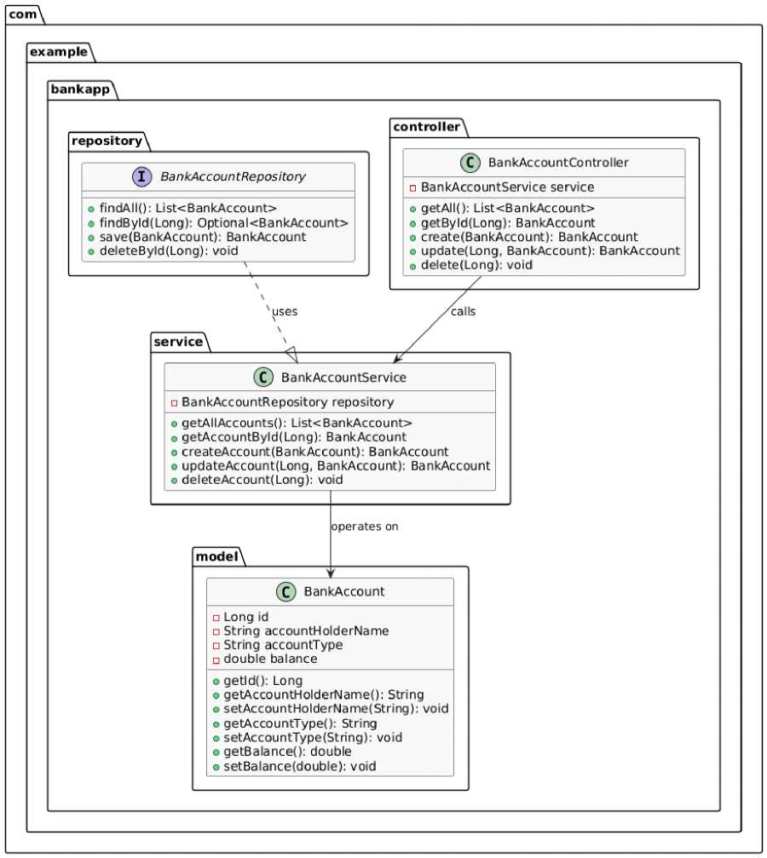
The UML (Unified Modeling Language) class diagram represents the structure of the Bank Application by showing the classes, their attributes, and relationships.
The BankAccount class is the Model with fields like id, accountHolderName, accountType, and balance.
The BankAccountRepository interface extends JpaRepository to provide built-in CRUD methods. The BankAccountService class contains business logic for managing bank accounts.

Slide 3
The BankAccountController class exposes REST APIs to interact with the application.
This diagram helps visualize how different components of the project interact in a layered architecture: Controller ^ Service ^ Repository ^ Model.
3) Code
Different packages used : com,example,bankapp,model,service,controller and repository a) controller
B ankAccountC ontroll er.j ava(class) package com.example.BankProject.Controller;
import com.example.BankProject.Model.BankAccount; import com.example.BankProject.Service.BankAccountService; import org.springframework.beans.factory.annotation.Autowired; import org.springframework.web.bind.annotation.*;
import java.util.List;
@RestController
@RequestMapping("/api/accounts") public class BankAccountController {
@Autowired
private BankAccountService service;
@GetMapping
public List<BankAccount> getAll() { return service.getAllAccounts();
}
@GetMapping("/{id}")
public BankAccount getById(@PathVariable Long id) { return service.getAccountById(id);
}

Slide 4
@PostMapping
public BankAccount create(@RequestBody BankAccount account) { return service.createAccount(account);
}
@PutMapping("/{id}")
public BankAccount update(@PathVariable Long id, @RequestBody BankAccount account)
{
return service.updateAccount(id, account);
}
@DeleteMapping("/{id}") public void delete(@PathVariable Long id) { servi ce.deleteAccount(id);
}
}
•Acts as the entry point for handling HTTP requests related to bank accounts.
•Annotated with @RestController to create RESTful web services.
•All endpoints are prefixed with /api/accounts using @RequestMapping.
•Uses @Autowired to inject the service layer.
•Implements:
a. @GetMapping - Fetch all accounts or one by ID.
b. @PostMapping - Create a new account.
c. @PutMapping - Update an existing account by ID.
d. @DeleteMapping - Delete an account by ID.
•Separates HTTP logic from business logic, keeping the architecture clean.
b) service
B ankAccountS ervice.java(class) package com.example.BankProject.Service;

Slide 5
import com.example.BankProject.Model.BankAccount; import com.example.BankProject.Repository.BankAccountRepository; import org.springframework.beans.factory.annotation.Autowired; import org.springframework.stereotype.Service;
import java.util.List;
@Service
public class BankAccountService {
@Autowired
private BankAccountRepository repository;
public List<BankAccount> getAllAccounts() { return repository.findAll();
}
public BankAccount getAccountById(Long id) { return repository.findById(id).orElse(null);
}
public BankAccount createAccount(BankAccount account) { return repository.save(account);
}
public BankAccount updateAccount(Long id, BankAccount updatedAccount) { BankAccount existing = repository.findById(id).orElse(null); if (existing != null) {
existing.setAccountHolderName(updatedAccount.getAccountHolderName()); existing.setAccountType(updatedAccount.getAccountType()); existing.setBalance(updatedAccount.getBalance()); return repository.save(existing);
}
return null;
}
public void deleteAccount(Long id) { repository.deleteById(id);
}
}

Slide 6
•Marked with @Service to define business logic layer.
•Injects the repository using @Autowired.
a. getAllAccounts() - Retrieves all accounts.
b. getAccountById(id) - Fetches account by ID.
c. createAccount(account) - Saves a new account.
d. updateAccount(id, account) - Modifies an existing account.
e. deleteAccount(id) - Removes an account.
•Ensures the controller doesn’t directly access the database.
c) repository
BankAccountRepository.java (class) package com.example.BankProject.Repository;
import com.example.BankProject.Model.BankAccount; import org.springframework.data.jpa.repository.JpaRepository;
public interface BankAccountRepository extends JpaRepository<BankAccount, Long> { }
•Interface that extends JpaRepository<BankAccount, Long>.
•Inherits built-in CRUD methods like save(), findByIdO, findAll(), deleteById().
•No custom implementation required; Spring Data auto-generates logic.
•Enables smooth database interaction with minimal code.
d) model

Slide 7
BankAccount.java (class)
package com.exampl e.BankProject.Model;
import jakarta.persistence.*;
@Entity
public class BankAccount {
@Id
@GeneratedValue(strategy = GenerationType. IDENTITY) private Long id;
private String accountHolderName; private String accountType; private double balance;
// Getters and Setters public Long getId() { return id;
}
public void setId(Long id) { this.id = id;
}
public String getAccountHolderName() { return accountHolderName;
}
public void setAccountHolderName(String accountHolderName) { this.accountHolderName = accountHolderName;
}
public String getAccountType() { return accountType;
}
public void setAccountType(String accountType) { this.accountType = accountType;
}

Slide 8
public double getBalance() { return balance;
}
public void setBalance(double balance) { this.balance = balance;
}
}
•Represents the entity or table structure for bank accounts. •Annotated with @Entity for ORM mapping.
•Contains fields: id, accountHolderName, accountType, balance. •@Id and @GeneratedValue auto-generate the account ID.
•Includes getter and setter methods for field access and modification. •Acts as the central data structure used across layers.
e) BankProject
BankProjectApplication.java (class) which is equivalent to main class package com.example.BankProject;
import org.springframework.boot.SpringApplication;
import org.springframework.boot.autoconfigure.SpringBootApplication;
@SpringBootApplication
public class BankProjectApplication {
public static void main(String[] args) {
SpringApplication.rw«(BankProjectApplication.class, args);
}
}
•Acts as the entry point of the Spring Boot application.
•Annotated with @SpringBootApplication to enable auto-configuration and component

Slide 9
scanning.
•Contains the main() method which runs SpringApplication.run(). •Launches the embedded(class) server and starts the full application. •Equivalent to the main() method in traditional Java programs.
f)
BankProjectApplicationTests.java (class) package com.example.BankProject;
import org.junit.j upiter.api.Test;
import org.springframework.boot.test.context.SpringBootTest; @SpringBootTest
class BankProjectApplicationTests {
@Test
void contextLoads() {
}
}
•Automatically created test class to validate application context. •Annotated with @SpringBootTest to load the full context for testing. •contextLoads() method checks if the app starts without errors.
•Ensures Spring beans and configuration are correctly set up.
•Does not test business logic but confirms stability of the app environment.
4) Output
CRUD (Create,Read,Update,Delete) Operations

Slide 10
1) Create Account (POST)
POST v http://localhost:8080/api/accounts
Params O none
Authorization ¹ form-data
Headers (8) Body • Scripts
Settings
O binary O GraphQL JSON v
O x-www-form-urlencoded O raw
1
2
3
4
5
6
i
“accountHolderName": “Ravi Kumar", "accountType": "Savings", "balance": 15000
id account_holder_name account_type balance
► 1 Ravi Kumar Savings 15000
_{t} mini mini mini inm
• URL: http://localhost:8080/api/accounts
• A POST request is sent with JSON data such as accountHolderName, accountType, and balance.
• The server processes this data, saves it to the database, and returns the created account with an auto-generated id.
2) Get All Accounts (GET)
GET v http://localhost:8080/api/accounts
 | id | account_holder_name | account_type | balance
► | 1 | Ravi Kumar | Savings | 15000
 | 2 | Seems Sharma | Savings | 18000
m |  |  | Hlinf | i;imi
• URL: http://localhost:8080/api/accounts
A GET request to this endpoint fetches the complete list of all existing bank accounts in

Slide 11
the system.
• The response is a JSON array containing details like account holder name, type, balance, and ID.
3) Update Account by ID (PUT)
PUT v http://localhost:8080/api/accounts/1
Params | Authorization | Headers (8) Body • | Scripts | Settings
O none | L) form-data | O x-www-form-urlencoded | O raw | C binary
GraphQL JSON v
1 -I
"accountHolderName": "Ravi Kumar", "accountType": "Current",
4 "balance”: 20000
5 j-
6
 | id | account _hoider _name | account _type | balance
► | 1 | Ravi Kumar | Current | 200Q0
 | 2 | Seems Sharma | Savings | 18000
* | ):nni | I;A»« |  | imn|
• URL: http://localhost:8080/api/accounts/1
• A PUT request is sent with updated JSON data for an existing account ID.
• If the account is found, it gets updated in the database and the new data is returned in the response.
4) Delete Account by ID (DELETE)
DELETE v http://localhost:8080/api/accounts/1

Slide 12
 | id | account_holder_name | account _type | balance
► | 2 | Seems Sharma | Savings | 18000
 | i!nm | rum | rcinwi | rm
• URL: http://localhost:8080/api/accounts/1
• A DELETE request removes the account with the given id from the database.
• The server responds with a blank or success status (like 200 OK or 204 No Content) indicating successful deletion.

