Slide 1
Statistical Analysis of Titanic Survival
Aaron Hall
2/28/2025

Slide 2
Variables Used in Study
Survival: Wether the individual survived or not. (0 = did not survive, 1 = survived)
Class: What passenger class the person belonged too. (1rst, 2nd, 3rd)
Age: What was the age of the person at time of sinking.
Fare: Price that was paid for ticket.
Sex: The sex of the passenger. (0 = male, 1 = female)

Slide 3
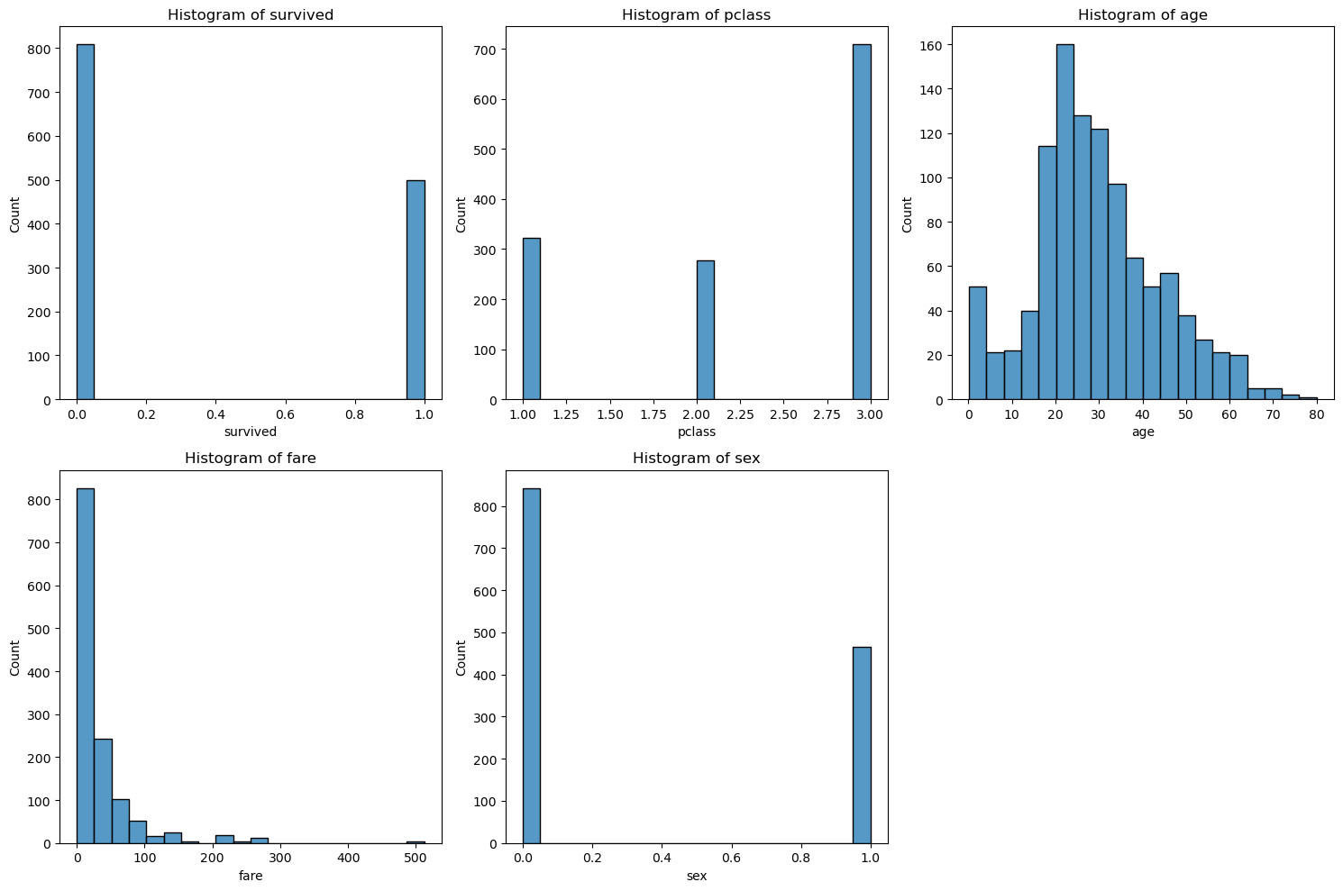
Histograms
Outliers in fare and age were considered but it was decided that they had no significant effect on analysis.

Slide 4
Descriptive Statistics
Survived: Mean = 0.38, Mode = 0, Spread = 1, Tails = Long right tail
Pclass: Mean = 2.31, Mode = 3, Spread = 2, Tails = Long left tail
Age: Mean = 29.88, Mode = 24, Spread = 79.08, Tails = Long right tail
Fare: Mean = 33.30, Mode = 8.05, Spread = 512.33, Tails = Long right tail
Sex: Mean = 0.36, Mode = 0, Spread = 1, Tails = Long right tail

Slide 5
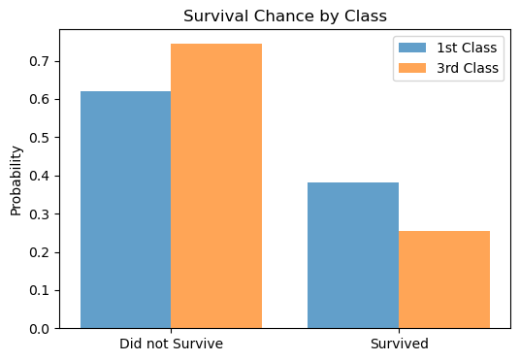
PMF – 1st vs 3rd class survival rates
Survival probability for 1st class vs 3rd class passengers.
The bar chart shows higher survival rates for those in first class.
First class passengers were significantly more likely to have survived.

Slide 6
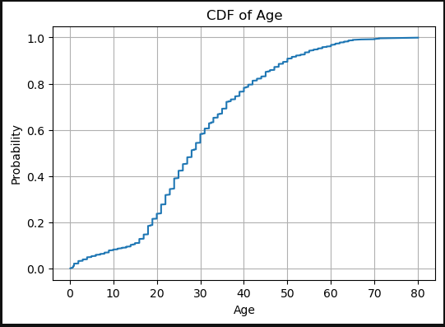
CDF of Age
Most passengers were under the age of 40.
Even though most passengers were younger it does not directly impact class survival rates.

Slide 7
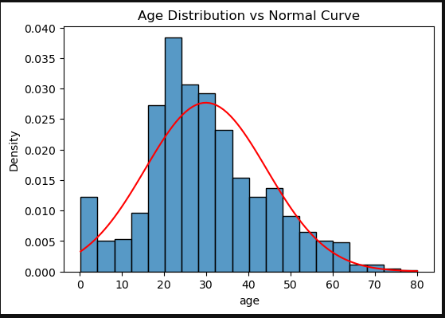
Age Distribution
Age is somewhat normal. However it has a right tail due to older passengers. This means that there was a mix of age groups aboard.

Slide 8
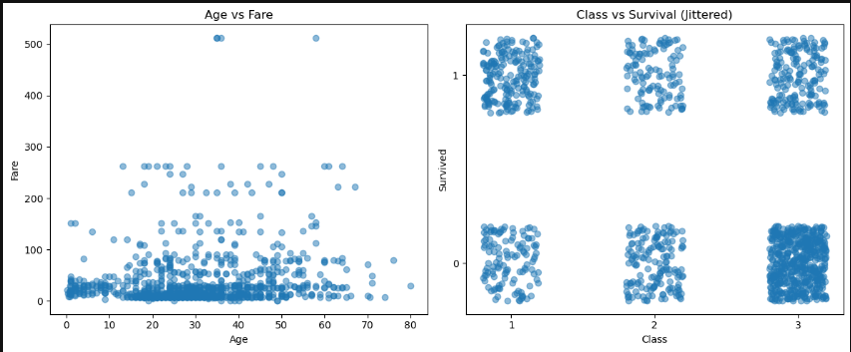
Scatter Plots
No visibly clear correlation in Age vs Fare. High fares show up across all ages.
1st class has more passengers that survived compared to 3rd class. This implies that class played an important factor.

Slide 9

Hypothesis Test
The Chi-square value of 127.86 and p<0.0001 rejects HO. This means that class had an impact on survival.

Slide 10

Regression Analysis
The regression shows that there was a drop in survival chance with every class increase. Highest chance in 1st, lowest in 3rd.

