Slide 1
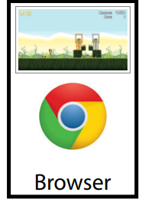
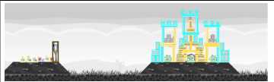

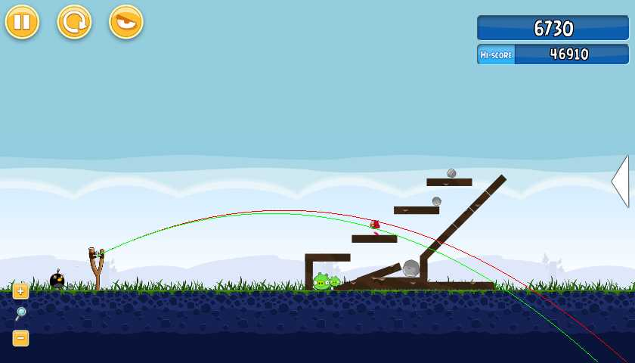
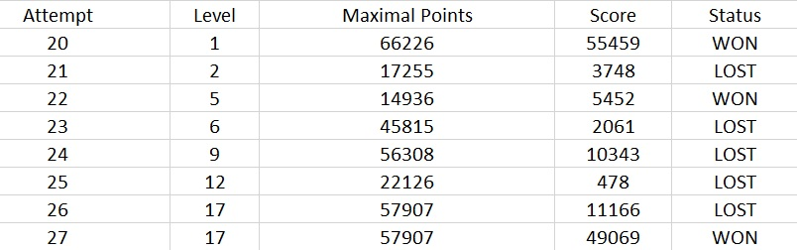
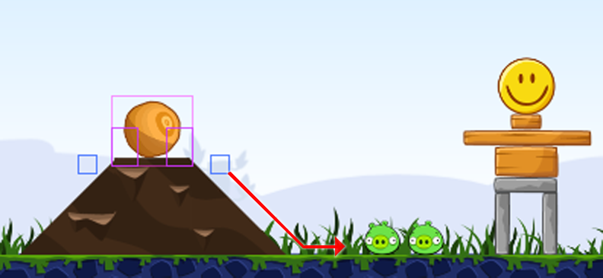
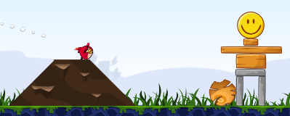
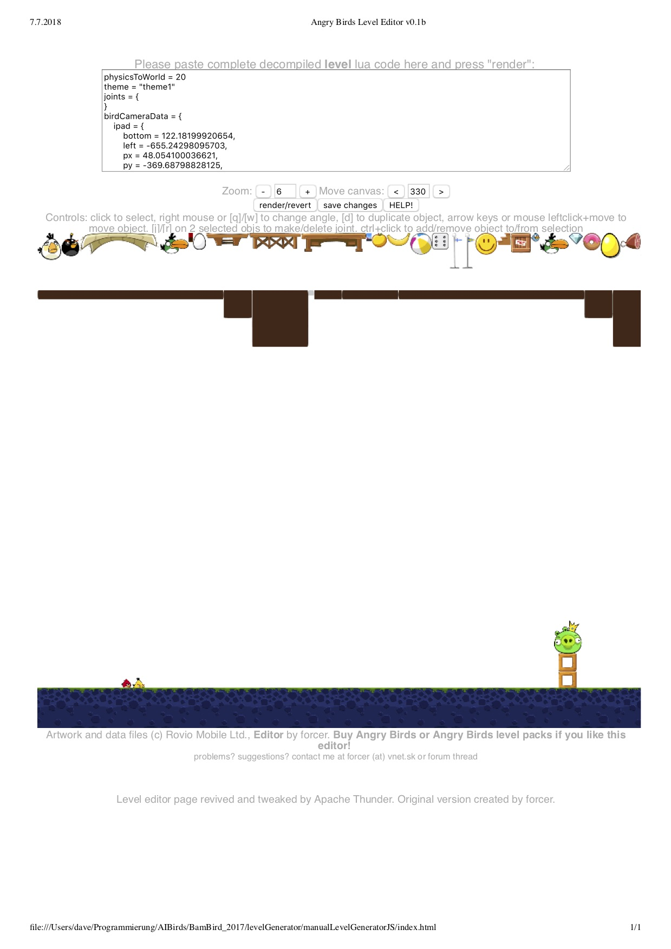
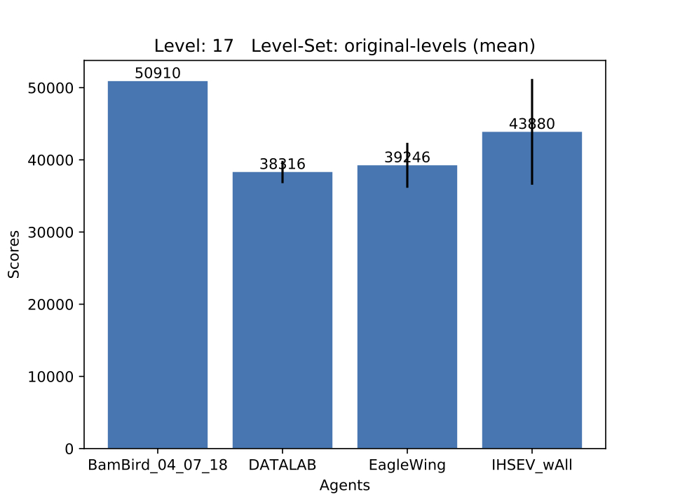

Creating an Intelligent Game Playing Agent for Angry Birds
Christian Bartenstein, David Hollinger, Felix Schweinfest, Harshit Gupta, Jan Martin, Johanna Seibert, Lara Aubele, Oleg Geier
Goal
Creating an agent that plays Angry Bird better than a human
Challenge
Planning with physical uncertainty
Agent Architecture
Screen content
Solution approach
Meta
Level Selection
Data flow
Instantiate and managing of all components
Shot
Calculation to reach the goal
Strategy
Calculation of a promising goal
Knowledge Representation
Creating an abstract description
Image processing
click
shot execution, level selection
Agent
Shot
Offline Learning
Shot angle
Calculation of the shots entry angle (high or low)
Parabola
Improved parabolic trajectory
Decision Tree
Saves the already applied strategies to hit a pig
Should decide wether the stategy was good or bad
Probabilistic Heuristic Learning
Offline runs for data gathering for probability generation.
Heuristically selecting Shot and Level based on probabilities.
Strategy
Level Generation & Evaluation
Base available actions on: Update Knowledge Generation:
Creating an evaluation framework with capabilities to
Amount of Pigs
Available Birds (Blue Birds vs. Ice)
Environment
Generate Relations between Objects
Fix faulty predicates
Update hit-ability calculation
Randomly generate levels
Generate custom levels manually with the help of an editor:
Automatically run own agent and other teams' agents of previous competitions (publicly available)
Logging scores and needed time while agents are running
Computing statistical analysis (means, median, sd, max scores) and generating bar charts showing achieved points
Environment Example: Slopes
Ball on 'hilltop'
Downward slope right on Ball
Pigs right of the slope
Ball is a valid target
unterstützt durch die TechnologieAllianzOberfranken

