Slide 1

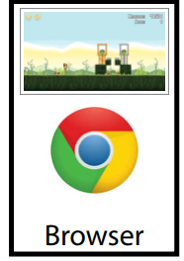
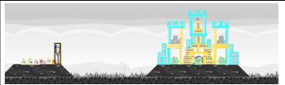
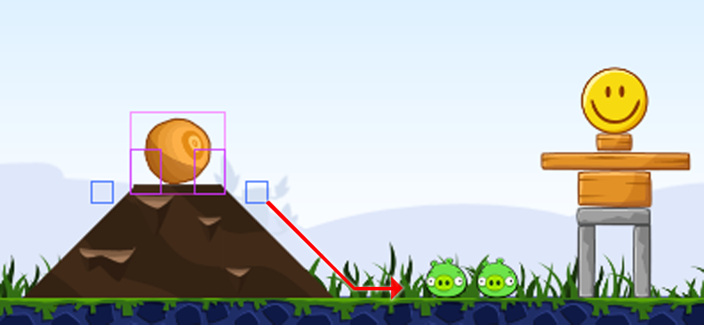
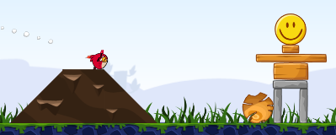
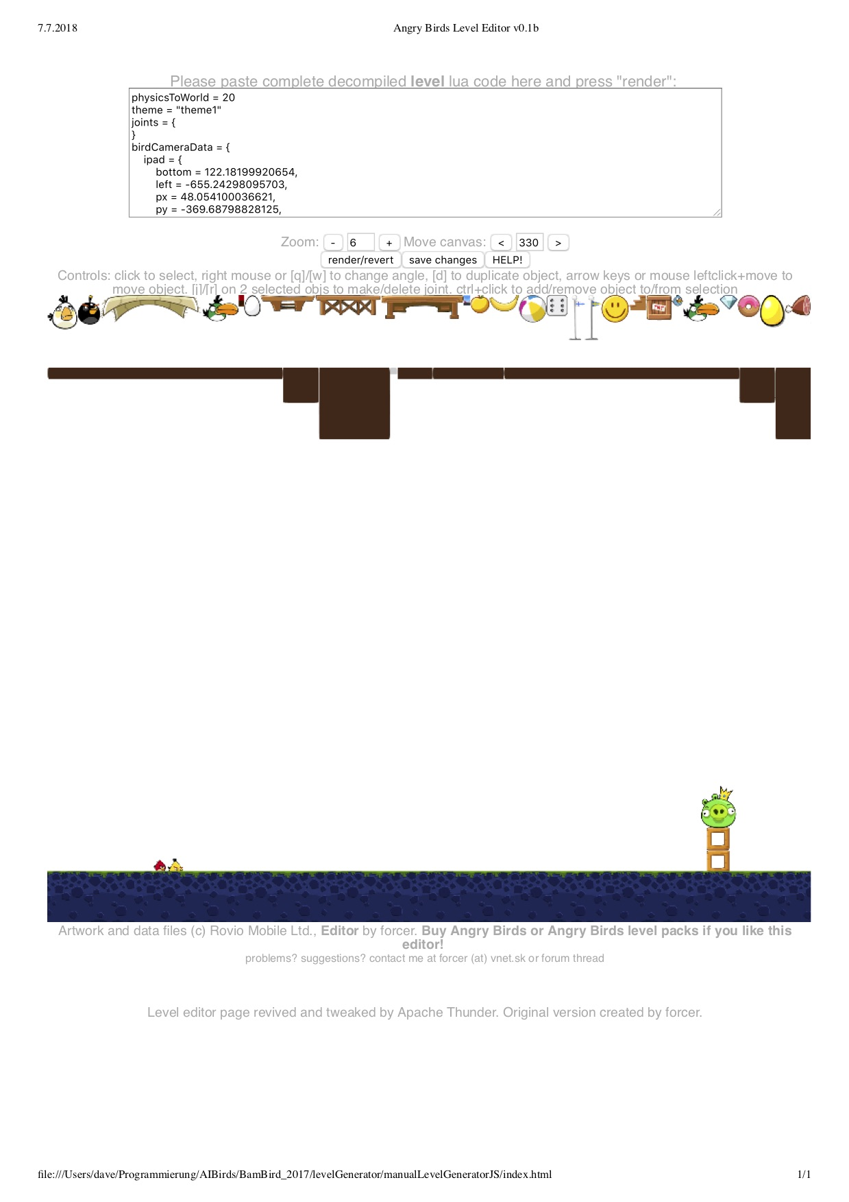
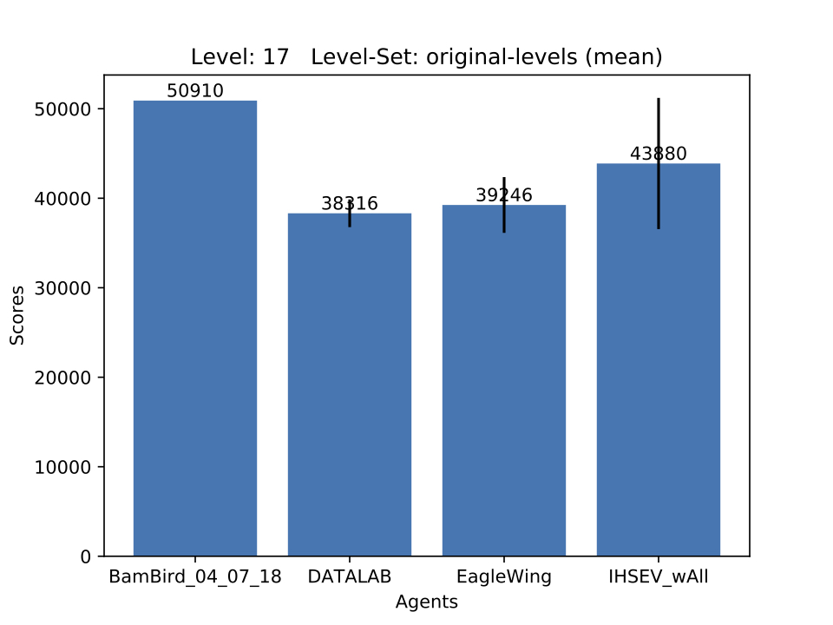

Creating an Intelligent Game Playing Agent for Angry Birds
Isabel Saffer, Jasmin Fritz, Nina Krob, Hendrik Vogel, Oliver Günay, Yannik Klubertanz, Felix Haase,
Alexander Böhner, Michael Fuchs, Jonas Amling, Thilo Martens
Goal: Create an agent that plays Angry Bird better than a human
by scoring more points in a given time
Challenge: Action selection under uncertainty
World Champion 2016
World Vice Champion 2018
2019 Competition in August
BamBirds
Agent Architecture
Shot Computation
Screen content
Agent
Strategy
Image processing
click
shot execution
Strategy
Knowledge-Based Shot Suggestions
Feedback-Controlled Shot Selection
Probabilistic Model for Level Selection
Combining Plans
Feedback
TBD
TBD
Probabilistic Heuristic Learning
Offline runs for data gathering for probability generation.
Heuristically selecting Shot and Level based on probabilities.
Level Selection
Level Generation
Base available actions on: Update Knowledge Generation:
Creating an evaluation framework with capabilities to
Amount of Pigs
Available Birds (Blue Birds vs. Ice)
Environment
Generate Relations between Objects
Fix faulty predicates
Update hit-ability calculation
Randomly generate levels
Generate custom levels manually with the help of an editor:
Automatically run own agent and other teams' agents of previous competitions (publicly available)
Logging scores and needed time while agents are running
Computing statistical analysis (means, median, sd, max scores) and generating bar charts showing achieved points
Environment Example: Slopes
Ball on 'hilltop'
Downward slope right on Ball
Pigs right of the slope
Ball is a valid target
unterstützt durch die
TechnologieAllianzOberfranken

