Slide 1


How to make music in Python
Halley Young
1/25/16

Slide 2
What is it?
Algorithmic composition – teaching computers how to make music
Computational Musicology
  Using computers to analyze music
  Figuring out the math behind how music works

Slide 3
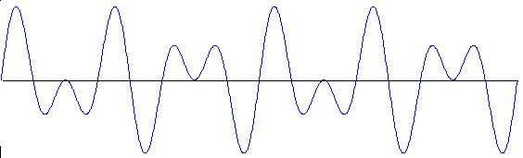
How do computers represent music?
Audio - WAV:
  44100 samples per second
  Time series view of the samples shows complex sine waves that look continuous and match how we hear music
http://home.cc.umanitoba.ca/~krussll/138/sec4/3-5plot.gif

Slide 4
How do computers represent music?
Notes:
MIDI – instructions on how to play
MusicXML – instructions on how to display (sheet music)
Can convert between the two

Slide 5
Programming Languages
Special audio/midi programming languages
  Graphical (Max/MSP, PureData)
  Text-based (Supercollider, Csound)
General-purpose programming languages with music libraries
  Java (JFugue, Jmusic or JMSL)
  Python (Music21, Scipy)

Slide 6
Music21
A tool for:
Computational analysis of music scores
Creation of new scores

Slide 7
Score Model
Notes have pitch and duration (how high/low, how long)
Notes are added to Chords or stand by themselves
Notes and chords are added to parts (e.g., violin part, flute part, etc)
Parts are added to the final score

Slide 8
Output
Score can be outputted to:
  PDF (with lilypond)
  MusicXML (to be read by other software)
  MIDI (playable)

Slide 9
How to create a score with one note (+ a little bit of theory)
Notes are divided into octaves – there are twelve notes in an octave (including sharps and flats)
Pitch classes have names (C, D, etc.) but can also be given a number 0-11 (C = 0, C# = 1, etc.)
Difference between a pitch and a pitch class: C in the 4th octave and C in the 5th octave are different pitch, same pitch class
Pitches can be described as pitchclass + (12*octave)

Slide 10
Scales
Not all notes in an octave are in a scale – a scale only has seven notes (the other 5 are skipped)
When we're talking about the first note in the octave, we say it's the first pitch
When we're talking about the first note in the scale, we say it's the first degree

Slide 11
Some more music theory
Chords – a group of two or more simultaneous notes
Triads: a root note, a note two scale degrees above that, and a note two scale degrees above that

Slide 12
Chord Progressions
Sequences of chords
Common progressions:
  I-IV-V-I
  I-II-V-I
  I-V-vi-IV

Slide 13
Musical Transformations
Transposition
Inversion
Retrograde

