Slide 1
Java Analysis Studio
May 9 2001
Mark Dönszelmann (CERN)
Tony Johnson (SLAC)

Slide 2
Outline
Introduction to JAS
JAS for online Monitoring
  Use on Babar
  Use of Plotting “Widget”
Current/Future plans
  FreeHEP library
  FreeHEP application framework
  FreeHEP plot package
Experience and Conclusions

Slide 3
Introduction to JAS
Pure Java Analysis Environment
  Data Format Independent
  Modular/Extensible via Plugins/Data Interface Modules
  Rich Easy to use GUI
  Built in editor/compiler for writing analysis code
  Local and Client-Server Operation
  Originally targeted at offline analysis – but used extensively for online monitoring as well

Slide 4
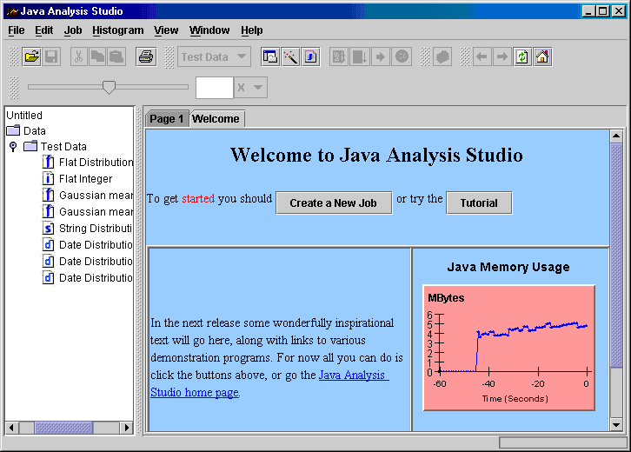
JAS GUI
Built in HTML viewer with embeddable “objects” (buttons, plots, etc).
Tree provides access to analysis objects:
Histograms
Plots
Data Sets
Analysis Routines
In principle any object.
Each item has popup menus and double click action.
Plot Widget, shows data in real time, optimized for fast refresh performance

Slide 5
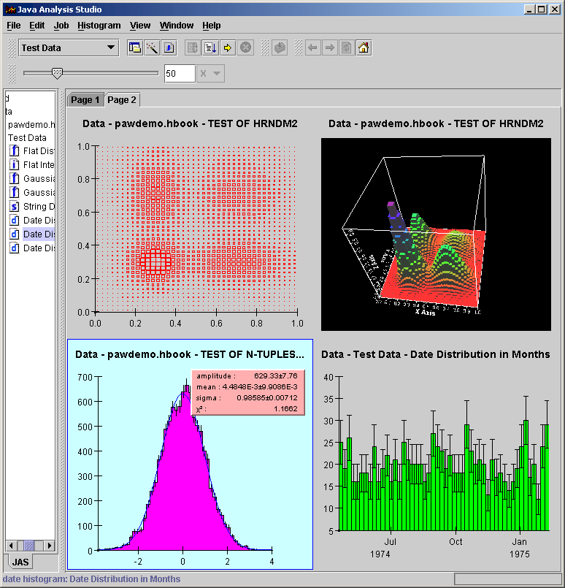
JAS Plotter
Rebin slider can be used to dynamically change # of bins.
Pages can display histograms. User can control layout, add remove plots, etc.
Plots are highly interactive, can be manipulated by the user by dragging on the axis, or bounding box. Labels (title, legend, axis labels) can be updated by clicking and typing.

Slide 6
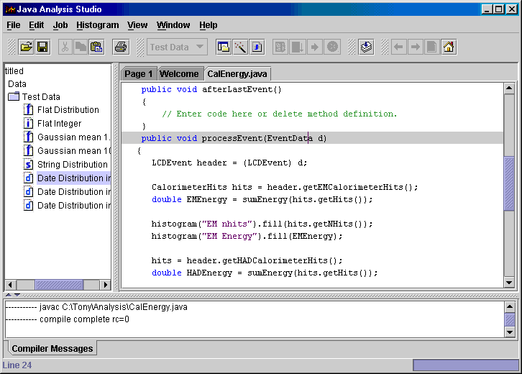
JAS Editor/Compiler
Built in code editor with syntax highlighting (based on open-source Jedit editor)
Built-in Java compiler. Can dynamically load (and unload) analysis code.

Slide 7
Data Format Independent
JAS
Client
Oracle
Paw
Root
Jazelle
Flat File
DIM
Objectivity
Hippo
JAS uses a simple interface (DIM) to isolate it from any particular data format. There are many DIM implementations which make different data formats accessible to the JAS client.
Flexible design works with many different types of data, from Ntuples, Database tables (via JDBC) to arbitrary trees of objects.

Slide 8
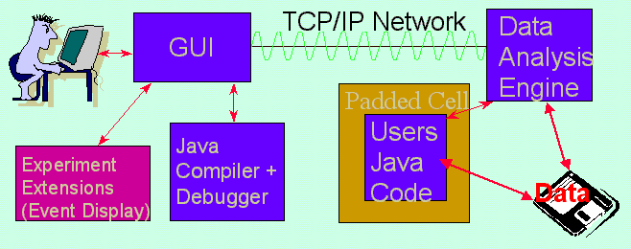
Remote Data Access
Rather than transporting peta-bytes of data to the physicist
  Transport the physics analysis code to the data
  Transparently - so that it feels just like local data access
  Just ship histogram contents back to the physicists desktop (on demand)
Allows remote analysis with modest network bandwidth
Allows user to “feel” as if using local machine even when accessing remote data.

Slide 9
Remote Data Access - Implementation
Exploit:
  Java Remote Method Invocation (RMI)
  Java sand box (like applets but in reverse – protect server from clients)
    Custom security manager limits what code loaded from server can do on server
Works quite well – but some RMI problems remain:
  ClassLoader problem (see discussion later)
  RMI not compatible with firewall (or VPN) at client
    For callbacks to work, server must be able to open socket connections back to arbitrary port on client.
    Could be worked around with custom transport implementation (e.g. multiplex over single client initiated socket connection), but custom protocols are unimplementable under JDK 1.3 due to bad design in java.net.ServerSocket class.

Slide 10
Extensible via Plugins
Plugins can:
  Define experiment specific utilities (event display, analysis utilities, specialized tables).
  Define data interfaces to handle new types of data.
  Define new plotting routines (e.g. to display special display).
  Add menus, create control areas, consoles, and output pages.
  Plugins will be more flexible in JAS 3.0 (see discussion of FreeHEP application framework, later).

Slide 11
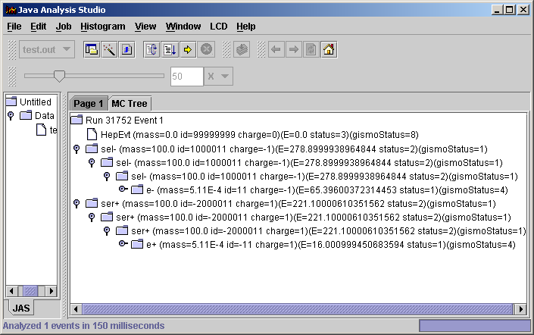
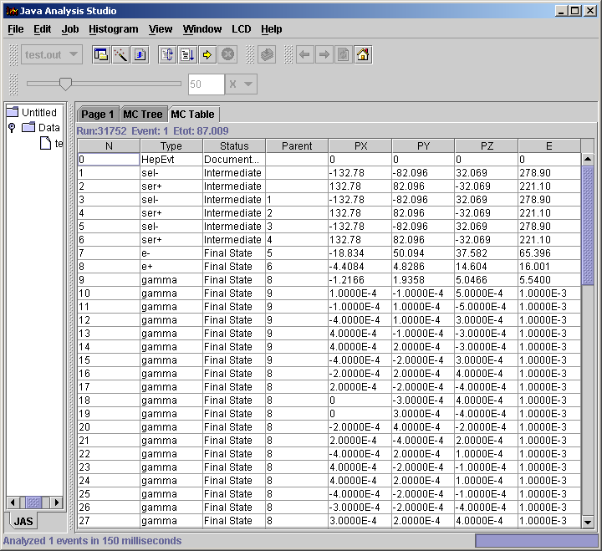
Examples of Plugins
Particle decay tree
Particle tabulation

Slide 12
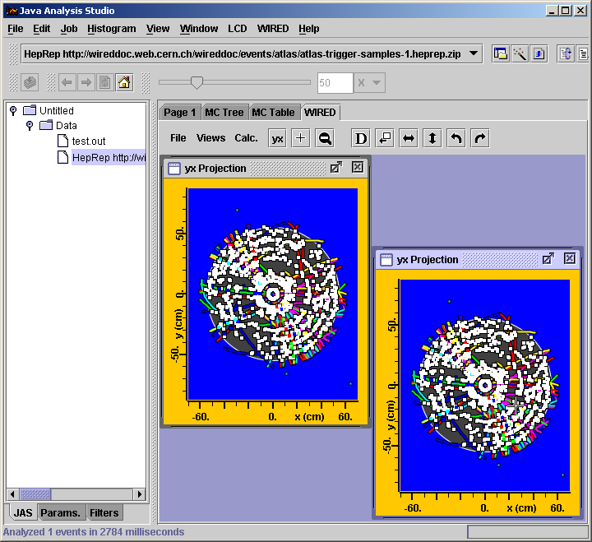
Examples of Plugins
WIRED event display

Slide 13
Plugin Implementation
Current Implementation
  At startup JAS scans
    System extensions directory
    User extensions directory
  All .jar files found are added to “classpath” for extension ClassLoader
  Each jar file is inspected to see if it contains a /JAS-inf/plugins.txt file
    If so the classes specified in the file are instantiated. These classes typically register services provided by the plugin.
  When running in client-server mode, plugin code can also be dynamically downloaded from the server.
    The JAS server includes a simple http server which can upload any class on the server’s CLASSPATH.
    So far we have not worried too much about security – we assume the client trusts the server or it would not have connected to it.
Limitations in Current Implementation
  Scanning extensions directory not compatible with JavaWebStart
  Custom classloader causes undesirable (lack of) interaction with RMI
    Classes loaded from server by RMI cannot see classes loaded by extension classloader.
  Will be addressed in FreeHEP studio (don’t know exactly how yet)

Slide 14
JAS ClassLoaders
Loads analysis code from “JAS CLASSPATH” (set through GUI). Allows unloading and reloading
Loads analysis code from “JAS CLASSPATH” (set through GUI). Allows unloading and reloading
Client
Only used for “remote” job. Code is loaded into sandbox on server.
Server
Job Class
Loader
JAS Class
Loader
Serves classes from server CLASSPATH
Loads from extensions directory
Extension Class
Loader
Built-in
http server
RMI Class
Loader
Loads from system CLASPATH
System Class
Loader
Built-in to RMI, loads code using http

Slide 15
Modular Design
Plugin
Histo/Plot
Adaptor
Analysis
Framework
GUI
Framework
Network
Adaptor
Histogram
Accumulation
3-4 Vector
Utilities
JASHist
(Plot Bean)
Fitting
Framework
Particle
Properties
Data
Interface
Functions
Fitters
Jet
Finder
Further improvements in modularity coming in JAS 3.0
PAW
SQL
stdHEP

Slide 16
JAS for online Monitoring
Two ways to use JAS for online:
  Use the entire JAS application (e.g. Babar)
    Exploit client-server operation
    Extensibility via plugins, dynamic code loading.
    HTML viewer for presenting pages of plots.
  Just use the plot widget (e.g. CLEO)
    Live updates
    Supports time/date axes for time histories

Slide 17
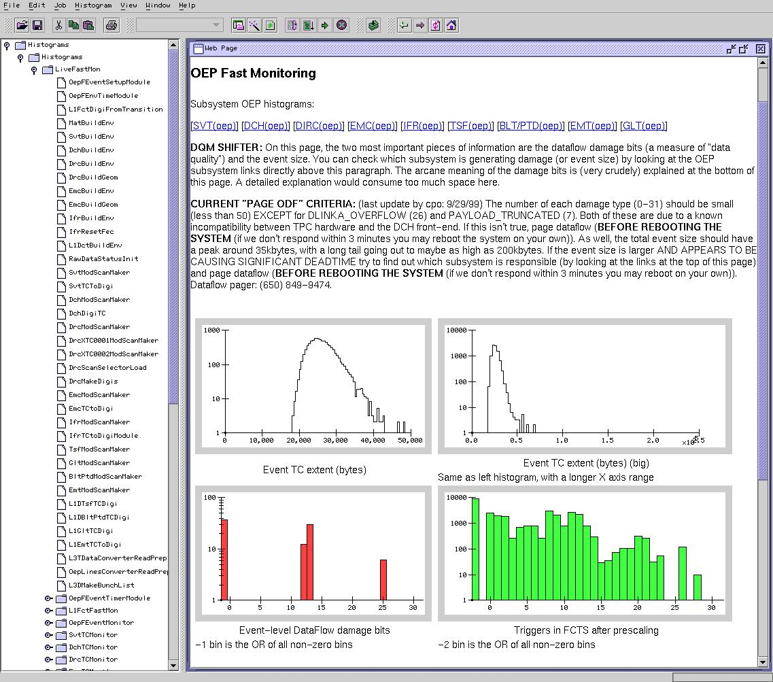
Babar Online Monitoring
Histogram
Accumulation
(C++)
Histogram
Accumulation
(C++)
CORBA
JAS/RMI
CORBA
Babar
Server
(Java)
Histogram
Accumulation
(C++)
JAS Clients
CORBA
JAS Clients
JAS/RMI
Reference histograms can be normalized and overlaid on live data.
Translates between Babar Corba protocol and JAS RMI protocol. Also maps Babar “pull” model to JAS “push” model
Reference
Histograms

Slide 18
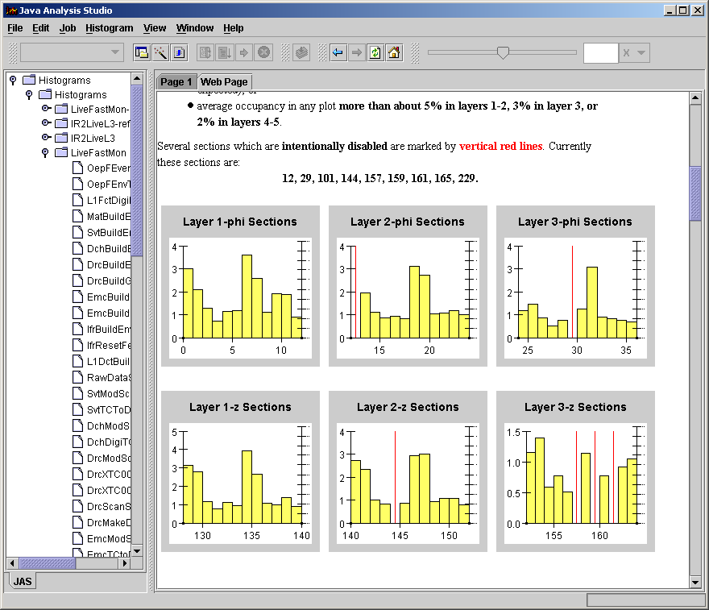
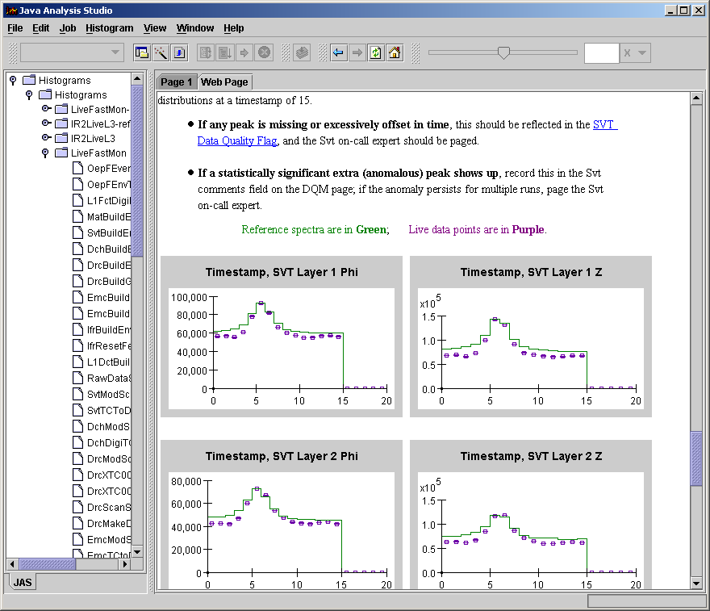
Examples of Babar Use
HTML Pages. Allows for textual explanation of plots, and embedded hyperlinks
Embedded plots. Style specified by XML file, data from server

Slide 19
Control via JAS
Although not currently used by Babar, JAS can also load:
  “control” modules which can send messages to the server to control data taking.
  “display” modules which can display arbitrary data (tables, status display etc).

Slide 20
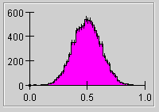
Using the Plotting Widget
Data Source
1D Histogram
2D Histogram
XY Plot
(future)
Scatter Plot
Simple DataSource interface makes it easy to attach to any data source.
Plot monitors data for changes (uses Observer/Observable pattern)

Slide 21
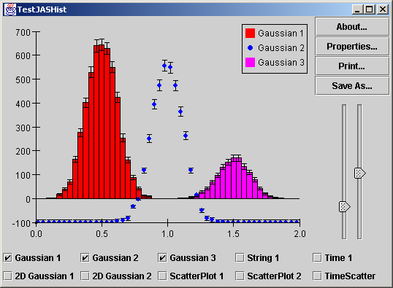
JAS Plot Demo
http://jas.freehep.org/demos/test.jnlp

Slide 22
Plot Component Features
1+2-D histograms and scatter plots
  Scatter Plot display optimized for many 1000’s of points
  3D Lego and Surface plots when Java 3D available
Overlaying of several histograms or scatter plots
Interactive function fitting for 1-D plots
Direct User Interaction by clicking and dragging
Numeric or time axes, plus axes with named bins
Many display styles that can be set interactively or programmatically
Dynamic creation and display of slices and projections of 2-D data.
Very efficient redrawing to support rapidly changing data (handles over 100 updates/second).
Printing using both Java 1 and Java 2 printing models. High quality print output is available when using Java 2.
Saving plots as GIF images or as XML. Support for encapsulated postscript and PDF will be available in JAS 3.0 (from FreeHEP library)
Custom overlays which allow data to be displayed using user defined plot routines for specialized plots.

Slide 23
Pros and Cons for online use
Pros
  Plot widget is entirely modular
  Easy to embed in other applications
  Efficient updating – ideal for real-time plots
  Flexible time axis -- great for time histories (see stock market demo)
Cons
  Histograms assume fixed bin widths, XYPlot not currently supported (will be fixed in JAS 3.0)

Slide 24
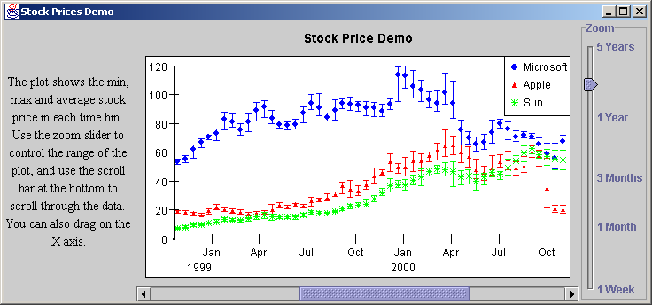
Stock Market (Time History) Demo
http://jas.freehep.org/demos/stocks.jnlp

Slide 25
The FreeHEP Library
Contributors:
Mark Dönszelmann - CERN
Julius Hrivnac - LAL
Gary Bower, Tony Johnson, Joseph Perl - SLAC
Charles Loomis – UC Santa Cruz

Slide 26
What is Freehep library
Started as a convergence of
    WIRED
    Java Analysis Studio (JAS)
  A common base library
    minimize unnecessary duplication of work
    maximize code reuse
  Soon realized many others working on Java
    Now have contributions from
      JAS, Wired, Atlas, Babar and US Linear Collider Detector (LCD)
        6 main contributors, plus students, others…
    Others welcome to contribute (contact current authors)
Today - a library of HEP-wide Java software
  Some very HEP specific (c.f. CLHEP)
  Some general purpose utilities
  Experiment Independent

Slide 27
Goals
Open source
  All code and documentation in CVS, web browsable
  All code licensed under LGPL to make it freely reusable
  Preview area for partly-baked ideas
Minimal interdependence between packages
  Take what you like, leave what you don’t.
  Use interfaces for input
Emphasis is on Java
  We include some C++ code
    In particular tools for helping Java and C++ to co-exist
  We include some language independent tools:
    XML formats
    HepRep, AIDA, Yappi

Slide 28
Goals continued
Platform Independence
  Both for developers and users
Don’t duplicate existing functionality
  Xerces, javahelp, log4j
  No need to build these!
Meta Goal
  Persuade other to reuse our components and extend or improve them as necessary,
    Rather than reinventing the wheel.
Ultimate Goal:
  Large library of reusable components which will reduce the time and effort needed to develop future HEP software

Slide 29
FreeHEP Components
Non-HEP specific
  Application Framework
  JACO – Java access to C++ Objects
  2D Vector Graphics – generates .eps, .svg, …
HEP specific
  hep.physics package
    3-vector, 4-vector’s and utilities
    Jet Finding, Event Shape routines
    Generator Framework, Diagnostic Event Generator
  hep.io – STDHEP, Root
  hep.aida – Java Aida interface + reference implementation
  Yappi – XML Particle Property Database
  HepRep – Event display See Joe Perl’s Talk
  HEP3D – Some Java 3D utilities

Slide 30
JAS 3
Will use FreeHEP/plugin architecture
Will introduce:
  AIDA (Abstract Interfaces for Data Analysis) compliant analysis environment
  Scripting
AIDAGUI:
  Toolkit for experimenting with ideas for JAS 3
    Scripting
    AIDA

Slide 31
FreeHEP Application Framework
JAS
WIRED
Your
Application
Provides
Set properties via "application properties" file
User preferences stored between sessions
A services package which allows to run as:
  Local application
  trusted JNLP applications
  untrusted JNLP applications.
Use of XML to define menus and toolbars
Use of a command manager for dispatching commands to command targets.
Command line parsing
About dialog
Print Preview capabilities
Recent File menu(s) maintained between sessions
Reporting of errors to the user.
JDK compatibility testing.
Dynamic Look and Feel switching and persistency between sessions
Window size and position maintained between sessions
Splash Screen
Status bar with message area and progress meter - including support for canceling time consuming operations.
Data Studio
Adds
Facilities for data access (DIMs)
Studio
Adds
Extensible via plugins
Maintainance of user “session” using XML.
MDI Application
Adds
pages, control(s) and console(s) areas.
dynamic switching of page managers to allow pages to be organized as tabbed panes, or as movable windows on a desktop.
multiple toolbars
Application

Slide 32
Studio/Data Studio
JAS currently supports “plugins”
Studio will extend this concept so application becomes bare framework, with:
  Data Access Plugin (c.f. JAS DIM’s)
  Histogramming (AIDA) Plugin
  Plotting Plugin
  Editing Plugin
  Compiler Plugin
  Scripting Plugin
  WIRED (Event Display) Plugin
  Etc. etc. etc.
Plugins can communicate either explicitly, or (better) though
  “service interfaces”
  “service registries”

Slide 33
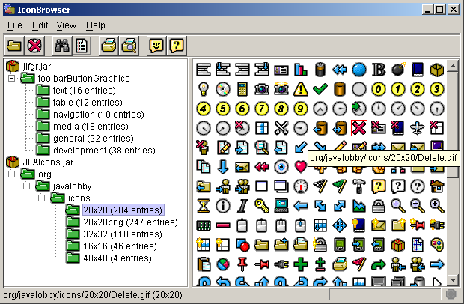
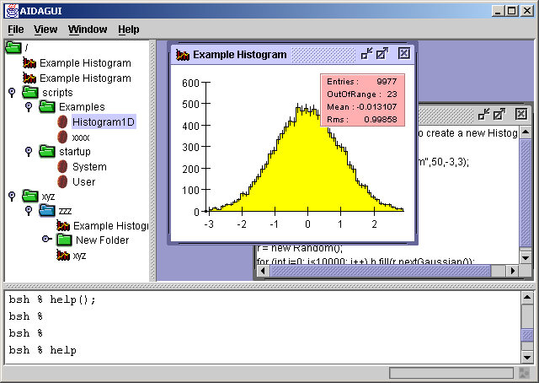
Test/Demo Apps

Slide 34
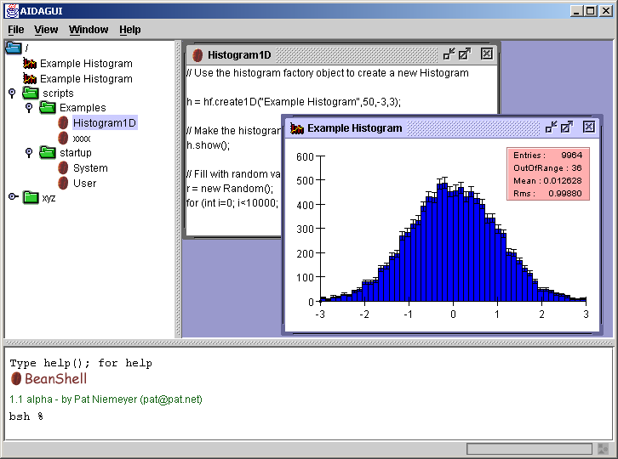
AIDAGUI

Slide 35
Scripting
JAS already supports “scripting” in Java
  Including “batch” mode with no GUI
Want something you can just type a line and see immediately what happens
Languages under consideration
Language
Java Like
Speed
User Friendly
Able to extend Java Classes
BeanShell
8
Went home before it finished
9 (nice console, command completion)
4
DynamicJava
10*
60 seconds
5
10
Jython
4
60 seconds
5
8
PNuts
9
Java
3 seconds

Slide 36
FreeHEP plot package
Next generation of JAS Plotting Widget.
  More flexible
    Current Rebinnable1DHistogram, Rebinnable2DHistogram, ScatterPlot data sources will become special cases of more general purpose data source
      Will support XYPlot, variable bin widths, higher dimensions
      Generic mechanism for user interaction (eg dragging on axis) to be communicated to data source.
      Will support tooltips/picking on individual data points.
    Algorithms will be separated from GUI components
      Axis “logic” (e.g. label/tick placement) will be usable with 2D or 3D graphical components
  More extensible
    All existing plot styles will use “plugin” architecture
    New plot styles will be easy to add
      E.g Could be used for stock market “candle” plots
  More understandable
    Get rid of “DataManager” class hierarchy which is too complex.

Slide 37
Experience and Conclusions
Java has been an excellent choice
  Relatively easy to learn
  Concentrate on good OO design
  Productive, Fun to use
  Cross platform platform support excellent
  Despite rumours to contrary, very fast as long as application is well designed. Modern PC gives very responsive GUI.
Still takes several (many) iterations to get OO design (almost) right.
In complex environment still need to use tools (e.g OptimizeIt) to find memory leaks, but way easier than C++.
Code reuse can be a reality – help us build FreeHEP!

