Slide 1
Particle Properties in XML
Patrick Hellwig
Universität Kaiserslautern, Germany
Department of Physics
Hellwig@physik.uni-kl.de
CERN Summer Student@EP/ALC, IP/API

Slide 2
Particle Properties in XML
particles and properties
data modeling
XML technology
JAS – Java Analysis Studio
Conclusion

Slide 3
Particles and Properties
Properties of Particles are needed for analysis
Standard source of data: Particle Data Group (PDG)
  But no database !
  Each software has its own database
Two areas:
  Particles
    General Information (Mass, Width, etc.)
    Decay Modes
  Family structure

Slide 4
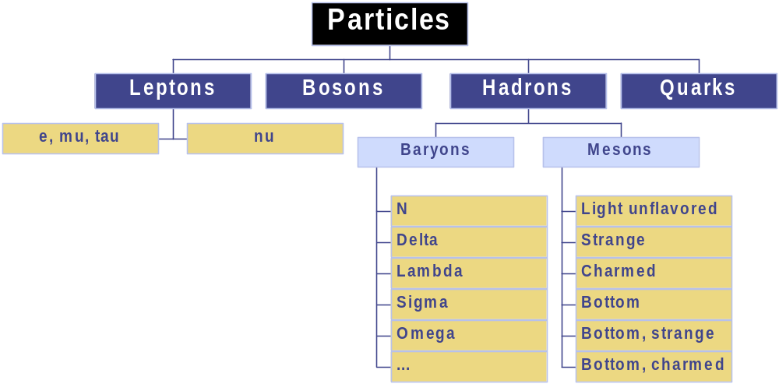
Data Model: Particle-Families

Slide 5
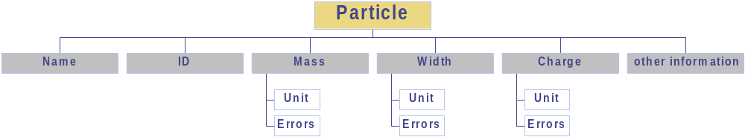
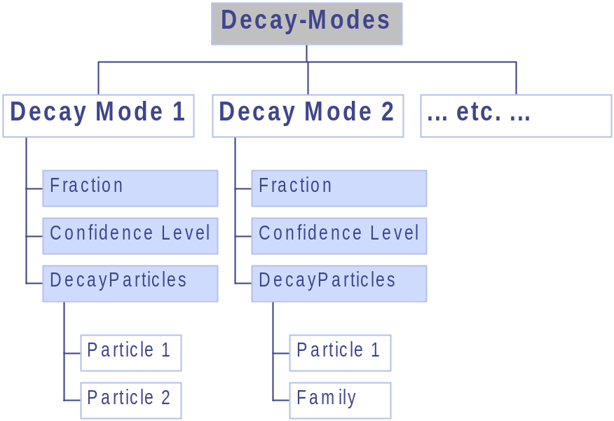
Data Model: Particle

Slide 6
XML Technology http://www.w3.org
Multiple parts:
  Data-file (XML)
  Schema-file (XSD/DTD)
  Style-file (XSL)
Elements
Attributes
XML:
<Particle Name="Proton">
<ID>2212</ID>
<Mass Unit="MeV">
938.272
</Mass>
</Particle>

Slide 7
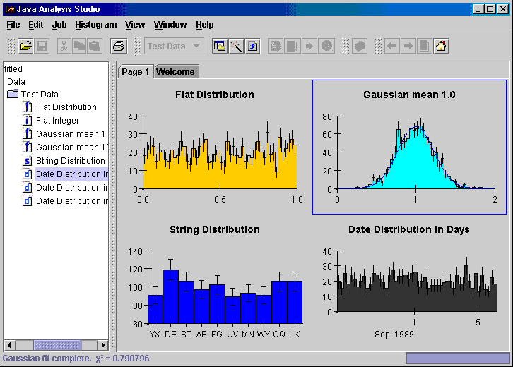
JAS – Java Analysis Studio http://jas.freehep.org
Analysis software for high energy physics
Access to XML-database via Java Interface
ParticleProperties.setParticlePropertyProvider(new XMLParticlePropertyProvider(file));
ParticleType pp = ParticleProperties.get( Particle_ID_Number);
pp.getMass();
pp.getWidth(); etc.

Slide 8
Conclusions
XML
  very open
  platform independent
  Ability to publish on the Web
  Easy accessible in many languages: Java, C++, …
Could be: one PDG data source for many
But: difficult to get data out of PDG-book

