Slide 1
Caching with Redis on Asp.Net
Brian Hall
Chief minion @ Nebbia Technology

Slide 2


Me
Brian Hall
Chief Minion @ Nebbia Technology
Twitter: @Hallmanac
Github: https://github.com/Hallmanac/redis-aspnet-azure
Github: https://github.com/Nebbia/RedisRepo
Email: Brian@NebbiaTech.com

Slide 3




About Us
DevOps & Application Lifecycle Management
Visual Studio Team Services / TFS
Software Development & Consulting
All about Azure – Born in the Cloud
Headquartered in Orlando, FL

Slide 4
Goals for this talk
Basic overview of Redis
Setting up Redis Locally
Plugging Redis into AspNet
Session State with Redis
Replace HttpRuntime.Cache with Redis

Slide 5

Interruptions welcome
Ask Questions
I’ll start

Slide 6



Slide 7






Cross platform, In-Memory, Key Value Store

Slide 8

It has Data Types other than strings
…unless people are the data

Slide 9
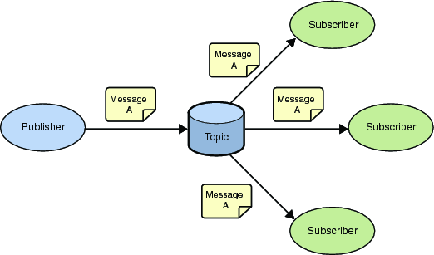
It’s a Pub/Sub system as well

Slide 10
Redis Types
String
List
Set
Sorted set
Hash

Slide 11
Redis Keys
Binary safe strings
Case Sensitive
Max 512MB
Don’t do it!
Hash the key instead

Slide 12
Redis Type: String
Binary safe

Slide 13
Redis Type: List
Collection of Non-unique strings
Setup like a Linked list
Push and pop is cheap
Small lists as fast as very large lists
Seek by index is expensive (a.k.a. random access)

Slide 14
Redis Type: Set
Unordered collection of strings
Random Access is fully supported
Additional operations like intersect and union

Slide 15
Redis Type: Sorted Set
Like a set but with ordering via a "floating point value" called a score
Score is based on how the elements are added/updated
Sort operation is done at time of writing to the Redis DB, based on the score value (not when reading)
Sorted by score and then lexigraphically
Example:
Key: “UserBirthdays”
Value:
{ “UserId”: “5”, “Username”: “Hallmanac” }
Score: 635787405990736030
DateTimeOffset.UtcNow.Ticks

Slide 16
Redis Type: Hash
Collection of name/value pairs
A single hash holds as much as you have memory available
A “Cache within a Cache”

Slide 17

But Why Redis?

Slide 18

Decouples app cache from app server
Redis Server
Web Server 1
API Server
Web Server 2

Slide 19
Survives App or API server recycle
Redis Server
Web Server 1
API Server
Web Server 2

Slide 20
How do we use it?
(Very Carefully)

Slide 21
Libraries And Tools
Redis Documentation
Redis Server (via Chocolatey)
Redis Desktop Manager
StackExchange.Redis (Nuget)
JSON.NET (or your JSON serializer of choice)

Slide 22
Libraries And Tools
Redis Documentation
http://redis.io/documentation
https://redis.io/topics/data-types-intro

Slide 23
Get Redis Server from Chocolatey NuGet
https://chocolatey.org/packages/redis-64
Libraries And Tools

Slide 24



Get Redis Server from Chocolatey NuGet
https://chocolatey.org/packages/redis-64
Libraries And Tools

Slide 25



Install Redis As a Service

Slide 26
Libraries And Tools
Redis Desktop Manager
It’s like SSMS for Redis (sort of)
http://redisdesktop.com/

Slide 27
Showcase Showdown
Install redis and The Redis Desktop Manager

Slide 28
Libraries And Tools
StackExchange.Redis
Via NuGet
Available on Github
https://github.com/StackExchange/StackExchange.Redis

Slide 29
Libraries And Tools
JSON.NET
Via NuGet
Using this as a string serializer

Slide 30
Showcase Showdown
Adding Redis To the Solution
Notes:
Add StackExchange.Redis
Add Web.Config appSettings
Add RedisConfig.cs
Add RedisStartupConfig.cs
Add AppConsts.cs
Call setup code from Global.asax.cs

Slide 31
Redis Cache Storage Strategies
Single cache key per object stored in a Redis string as JSON
Multiple objects stored in a single Redis hash
Where the hash field (a.k.a. key) is the object’s ID
And the hash value is the object stored as JSON

Slide 32
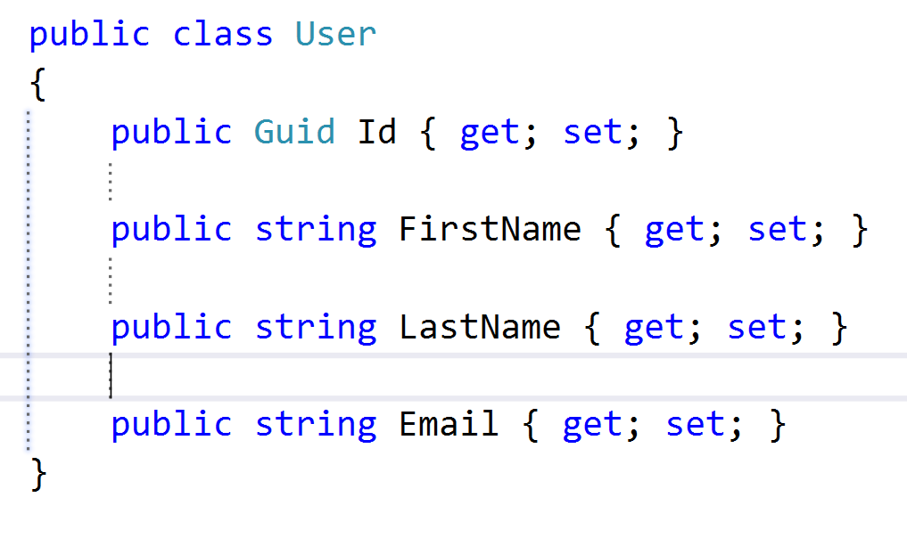
Object as a Redis String
Redis Key
user:0410a5cf-5cfe-40df-9524-81f05db76c33
Redis String Value
{
“Id”: 0410a5cf-5cfe-40df-9524-81f05db76c33,
“FirstName”: “Brian”,
“LastName”: “Hall”,
“Email”: “Brian@NebbiaTech.com”
}

Slide 33
Object as a Redis Hash
Redis Key
user:0410a5cf-5cfe-40df-9524-81f05db76c33
Redis Hash Value
Field - “Id” Value - “0410a5cf-5cfe-40df-9524-81f05db76c33”
Field - “FirstName” Value - “Brian”
Field - “LastName” Value - “Hall”
Field - “Email” Value - “Brian@NebbiaTech.com”

Slide 34
Collection of Object types as a Redis Hash
Redis Key
some-namespace:user
Redis Hash Field
“0410a5cf-5cfe-40df-9524-81f05db76c33”
Redis Hash Value
{
“Id”: 0410a5cf-5cfe-40df-9524-81f05db76c33,
“FirstName”: “Brian”,
“LastName”: “Hall”,
“Email”: “Brian@NebbiaTech.com”
}

Slide 35
Collection of Object types as a Redis Hash
Redis Key
some-namespace:users
Redis Hash Field
“0410a5cf-5cfe-40df-9524-81f05db76c33”
Redis Hash Value
{
“Id”: “0410a5cf-5cfe-40df-9524-81f05db76c33”,
“FirstName”: “Brian”,
“LastName”: “Hall”,
“Email”: “Brian@NebbiaTech.com”
}
Redis Hash Field
“f89708a8-b10e-4396-81a5-e18fa39ecec2”
Redis Hash Value
{
“Id”: “f89708a8-b10e-4396-81a5-e18fa39ecec2”,
“FirstName”: “Esteban”,
“LastName”: “Garcia”,
“Email”: “Esteban@NebbiaTech.com”
}

Slide 36
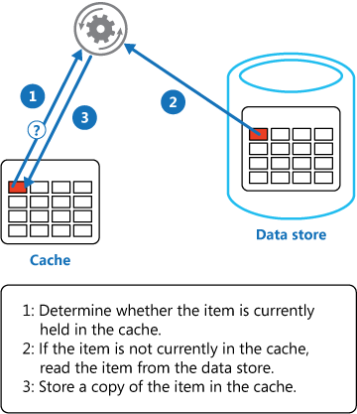
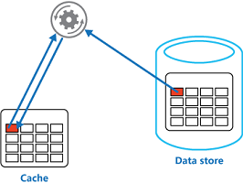
Cache Aside Pattern
Data Request

Slide 37
Showcase Showdown
Implementing Redis In Code
Notes:
Create IAppCache interface
Implement IAppCache inside RedisAppCache
Leverage Redis in the Minions controllers and views
Show how to use the RedisConfig as a singleton when constructing RedisAppCache
Show how the “partition” system works with Redis Hash types
Show the usage in the Commands and Read services

Slide 38
Libraries And Tools
Microsoft.Web.RedisSessionStateProvider
Via NuGet
Allows for the use of SessionState

Slide 39
Showcase Showdown
Using Redis Session State Provider
Notes:
Show the NuGet package
Show the Web.config
Show the RedisSessionStateConfig.cs
Show it being called from Global.asax
Show the strong-name issue in RedisAppCache.cs

Slide 40
Libraries And Tools
RedisRepo
Via NuGet - Beta
On Github:
https://github.com/Nebbia/RedisRepo

Slide 41
Key Take Aways
Redis should be accessed as a singleton via the multiplexer
Leverage the code from the RedisConfig.cs class
Redis can be used as something more than a Key-value store
Redis hash type: a cache within a cache

Slide 42
Questions?

Slide 43
Contact Info
Twitter: @Hallmanac
Github: https://github.com/Hallmanac/redis-aspnet-azure
Github: https://github.com/Nebbia/RedisRepo
Email: Brian@NebbiaTech.com
Credit for Minion Data: http://meminion.com/minion-names.html

