Slide 1
dausername
password
Login guest
Login admin

Slide 2
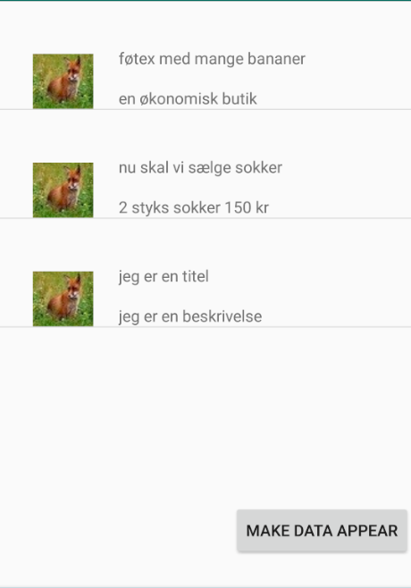

Log out
Here there will be a searchbox and a filter for finding specific discounts, company, product etc

Slide 3
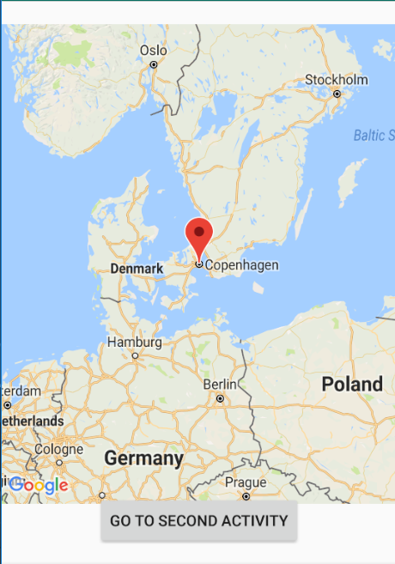
Log out
Here there will be a searchbox and a filter for finding specific discounts, company, product etc

Slide 4
Account stuff for guest happens here
Log out

Slide 5

See, make, change, delete the discounts your company offers here as an admin
Log out

Slide 6
Feedback for the discounts your company has had – beware ! If the feedback is really bad then your user might get removed (we will check if the bad feedback is true)
Log out

Slide 7
Do account stuff here as an admin. For example change picture, change company name etc
Log out

