Slide 1


Slide 2
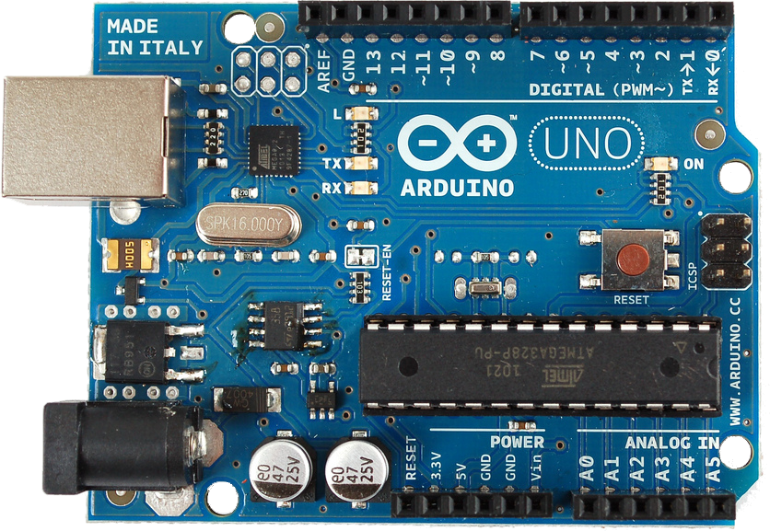
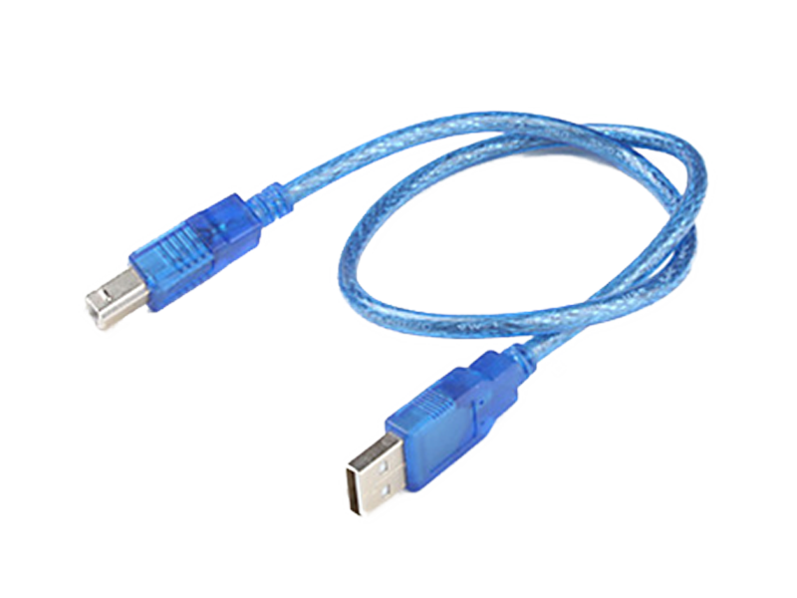
Arduino Uno (Mikrokontroler) + Kabel USB

Slide 3
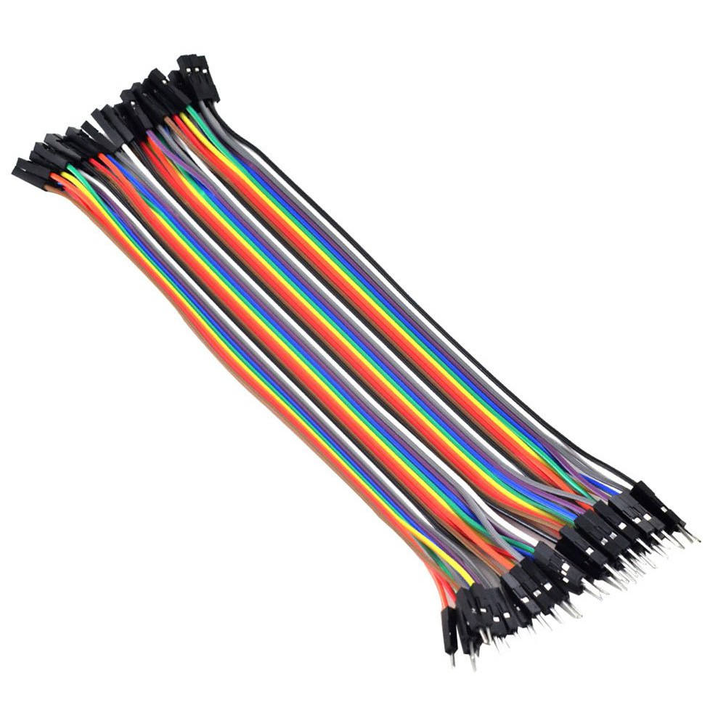
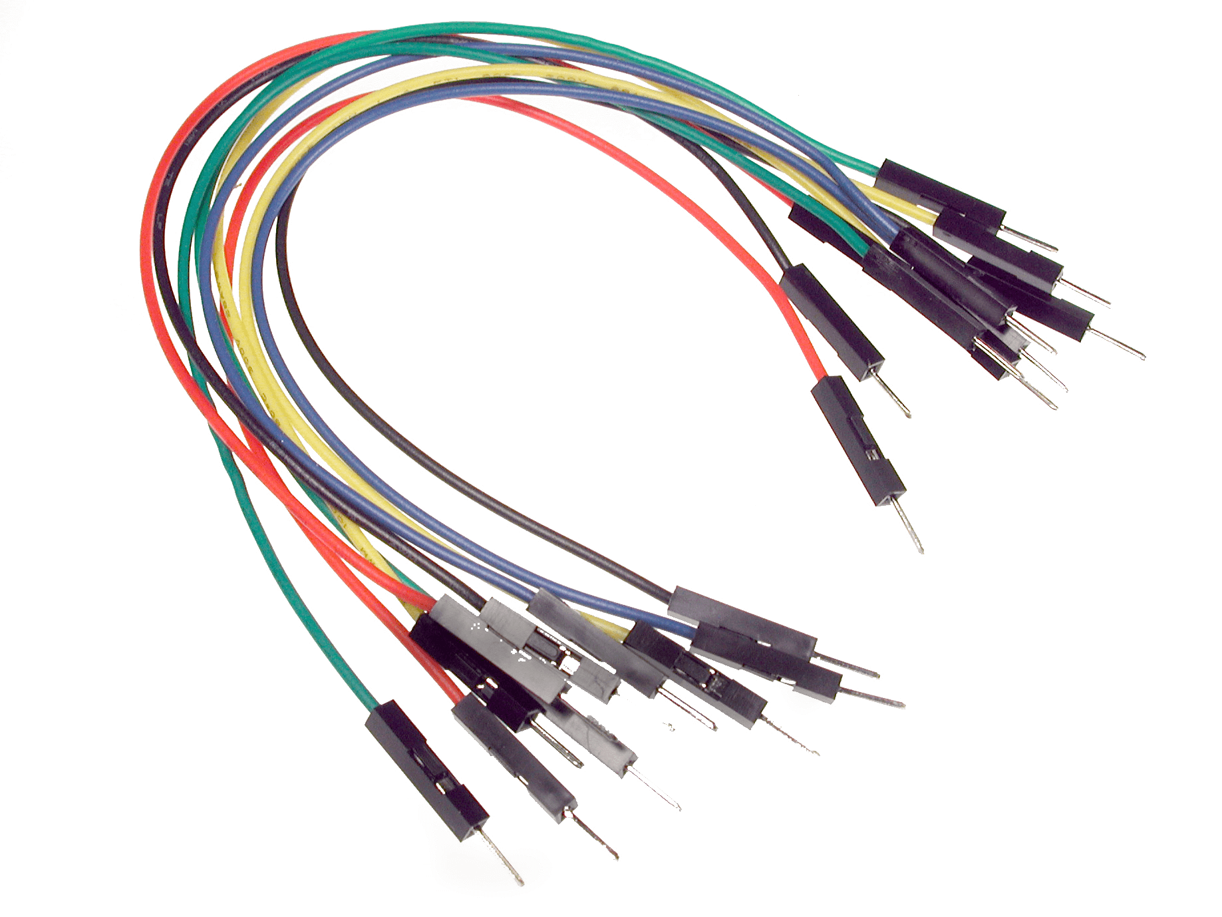
Kabel Jumper Male-Male dan Male-Female

Slide 4
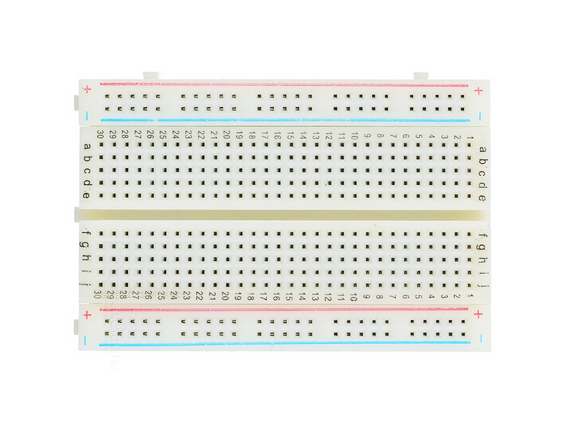
Breadboard
Bagian Atas
Keterangan:
Seri
Paralel
Bagian Tengah
Bagian Bawah

Slide 5
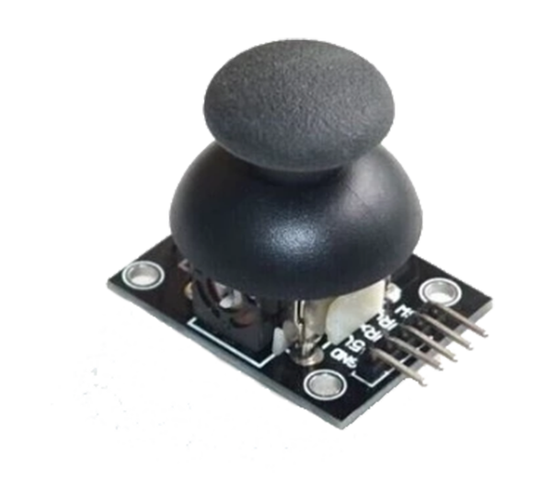
Joystick

Slide 6
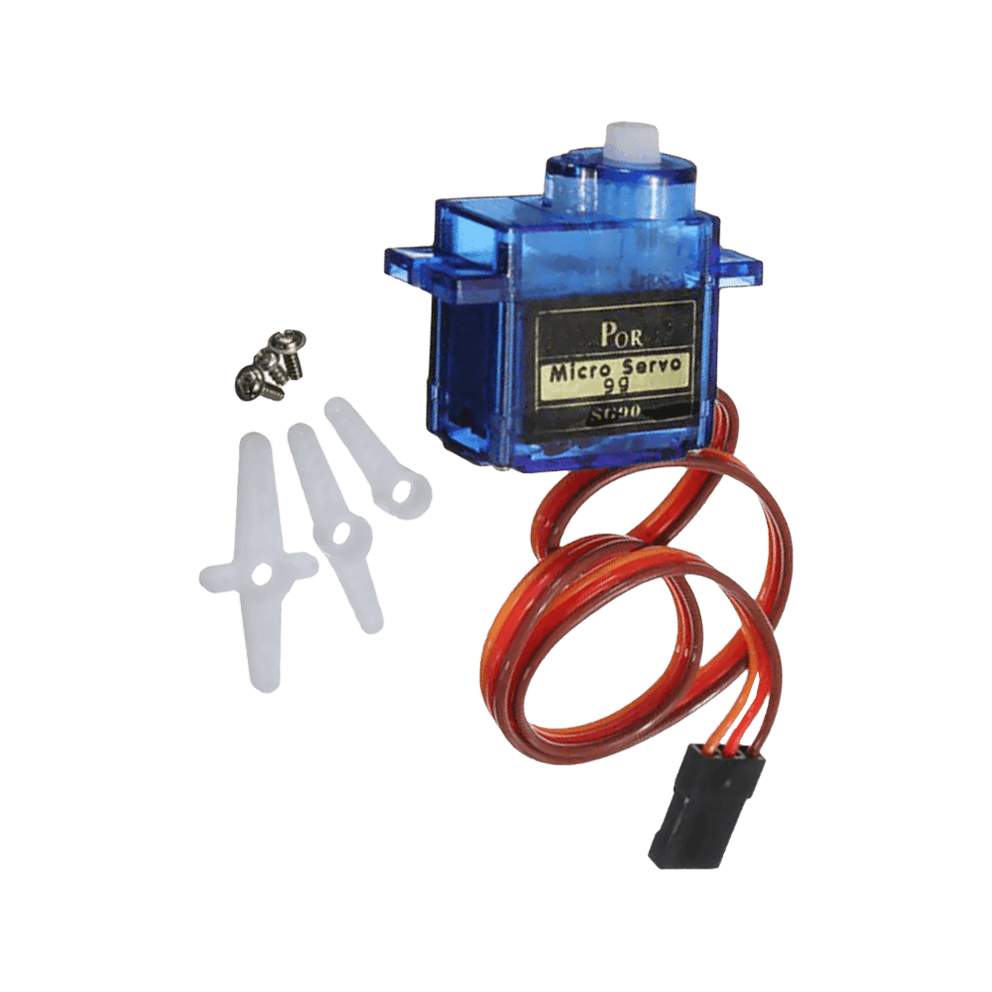
2 x Servo 180°

Slide 7
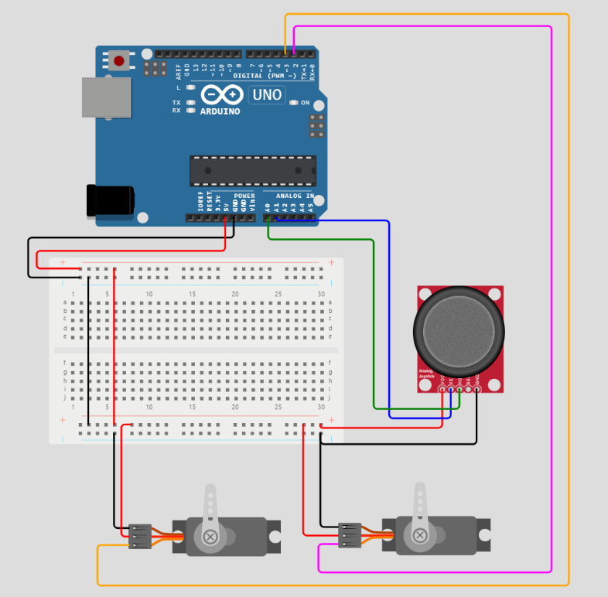
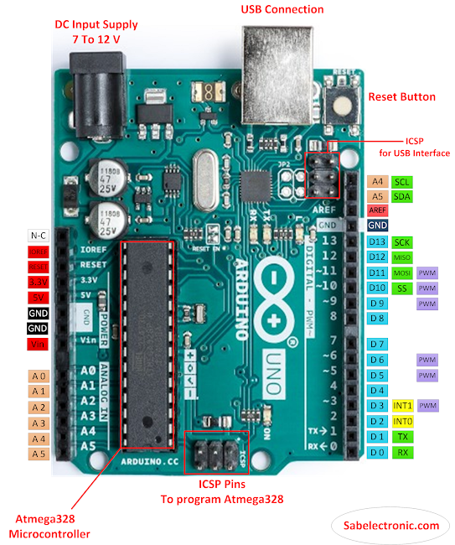
Wiring Diagram
Arduino Uno GPIO | Joystick | Servo 1 | Servo 2
2 |  | Signal
3 |  |  | Signal
A0 | VRX
A1 | VRY
GND | GND | GND | GND
5V | VCC | VCC | VCC
Y
X
Servo 2 : Sumbu Y
Servo 1 : Sumbu X

Slide 8


