Slide 1
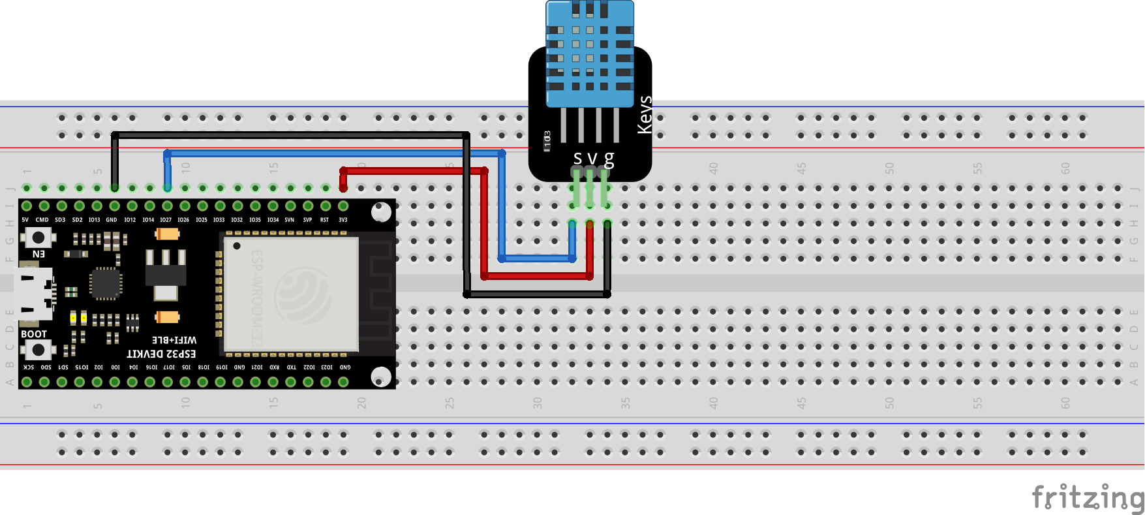
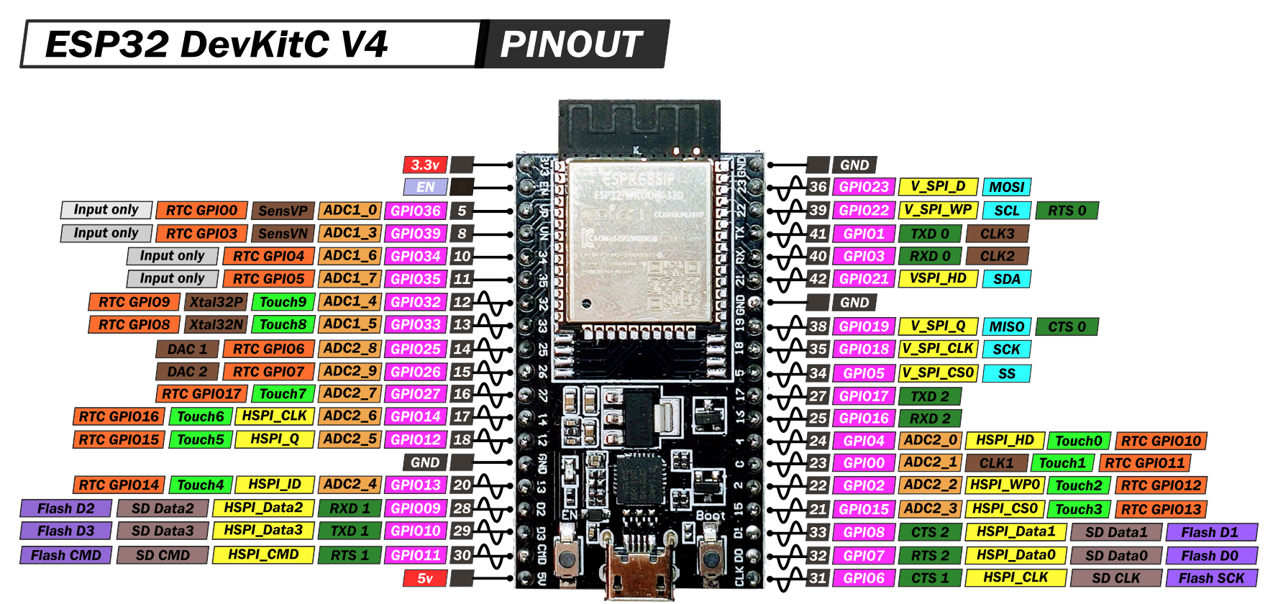
DHT11
Wiring Diagram
ESP32
List Component | DHT11 Sensor | ESP32 GPIO | Wire Color
1. ESP32 V4 (38 Pin GPIO) | VCC | 3.3V
2. DHT11 | GND | GND
3. Arduino IDE | DATA | GPIO27
4. Breadboard
5. Jumper Male to Male

Slide 2
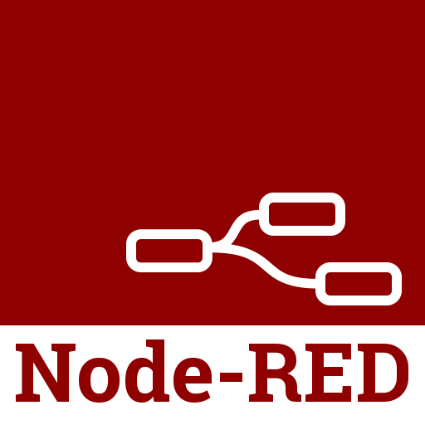


MQTT Protocol Architecture
MQTT (Message Queueing Telemetry Transport )
MQTT is an OASIS standard messaging protocol for the Internet of Things (IoT). It is designed as an extremely lightweight publish/subscribe messaging transport that is ideal for connecting remote devices with a small code footprint and minimal network bandwidth. MQTT today is used in a wide variety of industries, such as automotive, manufacturing, telecommunications, oil and gas, etc.
MQTT Client
MQTT Broker
MQTT Client
Publisher
Subscriber
Publish:
Publish:
Topic:
- /esp32-mqtt/temp
- /esp32-mqtt/humi
Subscribe:
Topic:
- /esp32-mqtt/temp
- /esp32-mqtt/humi
broker.mqtt-dashboard.com

Slide 3
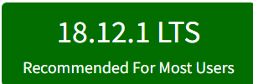
Node-RED Installation
Node-Red merupakan salah satu alat pemrograman (programming tools) yang dapat menghubungkan perangkat keras (hardware), API, dan layanan online dengan cara yang sangat mudah dan menarik.
Cara Install Node-RED pada Windows
1. Install Node.js
2. Install Node-RED
3. Run Node-RED
1). Link: https://nodejs.org/en/
2). Download Node.js versi LTS
terbaru dan Install
1). Buka CMD/Terminal
2). Pastikan Laptop/PC tersambung ke koneksi Internet
3). Copy dan Paste command berikut pada CMD/Terminal :
4). Tunggu sampe proses instalasi selesai
1). Tulis command berikut
pada CMD/Terminal :
2). Biarkan CMD/Terminal Berjalan
3). Buka Browser dan akses url link berikut :
Node-RED Editor: http://127.0.0.1:1880
Node-RED Dashboard :
http://127.0.0.1:1880/ui
node-red
npm install -g --unsafe-perm
node-red

Slide 4
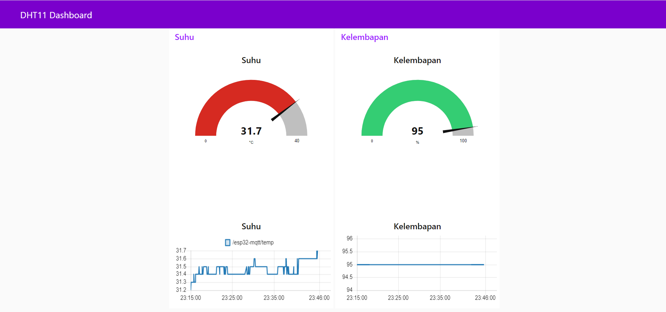
DHT11 Dashboard

