Slide 1
Forms and inputs

Slide 2
Forms
Wrapper for data collection elements
Text fields, dropdowns, etc
Tells the page
Where to send the data
How to send it
What is being sent

Slide 3
Form tag
<form></form>
Attributes
Method
Post,get,put,delete
Action
Url to send data to
Enctype
Multipart/form-data if uploading files

Slide 4
Altogether now
<form action=“register.php” method=“post” enctype=“multipart/form-data”>
<!--Data collection elements go here-->
</form>

Slide 5
Inputs
Layout
Place between <form> tags
Attributes
Type
Text,submit,password,email,checkbox,button,radio,file,etc
Name
Used server side
Placeholder
Value

Slide 6
Inputs
Complete Spec: http://www.w3schools.com/tags/tag_input.asp
Gotchas
The font-family for an input is not inherited!!!
This can lead to funny sizing issues on Macs vs. PCs where the default font is not the same

Slide 7
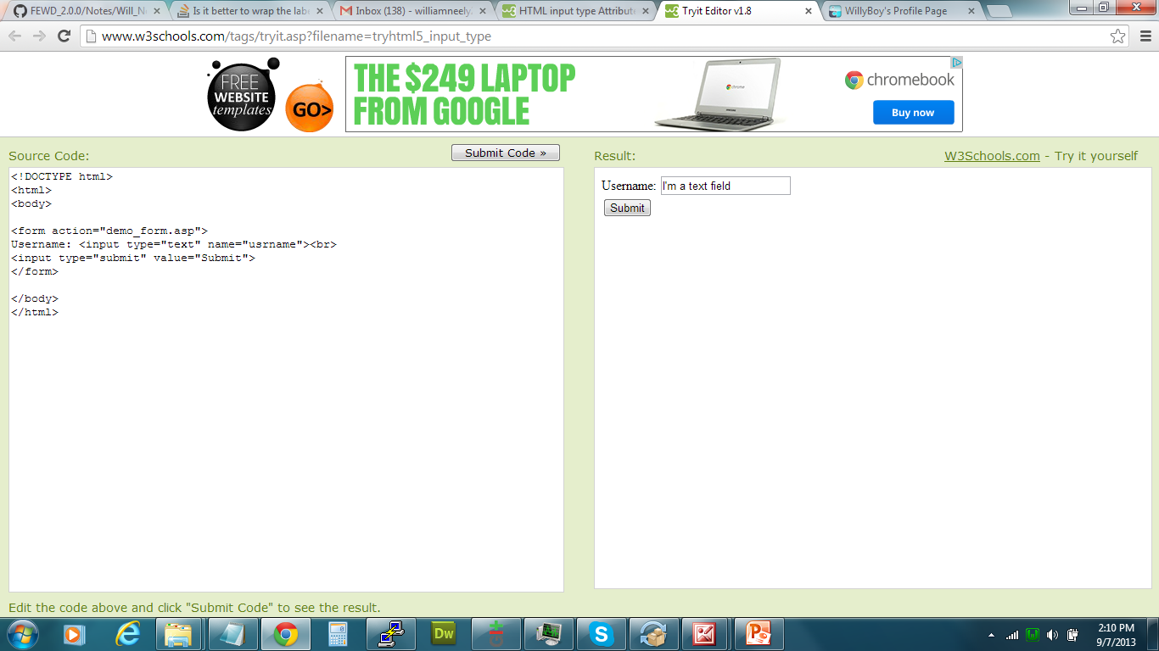

Text, Password, Email, etc
<input type=“text”>
Use value to set initial text
<input type=“email”>
Allows browser to autofill field
<input type=“password”>
Hides characters as typed

Slide 8
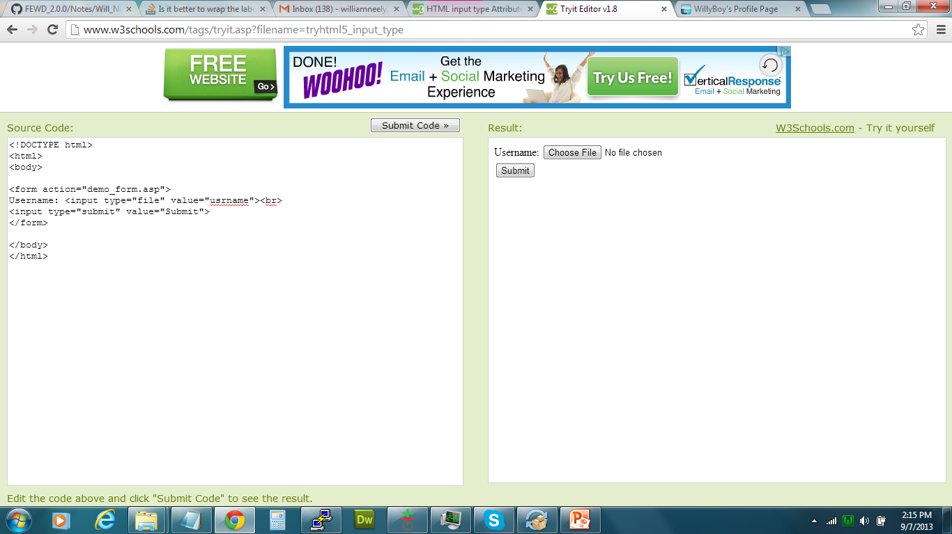

Submit, file, and button
<input type=“submit” value=“Submit”>
Value is button text
Defaults to submit in chrome, submit query in IE
<input type=“file”>
Creates a file upload element
<input type=“button”>
Creates clickable button

Slide 9
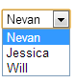
Select and option
<select></select>
Needs name
<option value=“1”>One</option>
Ex:
<select>
<option value=“thing1”>thing1</option>
<option value=“thing2”>thing2</option>
</select>

Slide 10
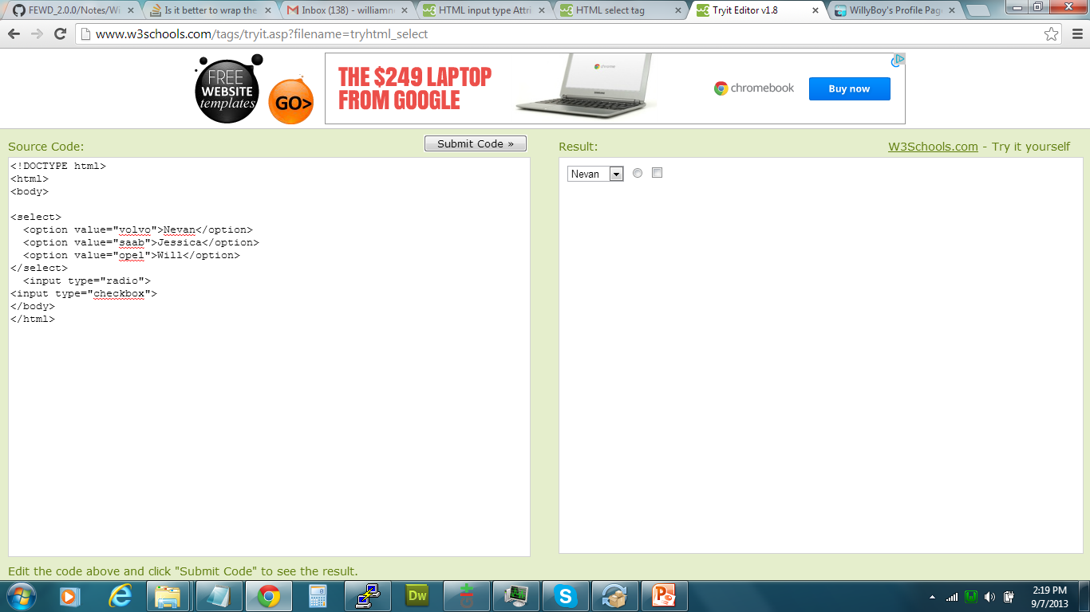
Radio buttons and checkboxes
<input type=“radio”>
Group using “name” attribute
Can only select one option
Use value to define
<input type=“checkbox”>
Group using “name” attribute
Select more than one option
Use value to define
<input type=“radio” name=“restaurants” value=“cbc”>Cambridge Brewing company
<input type=“radio” name=“restaurants” value=“pizzaHut”>Pizza hut

Slide 11
Labels
Information about the input field should be put in a <label> tag
<label>Name</label><input type=“text” name=“yourName”>
To tie the two together choose one of these methods:
<label>Name <input type=“text” name=“yourName”></label>
<label for=“yourName”>Name</label><input type=“text” name=“yourName” id=“yourName”>
Usability
Clicking the label text in either case places the focus in the input field (great for radio buttons)

Slide 12
Styling
Can’t be styled directly
Checkboxes, File upload inputs, Radio buttons
Number of ways to do this *instructor can cover all or just choose one
Opacity 0 on the element, set it’s height and width to define clickable area, set the height and width of it’s parent to be the same as the input (don’t forget position relative). Style the parent.
Hide the element, style a corresponding label how you wanted the element to appear
Try using pseudo elements and the selector :checked for no JS switching between checked and unchecked images used for styling

Slide 13
Lab
Optional: Form_Search (show ? Get params)
GA Application form

Slide 14
Optional: Fieldset/Legend
<fieldset>
Wrapper for grouped form elements
Ex: First, middle, last name text fields
<legend>
Goes inside fieldset
Defines the grouping term for the fieldset
<fieldset>
<legend>Your Name</legend>
<input type=“text” name=“first_name”>
<input type=“text” name=“middle_name”>
<input type=“text” name=“last_name”>
</fieldset>

Slide 15
Optional: Validation
Use library or simple if/else statements
Parsley.js is an easy library to show off

