Slide 1
Intermittent Fault Diagnosis in industrial systems

Slide 2
Introduction
Systems can be subject to failure events.
Intermittent faults can be hard to detect.
Goal is to diagnose intermittent faults given a system description.

Slide 3
Definitions
1
u
a
A system is abstracted as Discrete Event System.
Events = Σ = {a, b, c, u, f, r}.
Observable events: O = {a, b, c}.
Unobservable events: U = {u, f, r}.
2
3
a
f
4
5
c
b
b
c
6
7
r
8

Slide 4
Definitions
1
u
a
Fault events: F = {f}.
Recovery events: R = {r}.
Faults and recoveries are unobservable events.
Event trace: a sequence of events.
2
3
a
f
4
5
c
b
b
c
6
7
r
8

Slide 5
The problem
1
u
a
Trace 1 (Normal behavior):
u a b c b c … = ua(bc)*
Trace 2 (Faulty behavior):
a f b r c f b r c .. = a(fbrc)*
But what we can see is:
Trace 1 = Trace 2 = a(bc)*
In this case, the system is not diagnosable.
2
3
a
f
4
5
c
b
b
c
6
7
r
8

Slide 6
The algorithm
Declare each system’s state as «normal», «faulty» or «recovery», obtaining a labeled FSA.
Compute the model of the labeled FSA’s observable behavior, called projection.
Compute the product automaton of the projection with itself, called twin plant.
Check the presence of particular type of cycles in the twin plant.

Slide 7
Step 1: Labeled FSA
1. Labeling scheme
Σ\F
Σ\R
Σ\F
F
N
F
R
1N
F
u
a
R
PRODUCT
2N
3N
1
2. System model
a
u
a
f
4N
5F
2
3
c
b
f
a
f
b
4
5
6N
7F
3R
c
b
b
c
r
c
6
7
8R
r
8

Slide 8
Step 2: Projection
1N
u
a
1N
a
a
2N
3N
PROJECTION
4N
3N
a
f
c
b
b
4N
5F
f
6N
7F
c
b
b
6N
7F
3R
c
b
r
3R
c
8R

Slide 9
Step 3: Twin plant
Compute the product automaton of the projection with itself.
Among the states of the new automaton there can be:
NF-States, where the first label is N and the second one is F;
N*-States, where the first label is N and the second one can be anything.
(1N)(1N)
a
a
(4N)(4N)
(4N)(3N)
c
b
b
(6N)(6N)
(6N)(7F)
c
b
(4N)(3R)

Slide 10
Step 4: Verification
The system is diagnosable iff there is no cycle C = (q1, q2, .., qn, qn+1 = q1) such that:
1 ≤ i ≤ n, qi ∈ C is a N*-state
∃ j qj ∈ C is a NF-state
(1N)(1N)
a
a
(4N)(4N)
(4N)(3N)
c
b
b
(6N)(6N)
(6N)(7F)
c
b
(4N)(3R)

Slide 11
NuSMV Implementation
All the four steps can be executed inside NuSMV.
5 modules, 4 of which are reusable.
System
Labeling
Scheme
Labeled FSA
Projection
Twin Plant

Slide 12
NuSMV Implementation: Labeled FSA
1
u
a
2
3
Σ\F
Σ\R
Σ\F
a
f
4
5
F
c
b
b
c
N
F
R
F
6
7
R
r
8

Slide 13
NuSMV Implementation: Labeled FSA
1
u
a
2
3
Σ\F
Σ\R
Σ\F
a
f
4
5
F
c
b
b
c
N
F
R
F
6
7
R
r
8

Slide 14
NuSMV Implementation: Labeled FSA
1
u
a
2
3
Σ\F
Σ\R
Σ\F
a
f
4
5
F
c
b
b
c
N
F
R
F
6
7
R
r
8

Slide 15
NuSMV Implementation: Labeled FSA
1
u
a
2
3
Σ\F
Σ\R
Σ\F
a
f
4
5
F
c
b
b
c
N
F
R
F
6
7
R
r
8

Slide 16
NuSMV Implementation: Labeled FSA
1
u
a
2
3
Σ\F
Σ\R
Σ\F
a
f
4
5
F
c
b
b
c
N
F
R
F
6
7
R
r
8

Slide 17
NuSMV Implementation: Labeled FSA
1
u
a
2
3
Σ\F
Σ\R
Σ\F
a
f
4
5
F
c
b
b
c
N
F
R
F
6
7
R
r
8

Slide 18
NuSMV Implementation: Labeled FSA
1
u
a
2
3
Σ\F
Σ\R
Σ\F
a
f
4
5
F
c
b
b
c
N
F
R
F
6
7
R
r
8

Slide 19
NuSMV Implementation: Labeled FSA
1
u
a
2
3
Σ\F
Σ\R
Σ\F
a
f
4
5
F
c
b
b
c
N
F
R
F
6
7
R
r
8

Slide 20
NuSMV Implementation: Labeled FSA
1
u
a
2
3
Σ\F
Σ\R
Σ\F
a
f
4
5
F
c
b
b
c
N
F
R
F
6
7
R
r
8

Slide 21
NuSMV Implementation: Labeled FSA
1
u
a
2
3
Σ\F
Σ\R
Σ\F
a
f
4
5
F
c
b
b
c
N
F
R
F
6
7
R
r
8

Slide 22
NuSMV Implementation: Labeled FSA
1
u
a
2
3
Σ\F
Σ\R
Σ\F
a
f
4
5
F
c
b
b
c
N
F
R
F
6
7
R
r
8

Slide 23
NuSMV Implementation: Projection
Σ\F
Σ\R
Σ\F
F
N
F
R
1N
F
R
1
u
a
2
3
a
f
4
5
c
b
b
c
6
7
r
8

Slide 24
NuSMV Implementation: Projection
Σ\F
Σ\R
Σ\F
F
N
F
R
1N
F
a
R
3N
1
u
a
2
3
a
f
4
5
c
b
b
c
6
7
r
8

Slide 25
NuSMV Implementation: Projection
Σ\F
Σ\R
Σ\F
F
N
F
R
1N
F
a
R
3N
1
u
a
2
3
a
f
4
5
c
b
b
c
6
7
r
8

Slide 26
NuSMV Implementation: Projection
Σ\F
Σ\R
Σ\F
F
N
F
R
1N
F
a
R
3N
1
u
a
2
3
a
f
4
5
c
b
b
c
6
7
r
8

Slide 27
NuSMV Implementation: Projection
Σ\F
Σ\R
Σ\F
F
N
F
R
1N
F
a
R
3N
1
u
a
2
3
a
f
4
5
c
b
b
c
6
7
r
8

Slide 28
NuSMV Implementation: Projection
Σ\F
Σ\R
Σ\F
F
N
F
R
1N
F
a
R
3N
1
b
u
a
7F
2
3
a
f
4
5
c
b
b
c
6
7
r
8

Slide 29
NuSMV Implementation: Projection
Σ\F
Σ\R
Σ\F
F
N
F
R
1N
F
a
R
3N
1
b
u
a
7F
2
3
a
f
4
5
c
b
b
c
6
7
r
8

Slide 30
NuSMV Implementation: Projection
Σ\F
Σ\R
Σ\F
F
N
F
R
1N
F
a
R
3N
1
b
u
a
7F
2
3
a
f
4
5
c
b
b
c
6
7
r
8

Slide 31
NuSMV Implementation: Projection
Σ\F
Σ\R
Σ\F
F
N
F
R
1N
F
a
R
3N
1
b
u
a
7F
2
3
a
f
4
5
c
b
b
c
6
7
r
8

Slide 32
NuSMV Implementation: Projection
Σ\F
Σ\R
Σ\F
F
N
F
R
1N
F
a
R
3N
1
b
u
a
7F
2
3
a
f
c
4
5
3R
c
b
b
c
6
7
r
8

Slide 33
NuSMV Implementation: Projection
Σ\F
Σ\R
Σ\F
F
N
F
R
1N
F
a
R
3N
1
b
u
a
7F
2
3
a
f
c
4
5
3R
c
b
b
c
6
7
r
8

Slide 34
NuSMV Implementation: Projection
Σ\F
Σ\R
Σ\F
F
N
F
R
1N
F
a
R
3N
1
b
u
a
7F
2
3
a
f
c
4
5
3R
c
b
b
c
6
7
r
8

Slide 35
NuSMV Implementation: Projection
Σ\F
Σ\R
Σ\F
F
N
F
R
1N
F
a
R
3N
1
b
u
a
7F
2
3
a
f
c
4
5
3R
c
b
b
c
6
7
r
8

Slide 36
NuSMV Implementation: Projection
Σ\F
Σ\R
Σ\F
F
N
F
R
1N
F
a
R
3N
1
b
u
a
7F
2
3
a
f
b
c
4
5
3R
c
b
b
c
6
7
r
8

Slide 37
NuSMV Implementation: Projection
Σ\F
Σ\R
Σ\F
F
N
F
R
1N
F
a
R
3N
1
b
u
a
7F
2
3
a
f
b
c
4
5
3R
c
b
b
c
6
7
r
8

Slide 38
NuSMV Implementation: Twin Plant
We are looking for the product automaton of these automata.
1N
1N
a
a
a
a
3N
4N
3N
4N
b
c
b
b
c
b
7F
6N
7F
6N
b
c
b
c
3R
3R

Slide 39
NuSMV Implementation: Twin Plant
..but the actual system is the labeled automaton.
1N
1N
u
a
u
a
2N
3N
2N
3N
a
f
a
f
4N
5F
4N
5F
c
b
f
c
b
f
b
b
6N
7F
3R
6N
7F
3R
r
c
r
c
8R
8R

Slide 40
NuSMV Implementation: Twin Plant
How do we do that? Controlling the evolution of the instances of the system.
Given the two instances I₁, I₂, and the respective current events e₁, e₂:
They both move if e₁ = e₂, and events lead to explicit transitions or
I_{j} moves independently if e_{j} is an explicit transition and e_{j} is unobservable.

Slide 41
NuSMV Implementation: Twin Plant
Let’s see a small part of the product computation.
1N
1N
u
a
u
a
2N
3N
2N
3N
a
f
a
f
4N
5F
4N
5F
c
b
f
c
b
f
b
b
6N
7F
3R
6N
7F
3R
r
c
r
c
8R
8R

Slide 42
NuSMV Implementation: Twin Plant
Let’s see a small part of the product computation.
1N
1N
u
a
u
a
2N
3N
2N
3N
a
f
a
f
4N
5F
4N
5F
c
b
f
c
b
f
b
b
6N
7F
3R
6N
7F
3R
r
c
r
c
8R
8R

Slide 43
NuSMV Implementation: Twin Plant
Let’s see a small part of the product computation.
1N
1N
u
a
u
a
2N
3N
2N
3N
a
f
a
f
4N
5F
4N
5F
c
b
f
c
b
f
b
b
6N
7F
3R
6N
7F
3R
r
c
r
c
8R
8R

Slide 44
NuSMV Implementation: Twin Plant
Let’s see a small part of the product computation.
1N
1N
u
a
u
a
2N
3N
2N
3N
a
f
a
f
4N
5F
4N
5F
c
b
f
c
b
f
b
b
6N
7F
3R
6N
7F
3R
r
c
r
c
8R
8R

Slide 45
NuSMV Implementation: Twin Plant
Let’s see a small part of the product computation.
1N
1N
u
a
u
a
2N
3N
2N
3N
a
f
a
f
4N
5F
4N
5F
c
b
f
c
b
f
b
b
6N
7F
3R
6N
7F
3R
r
c
r
c
8R
8R

Slide 46
NuSMV Implementation: Twin Plant
Let’s see a small part of the product computation.
1N
1N
u
a
u
a
2N
3N
2N
3N
a
f
a
f
4N
5F
4N
5F
c
b
f
c
b
f
b
b
6N
7F
3R
6N
7F
3R
r
c
r
c
8R
8R

Slide 47
Verification on Twin Plant
For the system to be fault diagnosable, the twin plant must not have a cycle composed of N*-state, where at least one of them is a NF-state.
Likewise for establishing if the system is recovery-diagnosable.
(1N)(1N)
a
a
(4N)(4N)
(4N)(3N)
c
b
b
(6N)(6N)
(6N)(7F)
LTLSPEC ! F G (explicit_transitions &
p1.label = NORMAL & F(p2.label = FAULT));
c
b
(4N)(3R)

Slide 48
Verification on Twin Plant
But if the system is F-diagnosable then it should be R-diagnosable.
LTLSPEC
! F G (explicit_transitions & p1.label = NORMAL & F(p2.label = FAULT))
=>
! F G (explicit_transitions & p1.label = NORMAL & F(p2.label = RECOVERY))

Slide 49
Verification on the input system
Safety
At least one observable event exists between:
the occurrence of a fault event and its corresponding recovery event
LTLSPEC G (transition_type = fault -> ( G (!implicit_transition_taken) ->
F (transition_type = visible & F(transition_type = recovery))));
the occurrence of a recovery event and a new occurrence of the fault event
LTLSPEC G (transition_type = recovery -> ( G (! implicit_transition_taken) ->
F (transition_type = visible & F(transition_type = fault))));

Slide 50
Verification on the input system
Safety
Each occurrence of fault event is followed by the occurrence of its corresponding recovery event within a finite delay
LTLSPEC G (transition_type = fault -> (G (!implicit_transition_taken) - >
F(transition_type = recovery)));
Each occurrence of a recovery event is followed by a new occurrence of the fault event within a finite delay
LTLSPEC G (transition_type = recovery -> (G (!implicit_transition_taken) - >
F(transition_type = fault)));

Slide 51
Verification on the input system
Liveness
The system cannot reach a point at which no event is possible.
LTLSPEC ! F G (implicit_transition_taken);
Safety
There does not exist in G any cycle of unobservable events.
LTLSPEC ! F G (! implicit_transition_taken & transition_type ! = visible);

Slide 52
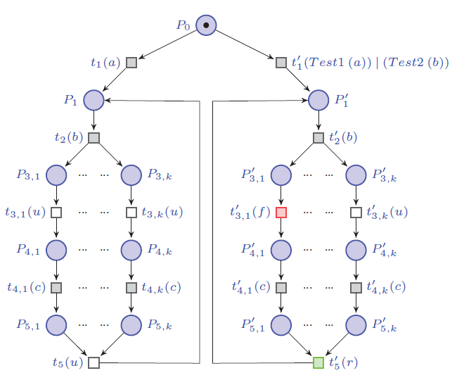
Testing and results: benchmark

Slide 53
Testing and results: experimental results
The following table shows the results obtained by the paper’s authors.
 | K | Nodes in RG | Nodes Twin Plant | Time for plant generation | Time for checking | Total time
Test 1 | 3 | 131 | 294 | 0,02s | 0,02s | 0,04s
 | 4 | 515 | 1542 | 0,17s | 0,28s | 0,45s
 | 5 | 2015 | 7686 | 3,04s | 2,70s | 5,74s
 | 6 | 8195 | 36870 | 57s | 361s | 418s
Test 2 | 3 | 131 | 294 | 0,01s | 0,02s | 0,03s
 | 4 | 515 | 1542 | 0,17s | 0,14s | 0,31s
 | 5 | 2015 | 7686 | 4,22s | 2,12s | 6,34s
 | 6 | 8195 | 36870 | 63s | 290s | 353s

Slide 54
Testing and results: experimental results
…and these are our results.
 | K | Nodes in RG | BDD Nodes | Reachable states | Time for checking
Test 1 | 3 | 57 | 947534 | 492040 | 0,51s
 | 4 | 164 | 515915 | 2^22.4979 | 3,16s
 | 5 | 488 | 1316319 | 2^25.9768 | 22,36s
 | 6 | 1460 | 3988872 | 2^29.3812 | 100s
Test 2 | 3 | 57 | 695081 | 239620 | 0,26s
 | 4 | 164 | 492381 | 2^21.4943 | 1,07s
 | 5 | 488 | 1286325 | 2^24.993 | 5,9s
 | 6 | 1460 | 3582845 | 2^28.409 | 31,9s

Slide 55
Testing and results: experimental results

Slide 56
Testing and results: experimental results

Slide 57
Testing and results: experimental results

Slide 58
Testing and results: experimental results

Slide 59
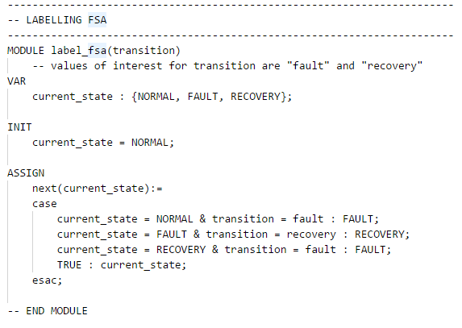
The code

Slide 60
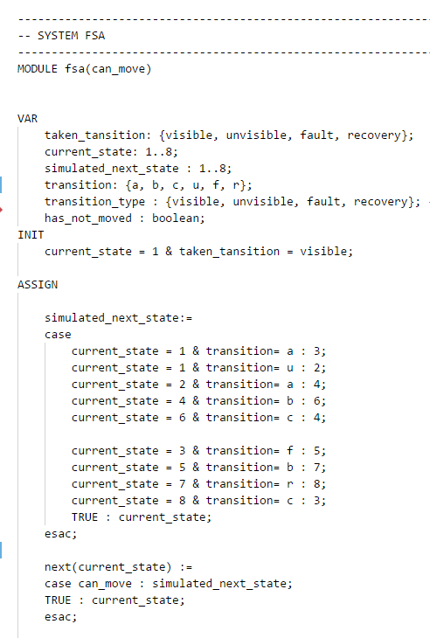
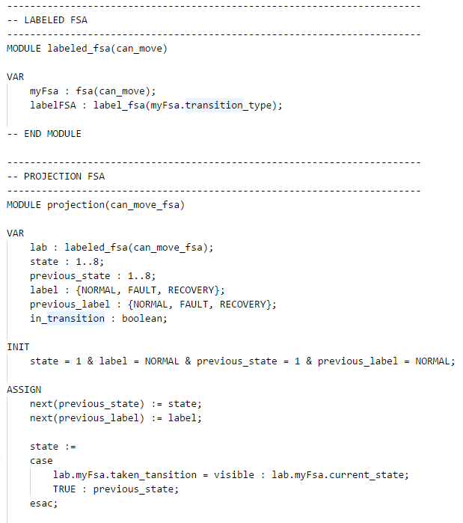

Slide 61
