Slide 1
Liver lesion segmentation based on weak labels
By Harald Lykke Joakimsen

Slide 2
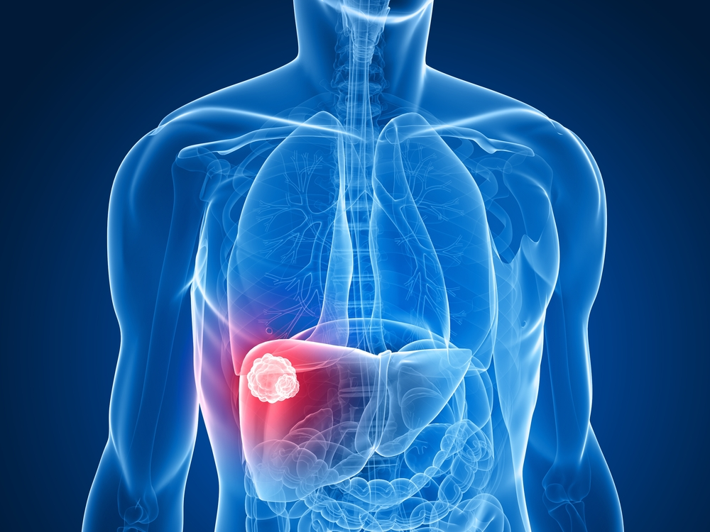
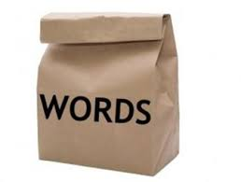
Long Term Goal
CT images, text labels
Real world data

Slide 3
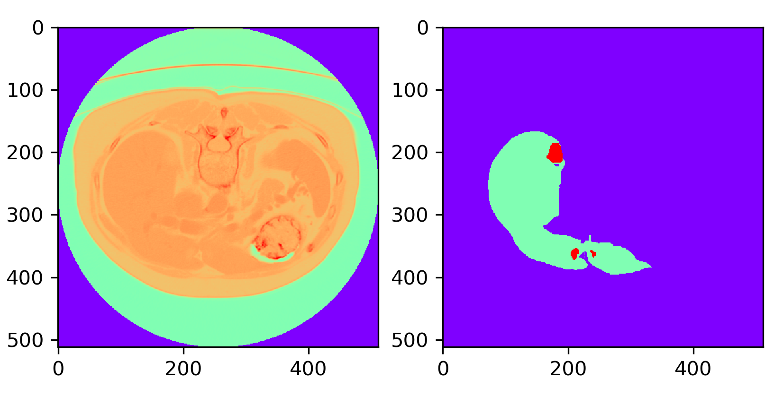
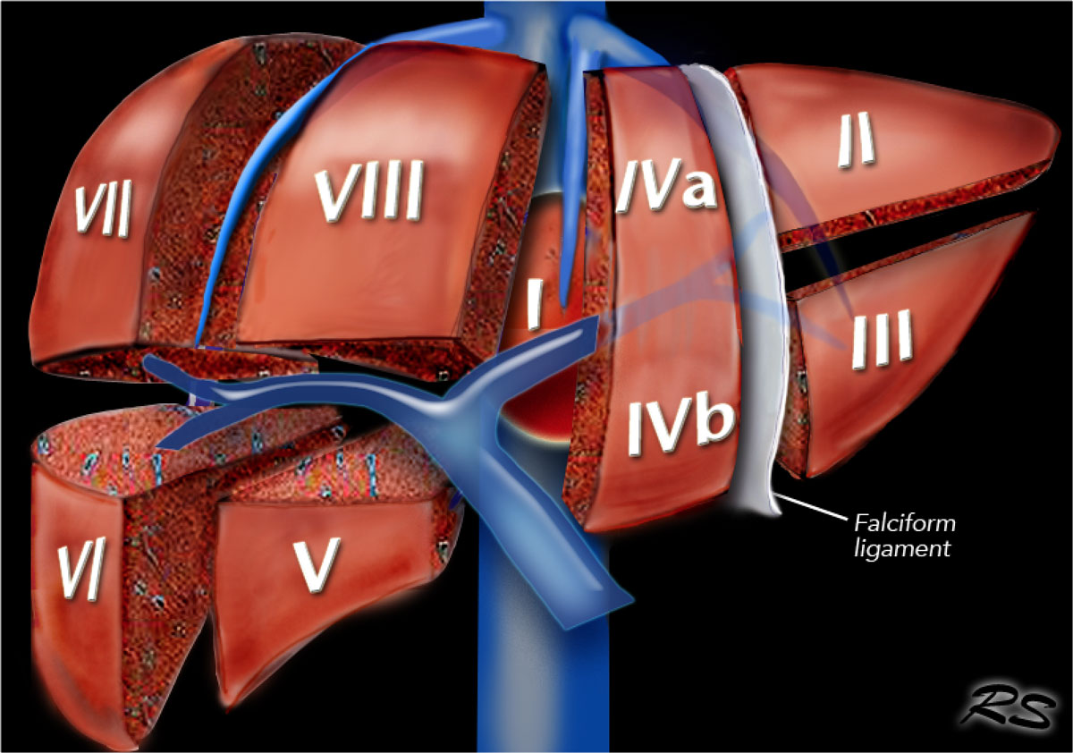
My Approach
LiTS
Limit label information

Slide 4
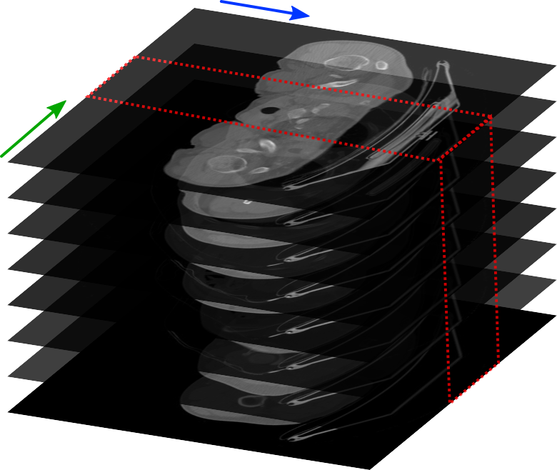
Today
LiTS solution
Image processing
  Big data(512x512x170+)
  Slice resampling

