Slide 1

Detect 'em!
Tensorflow on RPi3

Slide 2
What?
IP webcam(s)
RPi3
store images on disk only if following present
  cat/dog (sneaky little buggers!)
  burglar (any person if I'm not home)
in the past: OpenCV + diffs between images

Slide 3
How?
rapid advances in deep learning
no longer requires grunty GPUs to run on (sadly, still for training)
can detect objects in images
aim to run models on mobile phones, eg:
  TensorFlow Lite
  Caffee2Go
pre-trained models available

Slide 4
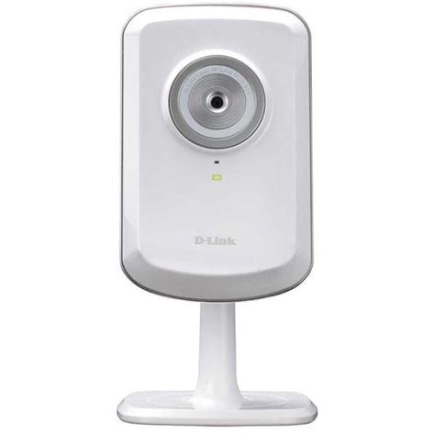

Network setup
192.168.1.103
192.168.1.101
WiFi Router
192.168.1.1

Slide 5
RPi setup
Instructions and code are based on:
  https://github.com/EdjeElectronics/TensorFlow-Object-Detection-on-the-Raspberry-Pi
  https://raw.githubusercontent.com/EdjeElectronics/TensorFlow-Object-Detection-on-the-Raspberry-Pi/master/Object_detection_picamera.py
Base image is Raspbian Stretch lite 2018-11-13:
  https://www.raspberrypi.org/downloads/raspbian/
  http://director.downloads.raspberrypi.org/raspbian_lite/images/raspbian_lite-2018-11-15/2018-11-13-raspbian-stretch-lite.zip

Slide 6
RPi setup (2)
Install packages to run Python virtual envs and TensorFlow
sudo apt-get install virtualenv
sudo apt-get install git
sudo apt-get install libatlas-base-dev
sudo apt-get install python3-tk python3-dev
sudo apt-get install libjpeg-dev libtiff5-dev libjasper-dev libpng12-dev
sudo apt-get install libavcodec-dev libavformat-dev libswscale-dev libv4l-dev
sudo apt-get install libxvidcore-dev libx264-dev
sudo apt-get install qt4-dev-tools
sudo apt-get install protobuf-compiler
sudo apt-get install libilmbase12
sudo apt-get install libopenexr22
sudo apt-get install ibgstreamer1.0-0

Slide 7
RPi setup (3)
create tensorflow dir:
  cd ~
  mkdir tf
  cd tf
get tensorflow (https://github.com/lhelontra/tensorflow-on-arm/releases):
  wget https://github.com/lhelontra/tensorflow-on-arm/releases/download/v1.8.0/tensorflow-1.8.0-cp35-none-linux_armv7l.whl
create virtualenv:
  virtualenv -p /usr/bin/python3.5 venv
  venv/bin/pip install tensorflow-1.8.0-cp35-none-linux_armv7l.whl
  venv/bin/pip install opencv-python
  venv/bin/pip install matplotlib
  venv/bin/pip install pillow

Slide 8
RPi setup (4)
clone tensorflow models:
  git clone --recurse-submodules https://github.com/tensorflow/models.git
update PYTHONPATH (~/.bashrc):
  export PYTHONPATH=$PYTHONPATH:/home/pi/tf/models/research:/home/pi/tf/models/research/slim

Slide 9
RPi setup (5)
compile the protobufs (for serializing structured data):
  cd ~/tf/models/research
  protoc object_detection/protos/*.proto --python_out=.
download SSD model from tensorflow model zoo:
  cd ~/tf/models/research/object_detection/
  wget http://download.tensorflow.org/models/object_detection/ssdlite_mobilenet_v2_coco_2018_05_09.tar.gz
  tar -xzvf ssdlite_mobilenet_v2_coco_2018_05_09.tar.gz
place object_detection_webcam.py in
  ~/tf/models/research/object_detection

Slide 10
Go!
change into
  ~/tf/models/research/object_detection
run the script
  ~/tf/venv/bin/python object_detection_webcam.py

