Slide 1
Intel Python vs Linux Mint Python
who is the fastest of them all?
Peter Reutemann

Slide 2
Background
Speeding up Python, using:
  Intel Math Kernel Library (Intel MKL) for BLAS and LAPACK
  Intel MKL vector math library for universal functions (uMath)
  Intel Data Analytics Acceleration Library (Intel DAAL) for machine learning and data analytics
  Integration with Intel Advanced Vector Extensions (Intel AVX), a feature of the latest Intel Xeon processors
https://software.intel.com/en-us/distribution-for-python/benchmarks

Slide 3
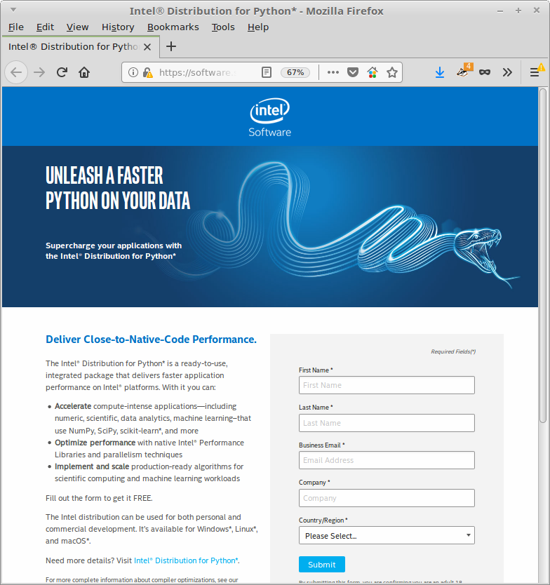
Download
https://software.seek.intel.com/python-distribution

Slide 4
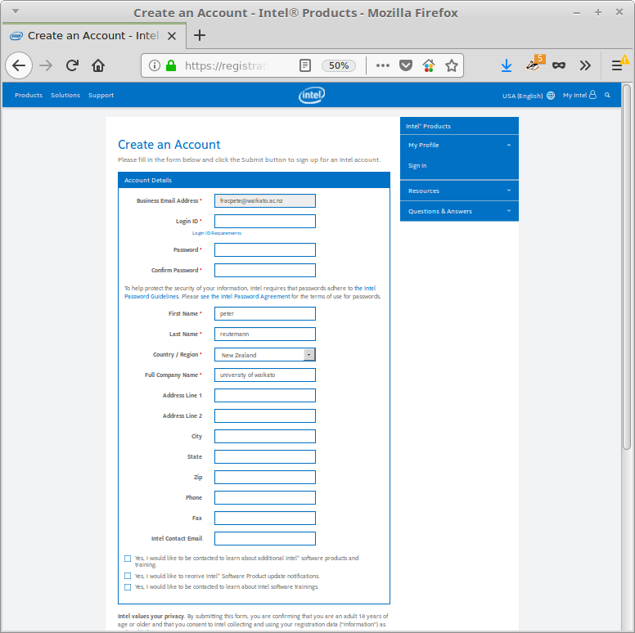
Download (2)
You need to
create an
account!

Slide 5
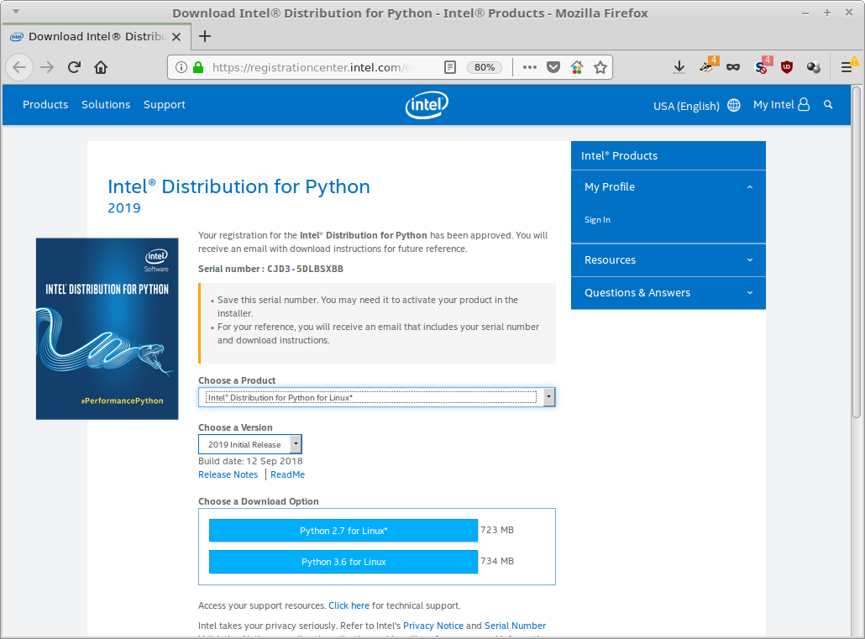
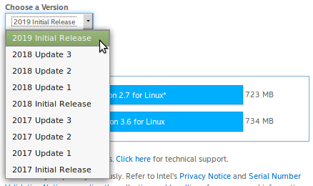
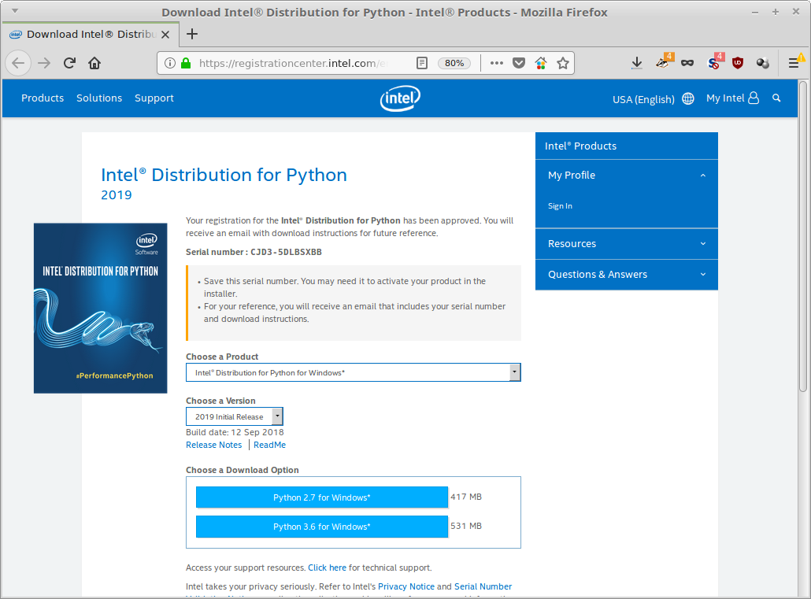
Download (3)
Available for Linux, OSX, Windows
Size: 420 - 730 MB

Slide 6
Testing
Linux Mint 18.2, Python 3.5
Intel Python 3, Python 3.6
using timeit module
  runs 1,000,000 times
tests
  list generation
  numpy matrix operations
  scipy linear algebra
inspired by Intel benchmarks
https://software.intel.com/en-us/distribution-for-python/benchmarks

Slide 7
Results
Test | Linux Mint | Intel Python
list with 1,000 elements | 24.335 | 29.399
list of 100 random numbers | 8.018 | 9.842
exp of 100 random numbers | 18.944 | 22.446
log10 of 100 random numbers | 20.692 | 23.854
sqrt of 100 random numbers | 15.866 | 20.772
random 100x100 matrix | 76.9 | 93.980
dot prod of two rand matrices (20x20) | 11.167 | 12.688
1000 normal dist random numbers | 40.841 | 43.698
1000 gamma dist random numbers | 68.015 | 69.726
array + scalar | 1.492 | 2.251
array - scalar | 1.584 | 2.049
array * scalar | 1.552 | 2.182
inverse of matrix | 49.827 | 58.822
fft and ifft | 35.680 | 48.088
LU decomposition | 8.488 | 10.358

Slide 8
Oh well...

