Slide 1
Introduction to MicroPython for Raspberry Pi Pico
Part 1 - Hardware
Hamilton Python Users Group
12 Dec 2022
Ian Stewart

Slide 2
MicroPython for Raspberry Pi Pico
Hardware:
ARM Cortex-M0+ Processor core
Raspberry Pi RP2040 Microcontroller Chip
Raspberry Pi Pico modules
Pico Kits, Addons, 3rd Party
Software:
C / C++
MicroPython
Pico Module
RP2040 Chip
Addons / Sensors
ARM Processors

Slide 3
ARM - Cortex-M0+
ARM Holdings. Formerly “Acorn RISC Machines” and “Advanced RISC Machines”.
ARM creates and licenses its technology as intellectual property.
Cortex-M0+:
32-bit RISC ARM processor core
Implements the ARMv6-M architecture
Optimized superset of the Cortex-M0.
Smallest ARM microcontrollers ,

Slide 4
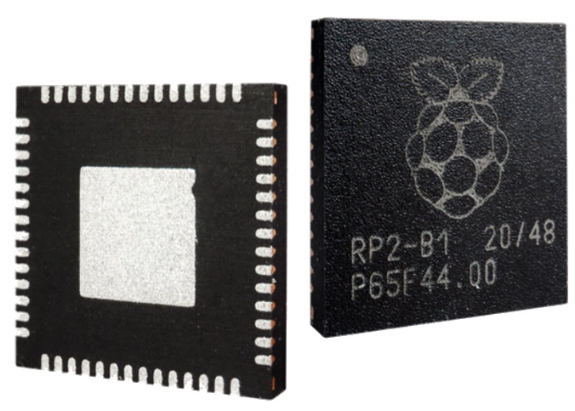
Raspberry Pi RP2040 Chip
PB Tech / Element14 ~$1.66
Designed by Raspberry Pi Ltd.
(~ not a Broadcom buy in)

Slide 5
RP2040
Dual ARM Cortex-M0+ @ 133MHz
264kB on-chip SRAM
Support for up to 16MB of off-chip Flash memory via dedicated QSPI bus
DMA controller
Fully-connected AHB crossbar
Interpolator and integer divider peripherals
On-chip programmable LDO to generate core voltage of 1.1V
2 on-chip PLLs to generate USB and core clocks
30 GPIO pins, 4 of which can be used as analogue inputs
Peripherals:
2 UARTs
2 SPI controllers
2 I2C controllers
16 PWM channels
USB 1.1 controller and PHY, with host and device support
8 PIO state machines
Abbreviations:
LDO Low DropOut Regulator
AHB Advanced High Perfromance Bus
PLL Phase Locked Loop
SPI Serial Peripheral Interface
GPIO General Purpose Input/Output
PIO Programmable Input/Output
PWM Pulse Width Modulation

Slide 6
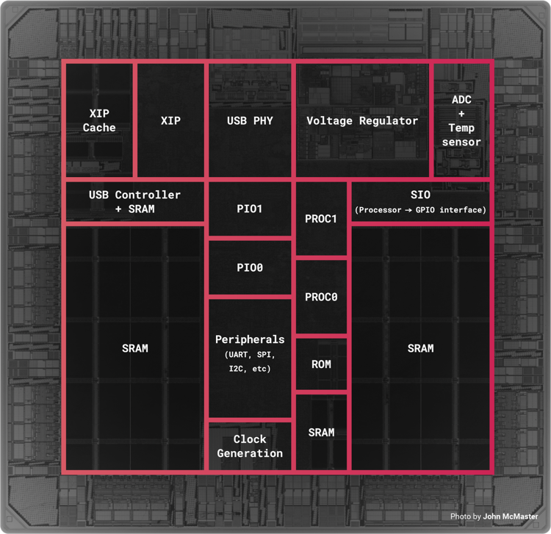
RP2040 Layout
R

Slide 7
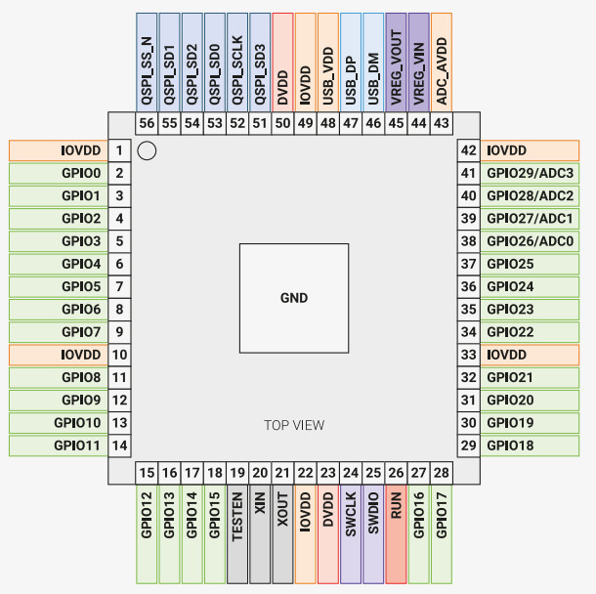
RP2040 Chip
4 x 14 pin = 56 pins
QFN-56 surface mount device
30 GPIO – 0 to 29
3.3V for the I/O
1.1V for the chip’s digital core
QFN Quad Flat No-leads

Slide 8
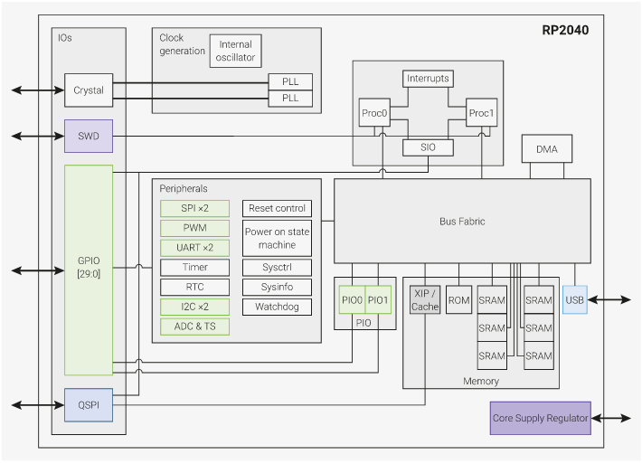
RP2040
RP

Slide 9

RP2040 – Model Numbering Scheme
Manfacturer – Raspberry Pi
Number of processor cores (2)
Loosely which type of processor (M0+)
floor(log2(ram / 16k))
floor(log2(nonvolatile / 16k)) or 0 if no onboard nonvolatile storage
>>> math.floor(math.log2(256000/16000))
4

Slide 10
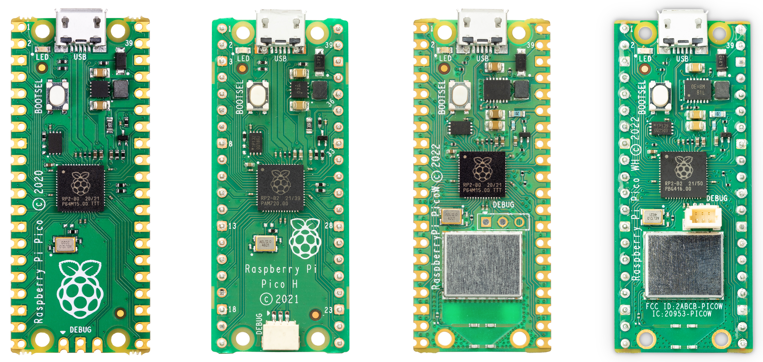
Raspbery Pi Pico - family of RP2040-based boards
Pico $8 Pico H $10 Pico W $12 Pico WH ?

Slide 11
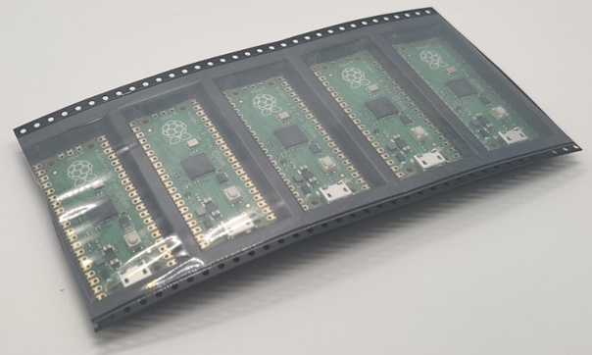
Raspbery Pi Pico – 5 Pack.

Slide 12
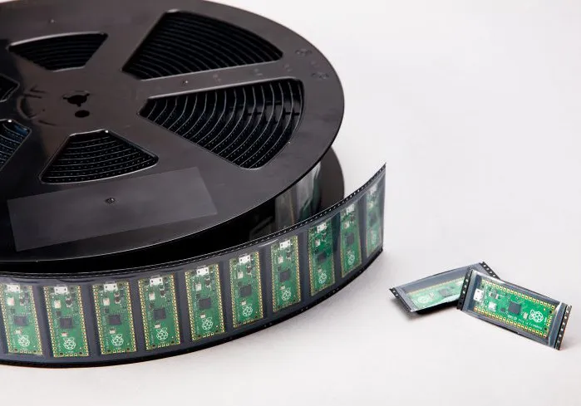
Raspbery Pi Pico – On a roll

Slide 13
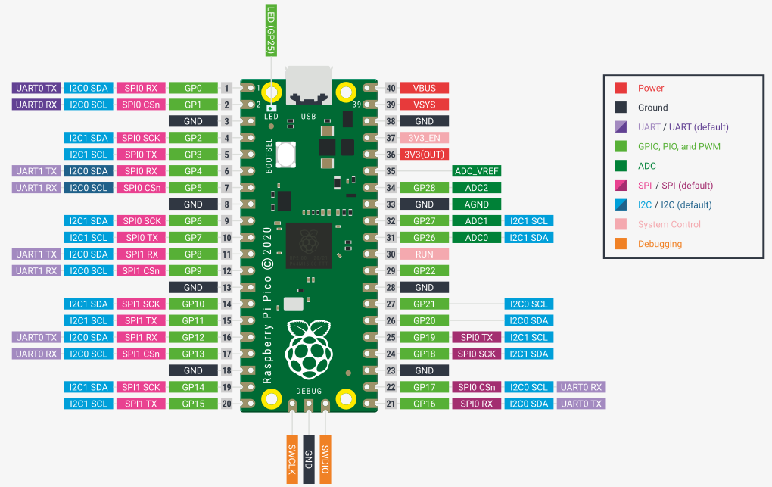
Raspbery Pi Pico – connections

Slide 14
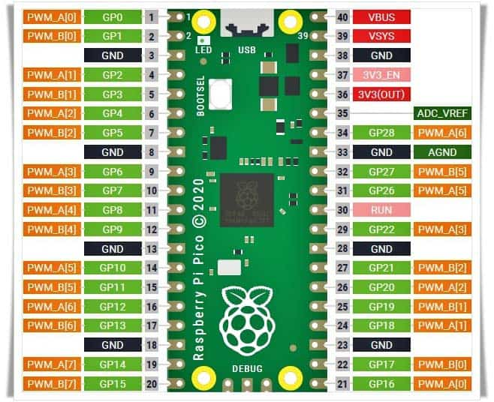
Raspbery Pi Pico - family of RP2040-based boards
PWM

Slide 15
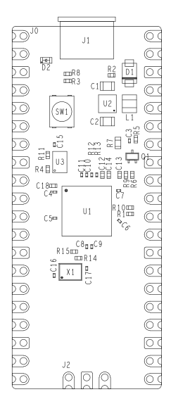
Raspbery Pi Pico
Operating Temp Max85°C
Operating Temp Min-20°C
VBUS5V ± 10%.
VSYS Min 1.8V
VSYS Max 5.5V
Current @5V < 100mA
Current Sleep Mode @5V 1.4mA
Size 51mm x 21mm
 | Model | Size | Vendor | Description
U1 | RP2040 | 7x7 | Raspberry Pi | 32-bit dual ARM Cortex-M0+ microcontroller
U2 | RT6150B-33GQW | 2.5x2.5 | Richtek | Buck-Boost Switching Regulator IC Positive Fixed 3.3V
U3 | W25Q16JVUXIQ | 2x3 | Winbond | 16M-bit 2M x 8 6ns
X1 | 12MHz | 3.2x2.5 | AEL | Crystal Oscillator

Slide 16
Raspbery Pi Pico – Components
3 x ICs: RP2040, +3.3V Regulator, 2MB Flash
18 x Capacitors
1 x Crystal (12MHz)
2 x Diodes (1 x LED)
1 x Mosfet
1 x Inductor
15 x Resistors
1 x Switch
6 x Test Points

Slide 17
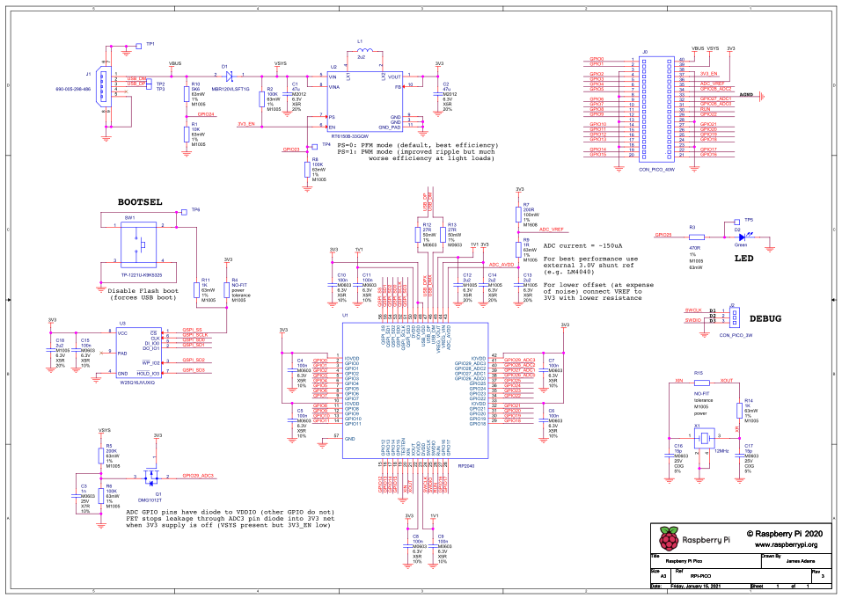
Raspbery Pi Pico – Schematic
29
ADC4 – Monitor CPU Temperature

Slide 18
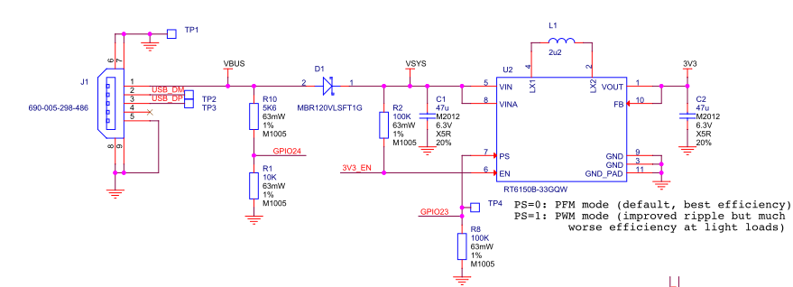
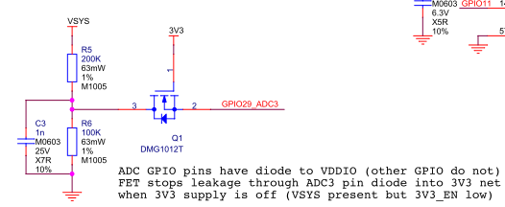
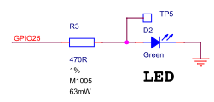
Raspbery Pi Pico – RP2040 GPIO used by Pico
24
23
25
29
ADC4 – Monitor CPU Temperature internal to RP2040

Slide 19
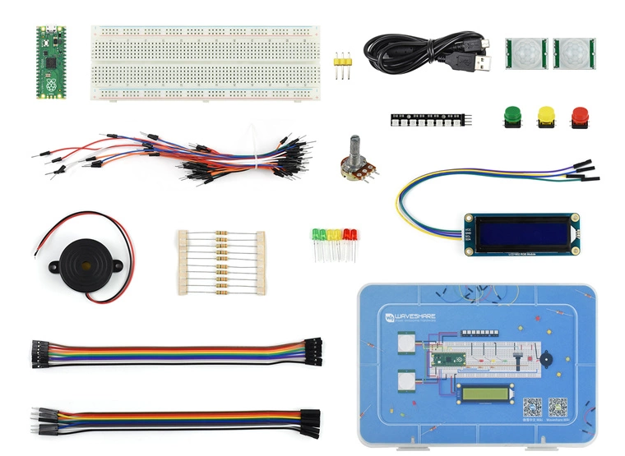
Raspbery Pi Pico – addons / evaluation kits
Kit Contents:
Raspberry Pi Pico With Header
LCD1602 RGB Module
PIR motion sensor
8-Bit WS2812 RGB LED
Alarm
Single-joint potentiometer
Round buttons
5mm LED
330R resistors
Breadboard and wires
Jumper wires
Plastic box
Basic Entry - Level Kit MicroPython Programming Learning Kit $73

Slide 20
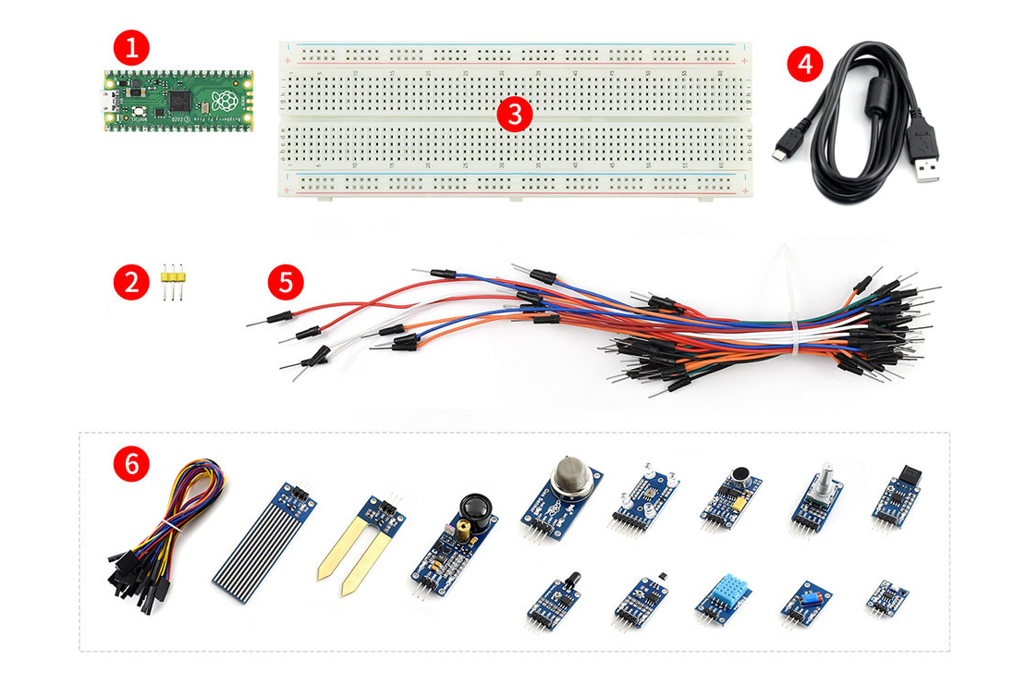
Raspbery Pi Pico – addons / evaluation kits
Sensors:
MQ-5 Gas
Color
Flame
Hall
Infrared Reflective
Laser
Moisture
Rotation
Sound
Temperature-Humidity
Tilt
UV
Liquid Level
Sensor Kit Development & Expansion Boards Kit Pack $110

Slide 21
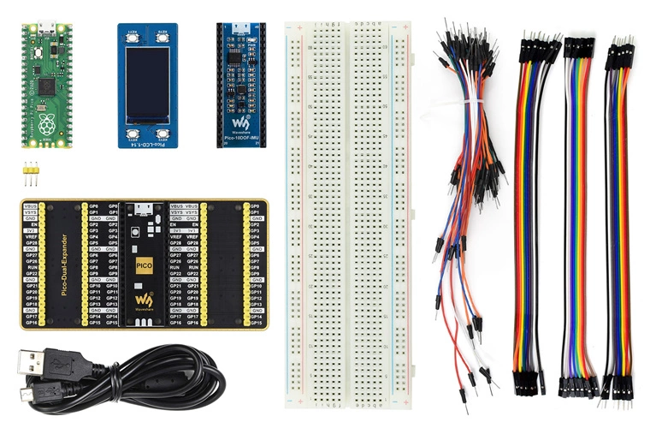
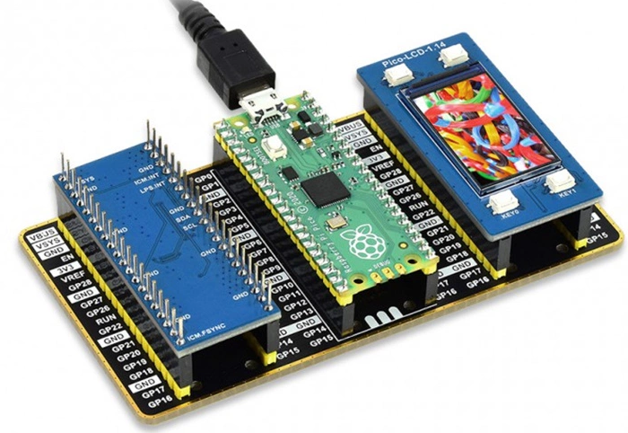
Raspbery Pi Pico – addons / evaluation kits
Evaluation Kit Type B The Pico + Colour LCD + IMU Sensor + GPIO Expander $100

Slide 22
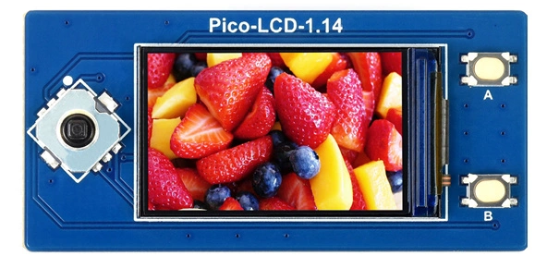
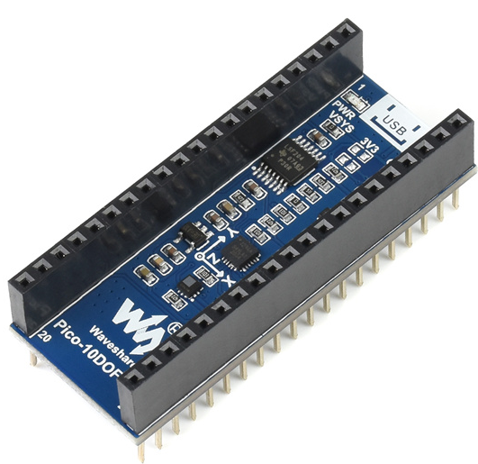
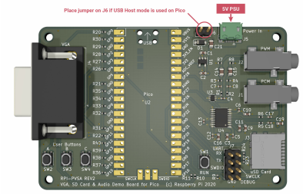
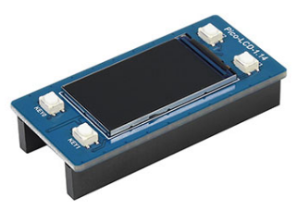
Raspbery Pi Pico – addons / evaluation kits
Sensor expansion module / LCD Displays

Slide 23
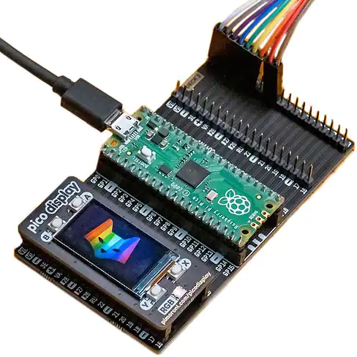
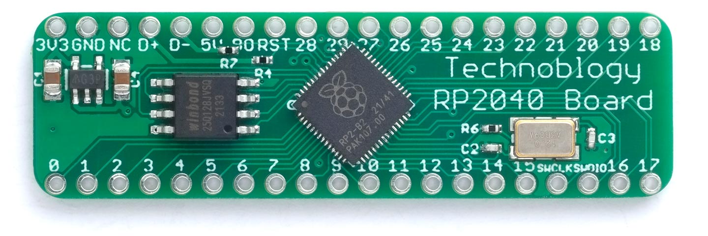
Raspbery Pi Pico – addons 3rd Party
Manufacturer Pimoroni Ltd
Manufacturer Product Number PIM556
Description PICO OMNIBUS (DUAL EXPANDER)
3rd Party 40pin Board – 30 x GPIO

Slide 24
GPIO IN/OUT Circuits
RP2040
Pico Module
+3.3V
Programmable
Pull-Down Resistor in RP2040
GPIO Pin
Programmable
Pull-Up Resistor in RP2040
Ground

Slide 25
GPIO Pin IN Pull-Down
RP2040
Pico Module
+3.3V
Programmable
Pull-Down Resistor in RP2040
GPIO Pin14
Switch 1.
Closed = On = Low = 0
Ground

Slide 26
GPIO Pin IN Pull-Up
RP2040
Pico Module
+3.3V
Switch 2.
Closed = On = High = 1
GPIO Pin 15
Programmable
Pull-Up Resistor in RP2040
Ground

Slide 27
GPIO Pin OUT on Pico Module
Pico Module
RP2040
GPIO Pin25
LED
Ground

Slide 28
GPIO Pin OUT on Pico Module.
GPIO Pin OUT
External
Pico Module
GPIO Pin16
RP2040
100~470Ω
LED
GPIO Pin25
470Ω
LED
Ground

Slide 29
Part 1 End.
Demo Hardware.

