Slide 1
Introduction to MicroPython for Raspberry Pi Pico
Part 2 - Software
Hamilton Python Users Group
12 Dec 2022
Ian Stewart

Slide 2
What is MicroPython?
Full implementation of the Python 3 programming language that runs directly on embedded hardware like Raspberry Pi Pico.
Interactive prompt (the REPL) to execute commands immediately via USB Serial port, and a built-in filesystem.
The Pico port of MicroPython includes modules for accessing low-level chip-specific hardware.
Documentation:
  https://www.raspberrypi.com/documentation/microcontrollers/micropython.html
  Demo of how to install to Pico module
Website:
  https://micropython.org
Download Micropython for Pico:
  https://micropython.org/download/rp2-pico/

Slide 3
What is Thonny?
Python IDE for Beginners.
Written in Tkinter
Website:
  https://github.com/thonny/thonny/wiki/Linux
Installation:
  sudo apt install python3-tk thonny
  pip install thonny

Slide 4
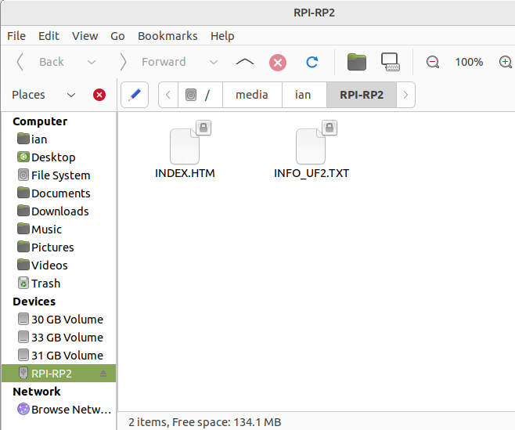
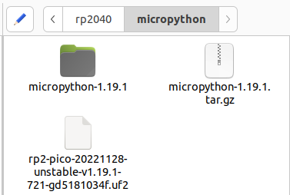
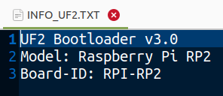
Plug in USB cable and release button
Drag and Drop .uf2 file into RPI-RP2 folder
After downloading – auto reboots

Slide 5
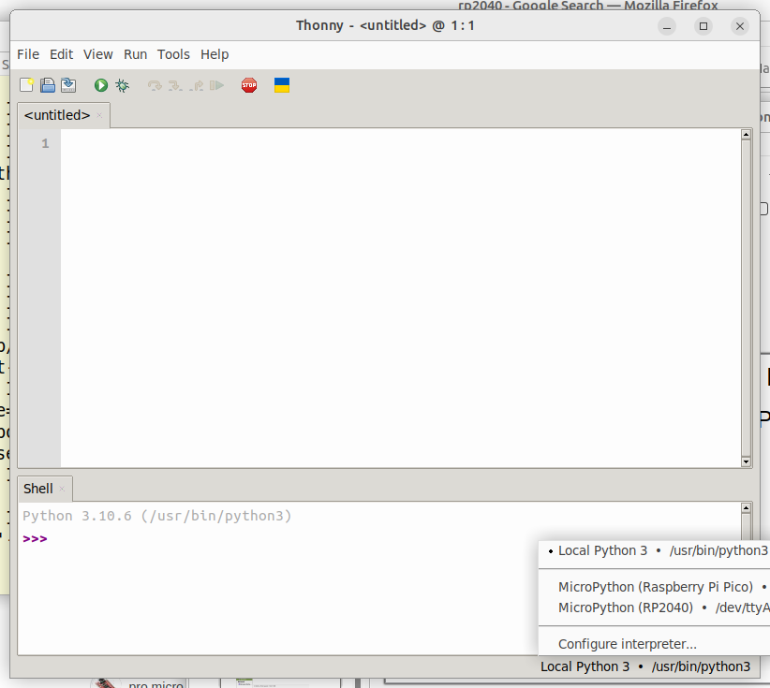
Thonny
Select connection to Raspberry Pi Pico

Slide 6
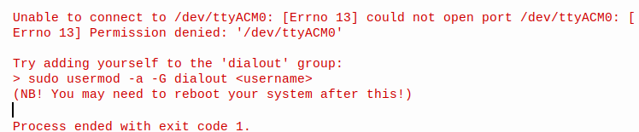
Thonny not connecting to Pico via USB?
Error message:
Allow Account to have Dialout:
ian@dell:~$ sudo usermod -a -G dialout ian
[sudo] password for ian:
ian@dell:~$ reboot

Slide 7
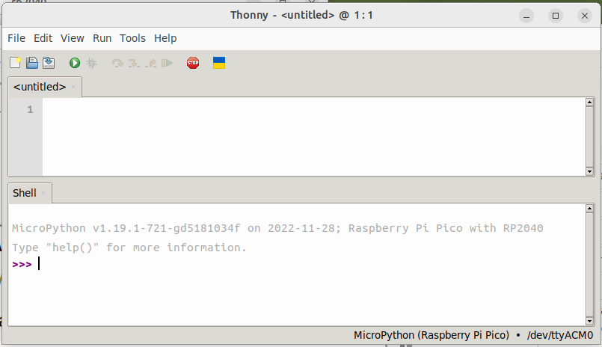
MicroPython REPL >>> on Pico

Slide 8
MicroPython >>> help() 1/3
Welcome to MicroPython!
For online help please visit https://micropython.org/help/.
For access to the hardware use the 'machine' module. RP2 specific commands
are in the 'rp2' module.
Quick overview of some objects:
machine.Pin(pin) -- get a pin, eg machine.Pin(0)
machine.Pin(pin, m, [p]) -- get a pin and configure it for IO mode m, pull mode p
methods: init(..), value([v]), high(), low(), irq(handler)
machine.ADC(pin) -- make an analog object from a pin
methods: read_u16()

Slide 9
MicroPython >>> help() 2/3
machine.PWM(pin) -- make a PWM object from a pin
methods: deinit(), freq([f]), duty_u16([d]), duty_ns([d])
machine.I2C(id) -- create an I2C object (id=0,1)
methods: readfrom(addr, buf, stop=True), writeto(addr, buf, stop=True)
readfrom_mem(addr, memaddr, arg), writeto_mem(addr, memaddr, arg)
machine.SPI(id, baudrate=1000000) -- create an SPI object (id=0,1)
methods: read(nbytes, write=0x00), write(buf), write_readinto(wr_buf, rd_buf)
machine.Timer(freq, callback) -- create a software timer object
eg: machine.Timer(freq=1, callback=lambda t:print(t))

Slide 10
MicroPython >>> help() 3/3
Pins are numbered 0-29, and 26-29 have ADC capabilities
Pin IO modes are: Pin.IN, Pin.OUT, Pin.ALT
Pin pull modes are: Pin.PULL_UP, Pin.PULL_DOWN
Useful control commands:
CTRL-C -- interrupt a running program
CTRL-D -- on a blank line, do a soft reset of the board
CTRL-E -- on a blank line, enter paste mode
For further help on a specific object, type help(obj)
For a list of available modules, type help('modules')

Slide 11
MicroPython >>> help("modules")
>>> help(modules")
__main__ framebuf uasyncio/funcs ujson
_boot gc uasyncio/lock umachine
_boot_fat math uasyncio/stream uos
_onewire micropython ubinascii urandom
_rp2 neopixel ucollections ure
_thread onewire ucryptolib uselect
_uasyncio rp2 uctypes ustruct
builtins uarray uerrno usys
cmath uasyncio/__init__ uhashlib utime
dht uasyncio/core uheapq uzlib
ds18x20 uasyncio/event uio
Plus any modules on the filesystem
>>>

Slide 12
>>> dir()
>>> dir()
['machine', '__thonny_helper', 'usys', '__name__', 'rp2']
>>> dir(machine)
['__class__', '__name__', '__dict__', 'ADC', 'I2C', 'I2S', 'PWM', 'PWRON_RESET', 'Pin', 'RTC', 'SPI', 'Signal', 'SoftI2C', 'SoftSPI', 'Timer', 'UART', 'WDT', 'WDT_RESET', 'bitstream', 'bootloader', 'deepsleep', 'dht_readinto', 'disable_irq', 'enable_irq', 'freq', 'idle', 'lightsleep', 'mem16', 'mem32', 'mem8', 'reset', 'reset_cause', 'soft_reset', 'time_pulse_us', 'unique_id']
>>> dir(rp2)
['__class__', '__name__', 'const', '__dict__', '__file__', 'Flash', 'PIO', 'StateMachine', 'asm_pio_encode', 'PIOASMError', 'PIOASMEmit', 'asm_pio', '_pio_funcs']

Slide 13
>>> dir()
>>> import usys
>>> import sys
>>> dir(usys)
['__class__', '__name__', '__dict__', 'argv', 'byteorder', 'exit', 'implementation', 'maxsize', 'modules', 'path', 'platform', 'print_exception', 'ps1', 'ps2', 'stderr', 'stdin', 'stdout', 'version', 'version_info']
>>> dir(sys)
['__class__', '__name__', '__dict__', 'argv', 'byteorder', 'exit', 'implementation', 'maxsize', 'modules', 'path', 'platform', 'print_exception', 'ps1', 'ps2', 'stderr', 'stdin', 'stdout', 'version', 'version_info']

Slide 14
>>> sys.
>>> sys.version_info
(3, 4, 0)
>>> sys.version
'3.4.0; MicroPython v1.19.1-721-gd5181034f on 2022-11-28'
>>> sys.platform
'rp2'

Slide 15
>>> os.
>>> import os
>>> dir(os)
['__class__', '__name__', 'remove', '__dict__', 'VfsFat', 'VfsLfs2', 'chdir', 'getcwd', 'ilistdir', 'listdir', 'mkdir', 'mount', 'rename', 'rmdir', 'stat', 'statvfs', 'umount', 'uname', 'unlink', 'urandom']
>>> os.uname()
(sysname='rp2', nodename='rp2', release='1.19.1', version='v1.19.1-721-gd5181034f on 2022-11-28 (GNU 12.1.0 MinSizeRel)', machine='Raspberry Pi Pico with RP2040')

Slide 16
>>> os.
>>> os.getcwd()
'/'
>>> os.listdir()
['adc_temp.py', 'blink.py', 'get_info.py', 'pin16_blink.py', 'pwm_pin16.py', 'pwm_pin25.py', 'pwm_pin25_dimmer.py', 'rtc_time.py', 'switch.py', 'switch_interupt.py', 'switch_interupt_routine.py']
>>>
Python programs written by me and saved on the Pico’s 2MB of flash RAM

Slide 17
First Programs...
>>> print ("hello world")
hello world
>>> from machine import Pin
>>> led = Pin(25, Pin.OUT)
>>> led.on()
>>> led.off()
>>> from machine import Pin, Timer
>>> led = Pin(25, Pin.OUT)
>>> tim = Timer()
>>> def tick(timer):
global led
led.toggle()
>>> tim .init(freq=2.5, mode=Timer.PERIODIC, callback=tick)
Pin25 is for the LED on-board the Pico module

Slide 18
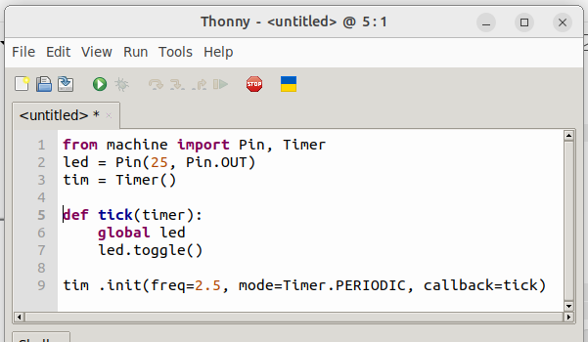
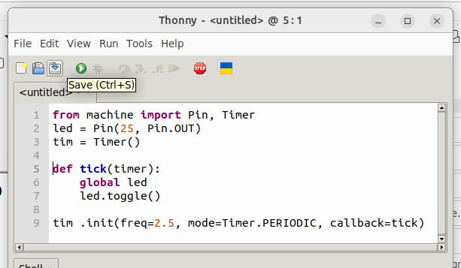
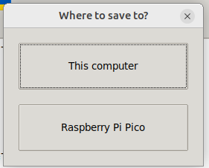
Saving program to Pico flash
“Click”

Slide 19
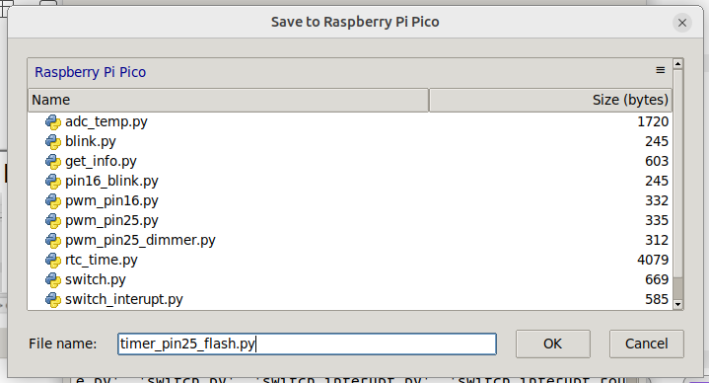
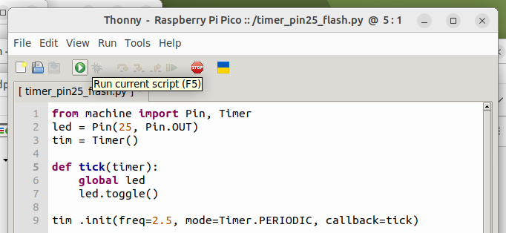
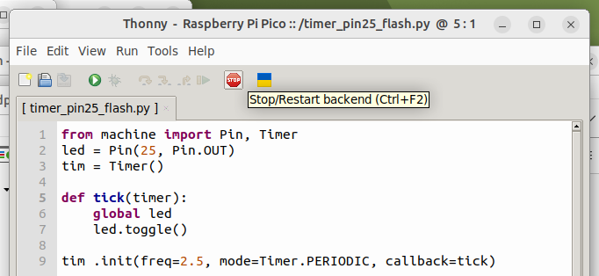
Saving program to Pico flash. Start / Stop
LED starts flashing
Give program a name

Slide 20
GPIO Pin OUT on Pico Module
Pico Module
RP2040
GPIO Pin25
LED
Ground
from machine import Pin
led = Pin(25, Pin.OUT)

Slide 21
GPIO Pin OUT on Pico Module.
GPIO Pin OUT
External
Pico Module
GPIO Pin16
RP2040
100~470Ω
GPIO Pin25
470Ω
LED
Ground
from machine import Pin
led = Pin(25, Pin.OUT)
led = Pin(16, Pin.OUT)

Slide 22
GPIO Pin IN Pull-Up / Pull-Down
RP2040
Pico Module
+3.3V
Switch 2.
Closed = On = High = 1
Programmable
Pull-Down Resistor in RP2040
GPIO Pin14
GPIO Pin 15
Switch 1.
Closed = On = Low = 0
Programmable
Pull-Up Resistor in RP2040
Ground

Slide 23
GPIO Pin IN
Pull-Up
Pull-Down
RP2040
Pico Module
+3.3V
Switch 2.
Closed = On = High = 1
Programmable
Pull-Down Resistor in RP2040
GPIO Pin14
GPIO Pin 15
Switch 1.
Closed = On = Low = 0
Programmable
Pull-Up Resistor in RP2040
Ground
from machine import Pin
switch_1 = Pin(14, Pin.IN, Pin.PULL_DOWN)
switch_2 = Pin(15, Pin.IN, Pin.PULL_UP)

Slide 24
GPIO Pin IN
Pull-Up Pull-Down
& Pin OUT
Pico Module
+3.3V
RP2040
Switch 2.
Closed = On = High = 1
Programmable
Pull-Down Resistor in RP2040
GPIO Pin14
GPIO Pin 15
GPIO Pin25
Programmable
Pull-Up Resistor in RP2040
LED
Ground
Switch 1.
Closed = On = Low = 0
from machine import Pin
switch_1 = Pin(14, Pin.IN, Pin.PULL_DOWN)
switch_2 = Pin(15, Pin.IN, Pin.PULL_UP)
led = Pin(25, Pin.OUT)

Slide 25
GPIO Pin IN
Pull-Up Pull-Down
& Pin OUT
Pico Module
+3.3V
GPIO Pin16
RP2040
Switch 2.
Closed = On = High = 1
Programmable
Pull-Down Resistor in RP2040
GPIO Pin14
GPIO Pin 15
GPIO Pin25
Programmable
Pull-Up Resistor in RP2040
LED
Ground
Switch 1.
Closed = On = Low = 0
switch_1 = Pin(14, Pin.IN, Pin.PULL_DOWN)
switch_2 = Pin(15, Pin.IN, Pin.PULL_UP)
led = Pin(25, Pin.OUT)
led = Pin(16, Pin.OUT)

Slide 26
MicroPython
Demos:
RTC
Switches
LEDs
PWM
Timer
Debouncing
Review MicroPython 1.19 source code

