Slide 1
PySide6 – Qt for Python
pyside6-assistant.py – Code Highlights
Hamilton Python Users Group
Ian Stewart
10 Oct 2022

Slide 2
PySide6 – Importing...
Previous programs: python-help, bash-help, pyqt6-help
Non-standard importing, so dir() function works.
Normal:
from PySide6.QtCore import QDate
Non-standard:
import PySide6.QtCore as QtCore
Can then get all Classes of the module. E.g:
dir(QtCore)
Can then get all attributes of a Class. dir(QtCore.QClass) E.g.:
  dir(QtCore.QDate)
Modules:46 Classes:1296 Total Attributes:127811
Attributes filtered out double_underscore.

Slide 3
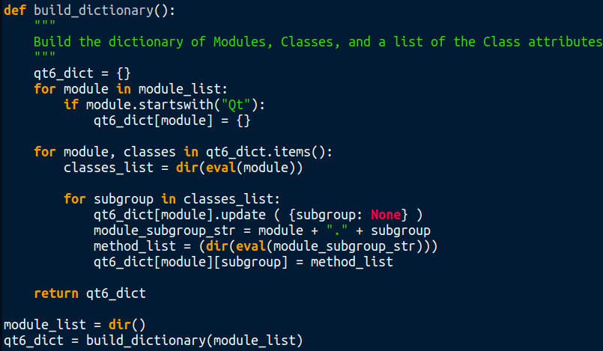
PySide6. Using dir() to get Classes and Attributes...

Slide 4
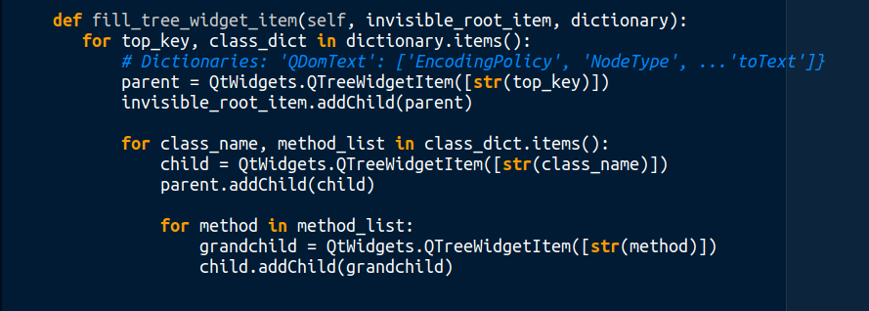
PySide6. Dictionary fills QTreeWidgetItem...

Slide 5
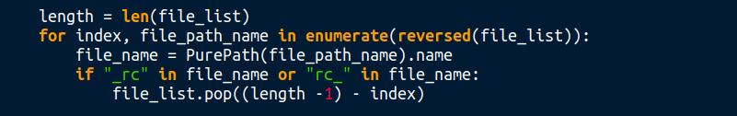
PySide6. Removal from a list with reversed pop()...

Slide 6
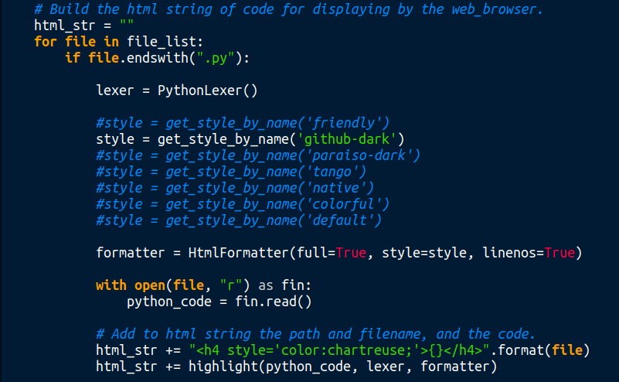
PySide6. Using “pygments” module to display code...

Slide 7
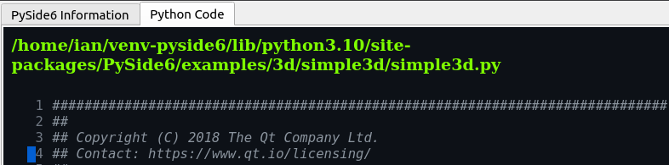
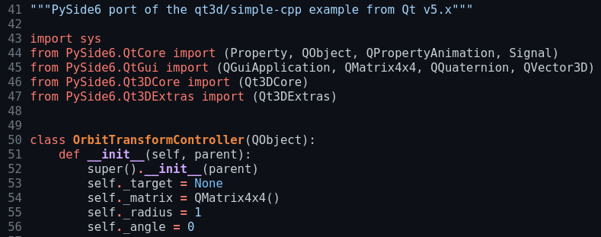
PySide6. Using “pygments” module to display code...

Slide 8
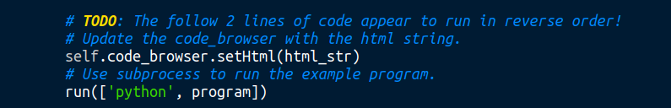
PySide6. Wrong order of execution. Huh?..
self.code_browser.refresh() ←Didn’t fix problem

Slide 9
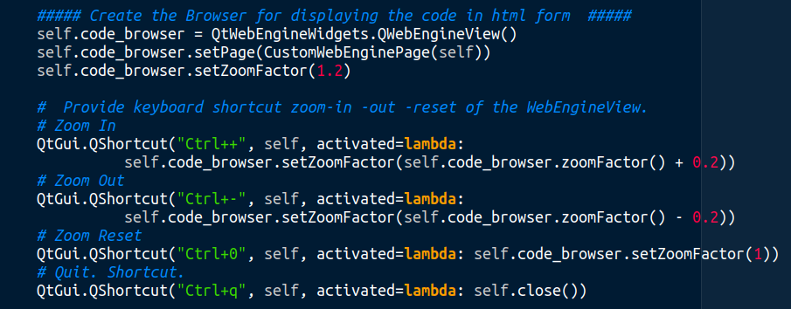
PySide6. Keyboard shortcut for zoom in and zoom out...

Slide 10

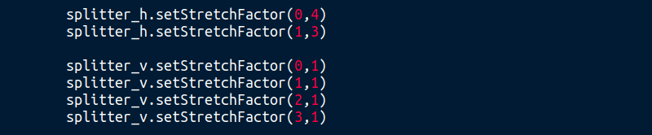
PySide6. Splitter...
Note: Cant find Splitter “handle” icon.

Slide 11
PySide6. End...
Modules:46 Classes:1296 Total Attributes:127811

