Slide 1
Client / Server Application featuring...
Raspberry-Pi Computer.
Hall Effect sensor
GPIO input pin pulsed.
Python Rpi.GPIO module.
Python pydbus module.
GDBus Interprocessor communication between client and server.
GTK+ client GUI.
...and a bicycle
Hamilton Python User Group
8 May 2017
Ian Stewart.

Slide 2

Overview
gDBus
Magnet
Hall Effect Sensor
Server pydbus module.
On command pass message to gDbus
Client pydbus module.
Send commands Recieve message_list
R-Pi GPIO port
R-Pi.GPIO module
Gtk GUI
Display / Commands
Pulse Counter
Calculations to produce message_list every Timer event
Repeating Timer
Repeating Timer
Real Time Clock
Gtk.mainloop
Server
GLib.mainloop
Client

Slide 3
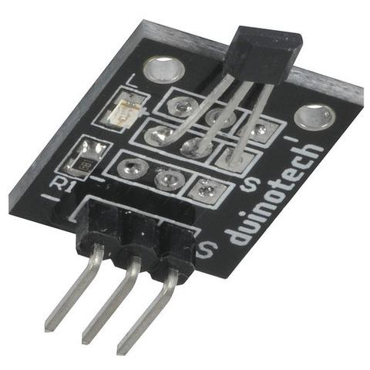
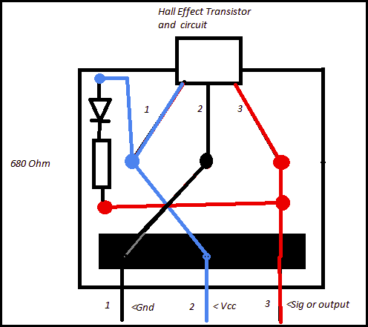
Hall Effect sensor board
Jaycar: Arduino Compatible Hall Effect Sensor Module CAT.NO: XC4434 NZ$7
Specification of Chip 3141 through 3144
http://www.digchip.com/datasheets/parts/datasheet/029/3144-pdf.php

Slide 4
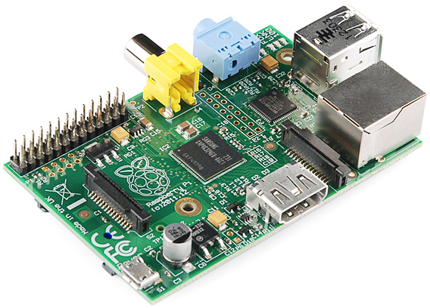
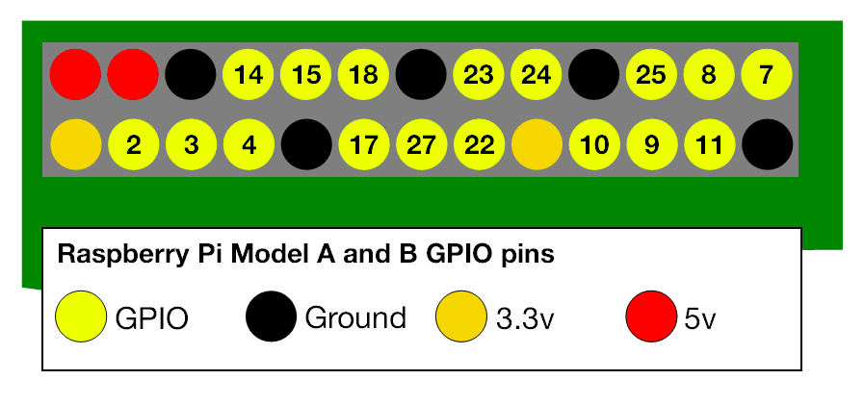
Raspberry Pi Model A & B GPIO pins
Use the BCM rather than BOARD setting
GPIO.setmode(GPIO.BCM)

Slide 5
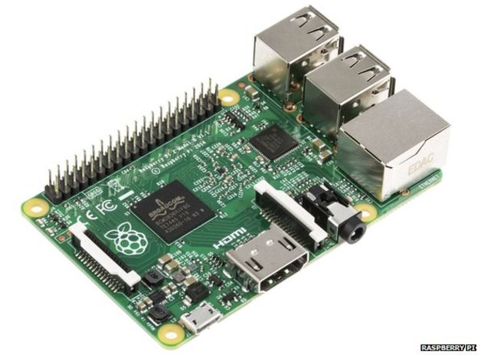
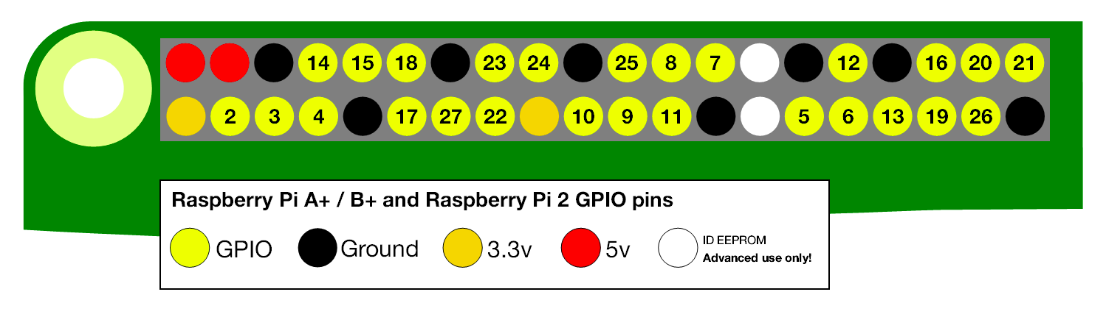
Raspberry Pi Model 0, 2 & 3 GPIO pins
Use the BCM rather than BOARD setting
GPIO.setmode(GPIO.BCM)

Slide 6
RPi.GPIO Module / Pulse Counter
Included with Raspbian or Ubuntu Mate for R-Pi
channel = 25
import RPi.GPIO as GPIO
GPIO.setmode(GPIO.BCM)
GPIO.setup(channel, GPIO.IN, pull_up_down=GPIO.PUD_UP)
GPIO.add_event_detect(channel,
GPIO.FALLING,
callback=pulse_callback,
bouncetime=1)
def pulse_callback(channel):
"""
Receive pulses on GPIO pin. Count until
timer_event resets pulse_count
"""
global pulse_count
pulse_count += 1

Slide 7
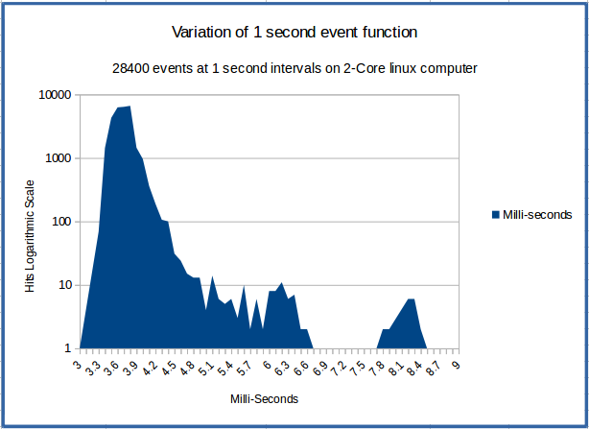
Repeating Timer - Accuracy
H

Slide 8
Repeating Timer 1/2
class RepeatedTimer(object):
"""
Repeating timer. Attempts to prevent drift
by using time.time()
If there was a delay, it should fire at next
correct point in real-time.
"""
def __init__(self, interval, function, *args, **kwargs):
self._timer = None
self.interval = interval
self.function = function
self.args = args
self.kwargs = kwargs
self.is_running = False
self.next_call = time.time()
self.start()

Slide 9
Repeating Timer 2/2
def _run(self):
self.is_running = False
self.start()
self.function(*self.args, **self.kwargs)
def start(self):
if not self.is_running:
self.next_call += self.interval
self._timer = threading.Timer(
self.next_call - time.time(), self._run)
self._timer.start()
self.is_running = True
def stop(self):
self._timer.cancel()
self.is_running = False
Link to code:
http://stackoverflow.com/questions/474528/what-is-the-best-way-to-repeatedly-execute-a-function-every-x-seconds-in-python

Slide 10
Real Time Clock – Total Trip Times
R-Pi has no battery backup RTC
RTC from internet time server.
time module
time.time() is seconds since 1 Jan 1970 – Unix epoch
import time
start_time = time.time()
# print(start_time)
# 1494218301.8900442
duration = time.time() - start_time
# Duration in seconds and decimal fractions of sec.
duration_dhms = ("{}days-{}"
.format(int(duration) // 86400,
time.strftime("%H:%M:%S",time.gmtime(duration))))
# 0days-21:05:01

Slide 11
Calculations
Every Repeating Timer event. E.g. Period of 1 second
Get pulse count.
Use wheel circumference to calculate distance.
Speed = distance over time (period)
Using RTC time from start. Total Average Speed.
Use a running average for more accuracy of speed.
# Running average buffer length
distance_list_length = 4
distance_list = [0] * distance_list_length
# Buffer for running average. Shuffle from right
# to left in the list
distance_list.append(counter_inc_value *
wheel_circumference)
distance_list.pop(0)

Slide 12
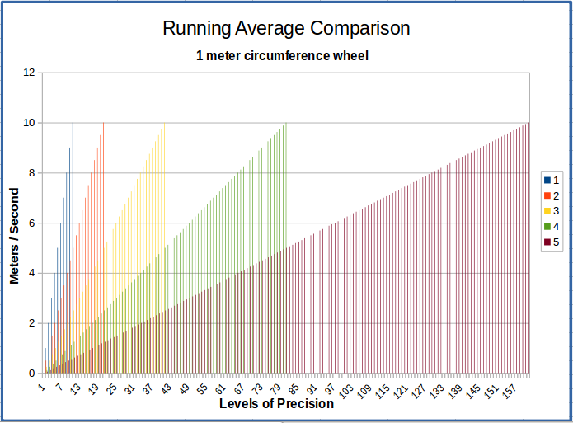
Running Average
H

Slide 13
Desktop Bus - DBus
Initial Design concepts started 2003
Released in 2006 with specification 0.12
Specification now at rev 0.30 https://dbus.freedesktop.org/doc/dbus-specification.html
libdbus – C library included with linux distros
Other libraries available that meet the DBus spec.
Gobject Introspection (gi.repository) libraries have an implementation referred to as g-DBus. (Doesn’t use libdbus)
pydbus is a python wrapper for the G.I. implementation
pydbus 0.6.0.
PyPI https://pypi.python.org/pypi/pydbus
Github: https://github.com/LEW21/pydbus/
To install: $ pip3 install pydbus

Slide 14
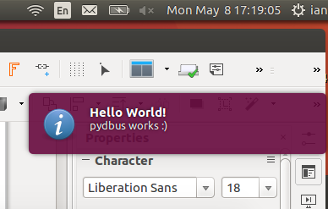
Desktop Bus - DBus
Example of sending a message over Dbus to the Desktop notification service.
from pydbus import SessionBus
bus = SessionBus()
notifications = bus.get('.Notifications')
notifications.Notify('test', 0, 'dialog-information',
"Hello World!", "pydbus works :)", [], {}, 5000)

Slide 15
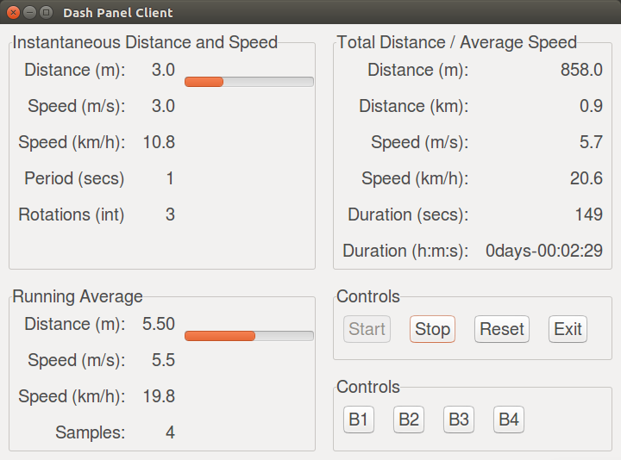
GTK+ GUI Client with pydbus
Provide a GUI to display the data from the message_list retrieved from server using pydbus.
Use GTK.main() for the loop
Some buttons send command messages to the DBus

Slide 16
Aside – Enlarging GTK font
# With video_projector set to True,
# then Gtk will use a larger font.
from gi.repository import Pango
PROJECTOR = True
PROJECTOR_FONT = "FreeSans, 15"
class MainWindow(Gtk.Window):
def __init__(self):
Gtk.Window.__init__(self, title=TITLE)
grid_main = Gtk.Grid()
self.add(grid_main)
# Modify overall font name and size
if PROJECTOR:
pangoFont = (
Pango.FontDescription(PROJECTOR_FONT))
self.modify_font(pangoFont)

Slide 17
Demo
Hall effect sensor on a bicycle wheel.
For simplicity of calculations:
Use circumference of 1 meter, and period of 1 second
1 meter per second.
3600 meters per hour = 3.6Kms/hr.
26 inch wheel has circumference of ~ 2.070 meters.

Slide 18
__end__

