Slide 1
Deep Learning on Edge Device
or
Pain and suffering

Slide 2
Why?
IoT is the “thing”
Avoid clogging up networks
Reduce network costs
Edge devices have increasing GPU capabilities

Slide 3
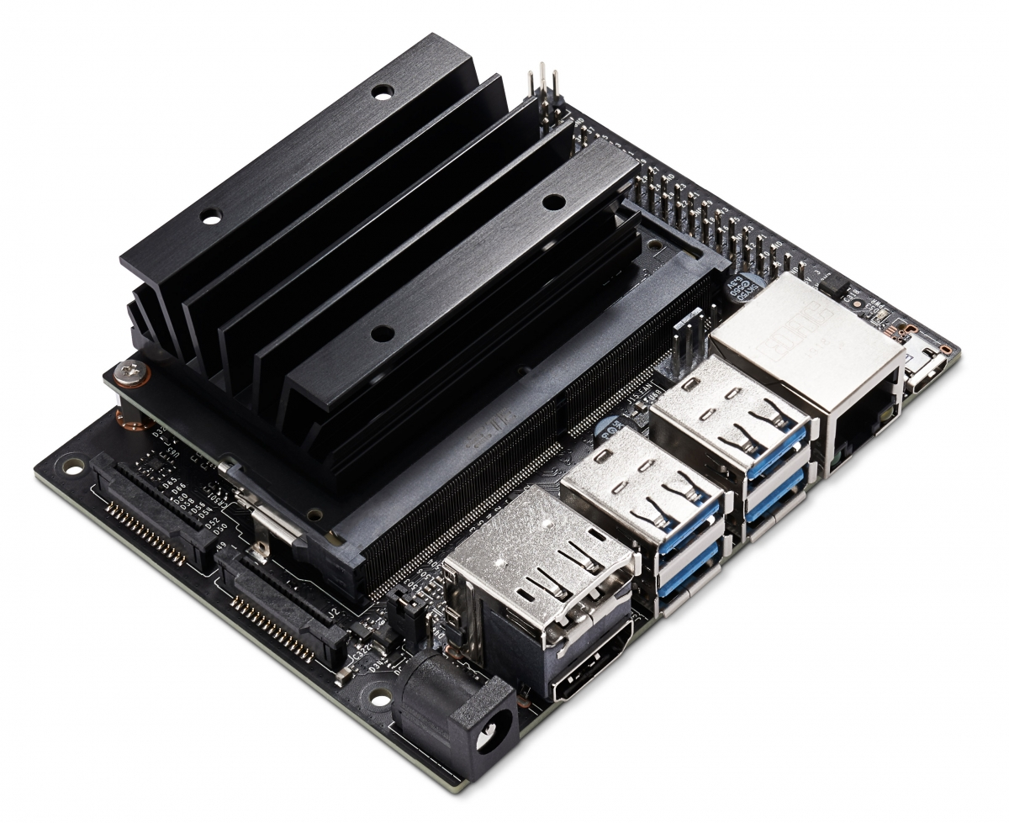
The Jetsons
Jetson Nano (~$240)
  GPU: 128 core Maxwell
  Quad core ARM A57
  4GB RAM (shared)
  2x CSI
  Gigabit Ethernet
  HDMI/Display port
  4x USB 3
  40pin GPIO
  Power: USB micro or barrel jack (5-10W)

Slide 4
Does it work?
Kind of...
  JetPacks (ie prebuilt images) only come with Python 3.6, based on Linux4Tegra (L4T)
  Compilation is terribly slow (missing wheel files)
  PyTorch can easily run out of memory
  Nvidia-based code/models does work

Slide 5
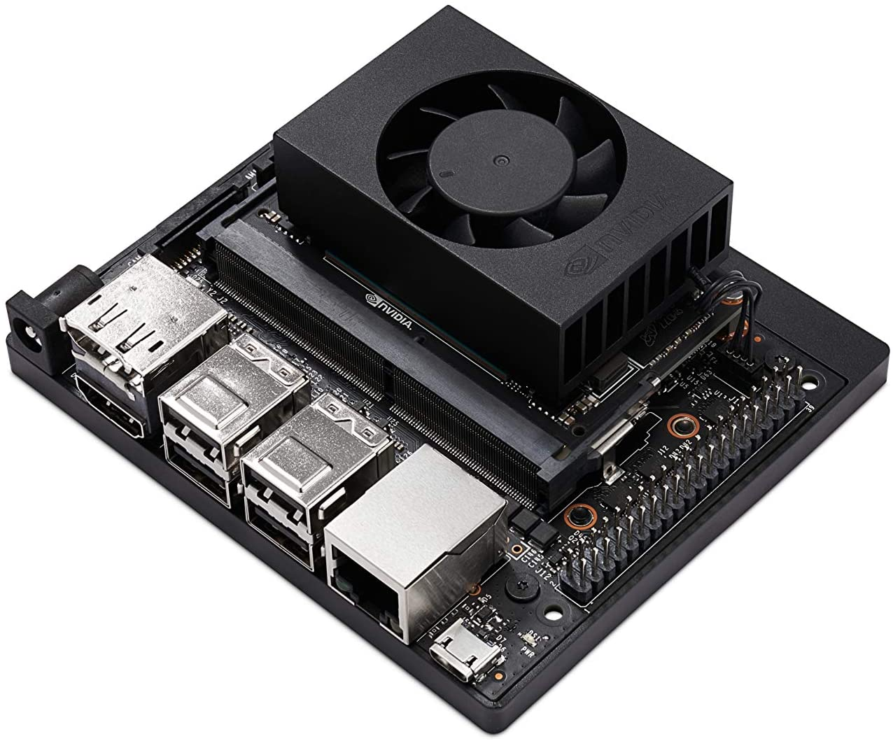
The Jetsons’ bigger brother
Jetson Xavier NX (>$400)
  512 core Volta
  8-core ARMv8.2
  2x CSI
  Gigabit Ethernet, M.2
  HDMI/Display port
  4x USB 3
  40pin GPIO
  Power: 19V barrel jack (10-15W)

Slide 6
Does it work?
Much better
  still limited with JetPacks and Python 3.6
  Compilation is way faster
  Double amount of RAM helps
  PyTorch works reasonable

