Slide 1
Converting program from GTK3 to GTK4
Original program: python-help-gui.gtk3.py
Final program: python-help-gui.gtk4.py
Migration Documentation: https://docs.gtk.org/gtk4/migrating-3to4.html
Code in: https://github.com/irsbugs/python-help
Hamilton Python Users Group
Ian Stewart
8 August 2022

Slide 2
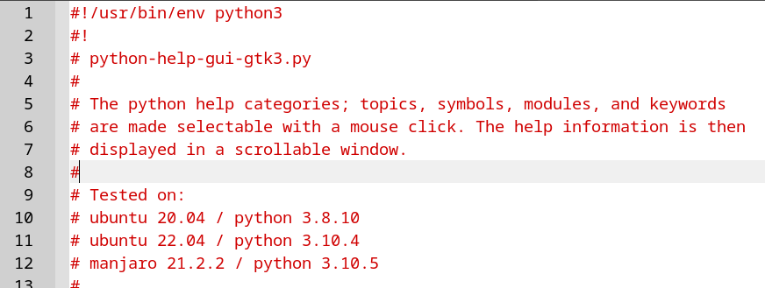
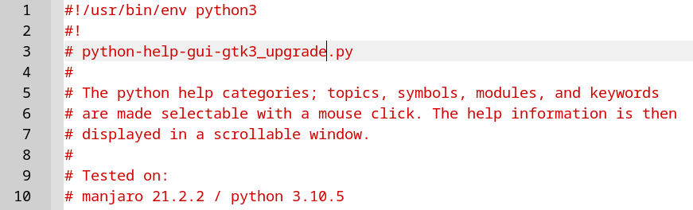
Converting program from GTK3 to GTK4
Original GTK3 program
To become the GTK4 program

Slide 3
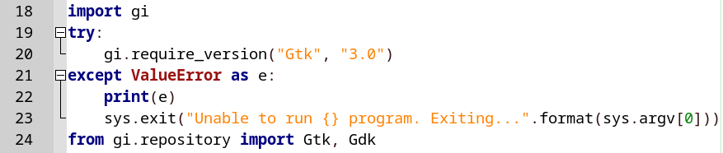
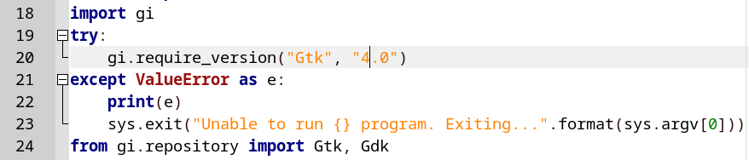
Gtk 3.0 to 4.0
Change gi.require_version to Gtk version 4.0...
Start running the program and see what errors are detected...

Slide 4
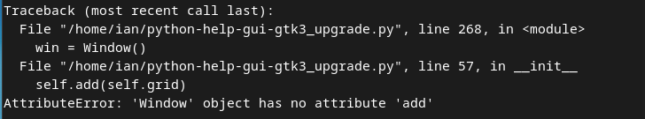
Gtk 3.0 to 4.0
Gtk.Window.add() replaced .set_child()

Slide 5
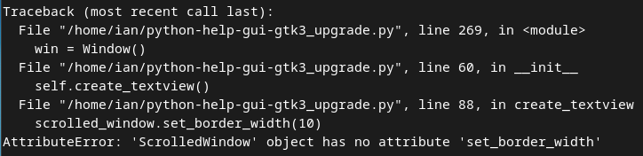
Gtk 3.0 to 4.0
.set_border_width() removed.
Quick fix – comment out the code

Slide 6
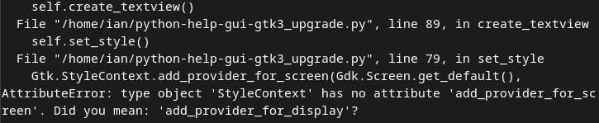
Gtk 3.0 to 4.0
.add_provider_for_screen()...
...becomes .add_provider_for_display()

Slide 7
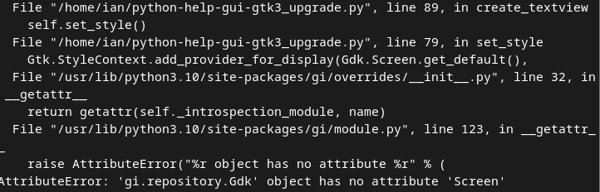
Gtk 3.0 to 4.0
Gdk.Screen becomes Gdk.Display

Slide 8

Gtk 3.0 to 4.0
More of the same...

Slide 9
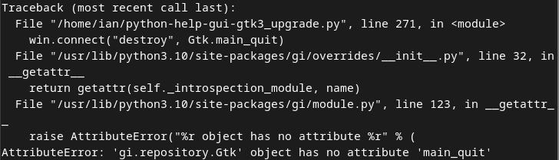
Gtk 3.0 to 4.0
Gtk.main_quit() removed...

Slide 10
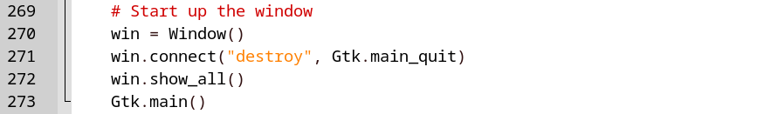
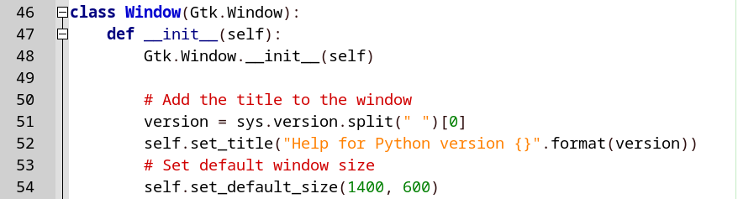
Gtk 3.0 to 4.0
Gtk3 way to launch the Window...

Slide 11
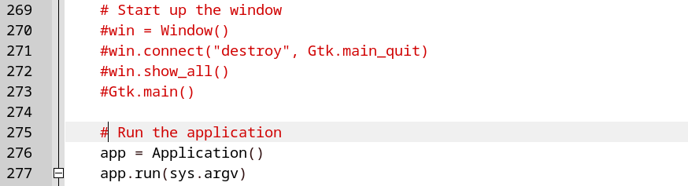
Gtk 3.0 to 4.0
Gtk4 code to launch “Application()”...

Slide 12
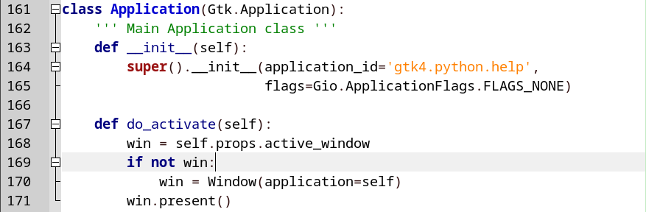
Gtk 3.0 to 4.0
Gtk.Application() function that “activates” and “presents” the Window

Slide 13
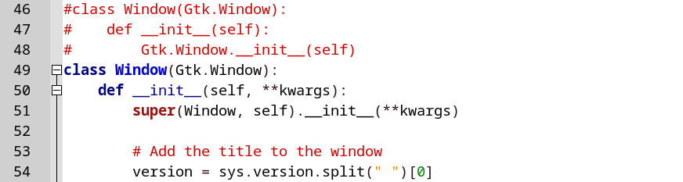
Gtk 3.0 to 4.0
Gtk.Window

Slide 14
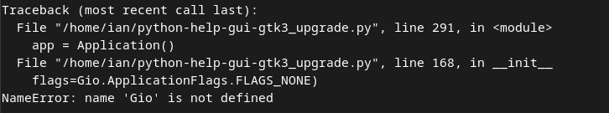
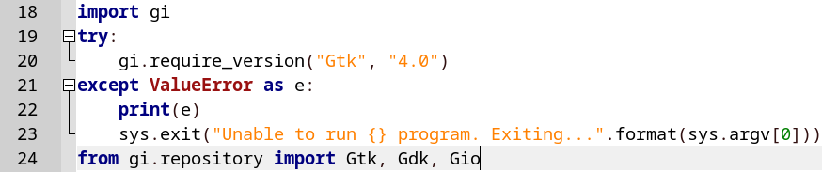
Gtk 3.0 to 4.0
Gio not imported...
Add Gio to the list of gi.repository imports...

Slide 15
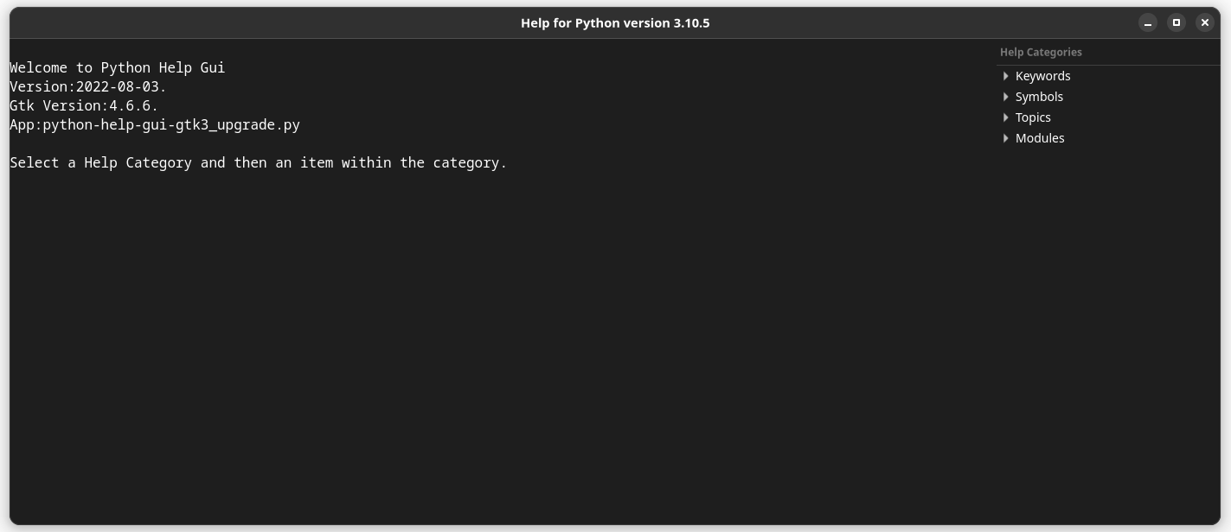
Gtk 3.0 to 4.0
Program launches using Gtk4 for the first time...
Note that there is no border / margin.

Slide 16
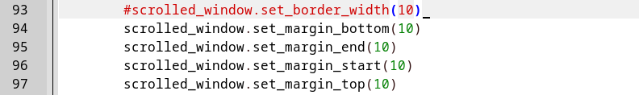
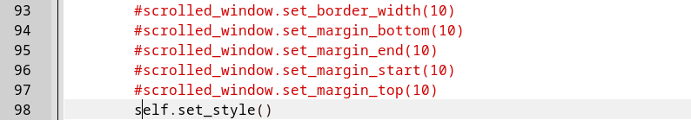
Gtk 3.0 to 4.0
One method of adding margins, which works but needs 4 lines of code...
Alternative method of calling the set_style function and using CSS...

Slide 17
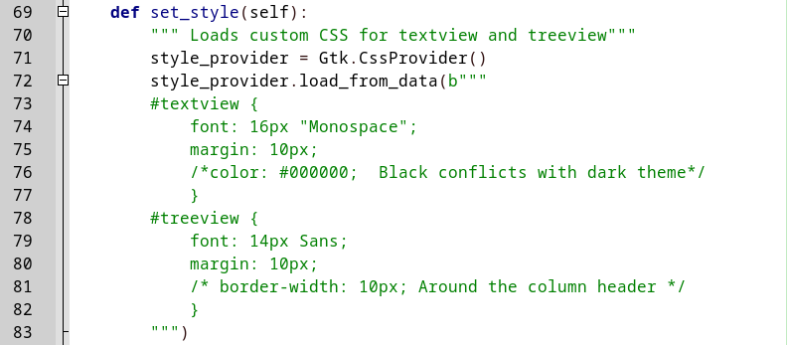
Gtk 3.0 to 4.0
Add “margin: 10px” to both the Textview and the Treeview widgets...

Slide 18
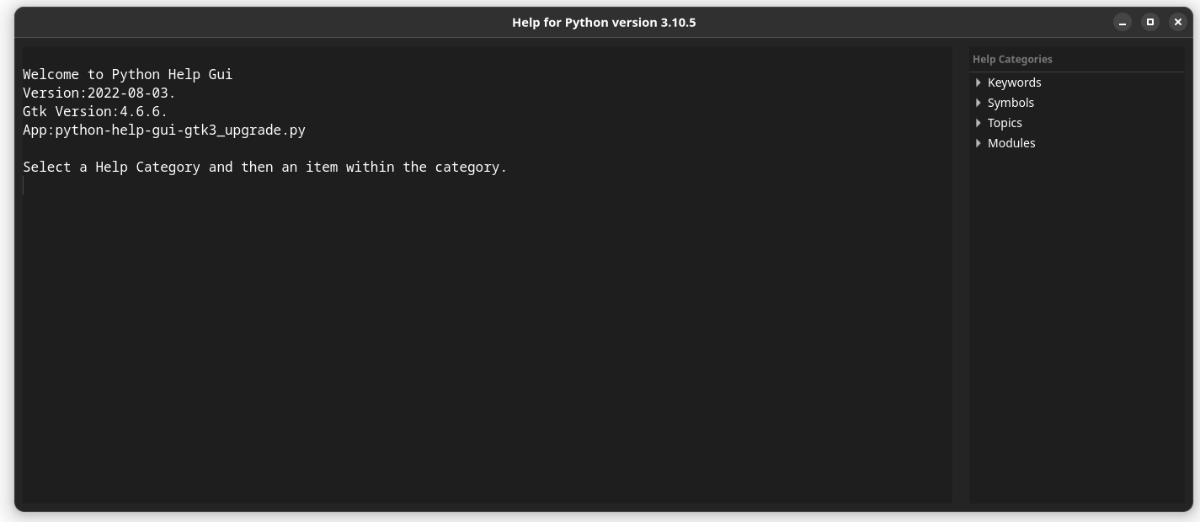
Gtk 3.0 to 4.0
Gtk Version: 4.6.6 and Python Version 3.10.5
...with 10px margins.

Slide 19
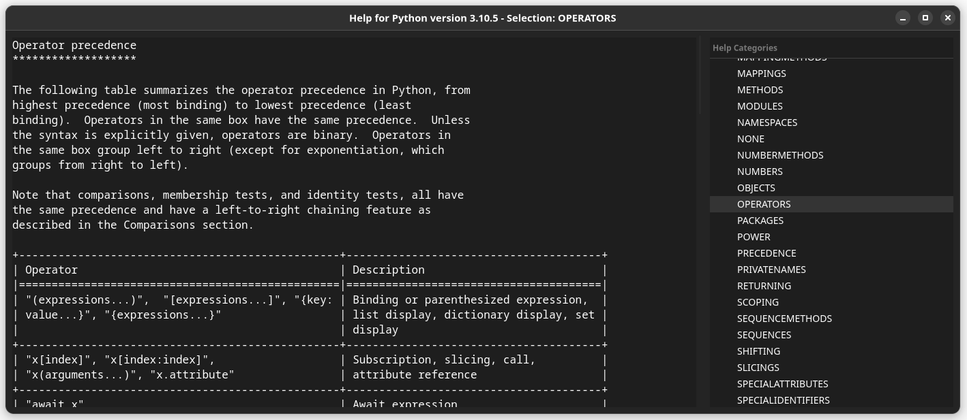
Gtk 3.0 to 4.0
Example: Displaying the Topic on OPERATORS...

Slide 20
Gtk 3.0 to 4.0
Display code / Demo program

