Slide 1

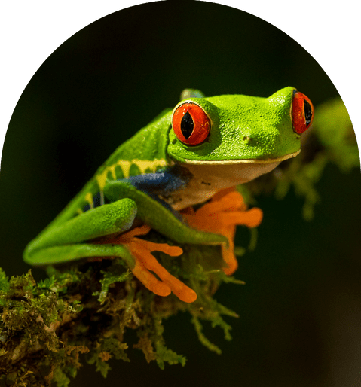
The coquí, pronounced "ko-kee", is a species of tree frog native to Puerto Rico.
TTS is Text-To-Speech. Also known as Speech Synthesis.
Hamilton Python Users Group
11 July 2022
Ian Stewart

Slide 2
Machines that speak.
Alarm clock, Answer phone. Playing local audio files.
Supermarket self service checkout. Stock sentences, no logic.
Espeak TTS (off-line)
Google TTS (online)

Slide 3
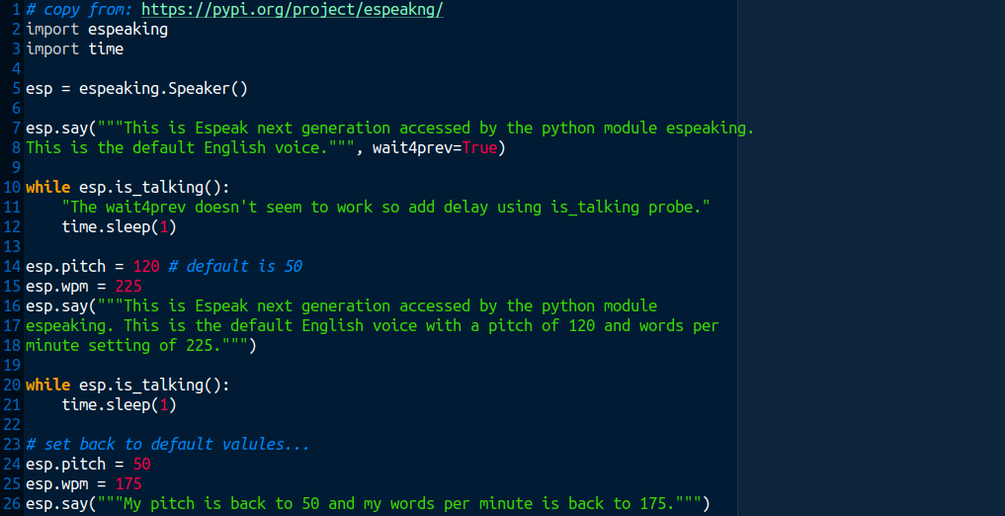
Espeak NG TTS
Python Example
$ sudo apt install espeak-ng
From: espeakng-1.0.2.tar.gz
Extract: __init__.py from
Rename: as espeaking.py

Slide 4
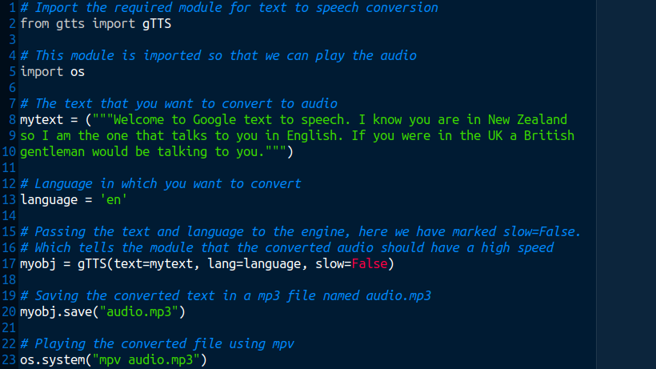
Google TTS
Python Example
pip3 install gTTS-token --upgrade
pip3 install gTTS --upgrade
Successfully installed gTTS-token-1.1.4
Successfully installed gTTS-2.2.4

Slide 5
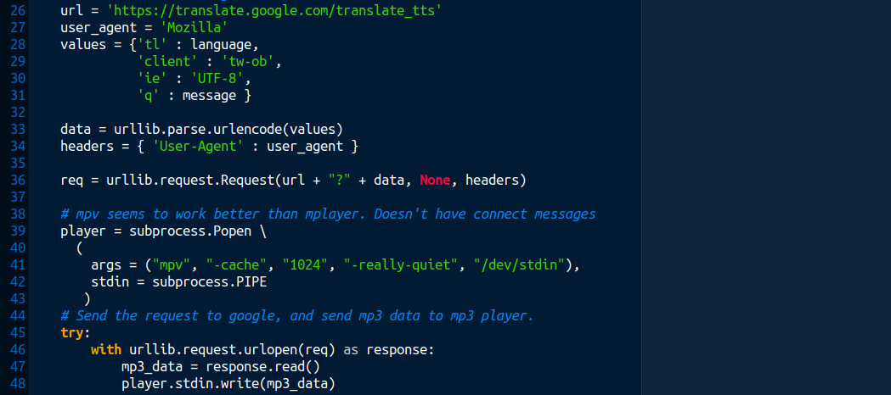
Google TTS – gspeak.py sample of code...
gspeak("Gspeak is a python3 program...")
gspeak("Bonjour comment-allez vous?", "fr")
gspeak("Guten Morgen.", "de")

Slide 6
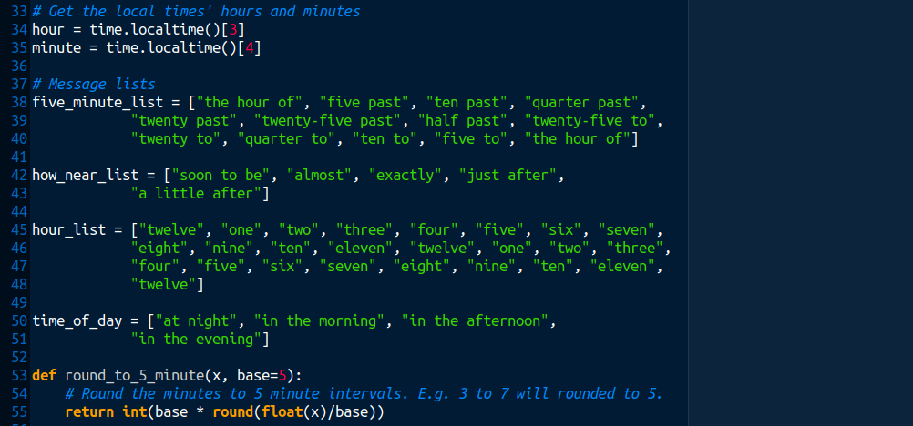
Google TTS - Python sample from “saytime”

Slide 7
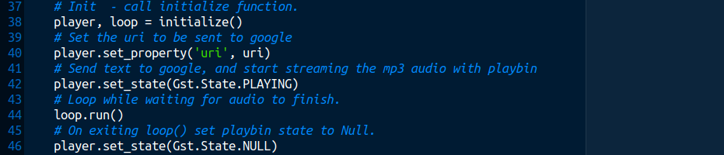
Google TTS – Gstreamer 1/2.

Slide 8
Google TTS – Gstreamer 2/2.

Slide 9
Do a demo of TTS:
Espeak (off-line) – Using python espeaking module
  python dev/espeak-tts/py-espeak.py
Google TTS (online) – Using python gTTS module
  python dev/google-tts/google-tts.py
Google TTS (online) – Lawrence and Ian connection to Google
  python dev/pylib/gspeak.py
Google TTS (online) – Apply logic
  python dev/pylib/saytime.py
  python dev/pylib/saytime.py full
Google TTS (online) – Gstreamer – playbin
  python dev/gstreamer/google_tts_gstreamer.py

Slide 10
What’s happening with Speech Synthesis:
Terminology:
Acoustic Model
Prosody
Vocoder
Deep Neuronal Networks (DNN)
Mel Spectrogram - https://en.wikipedia.org/wiki/Mel_scale
Speech Dataset
TTS Steps:
Generating a frequency representation of the sentence (the mel spectrogram)
Generating the waveform from this representation.

Slide 11
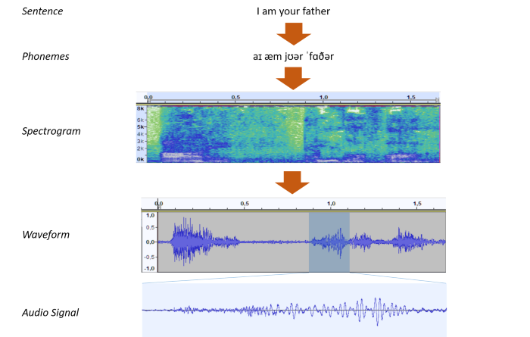
Steps:
Text Analysis /
Acoustic Analysis Model
Mel
Spectrogram
Vocoder
Diagram by: Patrick Meyer Jun 18, 2021

Slide 12
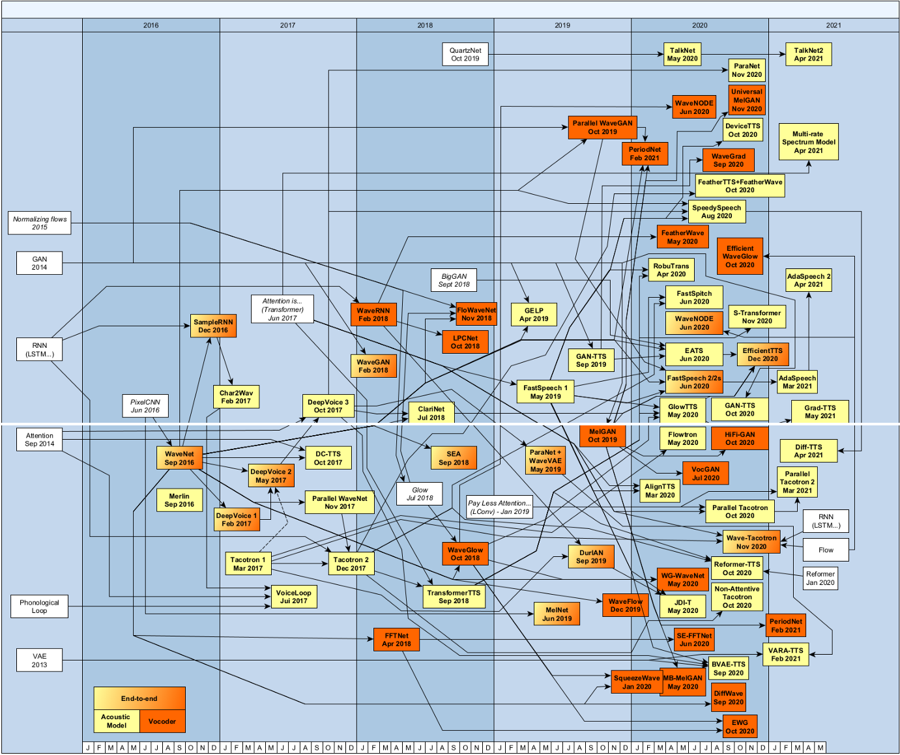
Speech Synthesis
Architectures
2016-2021
https://towardsdatascience.com/state-of-the-art-of-speech-synthesis-at-the-end-of-may-2021-6ace4fd512f2
Colour Code:
Yellow: Acoustic Model
Brown: Vocoder
Mix: End-to-end
Coqui TTS Defaults to:
Model: Tacotron 2 Model
Vocoder: Hifi Generative Adversarial Network (GAN)
HifiGAN
Tacotron2
Diagram by: Patrick Meyer Jun 18, 2021

Slide 13
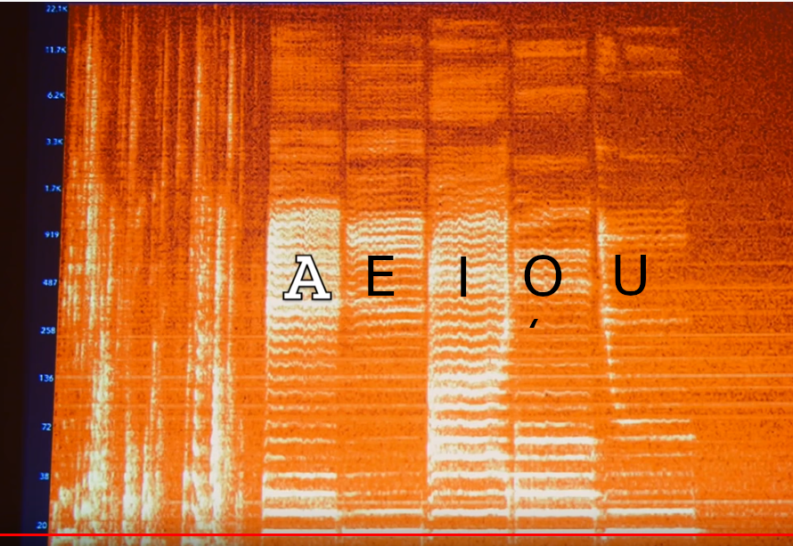
Spectrogram
Axis:
X: Time
Y: Frequency
Z: Power/Volume
Mel: Melody Scale

Slide 14
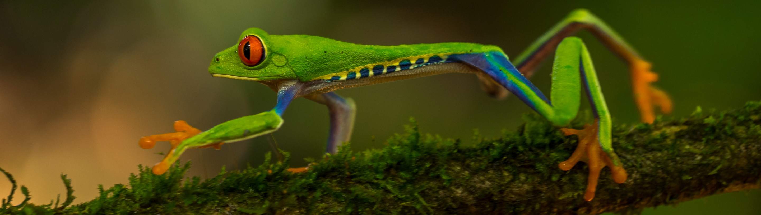
Coqui History
Called Coquí because the frog is well-known for being small but having a loud, clear voice.
In 2016 developers at Mozilla commenced open-source projects:
Developers:
DeepSpeech engine for STT https://github.com/mozilla/DeepSpeech/
TTS engines.
Capture thousands of hours of speech training data
Start the Coqui organization. Fork DeepSpeech
Main website: https://coqui.ai
Github repository: https://github.com/coqui-ai
PyPI: https://pypi.org/project/TTS/

Slide 15
Coqui TTS Installation on Ubuntu 22.04 Mate
$ sudo apt install python3.10-venv
To avoid the following error:
TTS/tts/utils/monotonic_align/core.c:19:10: fatal error: Python.h: No such file or directory
$ sudo apt install libpython3.10-dev
$ python -m venv tts-venv
$ source tts-venv/bin/activate
(tts-venv):~/tts-venv$ pip install TTS
OR
(tts-venv):~/tts-venv$ pip install pip setuptools wheel tts --upgrade
(tts-venv):~/tts-venv$ pip install python-mpv
Installs the following 83 python libraries (3.3GB+)...

Slide 16
Coqui TTS – Python libraries installed 1/2
anyascii-0.3.1 | Flask-2.1.2 | gruut-ipa-0.13.0
appdirs-1.4.4 | fonttools-4.33.3 | idna-3.3
audioread-2.1.9 | fsspec-2022.5.0 | inflect-5.6.0
Babel-2.10.3 | gruut_lang_cs-2.0.0 | itsdangerous-2.1.2
certifi-2022.6.15 | gruut_lang_de-2.0.0 | jieba-0.42.1
cffi-1.15.0 | gruut_lang_en-2.0.0 | Jinja2-3.1.2
charset-normalizer-2.0.12 | gruut_lang_es-2.0.0 | joblib-1.1.0
click-8.1.3 | gruut_lang_fr-2.0.2 | jsonlines-1.2.0
coqpit-0.0.16 | gruut_lang_it-2.0.0 | kiwisolver-1.4.3
cycler-0.11.0 | gruut_lang_nl-2.0.2 | librosa-0.8.0
cython-0.29.28 | gruut_lang_pt-2.0.0 | llvmlite-0.38.1
dateparser-1.1.1 | gruut_lang_ru-2.0.0 | MarkupSafe-2.1.1
decorator-5.1.1 | gruut_lang_sv-2.0.0 | matplotlib-3.5.2
docopt-0.6.2 | gruut-2.2.3 | mecab-python3-1.0.5

Slide 17
Coqui TTS – Python libraries installed 2/2
networkx-2.8.4 | Python-crfsuite-0.9.8 | threadpoolctl-3.1.0
num2words-0.5.10 | python-dateutil-2.8.2 | torch-1.12.0
numba-0.55.1 | pytz-2022.1 | torchaudio-0.12.0
numpy-1.21.6 | pytz-deprecation-shim-0.1.0.post0 | tqdm-4.64.0
packaging-21.3 | pyworld-0.2.10 | trainer-0.0.12
pandas-1.4.3 | pyyaml-6.0 | TTS-0.7.1
pillow-9.1.1 | regex-2022.3.2 | typing-extensions-4.2.0
pooch-1.6.0 | requests-2.28.0 | tzdata-2022.1
protobuf-3.19.4 | resampy-0.2.2 | tzlocal-4.2
pycparser-2.21 | scikit-learn-1.1.1 | umap-learn-0.5.1
pynndescent-0.5.7 | scipy-1.8.1 | unidic-lite-1.0.8
pyparsing-3.0.9 | six-1.16.0 | urllib3-1.26.9
pypinyin-0.46.0 | soundfile-0.10.3.post1 | Werkzeug-2.1.2
pysbd-0.3.4 | tensorboardX-2.5.1
776MB

Slide 18
The LJ Speech Dataset – LJ = Linda Johnson
Available from: https://keithito.com/LJ-Speech-Dataset/ (2.6GB)
Total Clips: 13,100
Total Words: 225,715
Total Characters: 1,308,678
Total Duration: 23:55:17
Mean Clip Duration: 6.57 sec
Min Clip Duration: 1.11 sec
Max Clip Duration: 10.10 sec
Mean Words per Clip: 17.23
Distinct Words: 13,821
Linda Johnson from LibriVox, 13100 passages from 7 non-fiction books (2017). Published between 1884 and 1964.
https://librivox.org/ Free public domain audiobooks

Slide 19
The LJ Speech Dataset – LJ = Linda Johnson
Keith Ito provided the metadata file associated with the .wav files.
Metadata is provided in transcripts.csv.
  One record per line, delimited by the pipe character (0x7c).
File Format. Fields are:
ID: this is the name of the corresponding .wav file
Transcription: words spoken by the reader (UTF-8)
Normalized Transcription: transcription with numbers, ordinals, and monetary units expanded into full words (UTF-8).
Each audio file is a single-channel 16-bit PCM WAV with a sample rate of 22050 Hz.
Available from: https://keithito.com/LJ-Speech-Dataset/ (2.6GB)

Slide 20
The LJ Speech Dataset – Notes.
Dataset is Public Domain.
Version 1.1 (fixes 30 mistakes in V1.0)
Clip boundaries generally align with sentence or clause boundaries, but not always.
The text was matched to the audio manually.
High quality. E.g. Don’t get hum in the recording.
19 of the transcriptions contain non-ASCII characters. E.g. LJ016-0257 contains "raison d'être".
Original LibriVox recordings were 128 kbps MP3 files.
Nancy corpus dataset. Nancy Krebs speaking. 16K wav files.
Blizzard 2012 dataset

Slide 21
The LJ Speech Dataset – Notes.
The first set was trained for 441K steps on the LJ Speech Dataset
Speech started to become intelligible around 20K steps.

Slide 22
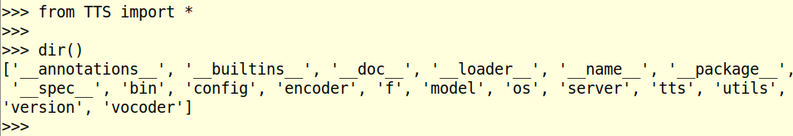
After installation – in tts virtual environment
Bash command: tts
Bash command: tts-server
Python: TTS library

Slide 23
Bash tts
$ tts –text “Some text.” will use the default model and vocoder and output a wav file to the current directory.
&& mpv tts_output.wav will play the wav file.
Defaults. Based on ljspeech dataset...
Model: tacotron2
Vocoder: hifigan_v2
First time, need to wait a few minutes for the model and vocoder to download.

Slide 24
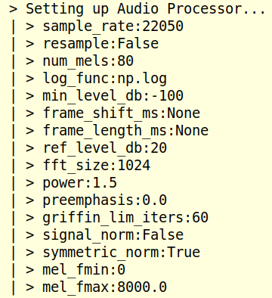
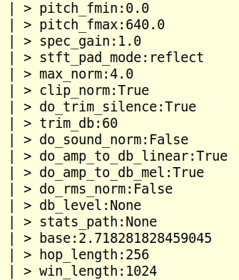
Bash tts – Default settings. 1/3

Slide 25
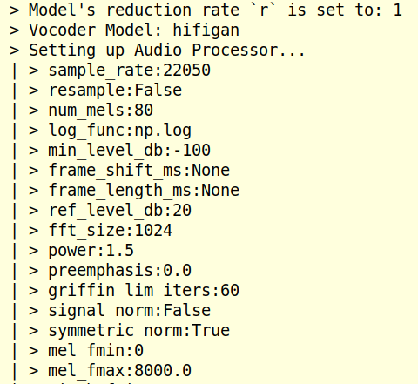
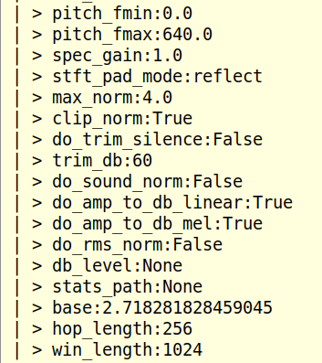
Bash tts – Default settings. 2/3

Slide 26
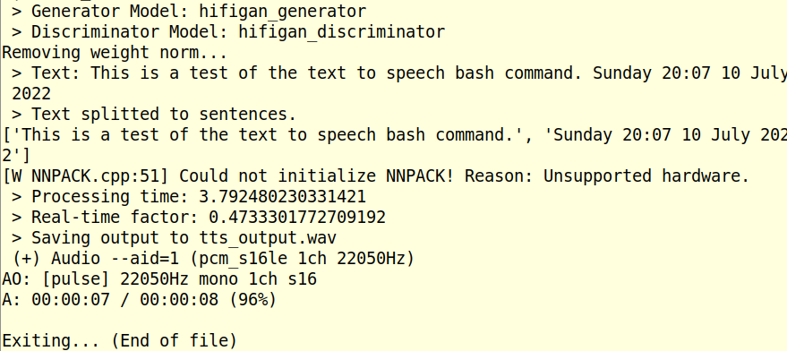
Bash tts – Default settings. 3/3
Old PC. Doesn’t have AVX2 instructions. Need Haswell microarchitecture (4th generation) Jun 2013 onwards.

Slide 27
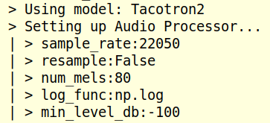
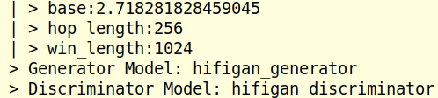
Bash tts-server 1/4
... snip ...

Slide 28
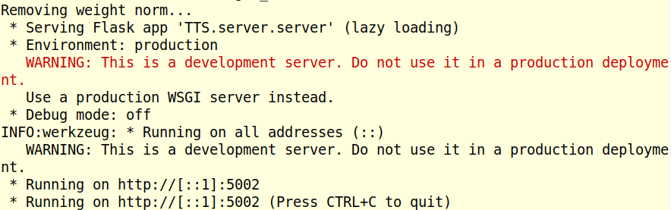
Bash tts-server 2/4
Go to blank tab on Browser and paste http://[::1]:5002

Slide 29
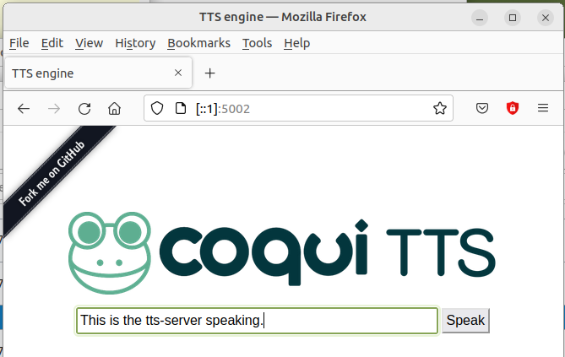
Bash tts-server 3/4

Slide 30
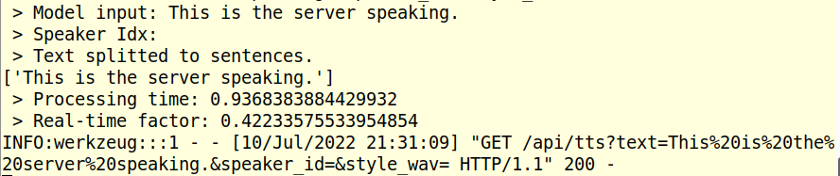
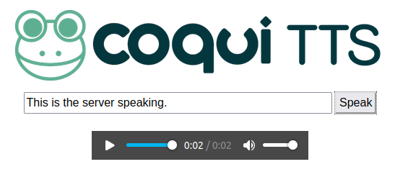
Bash tts-server 4/4. On clicking “Speak”
Changed “the tts-server speaking” to
the server speaking”

Slide 31
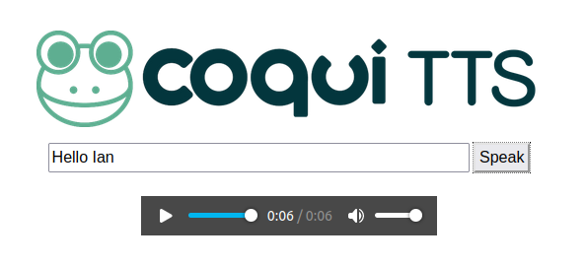
Demo: Bash tts-server.
Note 6 seconds. Huh?

Slide 32
Python?
>>> from TTS.bin import synthesize
>>> synthesize.Synthesizer.tts("Hello")
Traceback (most recent call last):
File "<stdin>", line 1, in <module>
File "/home/ian/tts-venv/lib/python3.10/site-packages/TTS/utils/synthesizer.py", line 203, in tts
raise ValueError(
ValueError: You need to define either `text` (for sythesis) or a `reference_wav` (for voice conversion) to use the Coqui TTS API.
>>> from TTS.tts.configs.tacotron_config import TacotronConfig
>>> config = TacotronConfig()
asd

Slide 33
Models:
(tts-venv) ian@dell:~$ tts --list_models
Name format: type/language/dataset/model
1: tts_models/multilingual/multi-dataset/your_tts
2: tts_models/en/ek1/tacotron2
3: tts_models/en/ljspeech/tacotron2-DDC [already downloaded]
4: tts_models/en/ljspeech/tacotron2-DDC_ph
5: tts_models/en/ljspeech/glow-tts [already downloaded]
6: tts_models/en/ljspeech/speedy-speech
7: tts_models/en/ljspeech/tacotron2-DCA
8: tts_models/en/ljspeech/vits
9: tts_models/en/ljspeech/fast_pitch
10: tts_models/en/vctk/vits
11: tts_models/en/vctk/fast_pitch
12: tts_models/en/sam/tacotron-DDC
13: tts_models/en/blizzard2013/capacitron-t2-c50
14: tts_models/en/blizzard2013/capacitron-t2-c150
15: tts_models/es/mai/tacotron2-DDC
16: tts_models/fr/mai/tacotron2-DDC
17: tts_models/uk/mai/glow-tts
18 to 33 Other languages: zh, nl, de, ja, tw, ...

Slide 34
Models (continued):
(tts-venv) ian@dell:~$ tts –list_models
Name format: type/language/dataset/model
1: vocoder_models/universal/libri-tts/wavegrad
2: vocoder_models/universal/libri-tts/fullband-melgan
3: vocoder_models/en/ek1/wavegrad
4: vocoder_models/en/ljspeech/multiband-melgan [already downloaded]
5: vocoder_models/en/ljspeech/hifigan_v2 [already downloaded]
6: vocoder_models/en/ljspeech/univnet
7: vocoder_models/en/blizzard2013/hifigan_v2
8: vocoder_models/en/vctk/hifigan_v2
9: vocoder_models/en/sam/hifigan_v2
10: vocoder_models/nl/mai/parallel-wavegan
11: vocoder_models/de/thorsten/wavegrad
12: vocoder_models/de/thorsten/fullband-melgan
13: vocoder_models/ja/kokoro/hifigan_v1
14: vocoder_models/uk/mai/multiband-melgan
15: vocoder_models/tr/common-voice/hifigan
...

Slide 35
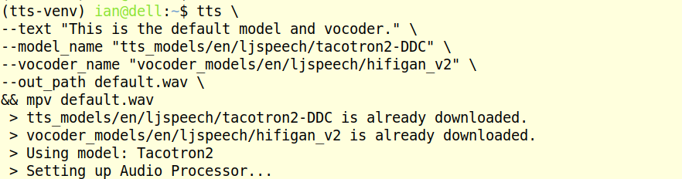
Bash tts:
(tts-venv) ian@dell:~$ tts \
--text "This is the default model and vocoder." \
--model_name "tts_models/en/ljspeech/tacotron2-DDC" \
--vocoder_name "vocoder_models/en/ljspeech/hifigan_v2" \
--out_path default.wav \
&& mpv default.wav
...

Slide 36
Bash tts scripts. Compare the audio results:
tts \
--text "This is the default model and vocoder." \
--model_name "tts_models/en/ljspeech/tacotron2-DDC" \
--vocoder_name "vocoder_models/en/ljspeech/hifigan_v2" \
--out_path default.wav \
&& mpv default.wav
tts \
--text "This is the glow model and melgan vocoder." \
--model_name "tts_models/en/ljspeech/glow-tts" \
--vocoder_name "vocoder_models/en/ljspeech/multiband-melgan" \
--out_path alternative.wav \
&& mpv alternative.wav
mpv default.wav && mpv alternative.wav && mpv default.wav && alternative.wav
Model: Tacotron2 vs. Glow-tts and Vocoder: HifiGAN vs. MelGAN

Slide 37
Bash tts scripts. Compare the “Hello” results:
tts \
--text "Hello" \
--model_name "tts_models/en/ljspeech/tacotron2-DDC" \
--vocoder_name "vocoder_models/en/ljspeech/hifigan_v2" \
--out_path default.wav \
&& mpv default.wav \
&& tts \
--text "Hello" \
--model_name "tts_models/en/ljspeech/glow-tts" \
--vocoder_name "vocoder_models/en/ljspeech/multiband-melgan" \
--out_path alternative.wav \
&& mpv alternative.wav
mpv default.wav && mpv alternative.wav && mpv default.wav && alternative.wav
Model: Tacotron2 vs. Glow-tts and Vocoder: HifiGAN vs. MelGAN

Slide 38
Bash tts scripts. Try the uk model and vocoder:
tts \
--text "This is the glow model and melgan vocoder." \
--model_name "tts_models/uk/mai/glow-tts" \
--vocoder_name "vocoder_models/uk/mai/multiband-melgan" \
--out_path glow_melgan.wav \
&& mpv glow_melgan.wav
> Downloading model to /home/ian/.local/share/tts/tts_models--uk--mai--glow-tts
> Model's license - MIT
> Check https://choosealicense.com/licenses/mit/ for more info.
> Downloading model to /home/ian/.local/share/tts/vocoder_models--uk--mai--multiband-melgan
2 x Downloads took 5 mins
Model: uk/mai/glow-tts and Vocoder: uk/mai/multiband-melgan

Slide 39
Bash tts scripts. Result uk model and vocoder:
> Text splitted to sentences.
['This is the glow model and melgan vocoder.']
this is the glow model and melgan vocoder.
[!] Character 't' not found in the vocabulary. Discarding it.
this is the glow model and melgan vocoder.
[!] Character 'h' not found in the vocabulary. Discarding it.
this is the glow model and melgan vocoder.
[!] Character 's' not found in the vocabulary. Discarding it.
this is the glow model and melgan vocoder.
[!] Character 'g' not found in the vocabulary. Discarding it.
this is the glow model and melgan vocoder.
[!] Character 'l' not found in the vocabulary. Discarding it.
this is the glow model and melgan vocoder.
[!] Character 'w' not found in the vocabulary. Discarding it.
this is the glow model and melgan vocoder.
[!] Character 'm' not found in the vocabulary. Discarding it.
this is the glow model and melgan vocoder.
[!] Character 'd' not found in the vocabulary. Discarding it.
this is the glow model and melgan vocoder.
[!] Character 'v' not found in the vocabulary. Discarding it.
Doesn’t know: t, h, s, g, l, w, m, d, v. OK with: i, e, o, n, c, r

Slide 40
Bash tts scripts. Try ljspeech/glow-tts and sam/hifigan_v2:
tts \
--text "This is the glow model and hifilgan vocoder." \
--model_name "tts_models/en/ljspeech/glow-tts" \
--vocoder_name "vocoder_models/en/sam/hifigan_v2" \
--out_path glow_hifigan.wav \
&& mpv glow_hifigan.wav
Dalek

Slide 41
Demos & Questions...

