Slide 1
pygubu-designer
Taking (some of) the pain out of tkinter

Slide 2
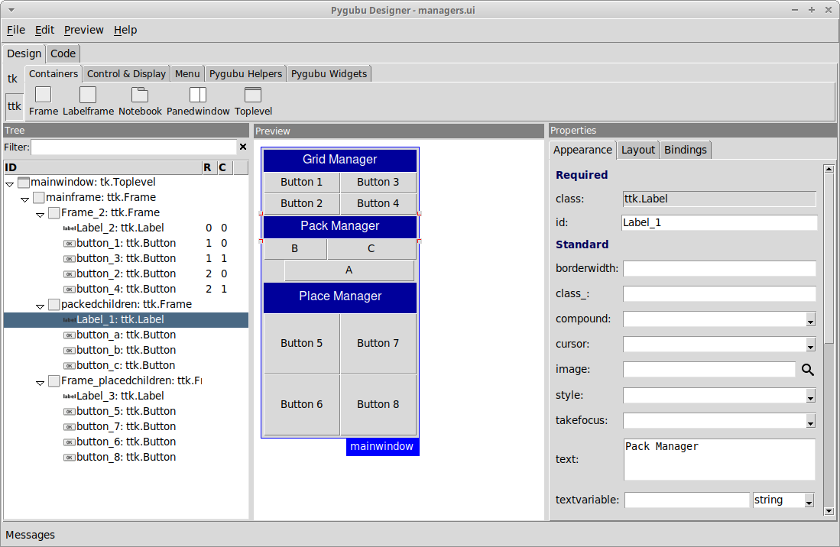
What?
Pygubu is a RAD tool to enable quick and easy development of user interfaces for the Python's tkinter module.
The user interfaces designed are saved as XML files, and, by using the pygubu builder, these can be loaded by applications dynamically as needed.
Pygubu is inspired by Glade*
https://github.com/alejandroautalan/pygubu-designer
* UI designer for GTK

Slide 3
How?
create a UI with the designer
generate wrapper code for application
retrieve objects via: builder.get_object(...)
import variables: builder.import_variables(self)
fill in callbacks of buttons, menus, etc
set theme (pre-existing or custom)

Slide 4
Caveats
Menu key bindings - manually in code:
  self.mainwindow.bind("<Control-o>", self.on_open_click)
"Live" changes get sluggish with larger UIs
Fixed widgets, additional ones require work
X11 has high CPU load after exiting designer

Slide 5
Get started
For developing UIs:
  pip install pygubu-designer
At runtime:
  pip install pygubu

Slide 6
Demo
Let's give it a go!

