Slide 1

Static Website Generator written in Python

Slide 2
What?
WordPress powers 25% of all websites
http://venturebeat.com/2015/11/08/wordpress-now-powers-25-of-the-web/
anachronistic?
static content
  fast, easy on resources
  no security issues (eg SQL injections)
features
  Python 3.3, extensible (plugins, themes)
  incremental builds (only new stuff)
  pages, blog, comments, tags, RSS, galleries, WP import, ...

Slide 3
How?
Content
(rest, md, ...)
HTML
CSS, JS
Deploy
Theme

Slide 4
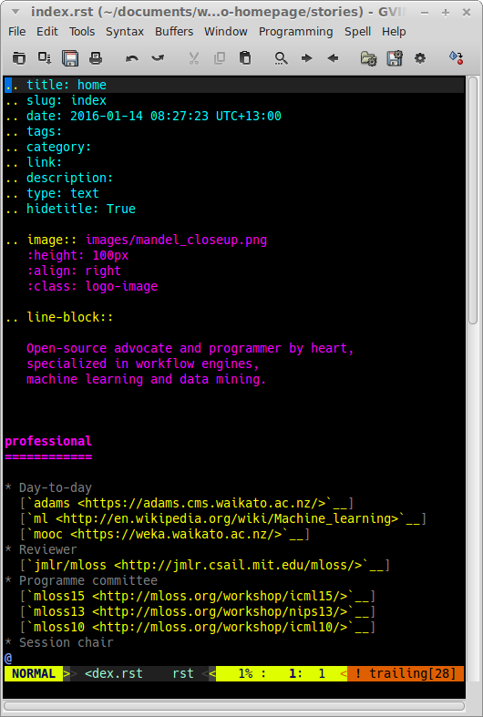
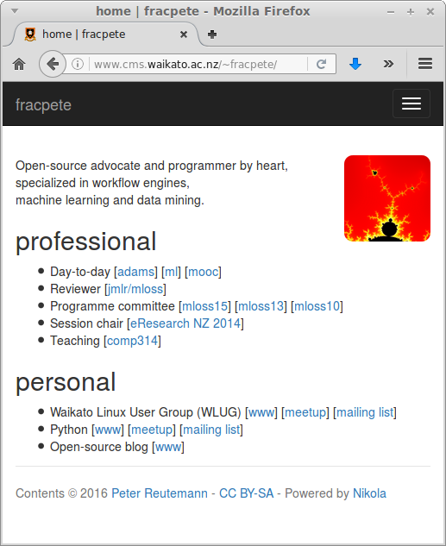
Example

Slide 5
Websites
Nikola (of course) - https://getnikola.com/
examples - https://users.getnikola.com/
my own pages
  uni homepage - http://www.cms.waikato.ac.nz/~fracpete/
  ADAMS - https://adams.cms.waikato.ac.nz/
  ACML 2016 conference - http://acml-conf.org/2016/

Slide 6
Hands-on
Create our own website
  nikola init [-q]
Test the site
  nikola build
  nikola serve [-b]
Add content
  “stories” for pages
    nikola new_page
  “posts” for blogging
    nikola new_post

Slide 7
Customize
Menu
  conf.py - NAVIGATION_LINKS
Theme
  create directory “themes”
  copy theme into it, e.g.:
  /usr/local/lib/python3.4/dist-packages/nikola/data/themes/bootstrap3
  remove minimized files/maps
  conf.py - THEME

Slide 8
Customize (2)
No blog? No problem:
https://getnikola.com/creating-a-site-not-a-blog-with-nikola.html
conf.py
  remove POSTS
  remove sub-path for PAGES
  INDEX_PATH = “blog” (avoids clash with index page)
  create new page “index”

