Slide 1
Python
Bits and Bytes
Hamilton Python Users Group
Ian Stewart
2023-04-12

Slide 2
Python Meetings
Hamilton Python Users Group
First meeting Feb 2014.
Forgot to celebrate 100th meeting.
102nd Meeting Apr 2023.

Slide 3

Python
Designed by Guido van Rossum – The Netherlands
First appeared 20 February 1991; 32 years ago
CPython:
Reference implementation of the Python programming language.
Written in C and Python.
Default and most widely used implementation of the Python
Defined as both an interpreter and a compiler. It compiles Python code into bytecode before interpreting it.
Licensing:
1991-1995 Stichting Mathematisch Centrum.
1995-2001 Corporation for National Research Initiatives.
2000 BeOpen.com
2001-2023 Python Software Foundation. https://www.python.org/

Slide 4
Python Sites Summary
https://www.python.org
Creator
Developers
Python Software Foundation
Python Conference
PyCon
Download and Documentation
https://github.com/python/
https://python.nz/
https://kiwpycon.nz/
https://www.youtube.com/c/kiwipycon
CPython
NZPUG
Kiwi PyCon XII
PEP’s
https://github.com/hampug
http://hampug.pythonanywhere.com/
http://hampug1.pythonanywhere.com/
https://www.youtube.com/channel/UC_yO5iRuyxfxC4vqDXFK59w
WebSite Examples / YouTube
HamPUG
Meeting
Presentations
Code Examples

Slide 5
External Sites for Example Python code
Stack Overflow
https://stackoverflow.com/questions/tagged/python/
You Tube videos
https://www.youtube.com/results?search_query=python
Program Creek
https://www.programcreek.com/python/
ChatGPT
https://chat.openai.com/
More?

Slide 6
Demo
Demo all links on previous two slides.

Slide 7
CPython Alternatives
Alternatives:
Jython, written in Java for the Java virtual machine (JVM).
PyPy, written in RPython and translated into C.
IronPython, which is written in C#.
Stackless Python
MicroPython, written in C.
CircuitPython, fork of MicroPython with emphasis on education.
Dialects:
Cython. Superset of Python.
Rpython. Restricted subset of Python
Starlark. Language similar to Python.

Slide 8
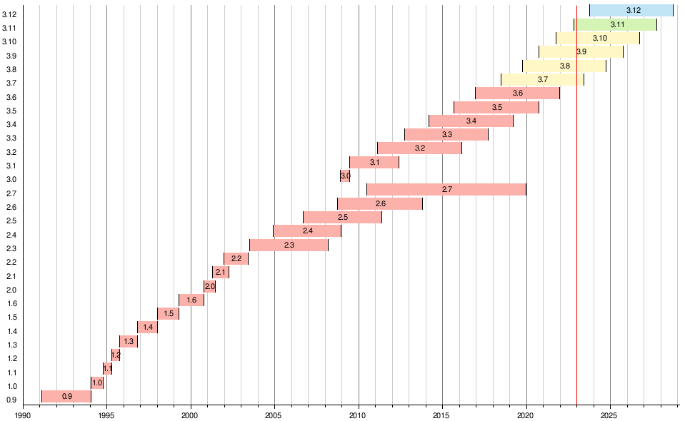
Python Release History

Slide 9
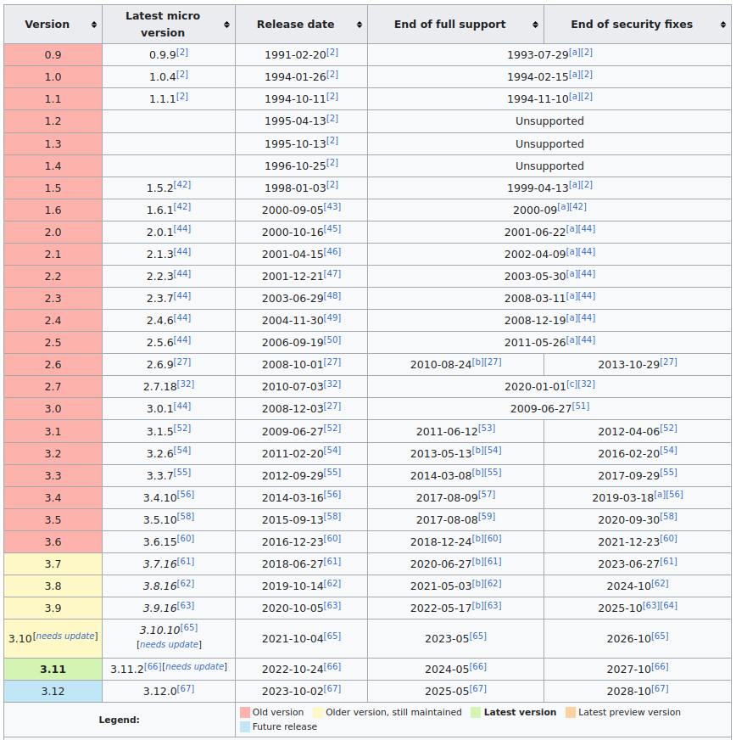
asd
asd

Slide 10
Python Release History
asd
https://en.wikipedia.org/wiki/History_of_Python

Slide 11
Bytecode

Slide 12
Python Compile to Bytecode
Python compiles Python code into bytecode before interpreting it.
Bytecode instructions may change with Python version.
Local Imported modules once converted to bytecode are stored in __pycache__ sub-folder as xxx.cpython-3nn.pyc files.
$ python -m compileall hello.py.
Creates: __pycache__/hello.cpython-310.pyc
Bytecode is interpreted by the “Python Virtual Machine”
The implementation of the bytecode interpreter is in the file Python/ceval.c.

Slide 13
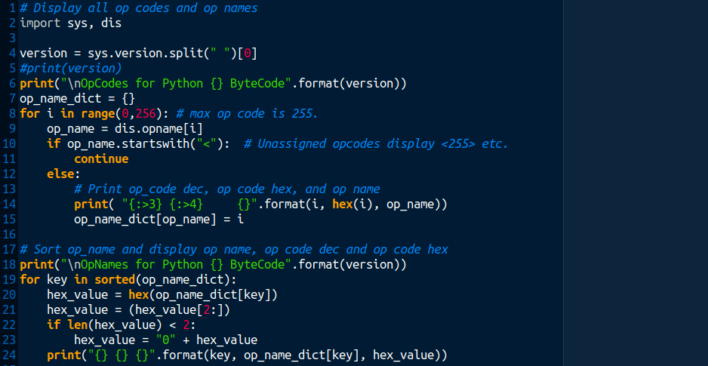
Display Op Names / Codes

Slide 14
Python 3.10 ByteCode. 127 Op Code Instructions.
OP Name | Dec | Hex | Op Name | Dec | Hex | Op Name | Dec | Hex
BEFORE_ASYNC_WITH | 52 | 34 | BUILD_STRING | 157 | 9d | EXTENDED_ARG | 144 | 90
BINARY_ADD | 23 | 17 | BUILD_TUPLE | 102 | 66 | FORMAT_VALUE | 155 | 9b
BINARY_AND | 64 | 40 | CALL_FUNCTION | 131 | 83 | FOR_ITER | 93 | 5d
BINARY_FLOOR_DIVIDE | 26 | 1a | CALL_FUNCTION_EX | 142 | 8e | GEN_START | 129 | 81
BINARY_LSHIFT | 62 | 3e | CALL_FUNCTION_KW | 141 | 8d | GET_AITER | 50 | 32
BINARY_MATRIX_MULTIPLY | 16 | 10 | CALL_METHOD | 161 | a1 | GET_ANEXT | 51 | 33
BINARY_MODULO | 22 | 16 | COMPARE_OP | 107 | 6b | GET_AWAITABLE | 73 | 49
BINARY_MULTIPLY | 20 | 14 | CONTAINS_OP | 118 | 76 | GET_ITER | 68 | 44
BINARY_OR | 66 | 42 | COPY_DICT_WITHOUT_KEYS | 34 | 22 | GET_LEN | 30 | 1e
BINARY_POWER | 19 | 13 | DELETE_ATTR | 96 | 60 | GET_YIELD_FROM_ITER | 69 | 45
BINARY_RSHIFT | 63 | 3f | DELETE_DEREF | 138 | 8a | IMPORT_FROM | 109 | 6d
BINARY_SUBSCR | 25 | 19 | DELETE_FAST | 126 | 7e | IMPORT_NAME | 108 | 6c
BINARY_SUBTRACT | 24 | 18 | DELETE_GLOBAL | 98 | 62 | IMPORT_STAR | 84 | 54
BINARY_TRUE_DIVIDE | 27 | 1b | DELETE_NAME | 91 | 5b | INPLACE_ADD | 55 | 37
BINARY_XOR | 65 | 41 | DELETE_SUBSCR | 61 | 3d | INPLACE_AND | 77 | 4d
BUILD_CONST_KEY_MAP | 156 | 9c | DICT_MERGE | 164 | a4 | INPLACE_FLOOR_DIVIDE | 28 | 1c
BUILD_LIST | 103 | 67 | DICT_UPDATE | 165 | a5 | INPLACE_LSHIFT | 75 | 4b
BUILD_MAP | 105 | 69 | DUP_TOP | 4 | 04 | INPLACE_MATRIX_MULTIPLY | 17 | 11
BUILD_SET | 104 | 68 | DUP_TOP_TWO | 5 | 05 | INPLACE_MODULO | 59 | 3b
BUILD_SLICE | 133 | 85 | END_ASYNC_FOR | 54 | 36 | INPLACE_MULTIPLY | 57 | 39

Slide 15
asd
OP Code | Dec | Hex | Op Code | Dec | Hex | Op Code | Dec | Hex
INPLACE_OR | 79 | 4f | LOAD_GLOBAL | 116 | 74 | SETUP_ANNOTATIONS | 85 | 55
INPLACE_POWER | 67 | 43 | LOAD_METHOD | 160 | a0 | SETUP_ASYNC_WITH | 154 | 9a
INPLACE_RSHIFT | 76 | 4c | LOAD_NAME | 101 | 65 | SETUP_FINALLY | 122 | 7a
INPLACE_SUBTRACT | 56 | 38 | MAKE_FUNCTION | 132 | 84 | SETUP_WITH | 143 | 8f
INPLACE_TRUE_DIVIDE | 29 | 1d | MAP_ADD | 147 | 93 | SET_ADD | 146 | 92
INPLACE_XOR | 78 | 4e | MATCH_CLASS | 152 | 98 | SET_UPDATE | 163 | a3
IS_OP | 117 | 75 | MATCH_KEYS | 33 | 21 | STORE_ATTR | 95 | 5f
JUMP_ABSOLUTE | 113 | 71 | MATCH_MAPPING | 31 | 1f | STORE_DEREF | 137 | 89
JUMP_FORWARD | 110 | 6e | MATCH_SEQUENCE | 32 | 20 | STORE_FAST | 125 | 7d
JUMP_IF_FALSE_OR_POP | 111 | 6f | NOP | 9 | 09 | STORE_GLOBAL | 97 | 61
JUMP_IF_NOT_EXC_MATCH | 121 | 79 | POP_BLOCK | 87 | 57 | STORE_NAME | 90 | 5a
JUMP_IF_TRUE_OR_POP | 112 | 70 | POP_EXCEPT | 89 | 59 | STORE_SUBSCR | 60 | 3c
LIST_APPEND | 145 | 91 | POP_JUMP_IF_FALSE | 114 | 72 | UNARY_INVERT | 15 | 0f
LIST_EXTEND | 162 | a2 | POP_JUMP_IF_TRUE | 115 | 73 | UNARY_NEGATIVE | 11 | 0b
LIST_TO_TUPLE | 82 | 52 | POP_TOP | 1 | 01 | UNARY_NOT | 12 | 0c
LOAD_ASSERTION_ERROR | 74 | 4a | PRINT_EXPR | 70 | 46 | UNARY_POSITIVE | 10 | 0a
LOAD_ATTR | 106 | 6a | RAISE_VARARGS | 130 | 82 | UNPACK_EX | 94 | 5e
LOAD_BUILD_CLASS | 71 | 47 | RERAISE | 119 | 77 | UNPACK_SEQUENCE | 92 | 5c
LOAD_CLASSDEREF | 148 | 94 | RETURN_VALUE | 83 | 53 | WITH_EXCEPT_START | 49 | 31
LOAD_CLOSURE | 135 | 87 | ROT_FOUR | 6 | 06 | YIELD_FROM | 72 | 48
LOAD_CONST | 100 | 64 | ROT_N | 99 | 63 | YIELD_VALUE | 86 | 56
LOAD_DEREF | 136 | 88 | ROT_THREE | 3 | 03
LOAD_FAST | 124 | 7c | ROT_TWO | 2 | 02
asd

Slide 16
Op Name Changes Example
Python 3.10
Total Op Names: 127
Op Names in 3.10, but not in 3.11: 46
Python 3.11
Total Op Names: 110
Op Names in 3.11, but not in 3.10: 29
Op Names in both 3.10 and 3.11: 81
https://leanpub.com/insidethepythonvirtualmachine/read
https://nedbatchelder.com/blog/200804/the_structure_of_pyc_files.html
https://towardsdatascience.com/understanding-python-bytecode-e7edaae8734d

Slide 17
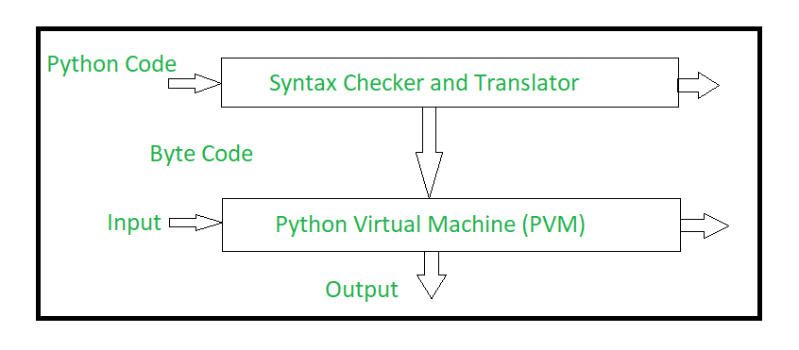
Python Compile and Interpret - Simplified
The Python source code goes through the following to generate an executable code :
Step 1: The python compiler reads a python source code or instruction. Then it verifies that the instruction is well-formatted, i.e. it checks the syntax of each line. If it encounters an error, it immediately halts the translation and shows an error message.
Step 2: If there is no error, i.e. if the python instruction or source code is well-formatted then the compiler translates it into its equivalent form in an intermediate language called “Byte code”.
Step 3: Byte code is then sent to the Python Virtual Machine(PVM) which is the python interpreter. PVM converts the python byte code into machine-executable code. If an error occurs during this interpretation then the conversion is halted with an error message
https://www.geeksforgeeks.org/internal-working-of-python/

Slide 18
Flow during the execution of source code
Initialization
main
Py_Main
Compilation
parse tree generation
AST generation
bytecode generation
bytecode optimization
code object generation
https://www.geeksforgeeks.org/internal-working-of-python/
code object execution
https://leanpub.com/insidethepythonvirtualmachine/read

Slide 19
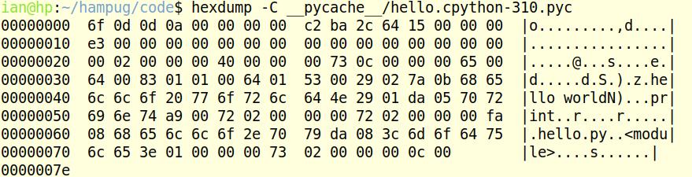
Bytecode

Slide 20
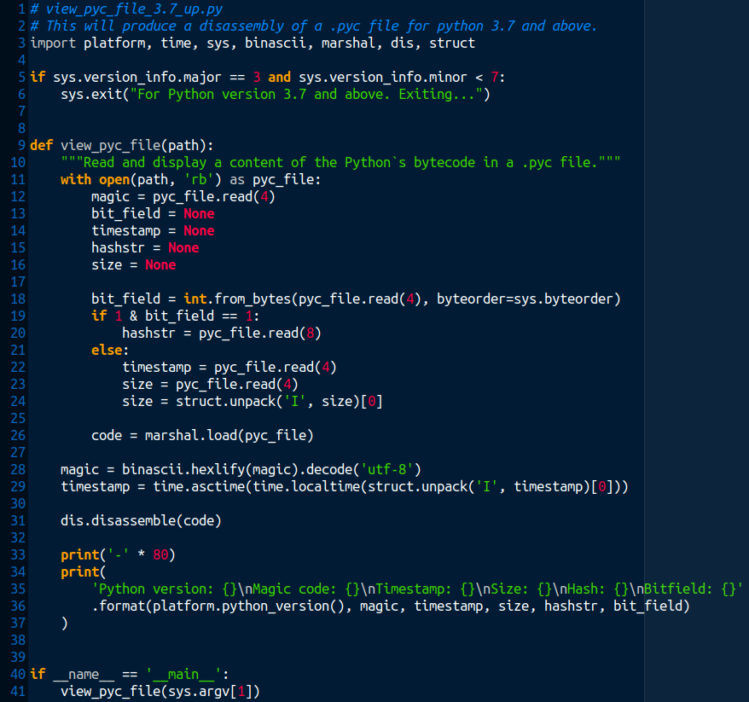
Disassemble
.pyc file 1/2

Slide 21
Program to Disassemble .pyc file 2/2

Slide 22
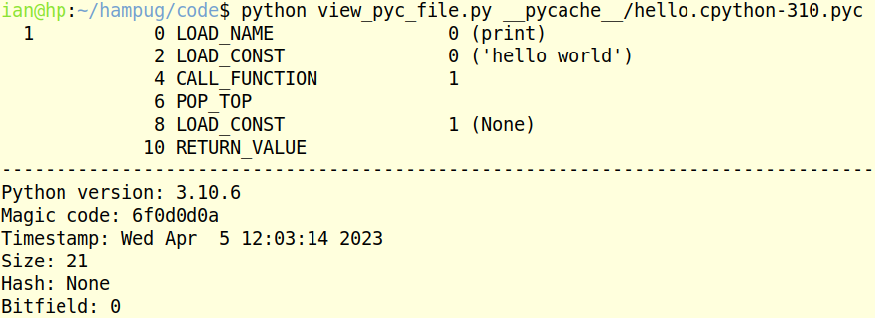
view_pyc_file.py

Slide 23
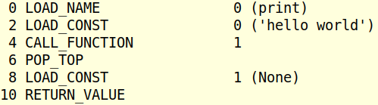
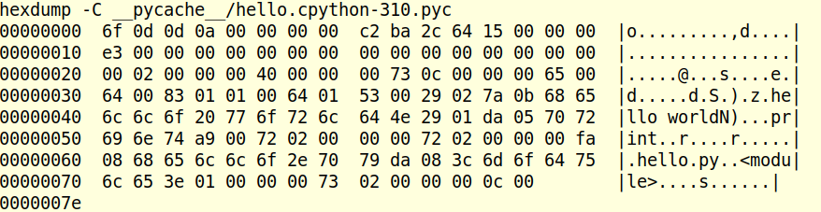
Op Codes in .pyc file
Op Name | Decimal | Hex
LOAD_NAME | 101 | 65
LOAD_CONST | 100 | 64
CALL_FUNCTION | 131 | 83
POP_TOP | 1 | 01
LOAD_CONST | 100 | 64
RETURN_VALUE | 83 | 53

Slide 24
Additional data in .pyc file
Date
$ hex=642cbac2
$ echo "ibase=16; ${hex^^}" | bc
1680652994
$ date --date='@1680652994'
Wed 05 Apr 2023 12:03:14 NZST
Size
$ hex=00000015
$ echo "ibase=16; ${hex^^}" | bc
21
Magic code: 6f0d0d0a
Bit Field: 00000000

Slide 25
Tools

Slide 26
Jupyter Notebook
https://jupyter.org/
Install the classic Jupyter Notebook with:
$ pip install notebook
OR:
$ sudo apt install jupyter-notebook
To run the notebook:
$ jupyter-notebook

Slide 27
IDE’s
Geany
https://geany.org/
$ sudo apt install geany
PyCharm
https://www.jetbrains.com/pycharm/
Download:
https://www.jetbrains.com/pycharm/download/#section=linux

Slide 28
Git / Github
Git
https://en.wikipedia.org/wiki/Git
Install:
$ sudo apt install git
Github
https://github.com

Slide 29
Python mailing-list
A general discussion list for the Python programming language.
Subscribe at:
https://mail.python.org/mailman/listinfo/python-list
NZPUG Mailing list:
https://groups.google.com/g/nzpug

Slide 30
Taylor Expansion Series – Raspberry Pi Pico ADC

Slide 31
Taylor Expansion Series – Raspberry Pi Pico ADC
Pico module has 5 x 12 bit ADC.
Inputs in the range 0 to 3.3V will output 0 to 4095.
Micropython converts this 12 bit value to a 16 bit value:
0 to 65535 in steps of “mostly” 16, but sometimes 17.
https://en.wikipedia.org/wiki/Taylor_series

Slide 32
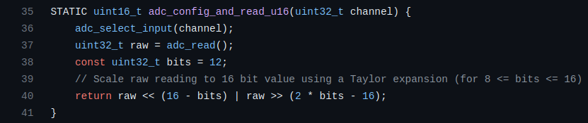
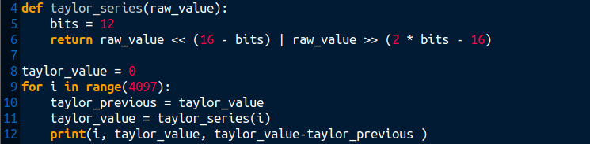
Taylor Expansion Series – Raspberry Pi Pico ADC
https://github.com/micropython/micropython/blob/master/ports/rp2/machine_adc.c

Slide 33
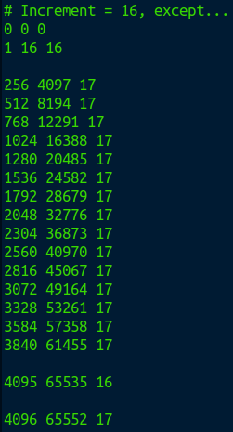
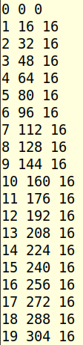
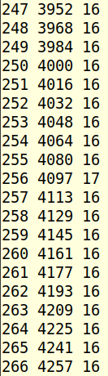
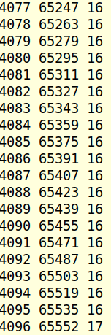
Taylor

Slide 34
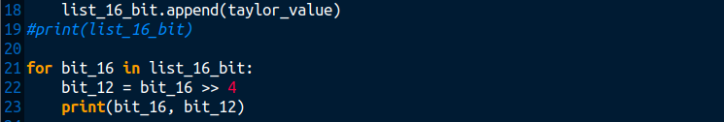


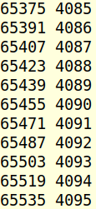
Taylor – 16 bit to 12 bit

Slide 35
Demo
Demo Pico module on breadboard with 100K ohm trim pot between +3.3V and ground.
Feed the trim pot wiper into the ADC channel.
Run adc_1.py to sample ADC every second...
While turning the trim pot through full range.
Output of program should be from 0 to 4095 (i.e. 12 bit range).

Slide 36
...end

