Slide 1
Number Theory
The joy of recursion / iteration
Hamilton Python Users Group
14 November 2022
Ian Stewart

Slide 2
Number Theory
The joy of Integers !!!
In Python, if integers in then integers out, with these operators:
+ Addition
- Subtraction
* Multiplication
// Integer divide
% Modulo
** Exponent / pow()
Also:
Reverse/Rearrange the order of digits in an integer
Sort order of digits in integer
Sort of integers in a list

Slide 3
Kaprekar Constant
D. R. Kaprekar
Recreational mathematician
1905 – 1986
https://en.wikipedia.org/wiki/Kaprekar%27s_routine
https://en.wikipedia.org/wiki/D._R._Kaprekar

Slide 4
Rules...
Kaprekar's routine is an iterative algorithm that, with each iteration:
Take a natural number in a given number base.
Must have at least two distinct digits.
Create two new numbers by sorting the digits of the number by descending and ascending order.
Subtract the second from the first to yield the natural number for the next iteration.
Natural number in base 10: 164
164 in descending order: 641
164 in ascending order: 146
====
Subtraction: 495

Slide 5
Example...
With three digits loop on 495
Natural number in base 10: 495
164 in descending order: 954
164 in ascending order: 459
====
Subtraction: 495
Demo:
python kaprekar_constant.py 164 – 1 iteration
python kaprekar_constant.py 100 – 6 iterations
555 and 495

Slide 6
What about a 4 digit number? E.g. 2060
Initial integer: 2060
Iteration count: 1
Rearranged decending: 6200
Rearranged accending: 0026
Sutraction result: 6174
Iteration count: 2
Rearranged decending: 7641
Rearranged accending: 1467
Sutraction result: 6174

Slide 7
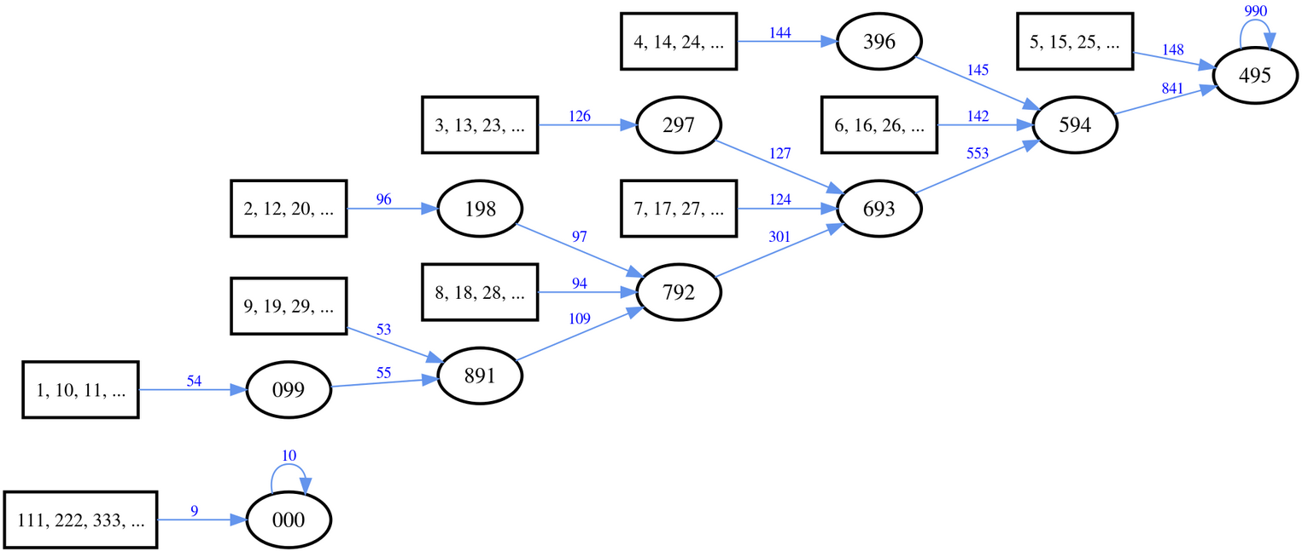
Kaprekar process for three digits...

Slide 8
Ian’s Python approach.
Only one mathematical operation (subtract) per iteration.
Most of the program concerns digit position manipulaton.
Keep data as string or string in a list.
So… Change string data to integer to perform the subtraction.

Slide 9
Ian’s Python approach.
Convert string to list:
>>> int_str = "1234"
>>> int_list = list(int_str)
>>> int_str
'1234'
>>> int_list
['1', '2', '3', '4']
>>> int_list = []
>>> int_str = "1234"
>>> int_list[:0] = int_str
>>> int_str
'1234'
>>> int_list
['1', '2', '3', '4']

Slide 10
Ian’s Python approach.
Convert string to list using sorted:
>>> int_str = "2341"
>>>
>>> sorted(int_str)
['1', '2', '3', '4']
>>> int_str = "2341"
>>>
>>> sorted(int_str, reverse=True)
['4', '3', '2', '1']
Sort list in reverse order:
Convert list back to string:
>>> int_list = ["2", "3", "4", "1"]
>>> int_list
['2', '3', '4', '1']
>>> int_list.sort(reverse=True)
>>> int_list
['4', '3', '2', '1']
>>> int_descend = "".join(int_list)
>>> int_descend
'4321'

Slide 11
Ian’s Python approach.
Reverse a list:
Reverse a string:
>>> int_list
['4', '3', '2', '1']
>>> int_list.reverse()
>>> int_list
['1', '2', '3', '4']
>>> int_str
'1234'
>>> int_str[::-1]
'4321'
Demo:
python kaprekar_constant.py - 100 to 9999 with their iteration count

Slide 12
Narcissistic Number
Also known as:
pluperfect digital invariant (PPDI)
Armstrong number
plus perfect number
Michael F. Armstrong
1941 – 2020
American mathematician and teacher of computer science

Slide 13
Narcissistic Number
A number that is the sum of its own digits each raised to the power of the number of digits.
E.g. 153₁₀ is three digits. So…
1³ + 5³ + 3³ = 153
1 + 125 + 27 = 153
There are only 89 narcissistic numbers in base 10, of which the largest is: 115,132,219,018,763,992,565,095,597,973,971,522,401
...with 39 digits.

Slide 14
Narcissistic Number
Get the total digits in a number:
Iterate integer divide method:
Length of string method
>>> y = 370
>>> digit_count = 0
>>> while y > 0:
... digit_count = digit_count + 1
... y = y // 10
...
>>> digit_count
3
>>> y = 370
>>> digit_count = len(str(y))
>>> digit_count
3
Demo:
python narcissistic.py – 26 seconds to get fir less than 1000000

Slide 15
Narcissistic Number
#for i in range (0, 1000000): # 1M 2 secs 21 found
for i in range (0, 10000000): # 10M 26 secs 25 found
#for i in range (0, 100000000): # 100M 278 secs 28 found
#for i in range (0, 1000000000): # 1B 3167 secs 32 found
Demo:
python narcissistic.py – 26 seconds to get fir less than 1000000
python narcissistic_1.py
Enter number:115132219018763992565095597973971522401

Slide 16
Prime Number
Tkinter program with various methods of finding prime numbers:
Skips the even numbers. Excessively recursive
Skip all modulo 6 that do not have a remainder of 1 or 5
Minimal Recursion
Use sympy: one at a time. list(sympy.primerange(i, i+1))
Use sympy: list(sympy.primerange(start_integer, end_integer))
Demo:
python prime_number_locator.py

