Slide 1
Python Gtk Introduction and simh for Alpha.
Hamilton Python Users Group
Ian Stewart
2021-04-12

Slide 2
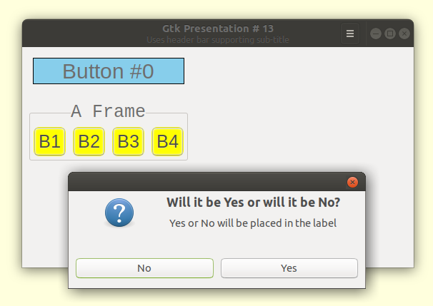
Construct a Gtk GUI Window

Slide 3
Example of Widgets and Containers
Window
Title
Minimize Maximize Close
Main Grid
My Label
Grid 0,0
Label
Frame
A Frame
Grid 0,1
F-Grid 0,0
F-Grid 1,0
F-Grid 2,0
F-Grid 3,0
Frame Grid
Button
0
Button
1
Button
2
Button
3
Button Arrray

Slide 4
Simh – Installing/Using V4.0 for Alpha
$ pdp11
PDP-11 simulator V3.8-1
sim> exit
Goodbye
ian@ian:~$ alpha
alpha: command not found
ian@ian:~$ sudo apt remove simh
Install guide:
https://github.com/simh/simh#building-and-running-a-simulator
https://github.com/simh/simh/archive/master.zip
sudo apt install libpcap-dev libpcre3-dev vde2 libsdl2-2.0-0 libsdl2-ttf-2.0-0
$ make {simulator-name (i.e. vax)}

Slide 5
$ sudo apt install libpcap-dev libpcre3-dev vde2 libsdl2-2.0-0 libsdl2-ttf-2.0-0
Reading package lists... Done
Building dependency tree
Reading state information... Done
libsdl2-2.0-0 is already the newest version (2.0.10+dfsg1-3).
libsdl2-2.0-0 set to manually installed.
The following package was automatically installed and is no longer required:
libllvm10
Use 'sudo apt autoremove' to remove it.
The following additional packages will be installed:
libpcap0.8-dev libpcre16-3 libpcre32-3 libpcrecpp0v5 libvde0 libvdeplug2
Suggested packages:
vde2-cryptcab qemu-kvm qemu
The following NEW packages will be installed:
libpcap-dev libpcap0.8-dev libpcre16-3 libpcre3-dev libpcre32-3
libpcrecpp0v5 libsdl2-ttf-2.0-0 libvde0 libvdeplug2 vde2
0 upgraded, 10 newly installed, 0 to remove and 0 not upgraded.
Need to get 1,339 kB of archives.
After this operation, 5,463 kB of additional disk space will be used.
Do you want to continue? [Y/n] y

Slide 6
$ gcc --version
gcc (Ubuntu 9.3.0-17ubuntu1~20.04) 9.3.0
Copyright (C) 2019 Free Software Foundation, Inc.
This is free software; see the source for copying conditions. There is NO
warranty; not even for MERCHANTABILITY or FITNESS FOR A PARTICULAR PURPOSE.

Slide 7
ian@ian:~/Desktop/simh/simh-master$ pwd
/home/ian/Desktop/simh/simh-master
ian@ian:~/Desktop/simh/simh-master$ make alpha
lib paths are: /lib/ /lib/x86_64-linux-gnu/ /usr/lib/x86_64-linux-gnu/libfakeroot/ /usr/lib/
include paths are: /usr/lib/gcc/x86_64-linux-gnu/9/include /usr/local/include /usr/include/x86_64-linux-gnu /usr/include
using libm: /lib/x86_64-linux-gnu/libm.so
using librt: /lib/x86_64-linux-gnu/librt.so
using libpthread: /lib/x86_64-linux-gnu/libpthread.so /usr/include/pthread.h
using libpcre: /lib/x86_64-linux-gnu/libpcre.so /usr/include/pcre.h
using semaphore: /usr/include/semaphore.h
using libdl: /lib/x86_64-linux-gnu/libdl.so /usr/include/dlfcn.h
using mman: /usr/include/x86_64-linux-gnu/sys/mman.h
***
*** alpha Simulator being built with:
*** - compiler optimizations and no debugging support. GCC Version: 9.3.0.
*** - Per simulator tests will be run.
***
*** git commit id is b90b1eaf6f3692f25f22b39ae4bc83b6ca18f19f.
*** git commit time is 2021-04-09T07:31:36-07:00.
***

Slide 8
***
gcc -std=gnu99 -U__STRICT_ANSI__ -O2 -finline-functions -fgcse-after-reload -fpredictive-commoning -fipa-cp-clone -fno-unsafe-loop-optimizations -fno-strict-overflow -DSIM_GIT_COMMIT_ID=b90b1eaf6f3692f25f22b39ae4bc83b6ca18f19f -DSIM_GIT_COMMIT_TIME=2021-04-09T07:31:36-07:00 -DSIM_COMPILER="GCC Version: 9.3.0" -DSIM_BUILD_TOOL=simh-makefile -I . -D_GNU_SOURCE -DUSE_READER_THREAD -DSIM_ASYNCH_IO -DHAVE_PCRE_H -DHAVE_SEMAPHORE -DHAVE_SYS_IOCTL -DHAVE_LINUX_CDROM -DHAVE_DLOPEN=so -DHAVE_UTIME -DHAVE_GLOB -DHAVE_SHM_OPEN ./alpha/alpha_500au_syslist.c ./alpha/alpha_cpu.c ./alpha/alpha_ev5_cons.c ./alpha/alpha_ev5_pal.c ./alpha/alpha_ev5_tlb.c ./alpha/alpha_fpi.c ./alpha/alpha_fpv.c ./alpha/alpha_io.c ./alpha/alpha_mmu.c ./alpha/alpha_sys.c ./scp.c ./sim_console.c ./sim_fio.c ./sim_timer.c ./sim_sock.c ./sim_tmxr.c ./sim_ether.c ./sim_tape.c ./sim_disk.c ./sim_serial.c ./sim_video.c ./sim_imd.c ./sim_card.c -I ./alpha -DUSE_ADDR64 -DUSE_INT64 -o BIN/alpha -lm -lrt -lpthread -lpcre -ldl
BIN/alpha RegisterSanityCheck </dev/null
Running internal register sanity checks on Alpha simulator.
*** Good Registers in Alpha simulator.
ian@ian:~/Desktop/simh/simh-master$

Slide 9
$ cd BIN
ian@ian:~/Desktop/simh/simh-master/BIN$ ./alpha
Alpha simulator V4.0-0 Current git commit id: b90b1eaf
sim>
sim> ev LDQ R0,8(R1)
0: 00000000A4010008
sim> d 1000 A4010008
sim> e 1000
1000: 00000000A4010008
sim> e -m 1000
1000: LDQ R0,8(R1)

Slide 10
$ cat jump_1
; Jump instruction
; sim> ev JMP R0,(R1),0
; 0: 0000000068010000
d 1000 68010000
go 1000 until 0
;$ ./alpha jump_1
;
;Alpha simulator V4.0-0 Current git commit id: 3c1c92dc
;
;Breakpoint, PC: 0 (0000000000000000)
;sim> e r0
;R0: 0000000000001004 <--- Updated PC before the jump
;sim>

Slide 11
ian@ian:~/Desktop/simh/simh-master/BIN$ rlwrap ./alpha jump_1
Alpha simulator V4.0-0 Current git commit id: b90b1eaf
Breakpoint, PC: 0 (0000000000000000)
sim> exit
Goodbye

Slide 12
Things to know:
Use rlwrap (especially for simh Version 3.8)
Control E to halt when hung
ev LDQ R0,8(R1)
...to evaluate macro to machine code
e -m 1000:1010
...to examine instructions and provide macro
go 1000 until 1100
... Start running code and provide the halt
; Semicolon is a comment delimiter

