Slide 1
MkDocs for HamPUG meetings repository
Using MkDocs application to create a static project website off the /docs folder of the HamPUG Github “meetings” repository.
Hamilton Python Users Group
Ian Stewart
2019-09-09.

Slide 2
Introduction
GitHub Pages
You can configure GitHub Pages to publish your site's source files from master, gh-pages, or a /docs folder on your master branch for Project Pages and other Pages sites that meet certain criteria. Refer:: https://pages.github.com/
MkDocs
MkDocs is a fast, simple and downright gorgeous static site generator that's geared towards building project documentation. Documentation source files are written in Markdown, and configured with a single YAML configuration file.
Refer: https://www.mkdocs.org/
MkDocs Overview: Slides 3 to 9

Slide 3
MkDocs – Markdown to Static Website 1/4
Edit file using:
ReText or Mark Text
# My Website
This is *my website*.
This document is created using [Markdown](https://www.markdownguide.org/).
Users Browser
Local web-server: http://127.0.0.1:8000
Folder: docs/
MkDocs
Application
Folder: site/
<h1>My Website</h1>
<p>This is <i>my website</i></p>...
Html file:
index.html
Markdown file:
index.md

Slide 4
MkDocs – Markdown to Static Website 2/4
Edit file using:
ReText or Mark Text
Users Browser
Web-server: https://mysite.org
Folder: /var/www/
Internet
# My Website
This is *my website*.
This document is created using [Markdown](https://www.markdownguide.org/).
Html file:
index.html
Upload
Folder: docs/
MkDocs
Application
Folder: site/
<h1>My Website</h1>
<p>This is <i>my website</i></p>...
Html file:
index.html
Markdown file:
index.md

Slide 5
MkDocs – Markdown to Static Website 3/4
Users Browser
Github Account: my_account
Web-server: https://mysite.org
Folder: source_docs/
Folder: /var/www/
Internet
Markdown file:
index.md
Html file:
index.html
Push
Upload
Folder: docs/
MkDocs
Application
Folder: site/
Html file:
index.html
Markdown file:
index.md

Slide 6
MkDocs – Markdown to Static Website 4/4
Users Browser
Github Account:
https://github.com/my_account/repo/
Github Pages. Web-server: https://my_account.github.io/repo/
Folder: source_docs/
Folder: / or docs/
Internet
Markdown file:
index.md
Html file:
index.html
Push
Deploy
Folder: docs/
MkDocs
Application
Folder: site/
Markdown file:
index.md
Html file:
index.html

Slide 7
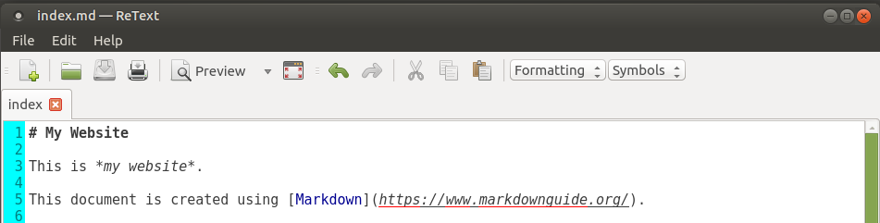
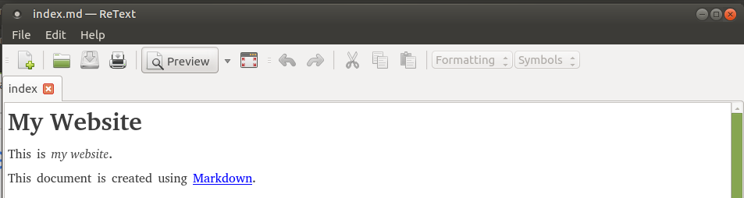
MkDocs – Create index.md file

Slide 8
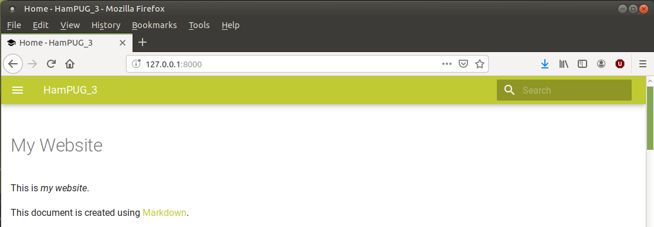
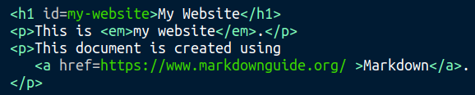
$ mkdocs build converts to html, build website.
$ mkdocs serve displays the website
Search facility

Slide 9
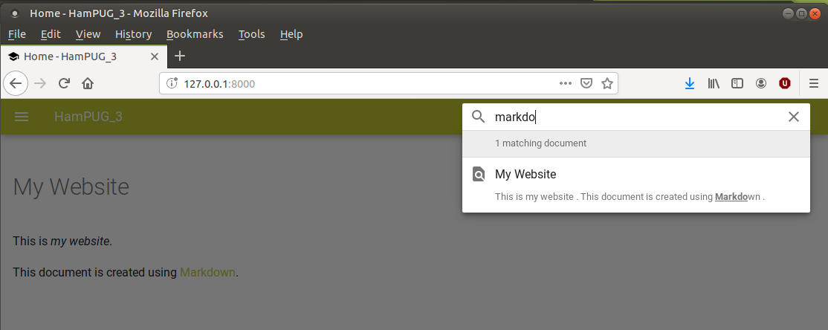
Website using search feature

Slide 10
Using MkDocs to create Meetings website
Steps:
Fork HamPUG meetings to personal Github repository
Create local directory
Git clone of GitHub to local repository
Generate a index.html as a test website home page
Push to Github
Update settings on Github to support project webpages.
Check project website
Create website: Slides 11 to 29

Slide 11
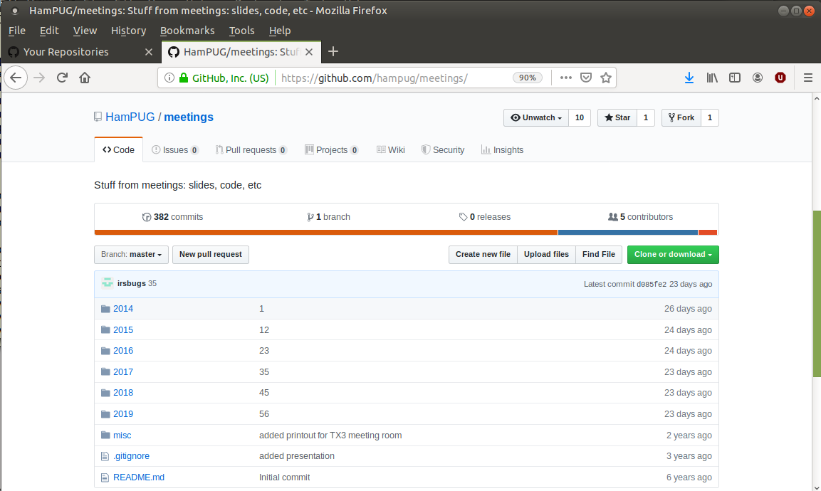
HamPUG meetings repository

Slide 12

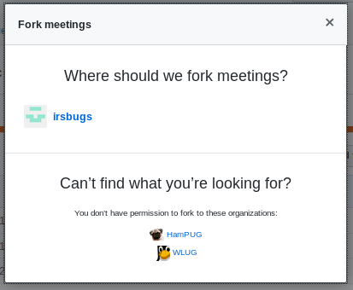
Fork
In HamPUG meeting repository – Click on “Fork”
In Fork meetings – Click on personal Github account

Slide 13
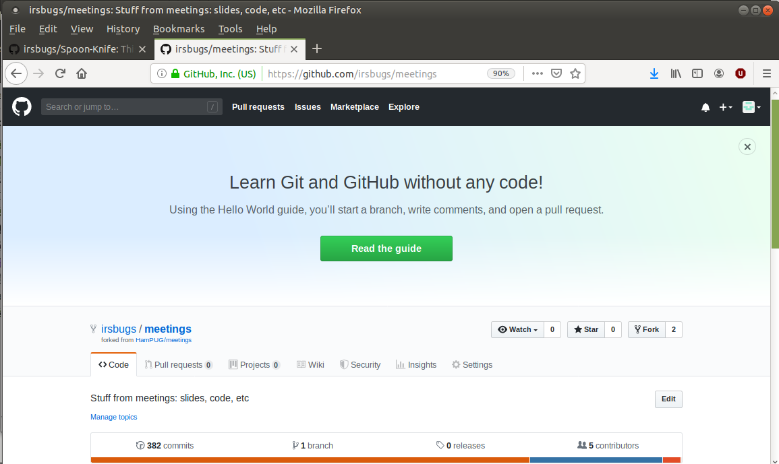
Personal Github account now has “meetings”

Slide 14
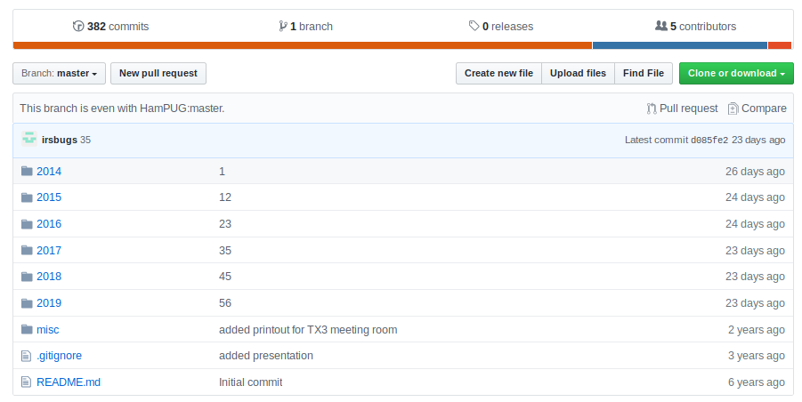
Branch is even with HamPUG master

Slide 15
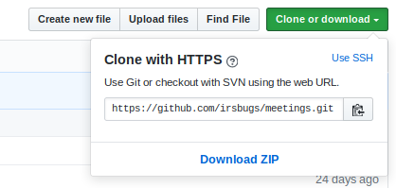
Prepare local directory for meeting repository
Click on “Clone or download” and copy URL
Launch Virtual Environment and create directory for cloned respository
ian@X200:~$ source venv7/bin/activate
(venv7) ian@X200:~$ mkdir hampug-website
(venv7) ian@X200:~$ cd hampug-website

Slide 16
Clone “meetings”
(venv7) ian@X200:~/hampug-website$ git clone https://github.com/irsbugs/meetings.git
Cloning into 'meetings'...
remote: Enumerating objects: 175, done.
remote: Counting objects: 100% (175/175), done.
remote: Compressing objects: 100% (165/165), done.
remote: Total 2360 (delta 66), reused 0 (delta 0), pack-reused 2185
Receiving objects: 100% (2360/2360), 98.39 MiB | 1.27 MiB/s, done.
Resolving deltas: 100% (995/995), done.
(Duration: About 1 minute)

Slide 17
Folders created
(venv7) ian@X200:~/hampug-website$ ls -l
drwxrwxr-x 11 ian ian 4096 Sep 5 19:43 meetings
(venv7) ian@X200:~/hampug-website$ ls -la meetings
drwxrwxr-x 10 ian ian 4096 Sep 5 19:37 .
drwxrwxr-x 3 ian ian 4096 Sep 5 19:36 ..
drwxrwxr-x 13 ian ian 4096 Sep 5 19:37 2014
drwxrwxr-x 13 ian ian 4096 Sep 5 19:37 2015
drwxrwxr-x 13 ian ian 4096 Sep 5 19:37 2016
drwxrwxr-x 13 ian ian 4096 Sep 5 19:37 2017
drwxrwxr-x 13 ian ian 4096 Sep 5 19:37 2018
drwxrwxr-x 9 ian ian 4096 Sep 5 19:37 2019
drwxrwxr-x 8 ian ian 4096 Sep 5 19:37 .git
-rw-rw-r-- 1 ian ian 28 Sep 5 19:37 .gitignore
drwxrwxr-x 2 ian ian 4096 Sep 5 19:37 misc
-rw-rw-r-- 1 ian ian 58 Sep 5 19:37 README.md
“meetings” folder is a git repository

Slide 18
Checking
Check Git status
(venv7) ian@X200:~/hampug-website$ cd meetings
(venv7) ian@X200:~/hampug-website/meetings$ git status
On branch master
Your branch is up to date with 'origin/master'.
nothing to commit, working tree clean
(venv7) ian@X200:~/hampug-website/meetings$ mkdir docs
(venv7) ian@X200:~/hampug-website/meetings$ cd docs
(venv7) ian@X200:~/hampug-website/meetings/docs$ touch index.html
(venv7) ian@X200:~/hampug-website/meetings/docs$ nano index.html
Generate a “test” website.

Slide 19
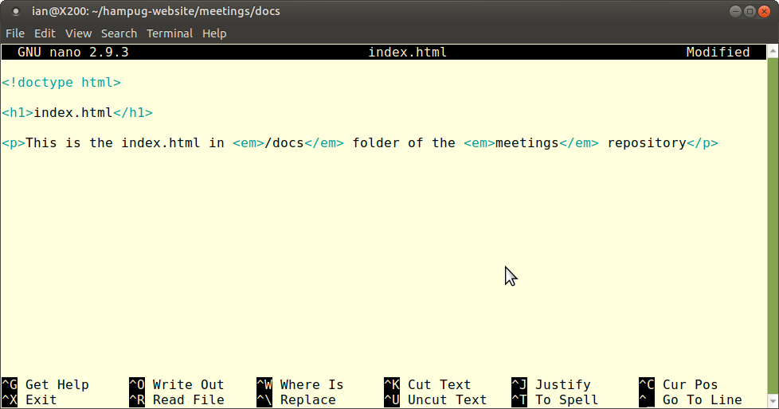
Use nano editor to create index.html

Slide 20
Check “test” webpage and git status
(venv7) ian@X200:~/hampug-website/meetings/docs$ cat index.html
<!doctype html>
<h1>index.html</h1>
<p>This is the index.html in <em>/docs</em> folder of the <em>meetings</em> repository</p>
(venv7) ian@X200:~/hampug-website/meetings/docs$ cd ..
(venv7) ian@X200:~/hampug-website/meetings$ git status
On branch master
Your branch is up to date with 'origin/master'.
Untracked files:
(use "git add <file>..." to include in what will be committed)
docs/
nothing added to commit but untracked files present (use "git add" to track)

Slide 21
Git: add, commit, push
(venv7) ian@X200:~/hampug-website/meetings$ git add --all
(venv7) ian@X200:~/hampug-website/meetings$ git commit -m "add test website"
[master 12c243c] add test website
1 file changed, 5 insertions(+)
create mode 100644 docs/index.html
(venv7) ian@X200:~/hampug-website/meetings$ git push -u origin master
Username for 'https://github.com': irsbugs
Password for 'https://irsbugs@github.com':
Counting objects: 4, done.
Delta compression using up to 2 threads.
Compressing objects: 100% (3/3), done.
Writing objects: 100% (4/4), 403 bytes | 403.00 KiB/s, done.
Total 4 (delta 1), reused 0 (delta 0)
remote: Resolving deltas: 100% (1/1), completed with 1 local object.
To https://github.com/irsbugs/meetings.git
d085fe2..12c243c master -> master
Branch 'master' set up to track remote branch 'master' from 'origin'.

Slide 22
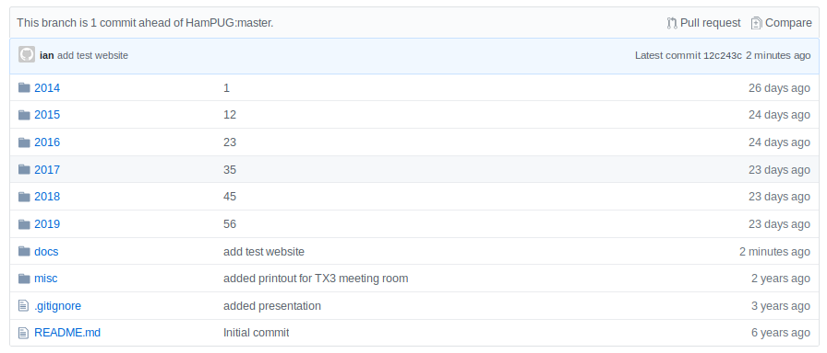
Review Github meetings repository
“docs” folder has been added

Slide 23
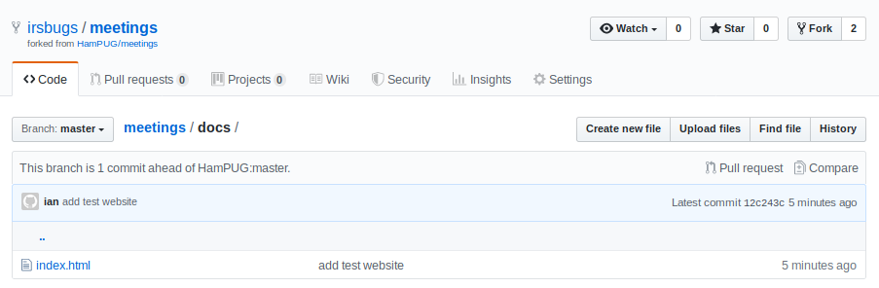
Review Github meetings/docs/ folder
“index.html” will become the home page of the website

Slide 24
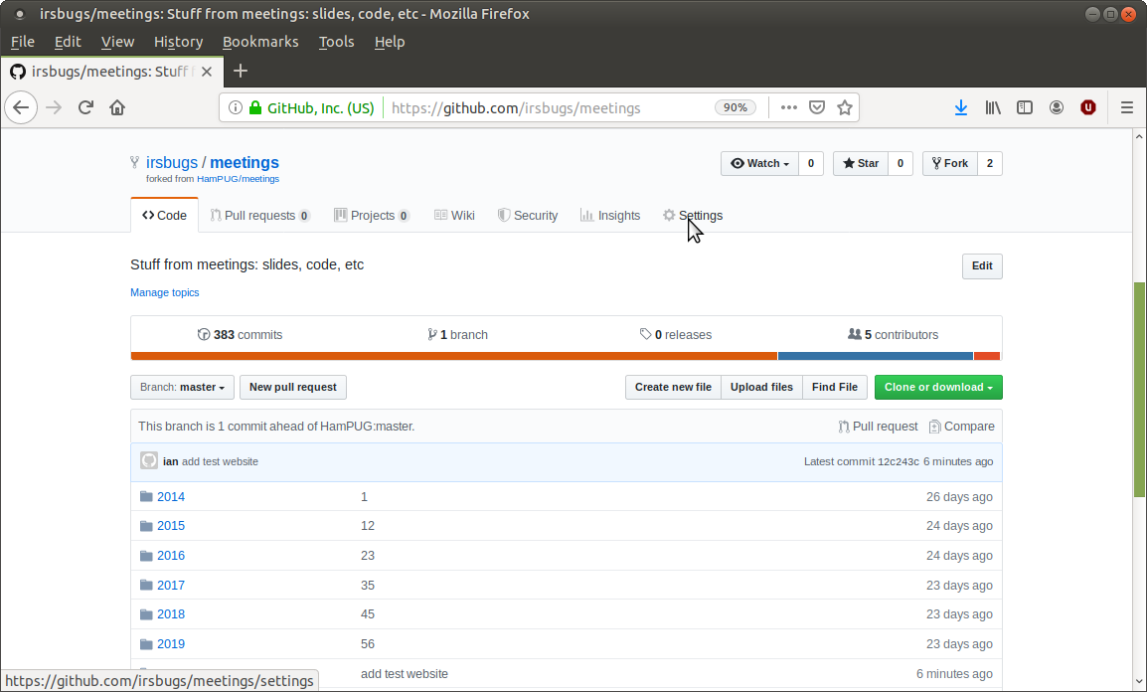
Change the Settings

Slide 25
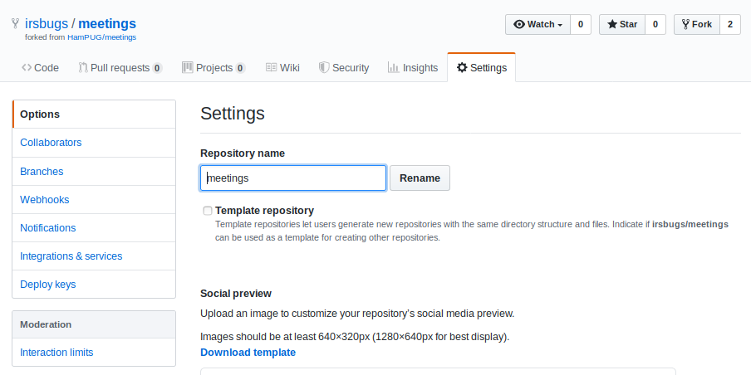
Settings. Scroll down

Slide 26
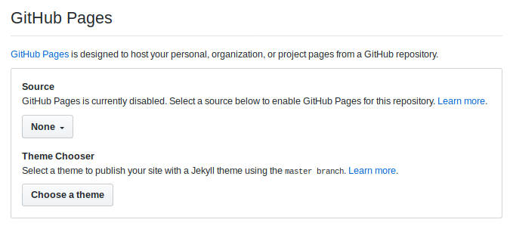
Settings. GitHub Pages
Default is “None”

Slide 27
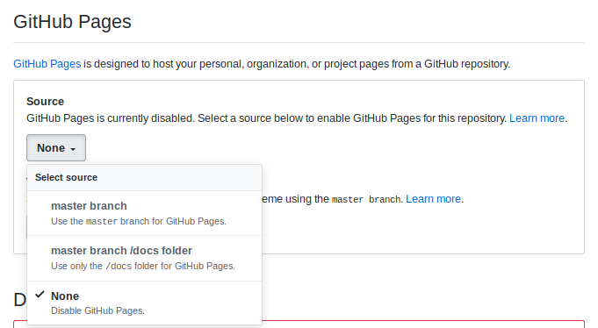
Settings. GitHub Pages
Select: master branch /docs folder

Slide 28
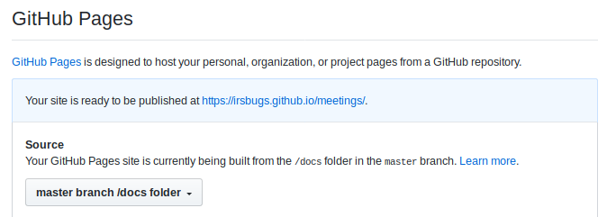
Settings. GitHub Pages

Slide 29
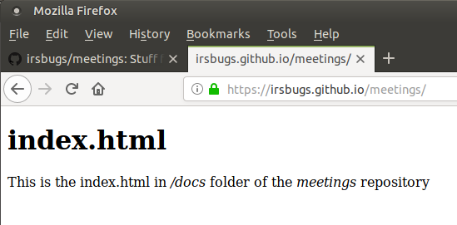
Check website: irsbugs/github.io/meetings

Slide 30
Python mkdocs-auto program
Objective:
A program that resides in the meetings repository that can be run to create a website of the markdown files in the meetings repository.
The meetings repository and the project website reside on Github.
Python program. Slides: 30 to 34

Slide 31
Python mkdocs-auto program.
Operation:
Check it is being run from meetings folder / repository
Check the markdown files in the meetings repository.
Create a mkdocs.yml configuration file and save up-one-level.
Go up-one-level and run mkdocs build –clean
meetings folder is the source, exclude meetings/docs/
Copy website files in docs/ to meetings/docs/
Push to Github
Website available at: https://irsbugs.github.io/meetings/

Slide 32
Python mkdocs-auto program. Steps:
(up one level)$ tree -L 2 -a
.
├── docs
│
├── meetings
│ ├── 2014
│ ├── 2015
│ ├── 2016
│ ├── 2017
│ ├── 2018
│ ├── 2019
│ ├── docs
│ ├── .git
│ ├── .gitignore
│ ├── mkdocs-auto
│ └── README.md
│
└── mkdocs.yml
5: Temporary folder for holding created website
Copy docs/*
1A: Clone of Github meetings repository
4A: Six Folders of meeting data. The README.md files will become index.html files in the website
6: docs folder that will become website on github
1B: Cloning created local .git repository
2: Python program to use mkdocs to create website.
4B: Mkdocs will convert this to index.html – home page
3: Program generated. Configuration file used my mkdocs

Slide 33
Python mkdocs-auto program
mkdocs.yml
site_name: HamPUG
docs_dir: meetings # Source files. Default is docs
site_dir: docs # Website files. (Temporary) Default is site.
# Website files are later rsync'ed to meetings/docs
plugins:
- exclude:
glob:
- docs/*
- "*.odp"
- "*.ipynb"
- "*.yml"
- about.md
- search:
Github website folder
Ensure that “search” plugin is envoked.
Currently there is no nav: in the mkdocs.yml file.

Slide 34
Python mkdocs-auto program
To Do’s:
Create nav: to place in mkdocs.yml?
Which theme and search engine?
Test adding images.
Standardize the README.md file layout.
Implement links
Implement using $ mkdocs gh-deploy
Source file using symbolic links to README’s

Slide 35
Demonstration / Questions
__end__

Slide 36
Links:
https://www.mkdocs.org/
https://www.mkdocs.org/user-guide/configuration/
https://github.com/apenwarr/mkdocs-exclude
https://github.com/mkdocs/mkdocs/blob/master/docs/user-guide/writing-your-docs.md
https://squidfunk.github.io/mkdocs-material/
https://github.com/adam-p/markdown-here/wiki/Markdown-Cheatsheet
https://daringfireball.net/projects/markdown/syntax
https://guides.github.com/activities/hello-world/
https://github.com/irsbugs/website/blob/master/source/about.md
https://www.mkdocs.org/user-guide/deploying-your-docs/
https://mkdocs.readthedocs.io/en/0.15.3/user-guide/deploying-your-docs/
https://romandc.com/techtalk-mkdocs/
https://help.github.com/en/articles/user-organization-and-project-pages#project-pages-sites
https://pages.github.com/
https://yaml.org/

