Slide 1

unchained
- from a novice point of view -

Slide 2
What is django?
high-level Python Web framework
  <= 1.11: Python 2.7 and 3.x
  >= 2.0: only 3.5+
not a CMS, though can be used to create CMS
rapid development
clean, pragmatic design
licensed under BSD
homepage
  https://www.djangoproject.com/

Slide 3
Features
authentication
database abstraction layer
  sqlite, mysql, postgresql, ...
  migrations when changing data models
secure
  no XSS, SQL Injection, clickjacking, etc
content administration
template support (jinja)
  eg add bootstrap for mobile/desktop interface
gazillions of plugins
  https://djangopackages.org/

Slide 4
Creating a project
excellent tutorial for newbies - like me
  https://docs.djangoproject.com/en/stable/intro/tutorial01/
create your project
  django-admin startproject hampug
fire up test server
  python manage.py runserver

Slide 5
Create first app
execute django command
  python manage.py startapp gallery
update settings.py
add a view (gallery/views.py)
INSTALLED_APPS = (
...
'gallery',
)
from django.http import HttpResponse
def index(request):
return HttpResponse("Hello World!")

Slide 6
Create first app (2)
add URL for view (gallery/urls.py)
add URL to project (hampug/urls.py)
from django.conf.urls import url
from . import views
urlpatterns = [
url(r'^$', views.index, name='index'),
]
from django.conf.urls import include, url
from django.contrib import admin
urlpatterns = [
url(r'^gallery/', include('gallery.urls')),
url(r'^admin/', admin.site.urls),
]

Slide 7
Bootstrap
create directory for static content
  hampug/static
download and unzip bootstrap into static
  http://getbootstrap.com/
let django know about static content (settings.py)
STATIC_URL = '/static/'
STATICFILES_DIRS = [
'hampug/static/',
]

Slide 8
Bootstrap (2)
create directory for templates
  hampug/templates
create base.html template
<html>
<head>
<title>{{ title }}</title>
<link rel="stylesheet" href="/static/css/bootstrap.min.css" type="text/css"/>
{% block head %}
{% endblock %}
</head>
<body>
{% block content %}this is the content{% endblock %}
<script src="/static/js/jquery.min.js"></script>
<script src="/static/js/bootstrap.min.js"></script>
</body>
</html>

Slide 9
Bootstrap (3)
add base_navbar.html template
{% extends "base.html" %}
{% block content %}
{% block top %}
<nav class="navbar navbar-inverse navbar-fixed-top">
<div class="container">
<div class="navbar-header">
<button type="button" class="navbar-toggle collapsed" data-toggle="collapse" data-target="#navbar" aria-expanded="false" aria-controls="navbar">
<span class="sr-only">Toggle navigation</span>
<span class="icon-bar"></span>
<span class="icon-bar"></span>
<span class="icon-bar"></span>
</button>
<a class="navbar-brand" href="/">Gallery</a>
</div>
</div>
</nav>
{% endblock %}
<div class="container">
{% block main %}
{% endblock %}
</div>
{% endblock %}

Slide 10
Bootstrap (4)
Create page for “Hello World!”
  gallery/templates/gallery/hello.html
{% extends "base_navbar.html" %}
{% block main %}
<h3>Hello World</h3>
<div class="panel panel-default">
<div class="panel-heading">
<h3 class="panel-title">Details</h3>
</div>
<div class="panel-body">
{{ text }}
</div>
</div>
{% endblock %}

Slide 11
Bootstrap (5)
update view (gallery/views.py)
from django.template import loader
from django.http import HttpResponse
def index(request):
template = loader.get_template('gallery/hello.html')
context = {
'text': "More details on the world"
}
return HttpResponse(template.render(context, request))

Slide 12
Bootstrap (final)
update settings.py
TEMPLATES = [
{
'BACKEND': 'django.template.backends.django.DjangoTemplates',
'DIRS': [
'hampug/templates'
],
'APP_DIRS': True,
'OPTIONS': {
'context_processors': [
'django.template.context_processors.debug',
'django.template.context_processors.request',
'django.contrib.auth.context_processors.auth',
'django.contrib.messages.context_processors.messages',
],
},
},
]

Slide 13
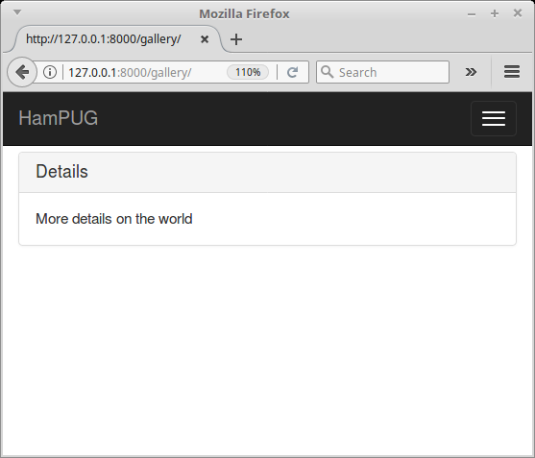
Mobile friendly website

