Slide 1
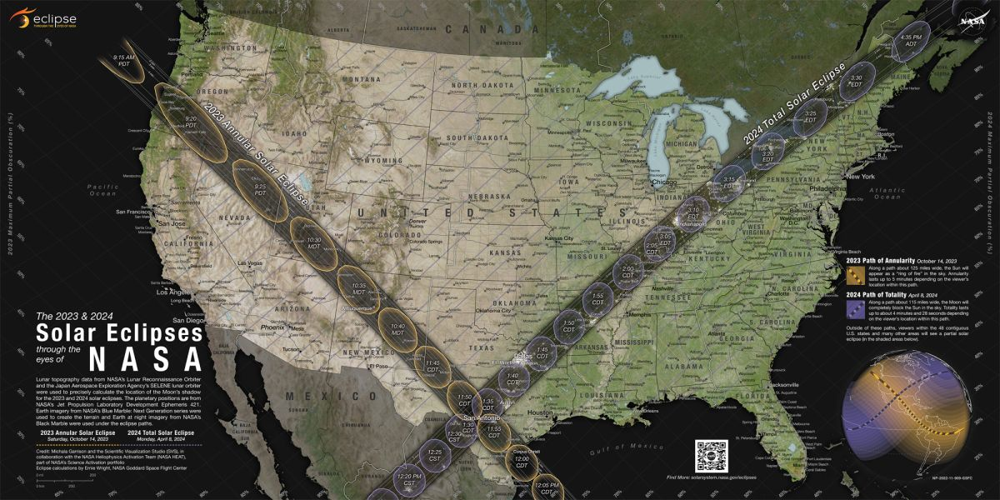
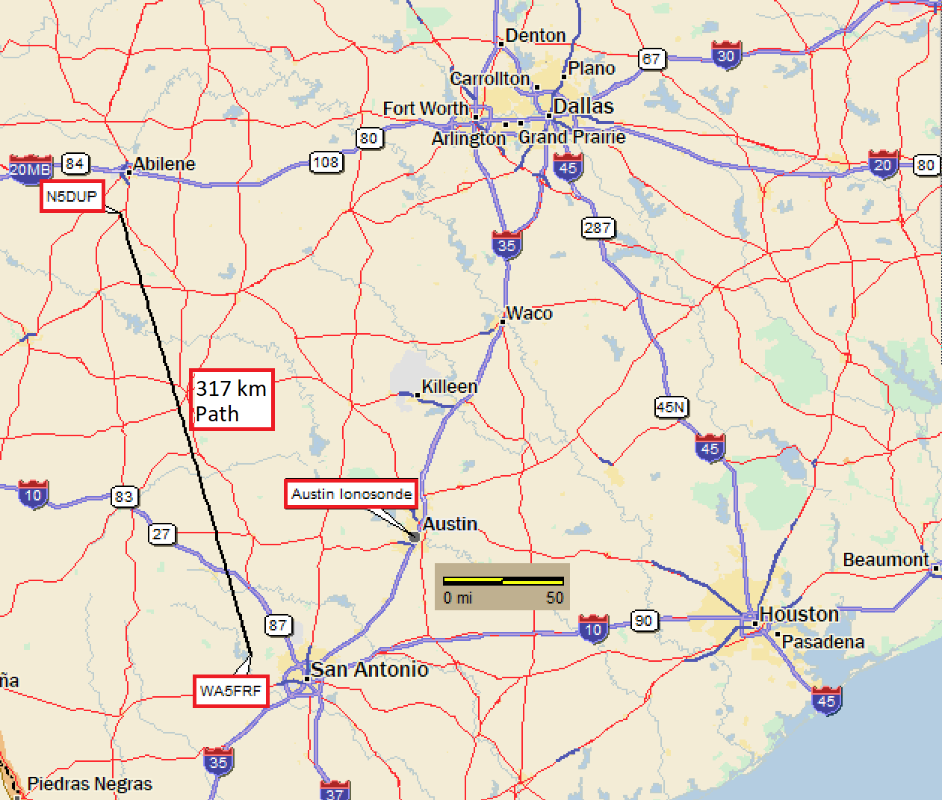
Setup for TDOA Eclipse Experiments
2023 Annular Eclipse
2024 Total Eclipse
N6RFM
N5DUP
407 km
Path
2023
Eclipse
2024
Eclipse
AB5YO
9 km NVIS
Path
WA5FRF
Geometry gave proximity to expected eclipse paths and Austin Ionosonde used for ground truth data.
Notes:
This slide shows the setup for the 2023 and 2024 Eclipse experiments. The radio propagation paths described in this paper are shown in the map overlay on the left. The upper right photo shows the eclipse paths and identifies the map location in Texas. The lower right photo shows amateur radio station WA5FRF used to transmit the TDOA waveforms. Both eclipses passed very nearly overhead this station though angular orientation and path directions were very different.

