Slide 1
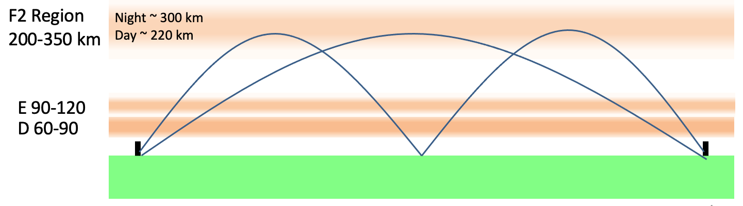
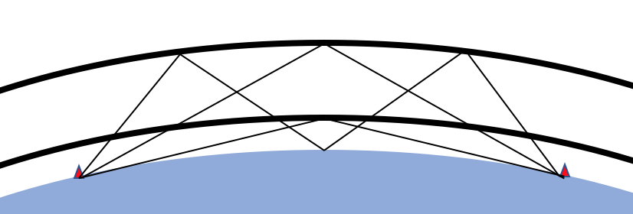
(a)
1- and 2-hop Refraction from the F2 Layer
(b)
(c)
Path Lengths and Times of Flight
1350 km Ground Distance
TOF-mS
F2 Region
3-hop
10.0
F2
8.33
h
E Region
6.67
E
0.67
1.10
5.00
Ground Distance
3.33
Notes:
The formulas for a virtual height model of multipath ionospheric propagation are used to approximate layer height from 1-hop/2-hop Time Difference of Arrival (TDOA). (a) Illustration of 1- and 2-hop Refraction from the F2 Layer (b) Virtual Height model used to calculate the relationship between virtual height $h$ and path length. Time of Flight = Path Length / $c$ (c) TDOA Example: At 1350 km ground distance the TDOA between 1 and 2 hop modes is 0.67 ms at 225 km layer height and 1.10 ms at 300 km.

Slide 2
Fig 1a. 1- and 2-hop Refraction from the F2 Layer.
Path Lengths and Times of Flight
1350 km Ground Distance
TOF-mS
F2 Region
3-hop
10.0
F2
8.33
h
E Region
6.67
E
0.67
1.10
5.00
Ground Distance
3.33
Fig 1b. Virtual Height model Used to Calculate Relationship between Virtual Height h and Path Length.
Time of Flight = Path Length / c
Fig 1c. TDOA Example: At 1350 km ground distance the Time Difference of Arrival between 1 and 2 hop modes is 0.67 ms at 225 km layer height and 1.10 ms at 300 km.
Notes:
The pictorial on the left depicts 1 and 2 hop modes from the F layer and a 1 hop mode for the E layer. For a fixed ground distance between TX and RX the propagation path is a function of ionization layer height and number of hops. Doppler shift can be caused by a changing path length, driven by ascending or descending layer height. A virtual height geometric model was used to relate path length to layer height for a given ground distance.

Slide 3
Simplified 1 and 2 Hop Refraction from The F2 Region
F2 Region
200-330 km
Day ~ 300 km
Night ~ 220 km
E 100-115
D 60-90
Great Circle Ground Distance
UV and X radiation from the sun photoionize the upper atmosphere into free electrons and positively charged ions.
Complex photochemical reactions with oxygen, ozone, nitrogen, and nitrous oxide arrange the ionization into layers labeled D, E, and F (F1 and F2).
Velocity gradients in the ionized layers refract upward directed radio waves back to earth. Multiple hops involving reflection from the earth and other layers are possible, enabling global radio propagation.
Most HF radio propagation comes from the E and F layers. The D layer primarily acts as an attenuator with attenuation increasing with wavelength.
Notes:
UV and X radiation from the sun photoionize the upper atmosphere into free electrons and positively charged ions.
Complex photochemical reactions with oxygen, ozone, nitrogen, and nitrous oxide arrange the ionization into layers labeled D, E, and F.
Velocity gradients in the ionized layers refract upward directed radio waves back to earth in the HF frequency range from 3-30 MHz.
Multiple hops involving reflection from the earth and other layers are possible, enabling global radio propagation.
Most HF radio propagation comes from the E and F layers. The D layer primarily acts as an attenuator with attenuation increasing with wavelength.
The F layer changes height significantly with diurnal changes in solar radiation. The E layer does so as well, but to a much smaller degree. The rate of height change imparts velocity on path length which results in Doppler shifts in frequency.
This paper postulates a phenomenology to explain observed complex Doppler behavior, specifically mode splitting, as a function of differential path velocity imparted on single and multiple hop modes by changing layer height.

Slide 4
Simultaneous 1 Hop Refraction from the E and F2 Regions
F2 Region
200-330 km
Day ~ 300 km
Night ~ 220 km
E 100-115
D 60-90
Great Circle Ground Distance
UV and X radiation from the sun photoionize the upper atmosphere into free electrons and positively charged ions.
Complex photochemical reactions with oxygen, ozone, nitrogen, and nitrous oxide arrange the ionization into layers labeled D, E, and F (F1 and F2).
Velocity gradients in the ionized layers refract upward directed radio waves back to earth. Multiple hops involving reflection from the earth and other layers are possible, enabling global radio propagation.
Most HF radio propagation comes from the E and F layers. The D layer primarily acts as an attenuator with attenuation increasing with wavelength.
Notes:
UV and X radiation from the sun photoionize the upper atmosphere into free electrons and positively charged ions.
Complex photochemical reactions with oxygen, ozone, nitrogen, and nitrous oxide arrange the ionization into layers labeled D, E, and F.
Velocity gradients in the ionized layers refract upward directed radio waves back to earth in the HF frequency range from 3-30 MHz.
Multiple hops involving reflection from the earth and other layers are possible, enabling global radio propagation.
Most HF radio propagation comes from the E and F layers. The D layer primarily acts as an attenuator with attenuation increasing with wavelength.
The F layer changes height significantly with diurnal changes in solar radiation. The E layer does so as well, but to a much smaller degree. The rate of height change imparts velocity on path length which results in Doppler shifts in frequency.
This paper postulates a phenomenology to explain observed complex Doppler behavior, specifically mode splitting, as a function of differential path velocity imparted on single and multiple hop modes by changing layer height.

Slide 5
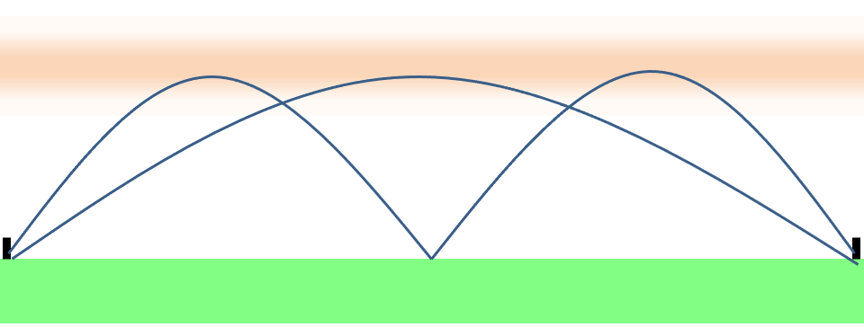
Computer with .wav Chirp Waveform
Sound
Card
Output
Mic
Input
Interface
HF
Transmitter
F2 Region
200-350 km
Night ~ 300 km
Day ~ 220 km
E 90-120
D 60-90

Slide 6
Notes:
UV and X radiation from the sun photoionize the upper atmosphere into free electrons and positively charged ions.
Complex photochemical reactions with oxygen, ozone, nitrogen, and nitrous oxide arrange the ionization into layers labeled D, E, and F.
Velocity gradients in the ionized layers refract upward directed radio waves back to earth in the HF frequency range from 3-30 MHz.
Multiple hops involving reflection from the earth and other layers are possible, enabling global radio propagation.
Most HF radio propagation comes from the E and F layers. The D layer primarily acts as an attenuator with attenuation increasing with wavelength.
The F layer changes height significantly with diurnal changes in solar radiation. The E layer does so as well, but to a much smaller degree. The rate of height change imparts velocity on path length which results in Doppler shifts in frequency.
This paper postulates a phenomenology to explain observed complex Doppler behavior, specifically mode splitting, as a function of differential path velocity imparted on single and multiple hop modes by changing layer height.

Slide 7
Computer with .wav Chirp Waveform
Computer with .wav Capture Program
Sound Card Output
Sound Card Input
Mic Input Interface
Audio Output
AM or SSB
HF Transmitter
Skywave path with ground distance and operating frequency suitable for multi-hop propagation.
AM or SSB
HF Receiver

Slide 8
Computer with .wav Chirp Waveform
Computer with .wav Capture Program
Sound Card Output
Sound Card Input
Mic Input Interface
Ground Distance = 317 km
Audio Output
WA5FRF SSB
HF Transmitter Near San Antonio, TX
N5DUP SSB
HF Receiver Near Abilene, TX
Skywave path with ground distance and operating frequency suitable for multi-hop propagation.
Frequencies for initial tests: 3.780 and 5.3715 MHz

