Slide 1

HamSCI HF Multipath Propagation Mode Analysis Using Amateur Radios and Audio Waveforms Sensitive to Time Difference of Arrival (TDOA)
Steve Cerwin WA5FRF, Jesse T. McMahan K1FR,
Alexandros Papadopoulos KC3WUD, Gerard Piccini KD2ZHK,
Paul Bilberry N5DUP, Sam Blackshear AB5YO
Kristina V. Collins KD8OXT, Nathaniel A. Frissell W2NAV
American Geophysical Union (AGU) Fall Meeting 2024
December 9-13, 2024
steve@cerwinconsulting.com
Notes:
Good morning! My name is Steve Cerwin and I am going to talk about a way of probing the bottom side ionosphere using ordinary amateur radios transmitting and receiving audio waveforms that can reveal the Time Difference of Arrival, or TDOA between multipath propagation modes.

Slide 2
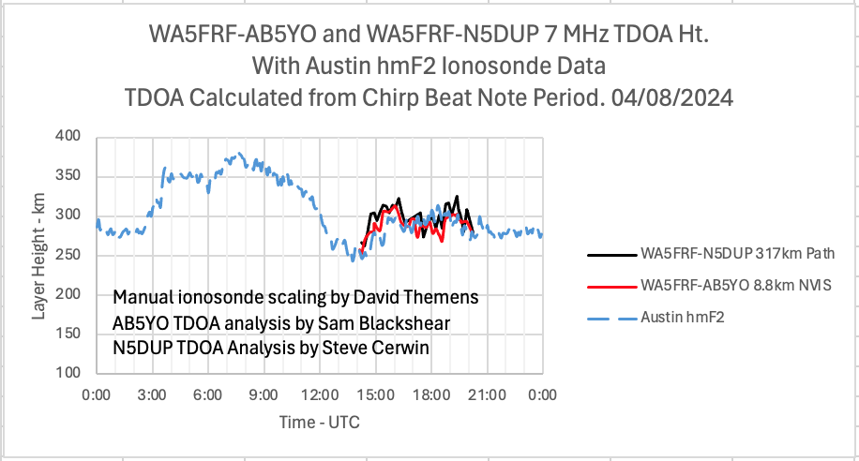
Layer Heights Calculated from TDOA at the Same Frequency Over Different Path Lengths Agreed Well with Each Other and With the Austin, TX Ionosonde
Manual ionosonde scaling averaged height data for higher resolution.
Transmit: WA5FRF near San Antonio, TX. Waveform: 10 Hz/ms Chirps.
Receive: AB5YO at 8.8 km and N5DUP at 317 km near Abilene, TX.
Eclipse Path of Totality was almost directly overhead TX location and nearly aligned with 317 km path.
Notes:
The next several charts show TDOA data collected during the 2023 and 2024 North American eclipses. This chart shows same-frequency data over two very different path lengths: a short NVIS path to a local station only 9 km away and a 317 km path that was in the same direction as the eclipse Path of Totality. Measured TDOA was consistent with 1 and 2 hops from the F2 layer, though the NVIS multipath could have been between ground wave and 1 or more hops from F2. The calculated F2 layer height data from both paths agreed well with each other and with hmF2 data from the Austin, TX ionosonde. Data were acquired from 1400 UTC to 2030 UTC which included local totality at the TX site at 1830 UTC. The measured height profile resembles a two-hump saddle with one peak at 1530 UTC and a second near the time of totality passage at 1830 UTC.

