Slide 1

HamSCI HF Multipath Propagation Mode Analysis Using Amateur Radios and Audio Waveforms Sensitive to Time Difference of Arrival (TDOA)
Steve Cerwin WA5FRF, Jesse T. McMahan K1FR,
Alexandros Papadopoulos KC3WUD, Gerard Piccini KD2ZHK,
Paul Bilberry N5DUP, Sam Blackshear AB5YO
Kristina V. Collins KD8OXT, Nathaniel A. Frissell W2NAV
American Geophysical Union (AGU) Fall Meeting 2024
December 9-13, 2024
steve@cerwinconsulting.com
Notes:
Good morning! My name is Steve Cerwin and I am going to talk about a way of probing the bottom side ionosphere using ordinary amateur radios transmitting and receiving audio waveforms that can reveal the Time Difference of Arrival, or TDOA between multipath propagation modes.

Slide 2
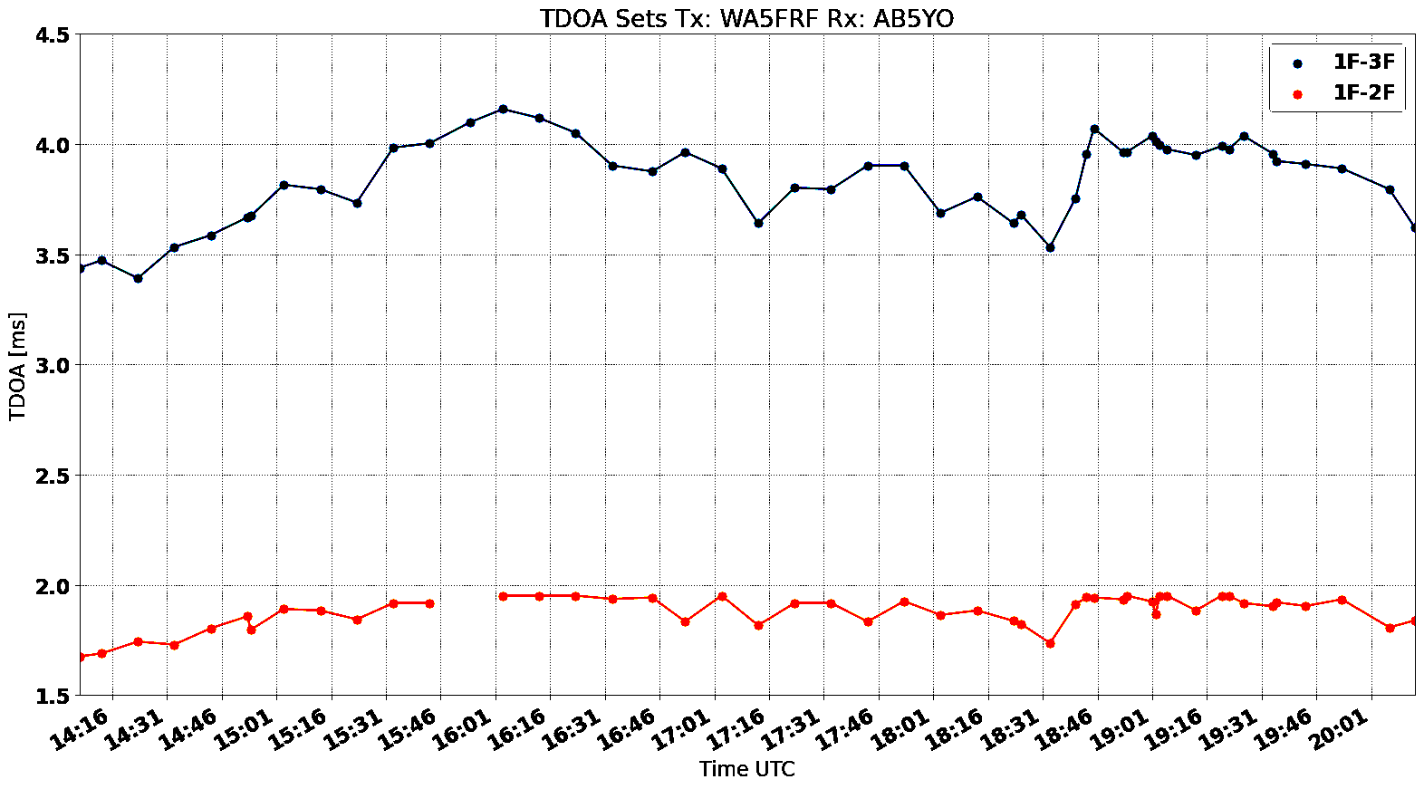
TDOA Plots with a 2:1 Relationship Observed Over a Near Vertical Incidence Skywave (NVIS) Path
NVIS Path Where Distance Between Stations is Small Compared to Layer Height
Ground Distance = 8.7 km
1F₂ - 3F₂
TDOA
F₂ Layer at ~ 290 km
h
Not to scale
1F₂ - 2F₂
TDOA
Earth
1F₂ 2F₂ 3F₂
The nearly exact doubling in TDOA is theorized to be a result of TDOA between 1-hop and 3-hops from F2.
Both the baseline values and the many of the inflection amplitudes along the plots are doubled.
Path 1F₂ - 2F₂ : ΔP = 4h - 2h = 2h
Path 1F₂ - 3F₂ : ΔP = 6h - 2h = 4h
Path Length for 1F₂ - 3F₂ is exactly twice
1F₂ - 2F₂ for NVIS Paths.

Slide 3
TDOA Plots with a 2:1 Relationship Observed Over a Near Vertical Incidence Skywave (NVIS) Path
F₂ Layer at ~ 290 km
Not to scale
Path 1F₂ - 2F₂ : ΔP = 4h - 2h = 2h
Path 1F₂ - 3F₂ : ΔP = 6h - 2h = 4h
Path Length for 1F₂ - 3F₂ is exactly twice
1F₂ - 2F₂ for NVIS Paths where distance between station is small compared to the layer height.
h
Earth
1F₂ 2F₂ 3F₂

