Slide 1

HamSCI HF Multipath Propagation Mode Analysis Using Amateur Radios and Audio Waveforms Sensitive to Time Difference of Arrival (TDOA)
Steve Cerwin WA5FRF, Jesse T. McMahan K1FR,
Alexandros Papadopoulos KC3WUD, Gerard Piccini KD2ZHK,
Paul Bilberry N5DUP, Sam Blackshear AB5YO
Kristina V. Collins KD8OXT, Nathaniel A. Frissell W2NAV
American Geophysical Union (AGU) Fall Meeting 2024
December 9-13, 2024
steve@cerwinconsulting.com
Notes:
Good morning! My name is Steve Cerwin and I am going to talk about a way of probing the bottom side ionosphere using ordinary amateur radios transmitting and receiving audio waveforms that can reveal the Time Difference of Arrival, or TDOA between multipath propagation modes.

Slide 2
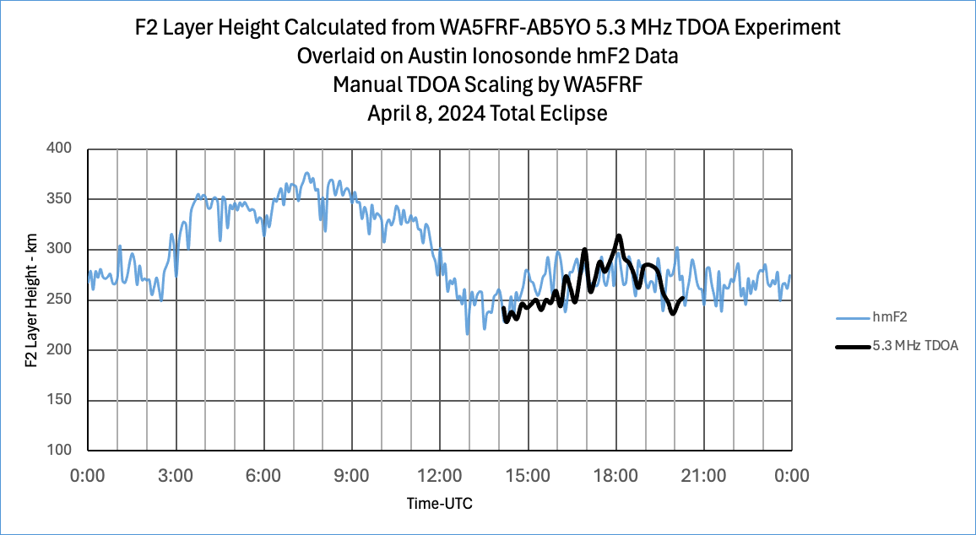
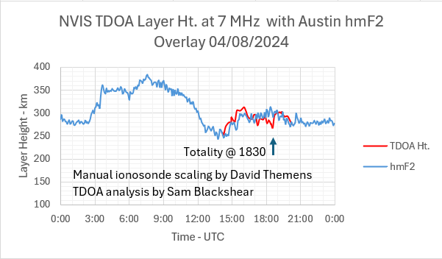
Simultaneous TDOA Measurements at Different Frequencies Over the Same Path Gave Different Height Profiles
Standard ionosonde scaling
Eclipse Passage
5.3 MHz TDOA data showed a height bump near the time of eclipse passage in Texas.
Austin ionosonde hmF2 overlay.
7.3 MHz TDOA data did not show a height bump. Manually scaled ionosonde hmF2 overlay.
Path: 8.8 km ground distance for Near Vertical Incidence Skywave (NVIS)
5.3 MHz data analyzed by Steve Cerwin WA5FRF; 7.3 MHz data analyzed by Sam Blackshear AB5YO
Notes:
These charts show TDOA data taken over the same NVIS path at two different frequencies of 5.3 MHz and 7.3 MHz. Both plots include the hmF2 overlay from the Austin, TX ionosonde. The calculated F2 layer height profile at 5.3 MHz showed definite peaking over the acquisition window with a well-defined peak that occurred about 20 minutes before local totality. Note that incident sun angle also peaks over this period. The 7.3 MHz data set showed the double-hump saddle with the second peak at 30 minutes after totality. The Austin ionosonde showed general peaking over this time window with only a modest peak at the time of totality. These TDOA data sets show a clear frequency dependence while still being generally consistent with Austin hmF2. Definite frequency dependent height bumps were obtained during the 2023 annular eclipse and reported at the 2023 AGU Fall meeting.

