Slide 1

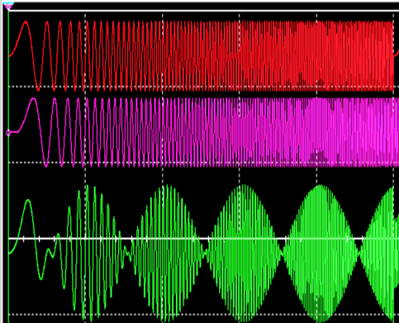
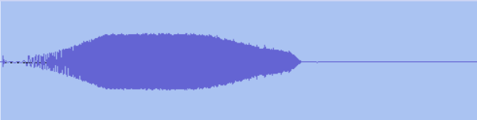
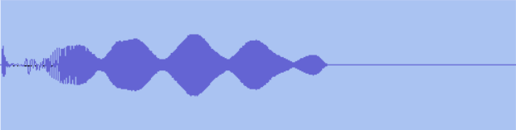
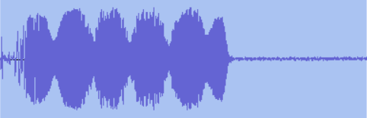
An Audio Frequency Chirp Transmitted By Stock SSB or AM Amateur Radios Can be Used to Measure Time Difference of Arrival (TDOA)
The summation of a linear chirp with a delayed copy of itself produces a beat note frequency at f_{b} = Sweep Rate * Δt.
Beat pattern has a period p = 1/ f_{b}. The Time Difference of Arrival (TDOA= Δt) can be calculated by:
TDOA = f_{b} / Sweep Rate -or- TDOA = 1/ p*Sweep Rate
0 Hz
FULL BANDWIDTH SIMULATION
5 kHz
10 Hz/ms Chirps
10 Repetitions
10 Hz/ms Chirp @ 0 delay
ACTUAL TX-RX WAVEFORMS
280 Hz
3 kHz
0 Hz
5 kHz
B. 10 Hz/ms Chirp delayed 1 ms
Direct – TX & RX1 Passbands
0 Hz
5 kHz
p = 0.063 s
TDOA = 1.6 ms
Ht = 260 km
C. SUM (A+B). Beats occur at period 1/ f_{b}. Summation occurs naturally in receiver
during multipath reception.
0 Hz
5 kHz
317 km Path – 2F₂-1F₂ RX1
p = 0.053 s
TDOA = 1.9 ms
Ht = 315 km
For 1 ms Time Delay f_{b} = 10 Hz
0 Hz
5 kHz
407 km Path. 2F₂ - 1F₂ RX2
Broadband SDR
100 ms=1/10Hz
Notes:
In multipath propagation over a fixed path, the shorter mode arrives first followed by the longer. Both naturally sum in the receiver. The Time Difference of Arrival between the two modes can be measured by using an audio waveform that is sensitive to summation with a delayed copy of itself. A linear frequency chirp is one such waveform. The center illustration is a simulation showing two 10 Hz/ms chirps summed with a 1 ms time delay to represent reception of two multipath modes. The chirps sweep from 0 to 5000 Hz in 500 ms. The 1 ms time delay means the delayed chirp will always be 10 Hz behind throughout the entire overlap period. When summed, this difference frequency manifests as a 10 Hz beat note that shows up as amplitude scalloping in the chirp envelope. In practice, TDOA can be calculated from the received waveform either in the frequency domain by measurement of beat note frequency or the time domain by measurement of beat note period. The audio clip gives the 10-chirp sequence that was used during the 2024 total eclipse. The right three illustrations show waveforms as received in on-air tests. The top waveform was recorded over a direct, non-ionospheric path to show how the chirp waveform envelope can be modified by bandwidth restriction and passband shape in actual radio equipment. Only about 3 kHz of the 5 kHz chirp makes it through a typical SSB TX passband, and overall shape shows the TX-RX low and high frequency skirt responses. The lower two waveforms show appearance of waveforms undergoing actual multipath interference. The center waveform shows a 1.6 ms TDOA over a 317 km path, which is consistent with 1 and 2 hops from the F2 layer at a height of 260 km. The bottom waveform similarly shows a TDOA of 1.9 ms over a 407 km path, which is consistent with 1 and 2 hops from the F2 layer at a height of 315 km.

