Slide 1
With an RX888 and a GPSDO,
What Kind of Ionospheric Science Can We Do?
Michael James Hauan (AC0G)
EM38, Central Missouri
4 stations · 9 frequencies · 17 simultaneous paths
Single RX888 SDR + Leo Bodnar GPSDO via KA9Q-radio
Notes:
This talk is organized around one question: if you have an RX888 and a GPSDO listening to time standard stations, what ionospheric science can you actually extract? The answer depends on your timing infrastructure, and it turns out the science payoff is much larger than you might expect.

Slide 2
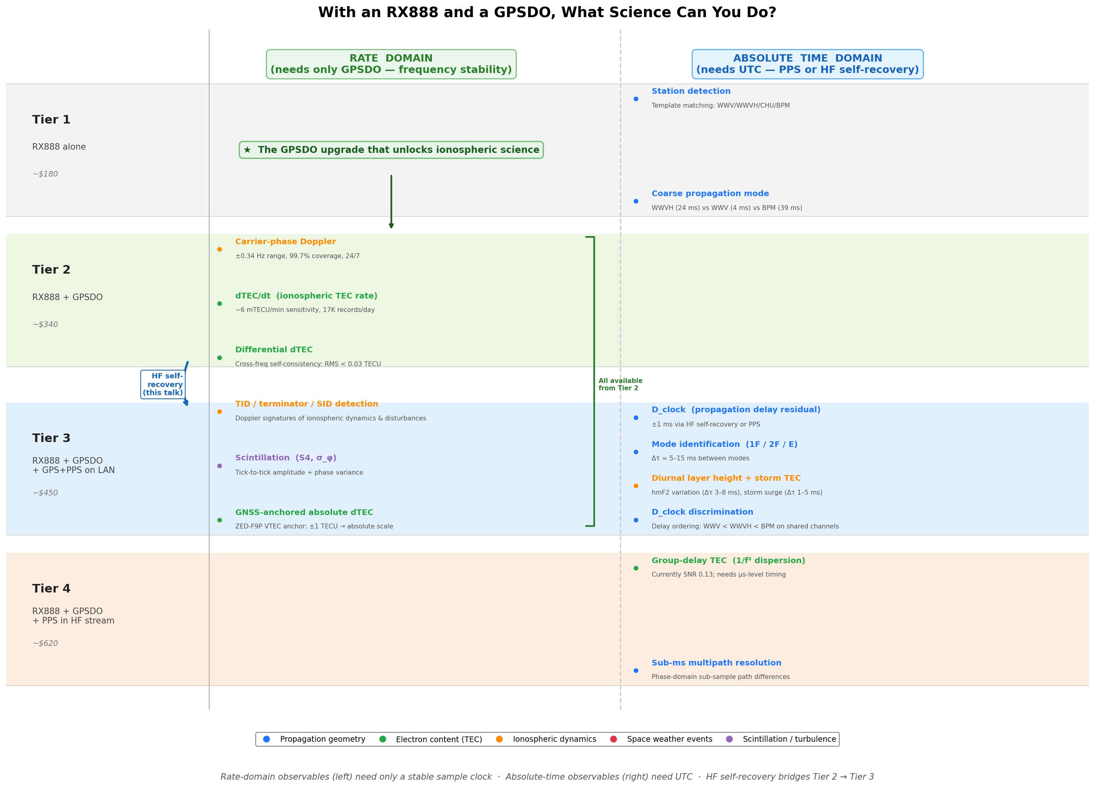
The Phenomena Ladder — What Each Tier Unlocks
Notes:
Here's the organizing framework. On the left is what hardware you have. On the right is what ionospheric phenomena you can observe. The GPSDO — around 160 dollars for a Leo Bodnar — is the single most important upgrade. It gives you a 1 part-per-billion sample clock, which makes carrier-phase measurements metrologically coherent. That unlocks Doppler, dTEC/dt, and scintillation — all rate measurements that don't need to know what time it is, only that consecutive samples are exactly spaced. The absolute delay products — D_clock, mode identification, group-delay TEC — need to know when in UTC each tick arrived. That's either an external PPS reference or, as I'll show, something we can recover from the time signals themselves.

Slide 3
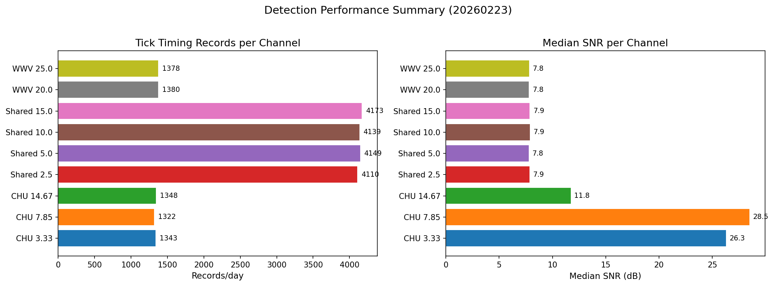
TickEdgeDetector — The Measurement Engine
50–57 ticks per minute, per channel
Matched-filter correlation with station-specific templates
Front-edge back-calculation + sub-sample interpolation
SNR-weighted robust median ensemble
From each tick:
• Timing error (AM domain)
• Carrier phase (IQ domain)
• SNR
From the minute ensemble:
• D_clock — needs UTC (Tier 3+)
• Doppler — needs only GPSDO (Tier 2)
• Mean SNR
Channel | Edges/min | SNR (dB) | D_clock (ms) | Doppler
CHU 7.85 | 51 | 27.3 | +1.96 | 99.8%
SHARED 10.0 | 57 | 7.9 | −0.02 | 99.7%
WWV 20.0 | 57 | 7.9 | −0.05 | 99.9%
~24K tick timing records/day ~850K per-tick phase records/day 9 channels, 24/7
Notes:
The measurement engine is a tick edge detector inspired by the ntpd WWV refclock driver. For every second of the minute, it cross-correlates a station-specific template against the IQ data, finds the front edge with sub-sample precision, and extracts both the timing error and the carrier phase. From 50 to 57 ticks, we build a robust median ensemble. The carrier phase across the minute gives Doppler — and notice, that only needs a stable sample clock. It doesn't need to know what time it is. But D_clock — the absolute propagation delay — does need UTC. That's the bridge we build next.

Slide 4
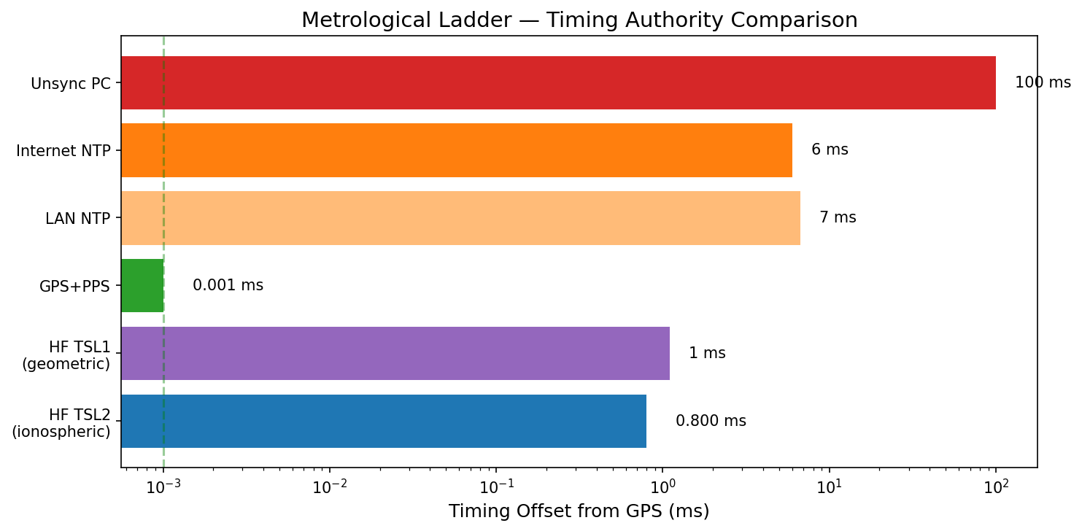
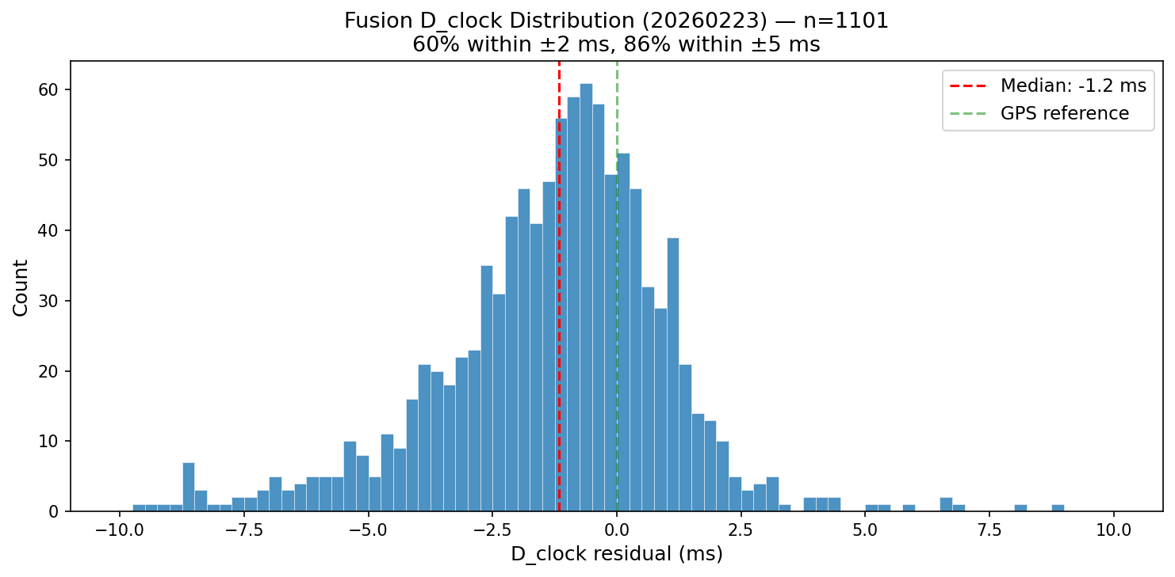
UTC Recovery — Dual Kalman Fusion
The time signals tell us what time it is.
Source | Offset vs GPS | Bound (±)
Internet NTP | −6.0 ms | ±19 ms
HF TSL1 (geometric) | +1.1 ms | ±2.0 ms
HF TSL2 (ionospheric) | +0.8 ms | ±0.6 ms
GPS+PPS (ground truth) | −0.001 ms | ±0.094 ms
HF timing is 100× better than internet NTP
L2 has 3.3× tighter bound than L1
Fusion D_clock: median −1.2 ms, 86% within ±5 ms
A Tier 2 station bootstraps itself to Tier 3
Notes:
Since we're listening to time standard stations and we know their broadcast schedules, we can recover UTC from the signals themselves. We run two independent Kalman filters — L1 uses geometric path delays, L2 adds an ionospheric correction. Both feed Chrony as reference clocks. The result: our HF-derived time is 100 times better than internet NTP and within about 1 millisecond of GPS ground truth. The ionospheric correction makes L2 three times tighter than L1 — it's doing real work. This is the bridge: a station with only a GPSDO can recover absolute time from the HF signals and unlock the D_clock products.

Slide 5
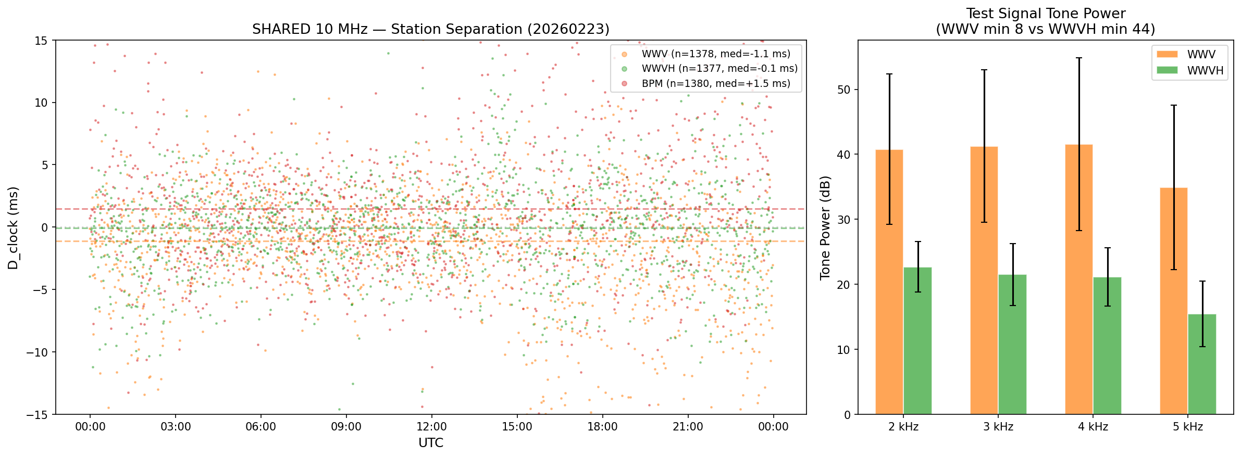
Shared-Channel Discrimination
Three stations on one frequency — physics tells them apart
Tick frequency: 1000 Hz (WWV/BPM) vs 1200 Hz (WWVH)
Tick duration: 5 ms (WWV/WWVH) vs 10 ms (BPM)
NIST tone schedule: ground truth 14 min/hr
D_clock ordering: WWV < WWVH < BPM
Station | Records/day | Median D_clock | Median SNR
WWV | 1,380 | −1.12 ms | 26.2 dB
WWVH | 1,379 | −0.08 ms | 17.8 dB
BPM | 1,380 | +1.48 ms | 21.1 dB
Cross-station Doppler: r ≈ 0 (independent paths) Same-station cross-freq: r = 0.43 (shared path)
Notes:
On the shared frequencies, three stations transmit simultaneously. We separate them with a layered approach. The strongest discriminator is the tick frequency gate — WWV at 1000 Hz, WWVH at 1200 Hz. For ground truth, the NIST tone schedule gives us 14 minutes per hour where only one station is broadcasting its audio tone. The physical validation is compelling: the D_clock offsets follow propagation geometry on all four shared frequencies, and the cross-station Doppler correlations are zero — proving these really are independent ionospheric paths, not artifacts of the discrimination.

Slide 6
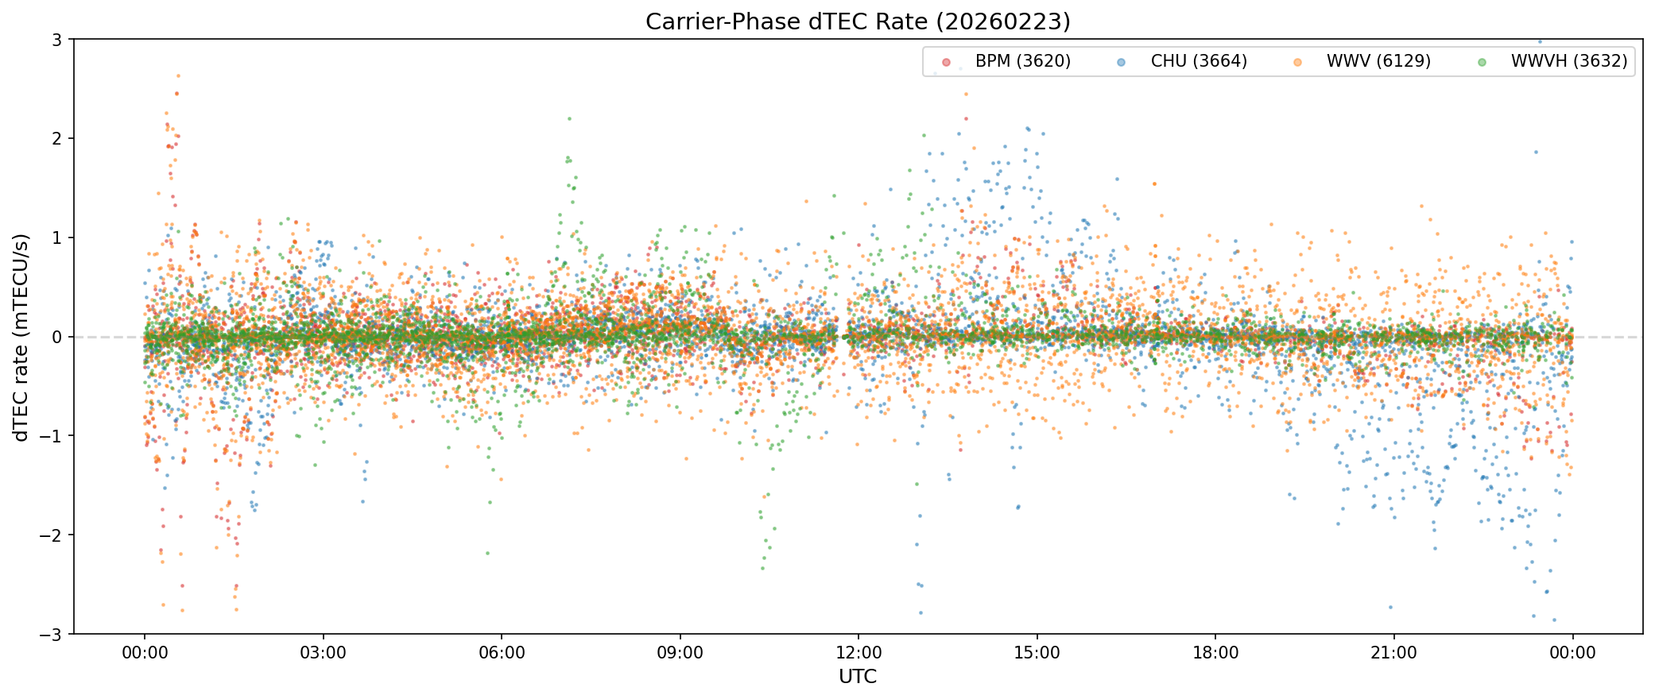
Carrier-Phase dTEC — The Primary Science Product
Bypassing the propagation model noise floor
Group-delay TEC: signal 0.85 ms, noise 6.5 ms → SNR 0.13 (buried)
Carrier-phase dTEC: ~6 mTECU/min sensitivity → SNR 17–330×
dTEC/dt = −f_D × c × f / 40.3
This is a Tier 2 product — needs only the GPSDO
17,045 dTEC records/day (per-minute)
848,599 per-tick records/day (1-second resolution)
GNSS-anchored: ZED-F9P VTEC 41.7 TECU, ±1 TECU
Notes:
Here's the payoff. Group-delay TEC — the classical approach of measuring 1/f² dispersion — is below our noise floor. The propagation model has 6.5 millisecond errors, the dispersion signal is 0.85 milliseconds. We can't see it. But carrier-phase dTEC bypasses this entirely. We measure the Doppler shift — the rate of change of carrier phase — and convert it to dTEC/dt. The sensitivity is 6 milli-TECU per minute. And crucially, this is a Tier 2 product: it only needs the GPSDO, not absolute time.

Slide 7
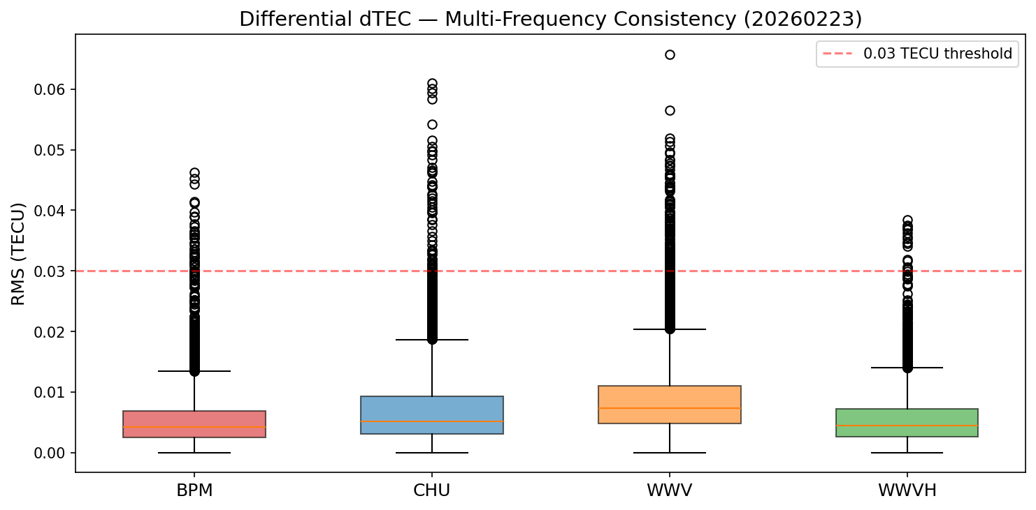
Differential dTEC — Self-Consistency
Same ionosphere, different frequencies — do they agree?
Station | Widest freq pair | RMS
CHU | 3.33 – 14.67 MHz | 0.005–0.007 TECU
WWV | 2.50 – 25.00 MHz | 0.005–0.026 TECU
22,474 records/day, all GOOD quality
Also a Tier 2 product
Cross-frequency consistency validates the physics
Notes:
How do we know we're measuring real ionospheric physics? For each station, we compare dTEC at different frequencies on the same path. They agree to within 0.03 TECU RMS. This is 22,000 consistency checks per day, all passing.

Slide 8
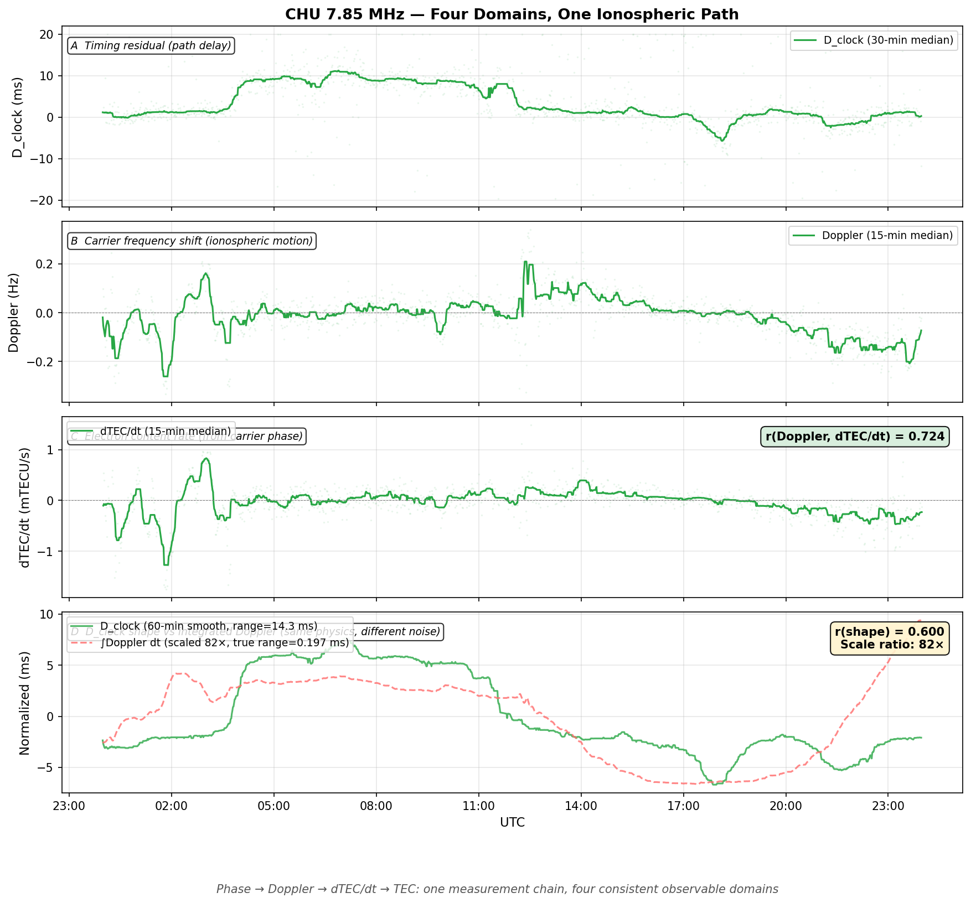
Cross-Domain Consistency — Physics Cascade
CHU 7.85 MHz — exclusive channel
Panel A: D_clock (absolute delay, Tier 3+)
Panel B: Doppler (phase rate, Tier 2)
Panel C: dTEC/dt (derived from Doppler)
Panel D: Integrated Doppler vs D_clock
The money shot (Panel D):
Integrated Doppler tracks the shape
of D_clock at 82× smaller amplitude
r = 0.60 correlation
Same ionosphere, different physics,
consistent measurements
Notes:
This is CHU at 7.85 MHz — an exclusive channel with no discrimination ambiguity. Four panels, one ionospheric path. At top, D_clock shows the diurnal propagation delay variation. Below, Doppler — the carrier phase slope. Then dTEC/dt derived from Doppler. The bottom panel is the key: if we integrate the Doppler, it should track the shape of D_clock. It does — r = 0.60 — but at 82 times smaller amplitude. The Doppler is measuring real ionospheric motion, at a sensitivity 82 times finer than D_clock noise.

Slide 9
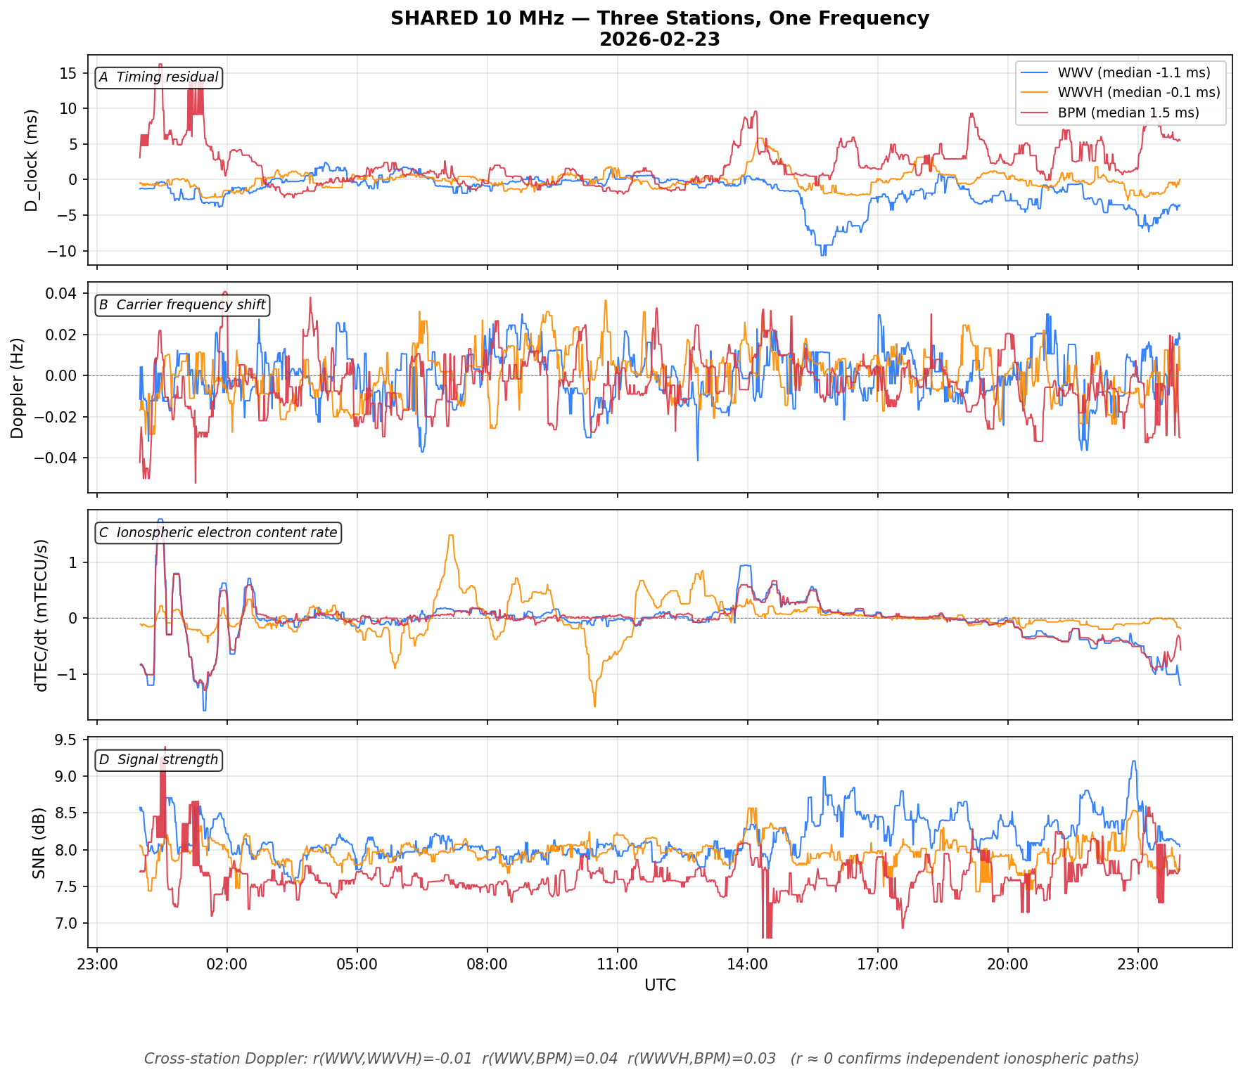
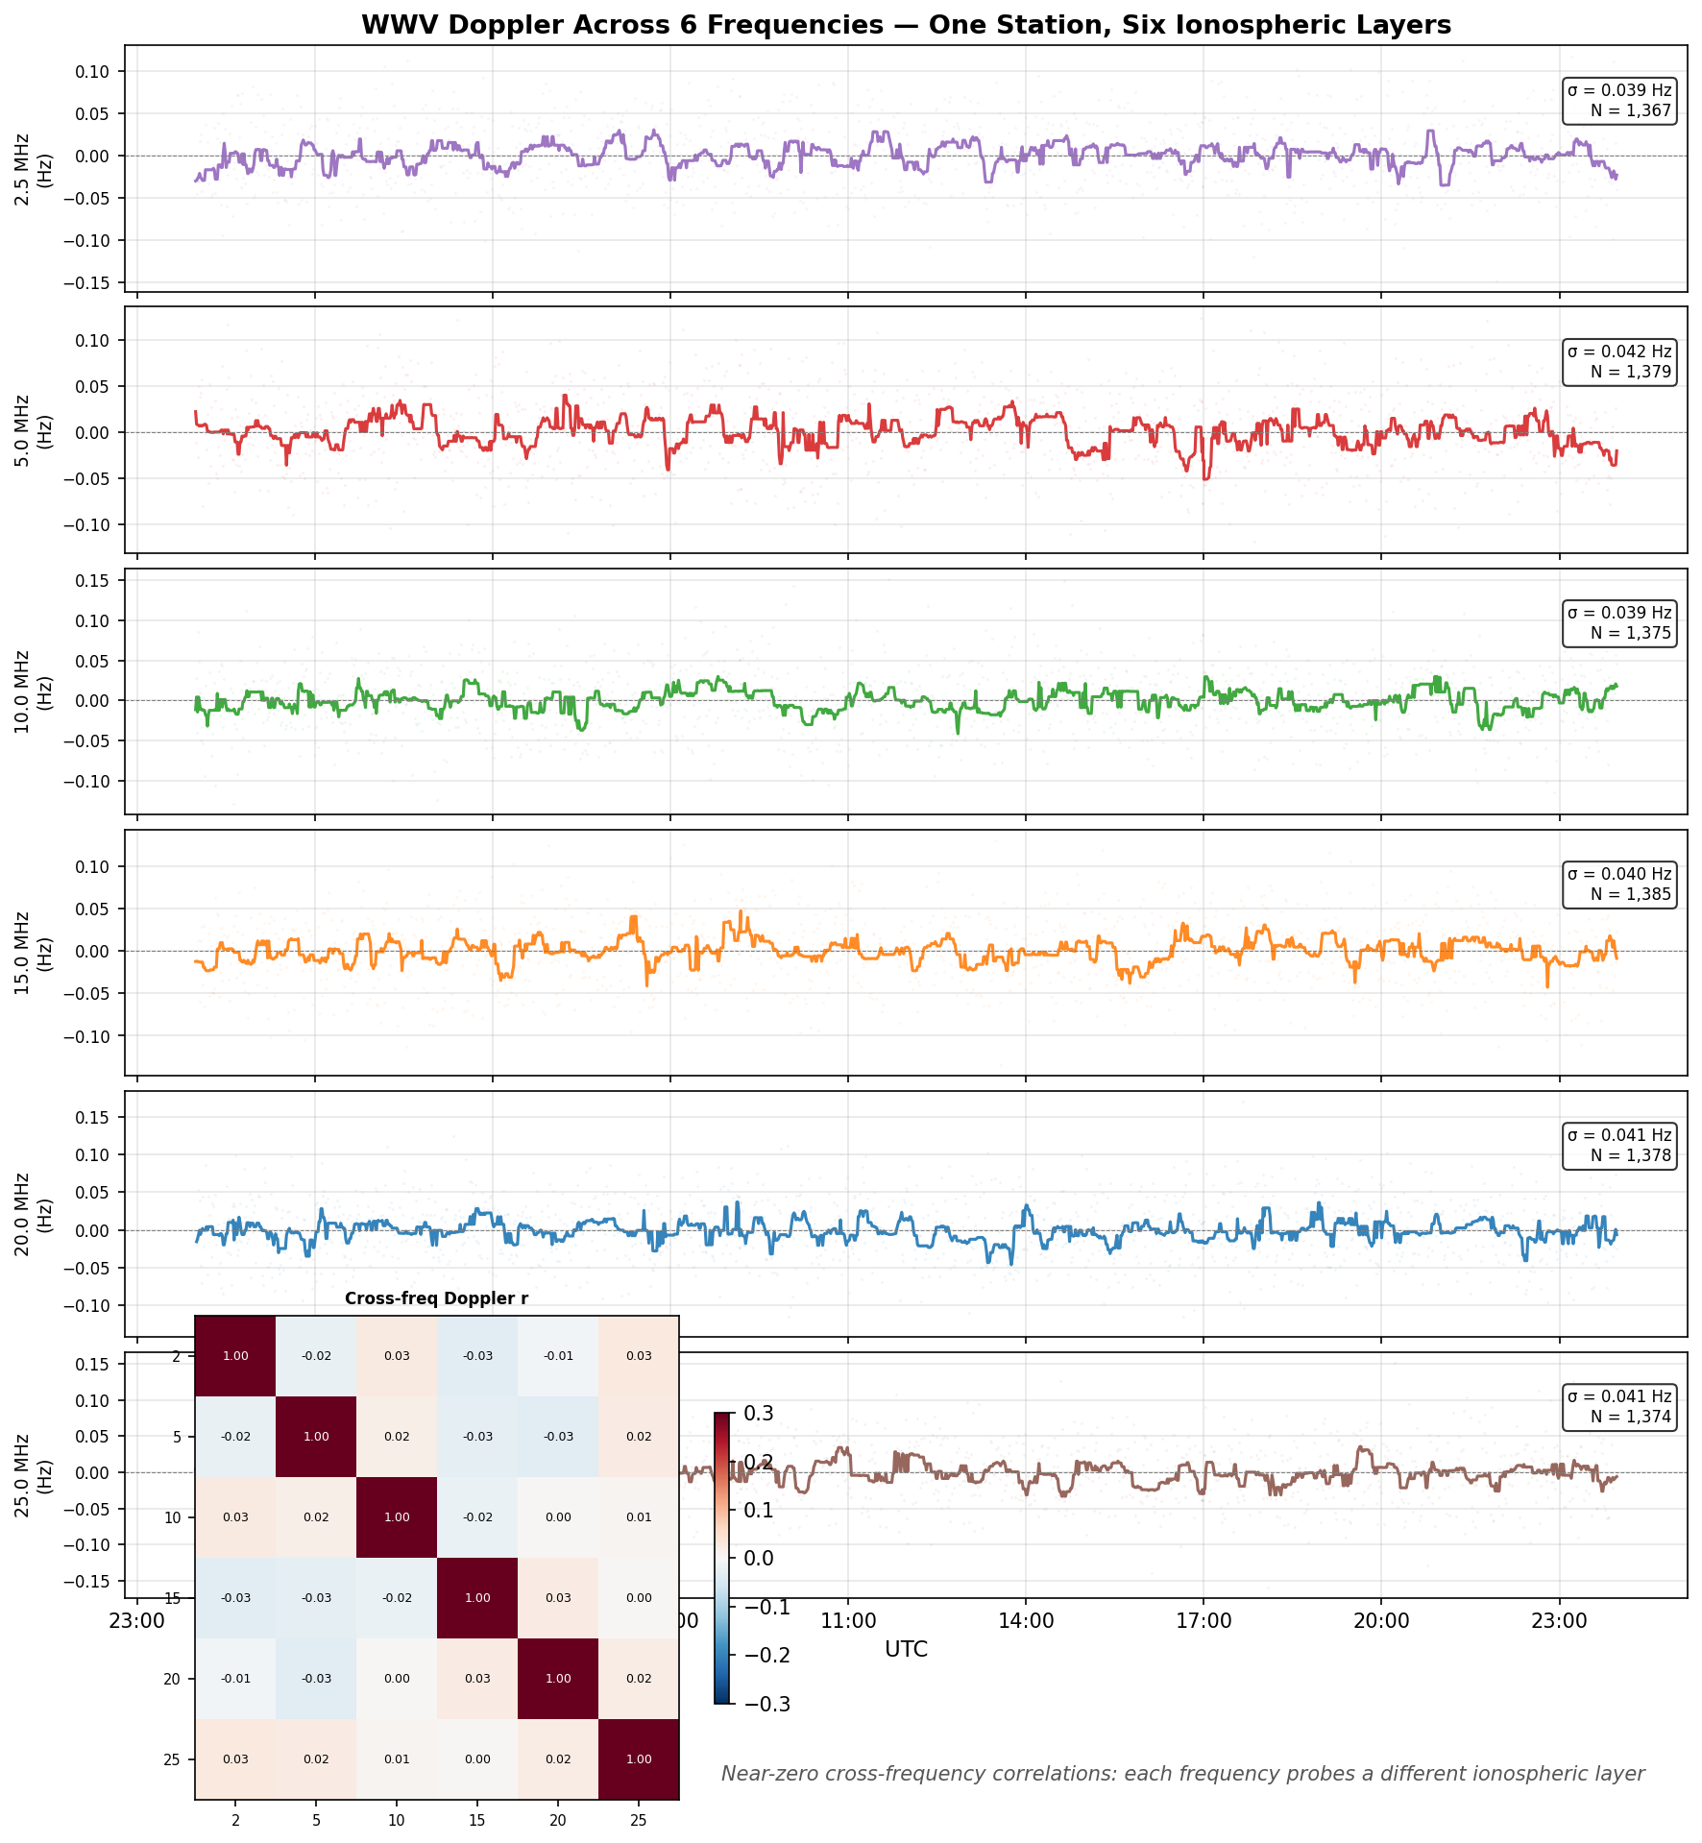
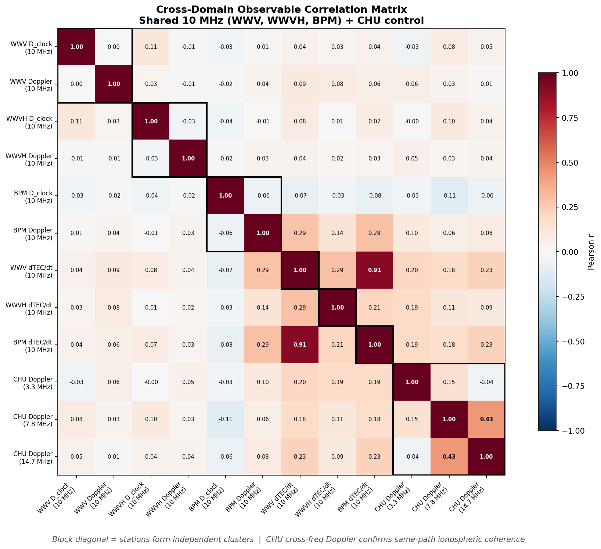
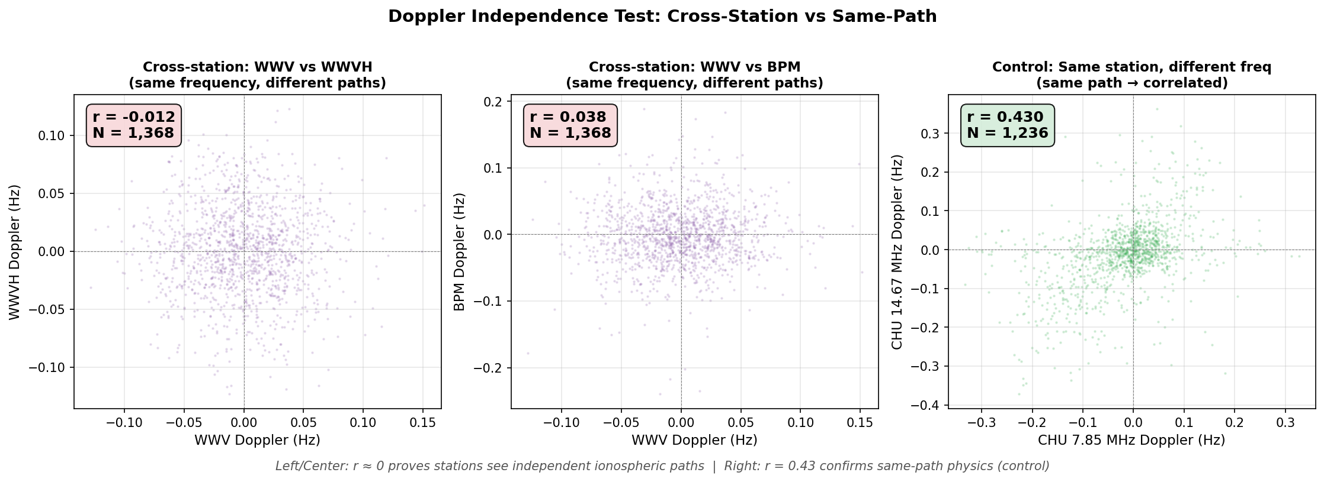
17 Simultaneous Ionospheric Paths
Notes:
The full system monitors 17 simultaneous paths through the ionosphere. On the shared channels, three stations at the same frequency give three independent ionospheric soundings — the Doppler correlation is zero, confirming they see different paths. Across frequencies, WWV from 2.5 to 25 MHz samples six different layers. CHU across three frequencies shows correlated Doppler — same path, same ionosphere, consistent. The correlation heatmap makes the structure clear: station clusters are independent, within-station cross-frequency is correlated. This is essentially a passive oblique ionosonde with 17 beams.

Slide 10
What's Next — Honest Assessment
Current limits:
Network of stations →
Group-delay TEC: below noise floor (SNR 0.13)
VTEC maps from HF alone: noise-dominated
Scintillation: infrastructure ready, awaiting storm
Spatial TEC gradients → horizontal structure
TID wavefront tracking (direction + velocity)
Continental-scale passive oblique ionosonde
No transmitter needed — use existing infrastructure
Just deployed:
✅ GNSS-anchored dTEC (ZED-F9P, ±1 TECU)
2–4 GPSDO-locked RX888s at one site →
Under development:
Phased-array angle-of-arrival (λ/2 ≈ 15 m at 10 MHz)
Separate multipath by direction, not just delay
Per-mode Doppler and dTEC on individual ray paths
Scintillation spatial coherence measurements
Same GPSDO → zero relative timing error
Tier 4: PPS injection into HF IQ stream
Per-path slant correction for GNSS anchoring
Notes:
What doesn't work yet: group-delay TEC is buried in noise. VTEC maps from HF alone aren't credible. Scintillation monitoring is built but the ionosphere has been quiet. What just shipped: GNSS-anchored dTEC, using a local GPS receiver to provide absolute scale. What's coming: PPS injection directly into the HF IQ stream — that's Tier 4, which would give us microsecond timing on every sample and potentially rescue group-delay TEC. But I want to leave you with two bigger ideas. First: a network of these stations. Each one gives 17 ionospheric paths. Ten stations across the continent gives 170 paths — that's a passive oblique ionosonde network using transmitters that are already on the air. Correlated Doppler across sites gives you TID wavefront direction and velocity. Second: multiple GPSDO-locked RX888s at a single site. Because they share the same 10 MHz reference, the antennas are phase-coherent — you get a phased array for free. Antenna spacing of 15 meters at 10 MHz gives you angle-of-arrival discrimination. That means you can separate multipath arrivals by direction, not just by delay, and track Doppler and dTEC on individual ray paths. The infrastructure is the same — the GPSDO is doing the heavy lifting.

Slide 11
Summary & Call to Action
With an RX888 (~$180) and a GPSDO (~$162), you can:
Measure ionospheric Doppler at 99.7% coverage, 24/7
Extract dTEC/dt at ~6 mTECU/min sensitivity on 17 paths
Discriminate three co-channel stations via physics
Self-recover UTC to ±1 ms from the time signals
Daily output: 24K timing · 850K phase · 17K dTEC · 22K consistency checks
Open source: github.com/mijahauan/hf-timestd (MIT license)
~$340 of hardware, open-source software, and the time standard stations already on the air → a 17-path ionospheric sounder running 24/7
Notes:
So: with about 340 dollars of hardware — an RX888 and a Leo Bodnar GPSDO — open-source software, and the time standard stations that are already on the air, you can build a 17-path ionospheric sounder that runs 24/7. The data products are scientifically meaningful, self-consistent, and validated against GPS ground truth. The code is on GitHub under MIT license. I'd love to see a network of these stations.

