Slide 1
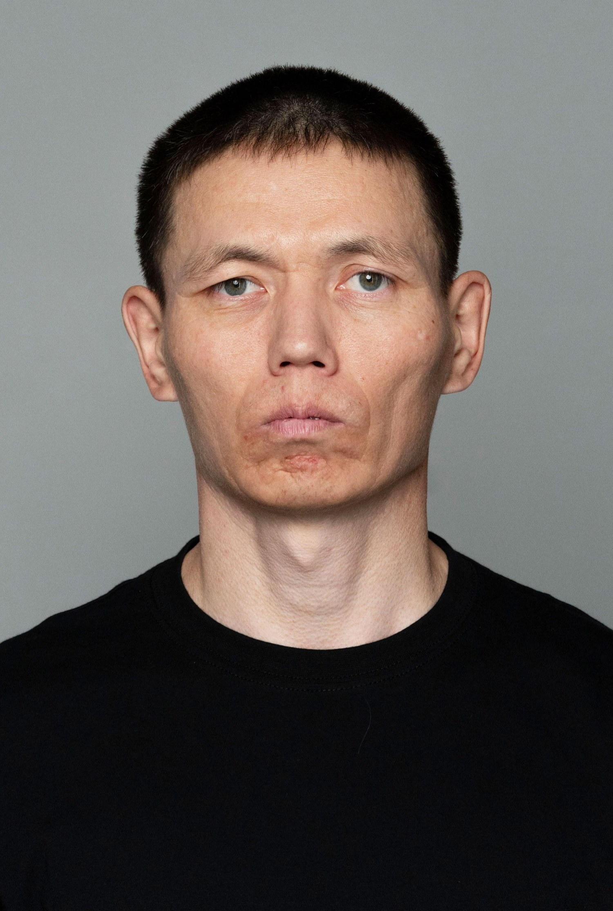
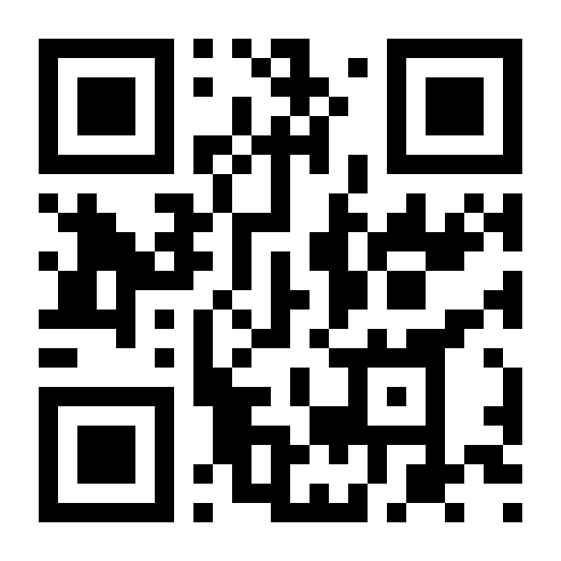
Hama
Date of birth
October 11, 1985
Height / Weight
177 cm / 65 kg (143 lb)
Education
Abai Kazakh National Pedagogical University (higher education)
Based in
Almaty, Kazakhstan
Contact
Instagram
@hama_gamma
Telegram
@hama_gamma
Website
hama-actor.com
KakaoTalk
open.kakao.com/o/s7KXzwKi
Email
Website QR
admiral3nelson7@gmail.com

Slide 2
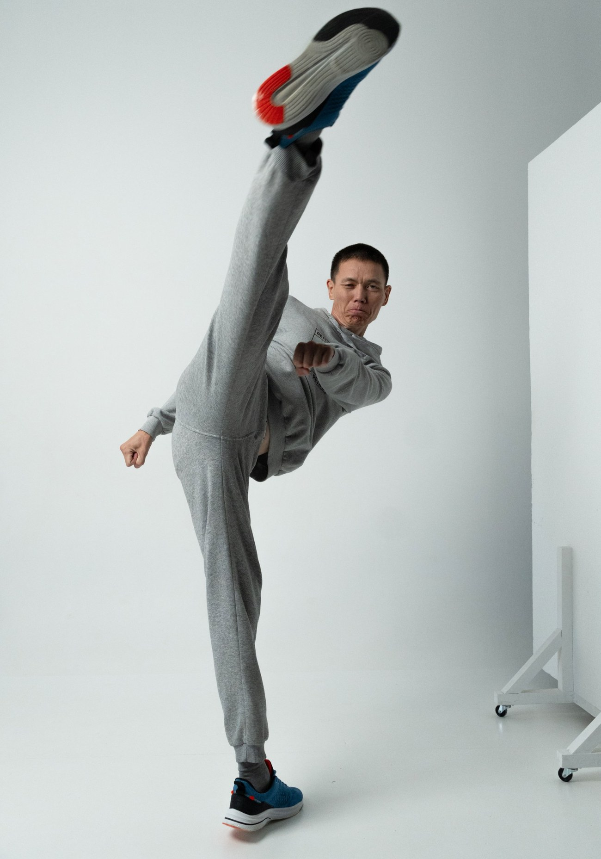
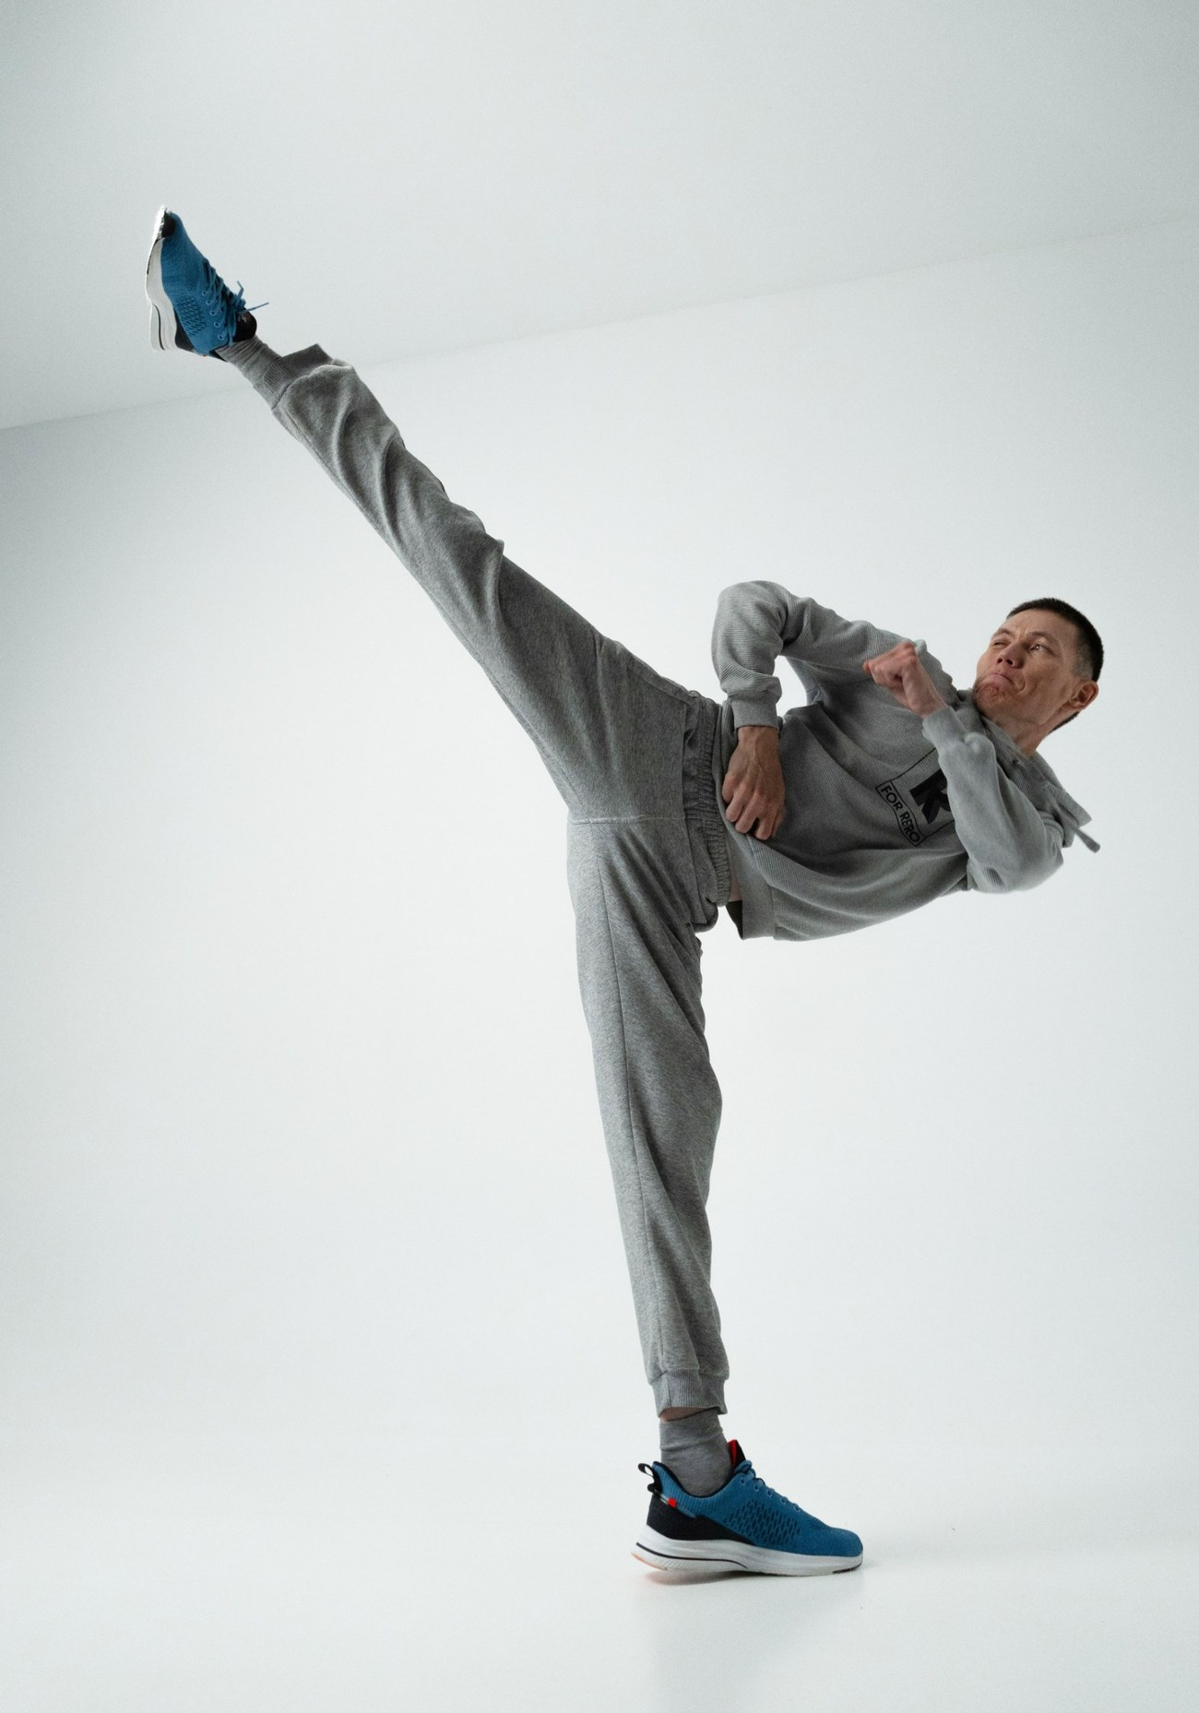
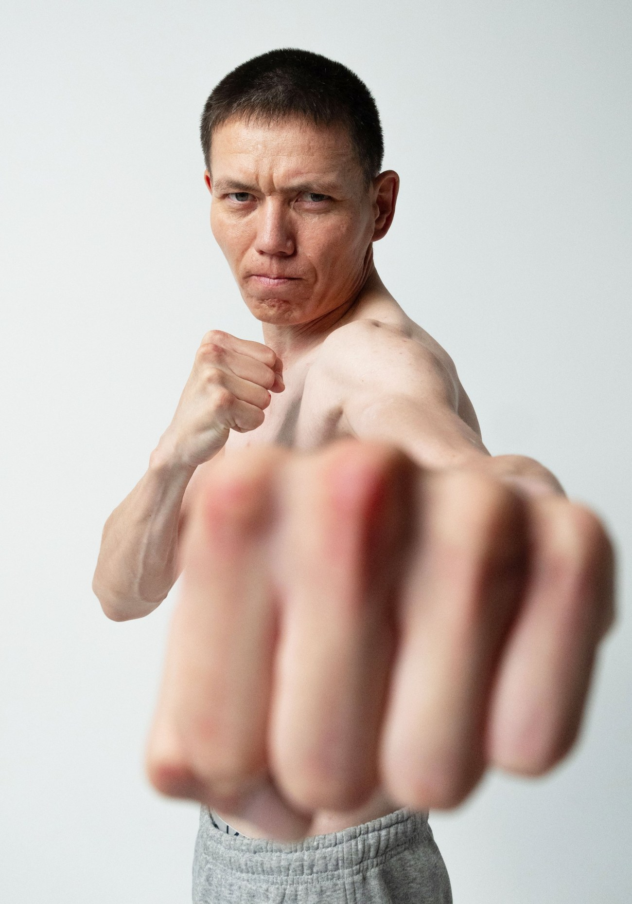
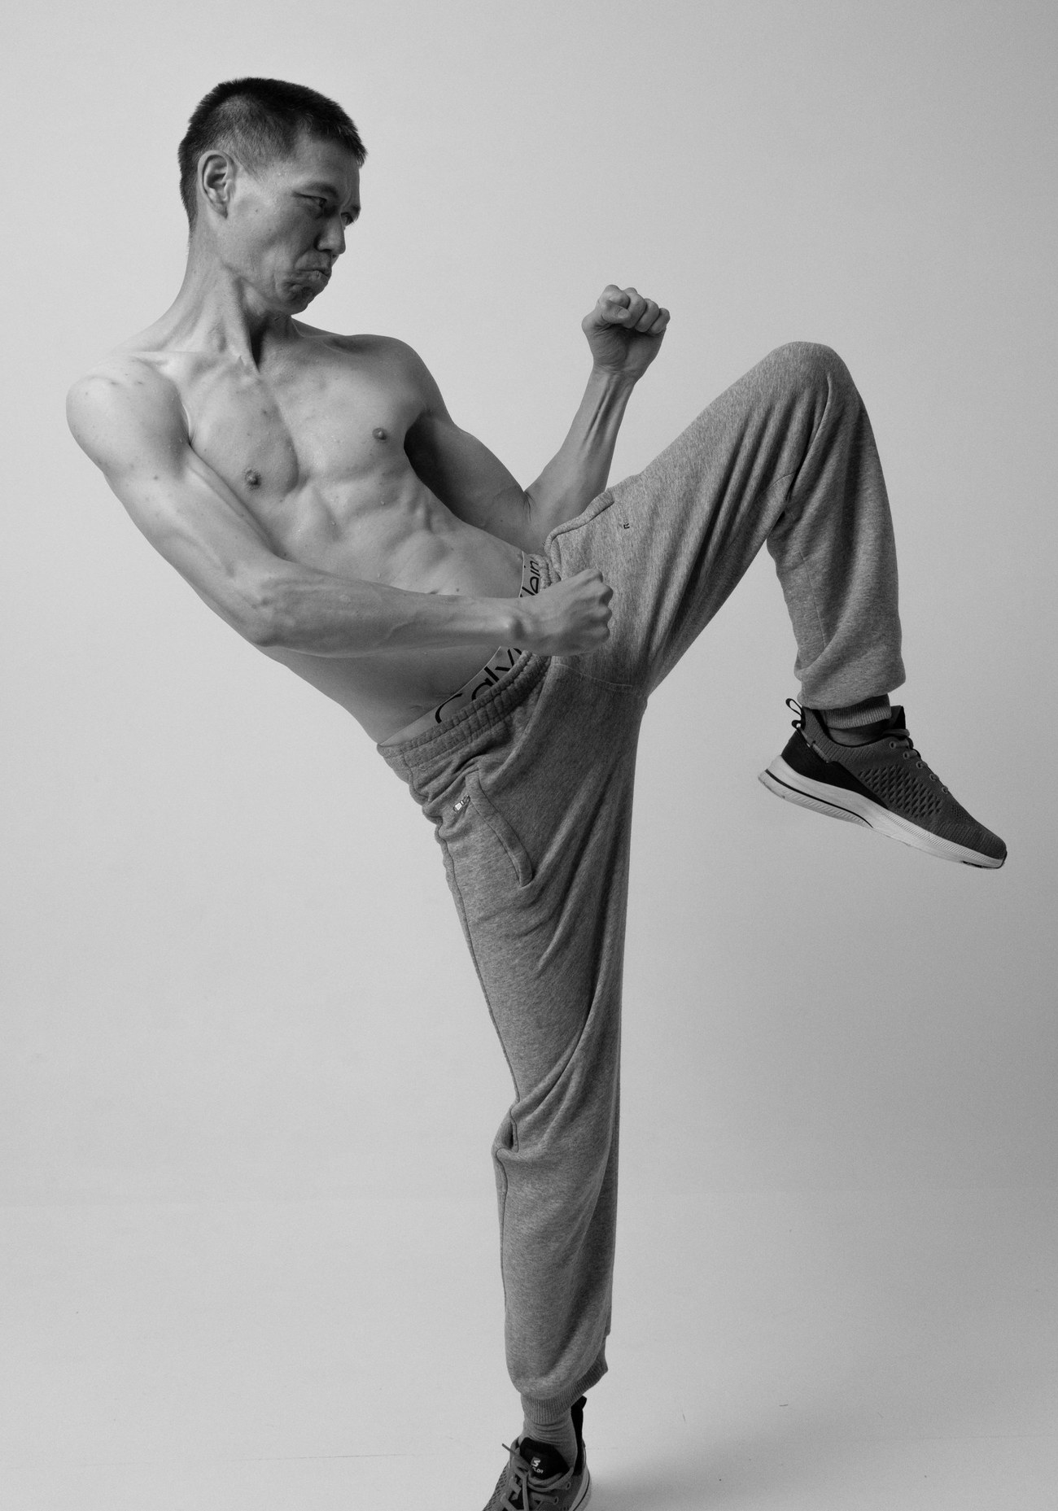
Filmography
2026
Prince of Asia
Extra (episode) · Korea-Kazakhstan co-production
2026
Armour of God IV: Ultimatum
Extra · Aktau, Kazakhstan
2022
Asyl Arman
Lead, short action film · Almaty, Kazakhstan
2018
Stavka (The Bet)
Lead, short film · Zhezkazgan, Kazakhstan
2017
Story of Blind Love
Lead, short film · Zhezkazgan, Kazakhstan
Skills
Martial arts
Taekwondo · Boxing · MMA · Wrestling · Muay Thai
Other
Basic acrobatics · Motorcycle riding
Car driving (manual transmission)
Languages
Russian (native) · Kazakh · English (fluent)
Korean (intermediate, with accent)

