Slide 1
3-Pieces
X
O
X
Tic-Tac-Toe
X
AI Agents: Alpha-Beta & MCTS
O
Mohammed Lafi Almutairi • 442015682
Hamad Waleed Altuwayjiri • 445007860
Mohamed Abdulrazaq alfagih • 445014756
IMSIU • CS 1360 – Artificial Intelligence

Slide 2

Game Overview
What is 3-Piece TicTacToe?
Project Goals
Each player places pieces one at a time,
but can only have 3 pieces on the board
at once.
When a 4th piece is placed, the oldest piece disappears.
The board keeps changing — no easy draws!
1
Build AI agents
Alpha-Beta Pruning (Minimax) and MCTS
2
Compare performance
100 games per match-up, multiple settings
3
Graphical interface
vs. Standard TicTacToe
Streamlit app — playable from browser
Pieces stay forever → board fills up → draw is common.
Here pieces expire → game stays alive & tactical.
4
Human vs AI
Adjustable difficulty via depth slider

Slide 3

Game Representation & Design
Board as Integer Array
3-Piece Rule
history[] tracks insertion order. When a 4th piece is placed, the oldest is auto-removed.
1
0
-1
Legal Moves
0
1
0
get_empty_cells() returns all cells with value = 0. Used by both agents.
-1
0
1
Win Detection
check_winner() tests all 8 lines. Infinite game prevention: 20-min limit + repeated-state detection.
1 = X -1 = O 0 = empty
Line sum = +3 → X wins
Line sum = −3 → O wins
Evaluation
Heuristic scores lines: ±1 (one piece), ±10 (two pieces), ±100 (win/loss).

Slide 4

Implemented Algorithms
Alpha-Beta Pruning
Monte Carlo Tree Search
Minimax with pruning — cuts branches that can't change the final decision (β ≤ α).
Estimates move quality by running many random simulations instead of using a formula.
Tested depths:
4 phases per simulation:
k = 2
Near instant
0.0024 s/move
1
Selection
UCB1 balances exploit vs explore
k = 5
Recommended
0.022 s/move
2
Expansion
Add unexplored child node
3
Simulation
k = 10
Strongest
0.52 s/move
Random play to terminal state
4
Backprop
Update win/visit counts up tree

Slide 5

Experimental Results
Alpha-Beta vs Alpha-Beta (100 games each)
Key Highlights
100%
AB higher depth always wins
3/100
Best MCTS wins vs AB k=2
6.3s
MCTS vs MCTS → Nearly equal
AB k=10 first-move time
500 vs 200: 50–50 | 1000 vs 200: 43–57 | 500 vs 1000: 51–49
More simulations gave no consistent advantage.
0.15s
MCTS 1000 avg per move

Slide 6

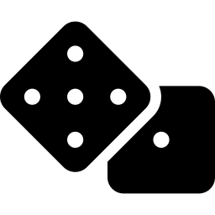

Analysis & Discussion
At lower depths (≤3), Player O dominated (100% win rate) due to the myopic nature of Alpha-Beta. When depth increased to 5, Player X exploited the first-mover advantage — completely reversing results to 100% win rate for X.
Depth = Everything for AB
MCTS Quantity ≠ Quality
AB wins overall
Every higher depth beats every lower depth 100–0. The heuristic works well — deeper lookahead always pays off.
More simulations don't help in MCTS vs MCTS — random rollouts can't capture the tactical precision needed.
Alpha-Beta dominates across all cross-algorithm tests. The structured game rewards exact heuristic search over random simulation.

Slide 7
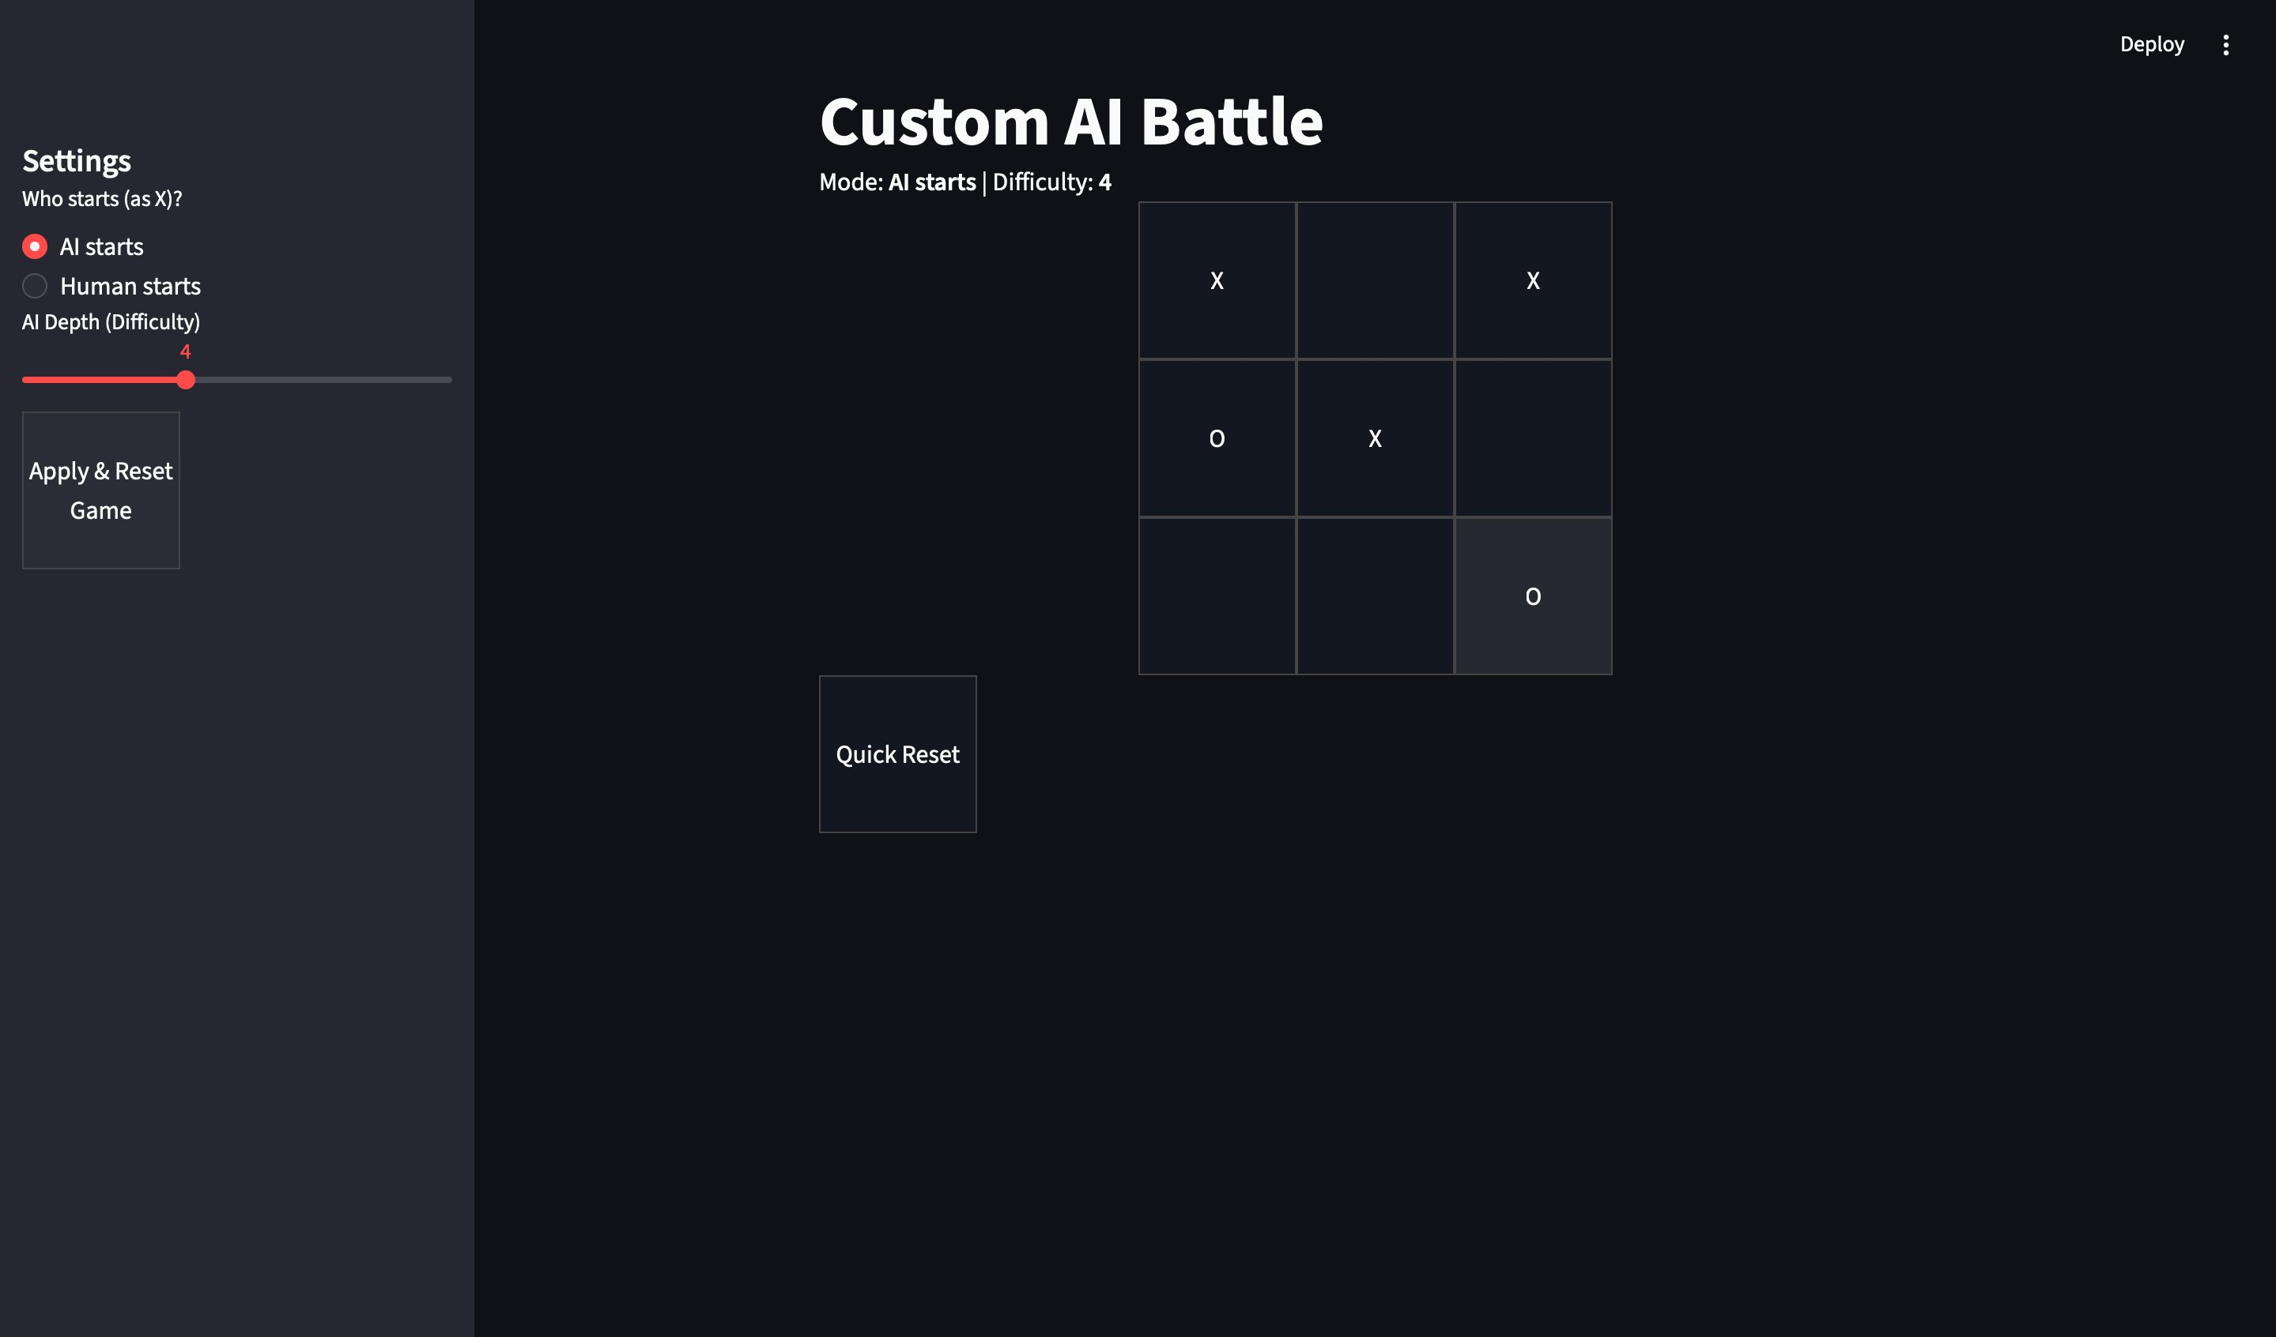
Live Demo
Framework
Streamlit (Python) — deployed on cloud
Supported Modes
AI vs AI • Human vs AI
Adjustable difficulty (depth slider)
Try it live
agentxo.streamlit.app
GitHub:
github.com/Hamad-waleed/agent_xo

Slide 8
Conclusion
01
Alpha-Beta > MCTS
02
Depth is decisive
AB dominates in every cross-algorithm match-up. Heuristic precision beats random simulation for this game.
Higher depth always beats lower depth 100–0. The first-mover advantage reverses at depth ≥ 5.
03
MCTS: quality > quantity
04
What we learned
More simulations don't help. Random rollouts lack the tactical precision this game demands.
Game structure determines which AI works best. Structured games favor deterministic heuristic search.
Mohammed Lafi Almutairi • Hamad Waleed Altuwayjiri | IMSIU – CS 1360

