Slide 1
Olympics 2021 Data Analysis
Done by:
Hamad sami s. alassafi

Slide 2
Data source & Tools
I download a cleaned dataset from Kaggle (https://www.kaggle.com/arjunprasadsarkhel/2021-olympics-in-Tokyo)
I have used Python, Pandas, and Matplotlib in the analysis process

Slide 3

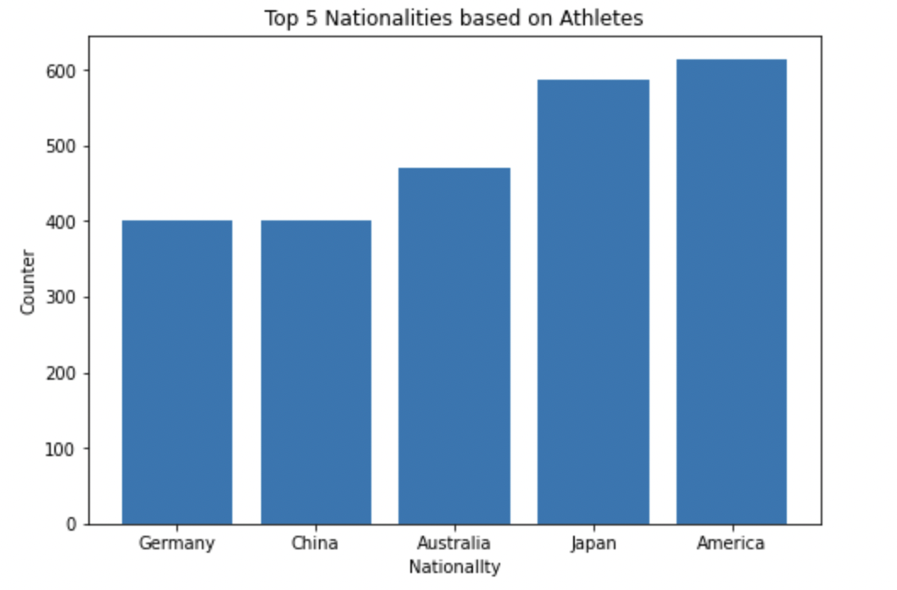



Data Visualization

Slide 4
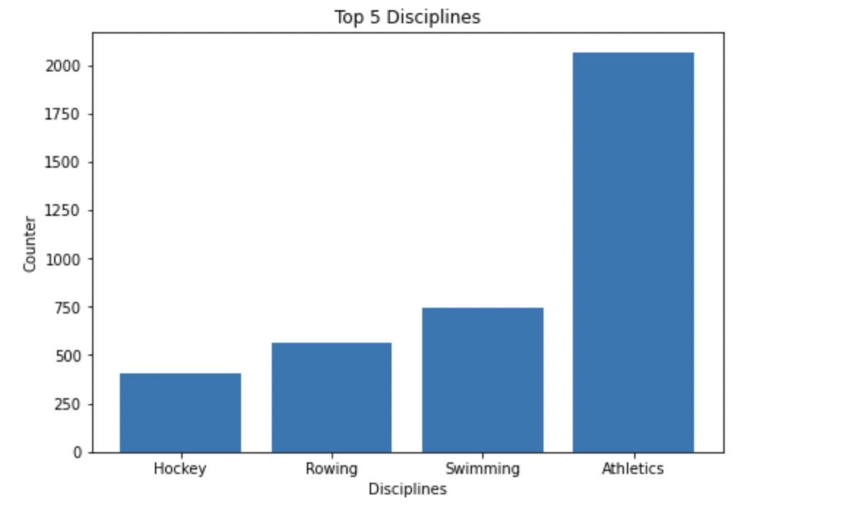
Data Visualization

Slide 5
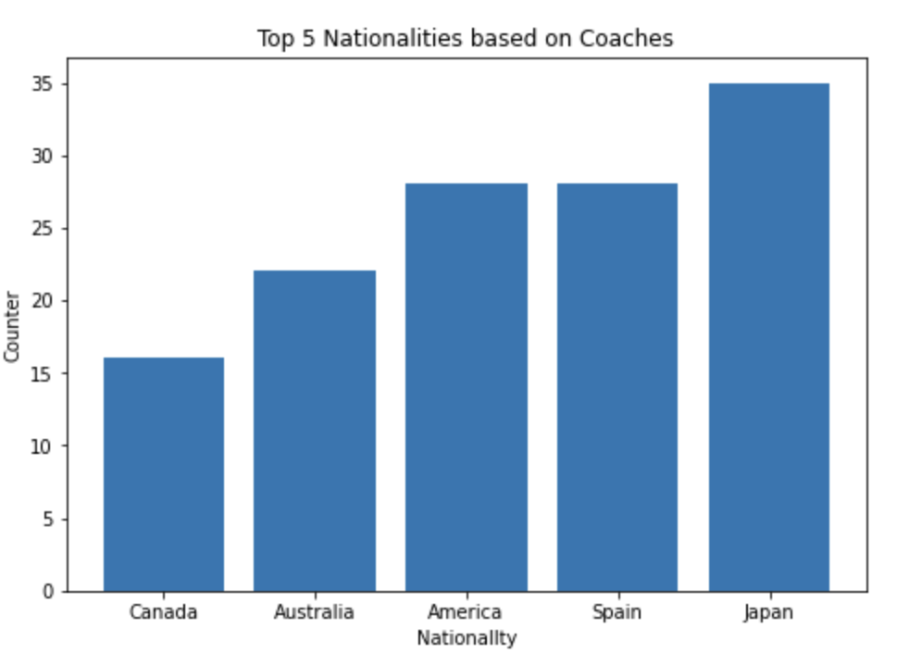
Data Visualization

Slide 6
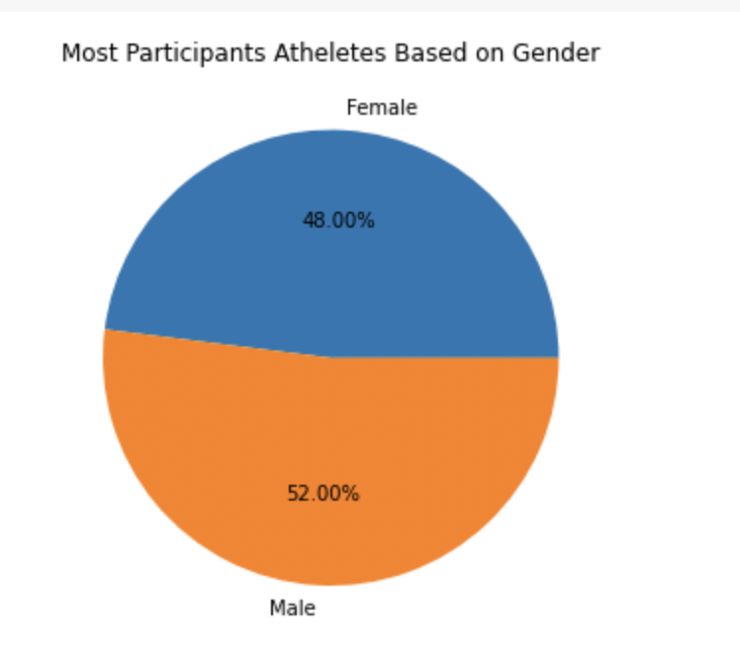
Data Visualization

Slide 7
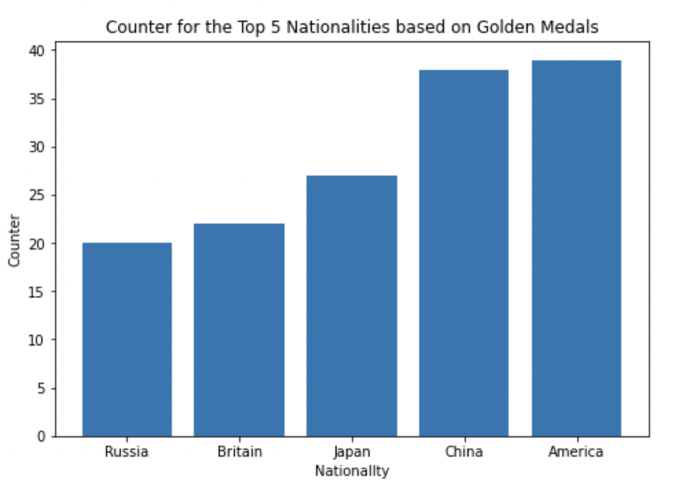
Data Visualization

Slide 8
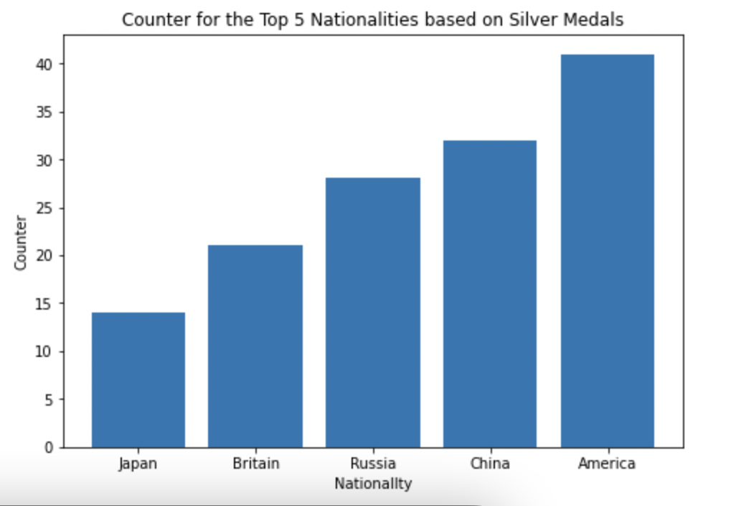
Data Visualization

Slide 9
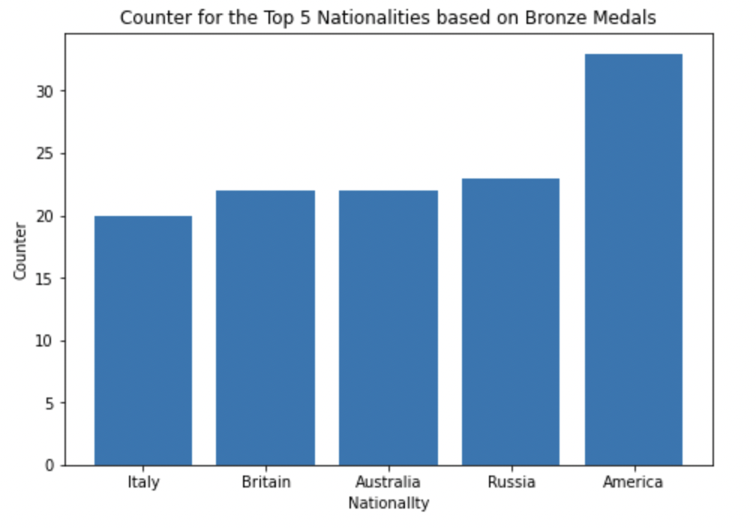
Data Visualization

Slide 10
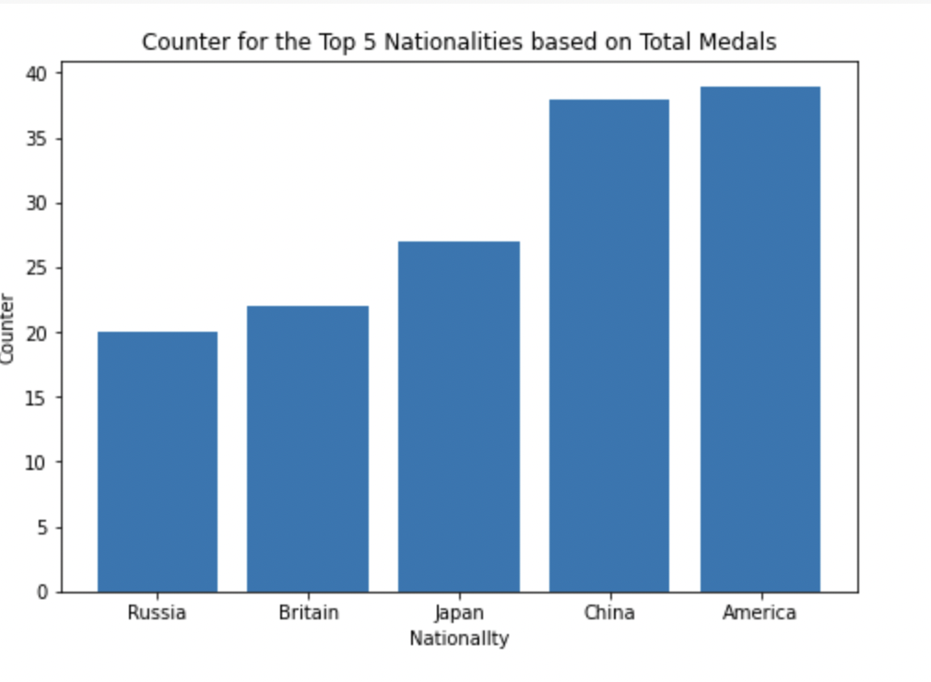
Data Visualization

Slide 11
Thank You !

